Slide 1

I.P. COLLEGE, CAMPUS-II, BULANDSHAHR
Batch(2019-2022)
CH. CHARAN SINGH UNIVERSITY, MEERUT
SUBMITTED TO:- SUBMITTED BY:-
MR.VISHAL SHARMA
ASST. PROFFESSOR
DEPT. OF COMPUTER SCIENCE
I.P. COLLEGE CAMPUS-II
BULANDSHAHR
GROUP NO.17
ANJALI BANSAL (R190955106022)
BHAVYA JAIN (R190955106039)
CHETANA TYAGI (R190955106041)
TANISHKA SHARMA (R190955106175)
YASHPREET KAUR(R190955106192)

Slide 2
PROJECT TYPE BULANDSHAHR KART (WEBSITE)

Slide 3
introduction
It is multivendor e-commerce website made at city level.
It is named as “Bulandshahr Kart”.
The main motive behind this website is to provide the benefit both the customer and shopkeeper of the city.
Over their customers find many stores of the city selling different product under one roof and buying products from multiple seller via internet.
Vendor upload their product virtually at the websites.
The website is designed into two modules –First is for the shopkeepers who sell their products virtually. Second is for the customers who can purchase the products at reasonable rate at their comfort zone.
The Server processes the customers and the items are shipped to the address submitted by them.

Slide 4
objective

Slide 5





TOOLS / PLATFORM USED
FRONT END
BACKEND

Slide 6
HARDWARE REQUIREMENT
CPU: 1.5 GHz processor speed or more
RAM: 2 GB or more
Hard Disk: 256 GB or more
Display: Minimum 1028X768 pixel

Slide 7
SOFTWARE REQUIREMENT
Operating System: MS Windows-7/8/10 32/64bit
Browser: Google Chrome/Mozilla Firefox/Internet Explorer
Server: APACHE
Server Side Script: PHP
Database: MySQL
Text Editor: VS Code/Sublime/Notepad

Slide 8
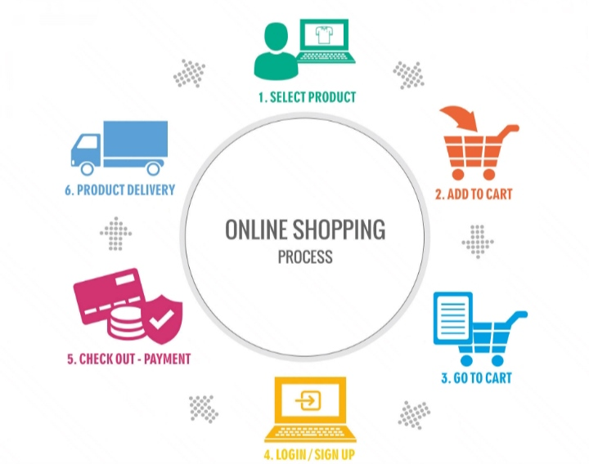
PROCESS OF SHOPPING

Slide 9



ADVANTAGES
Comfort of own home
Opportunity to compare as many products ad price
A lot of stores within a click away
Infinite choice
24*7 Availability
No need of waiting in lines
Savings in time

Slide 10



MODES OF PAYMENT

Slide 11
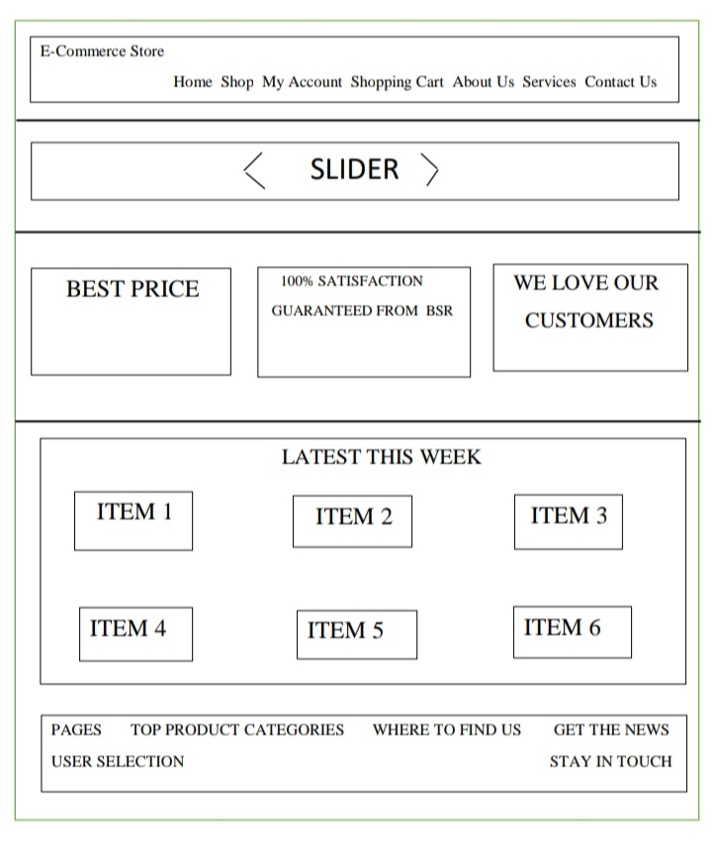
DESIGN

Slide 12
Screenshots of website

Slide 13
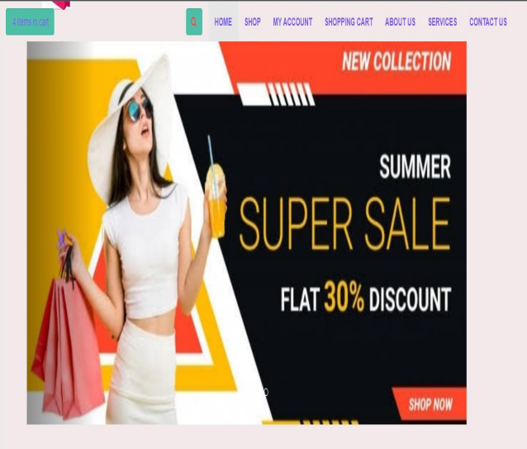
homepage

Slide 14
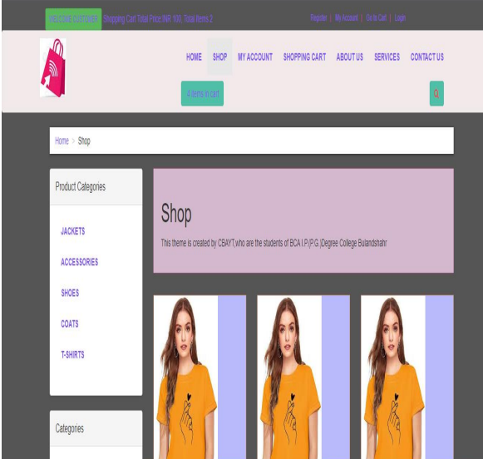
shop

Slide 15
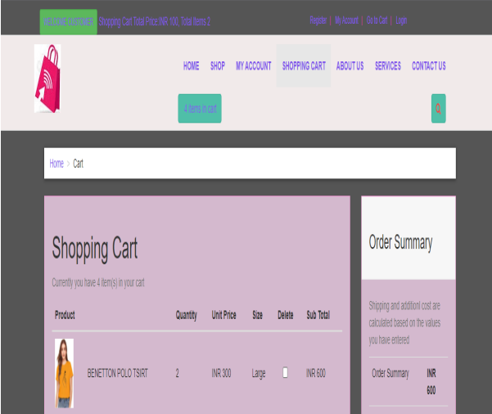
shopping cart

Slide 16
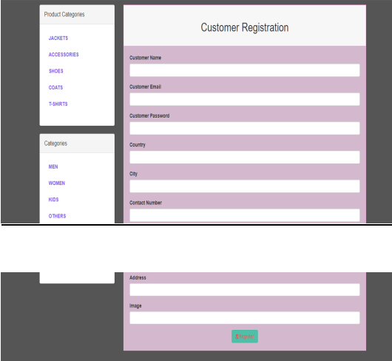
customer registration

Slide 17

SECURITY
On the security purpose our website is safe.
No virus or Trojan can affect the customer device.
No harm of privacy of the customer.
Keep password private of customer account.
Website should be up-to-date.

Slide 18
CONCLUSION
On the basis of data analysis it can be conclude that customer buy goods from the website in the basis of factors like offer and discounts, variety of product available, free home delivery, cash of delivery payment option. From the above data analysis it can be determined that most of respondent would agree to buy products online rather than shopping product with the tradition method.

Slide 19


