Slide 1
BACK END ENGINEERING(24CAI0303)
Project Title : ExpenseGuard — Recurring Expense Anomaly Detector
STUDENT NAME
ROLL NO.
Bhavya Kakkar (Leader)
2410993144
Muskan
2410993164
Denish Kashnia
2410993184
Class Group: 5-G-10
Project Guide Name (Ms. Ekta Verma):
____________________________
Chitkara University Institute of Engineering and Technology, Punjab

Slide 2
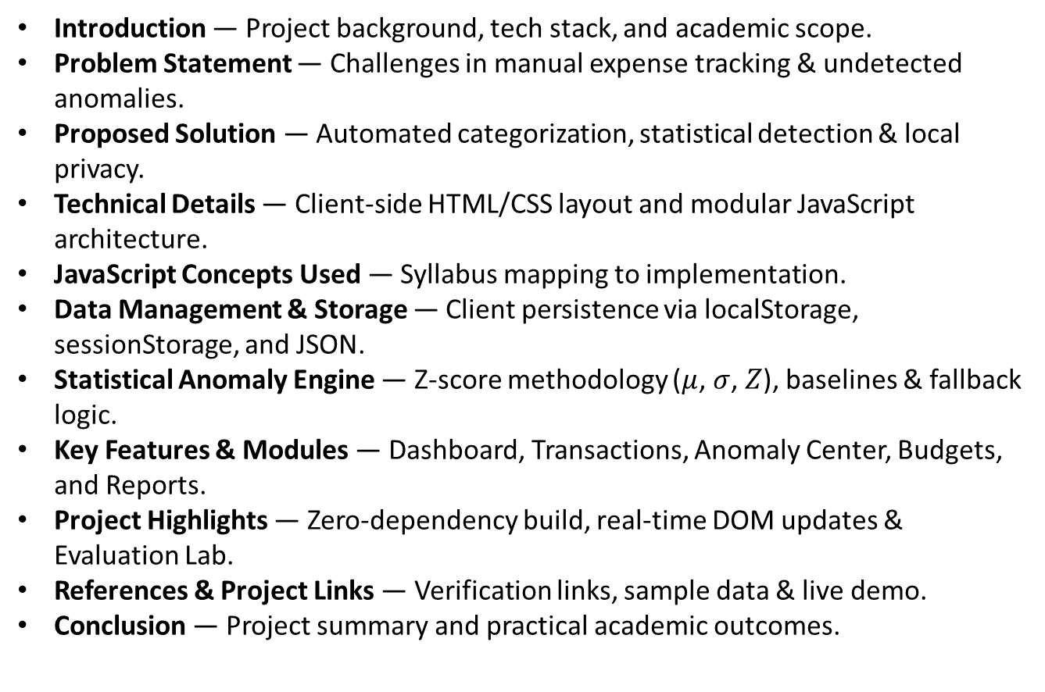
Table of Contents
Introduction — Project background, tech stack, and academic scope.
Problem Statement — Challenges in manual expense tracking & undetected anomalies.
Proposed Solution — Automated categorization, statistical detection & local privacy.
Technical Details — Client-side HTML/CSS layout and modular JavaScript architecture.
JavaScript Concepts Used — Syllabus mapping to implementation.
Data Management & Storage — Client persistence via localStorage, sessionStorage, and JSON.
Statistical Anomaly Engine — Z-score methodology ($μ$, $σ$, $Z$), baselines & fallback logic.
Key Features & Modules — Dashboard, Transactions, Anomaly Center, Budgets, and Reports.
Project Highlights — Zero-dependency build, real-time DOM updates & Evaluation Lab.
References & Project Links — Verification links, sample data & live demo.
Conclusion — Project summary and practical academic outcomes.

Slide 3
Introduction
Client-Side Financial Intelligence & Anomaly Detection System
Project Name: ExpenseGuard
Core Purpose: Automatically detect unusual or out-of-pattern recurring spending using dynamic statistical Z-score analysis without third-party frameworks or cloud dependencies.
Technology Stack: Pure HTML5, Vanilla CSS3 (Custom Dark Navy Theme System), and Modern ES6+ JavaScript Standard Library.
Academic Scope: Practical demonstration of core Web
Development concepts—DOM Manipulation, Event Handling, Higher-Order Array Methods, Form Validation, LocalStorage Management, and Modular JavaScript Architecture.

Slide 4
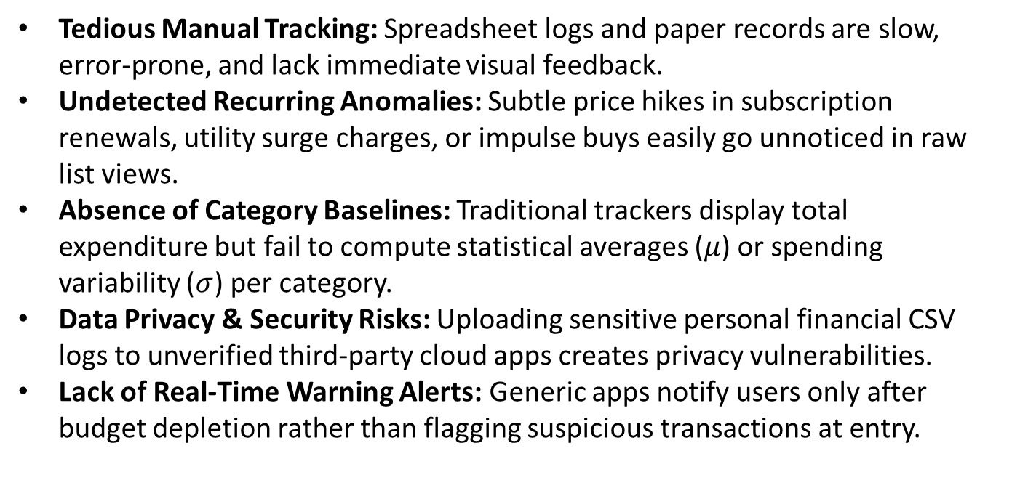
Problem Statement
Challenges in Recurring Expense Tracking & Financial Visibility
Tedious Manual Tracking: Spreadsheet logs and paper records are slow, error-prone, and lack immediate visual feedback.
Undetected Recurring Anomalies: Subtle price hikes in subscription renewals, utility surge charges, or impulse buys easily go unnoticed in raw list views.
Absence of Category Baselines: Traditional trackers display total expenditure but fail to compute statistical averages ($μ$) or spending variability ($σ$) per category.
Data Privacy & Security Risks: Uploading sensitive personal financial CSV logs to unverified third-party cloud apps creates privacy vulnerabilities.
Lack of Real-Time Warning Alerts: Generic apps notify users only after budget depletion rather than flagging suspicious transactions at entry.

Slide 5
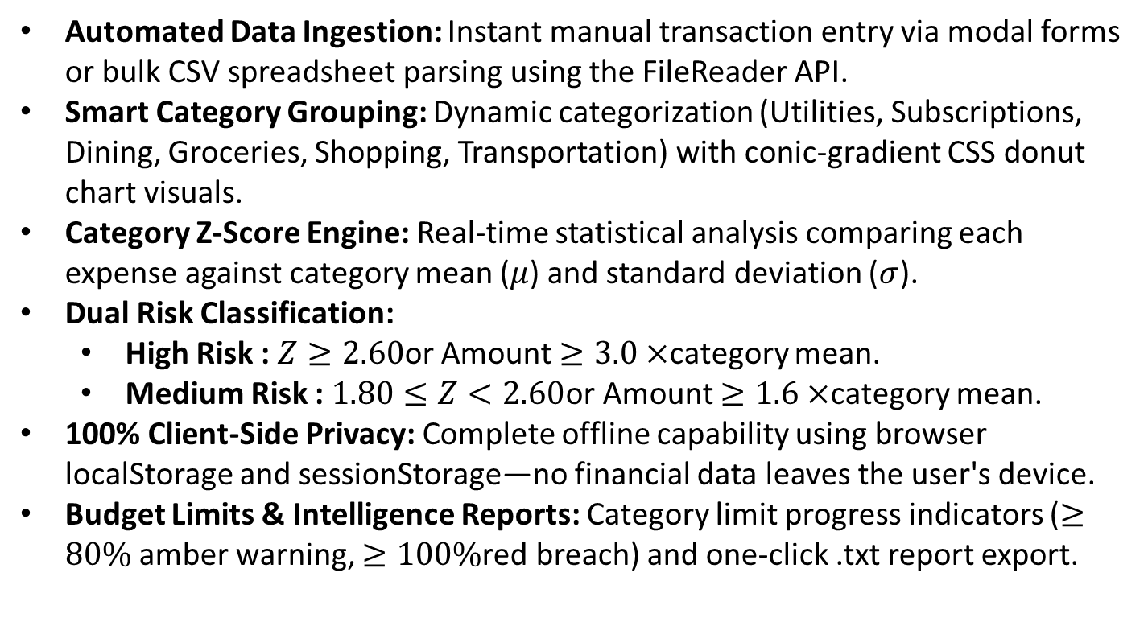
Proposed Solution
How ExpenseGuard Resolves Spending Visibility & Risk Detection
Automated Data Ingestion: Instant manual transaction entry via modal forms or bulk CSV spreadsheet parsing using the FileReader API.
Smart Category Grouping: Dynamic categorization (Utilities, Subscriptions, Dining, Groceries, Shopping, Transportation) with conic-gradient CSS donut chart visuals.
Category Z-Score Engine: Real-time statistical analysis comparing each expense against category mean ($μ$) and standard deviation ($σ$).
Dual Risk Classification:
High Risk : $Z≥2.60$or Amount $≥3.0×$category mean.
Medium Risk : $1.80≤Z<2.60$or Amount $≥1.6×$category mean.
100% Client-Side Privacy: Complete offline capability using browser localStorage and sessionStorage—no financial data leaves the user's device.
Budget Limits & Intelligence Reports: Category limit progress indicators ($≥80\%$ amber warning, $≥100\%$red breach) and one-click .txt report export.

Slide 6
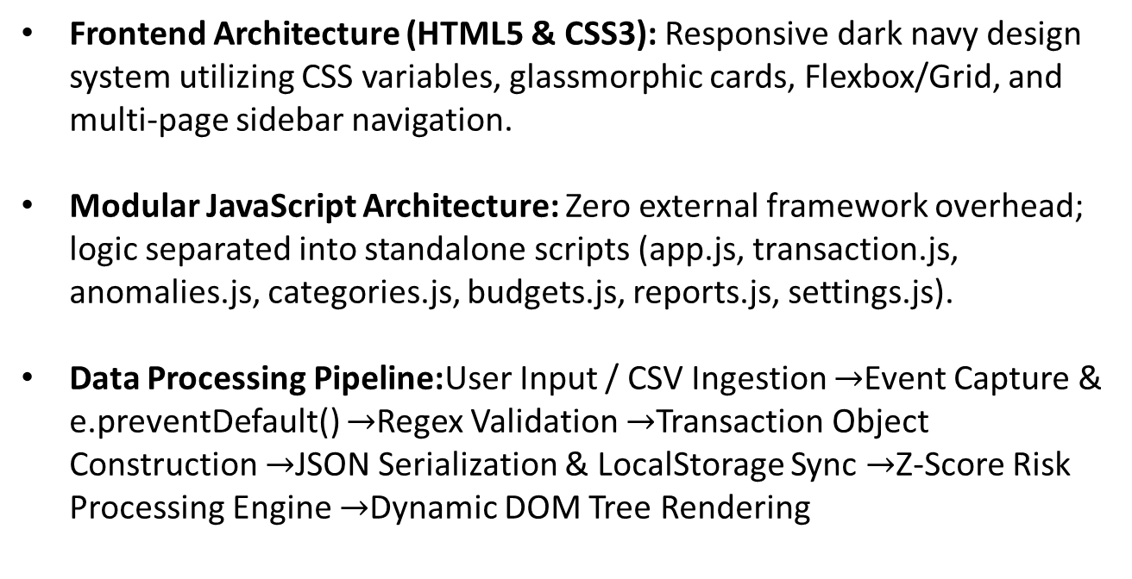
Technical Details
System Architecture & Data Pipeline
Frontend Architecture (HTML5 & CSS3): Responsive dark navy design system utilizing CSS variables, glassmorphic cards, Flexbox/Grid, and multi-page sidebar navigation.
Modular JavaScript Architecture: Zero external framework overhead; logic separated into standalone scripts (app.js, transaction.js, anomalies.js, categories.js, budgets.js, reports.js, settings.js).
Data Processing Pipeline:User Input / CSV Ingestion $→$Event Capture & e.preventDefault() $→$Regex Validation $→$Transaction Object Construction $→$JSON Serialization & LocalStorage Sync $→$Z-Score Risk Processing Engine $→$Dynamic DOM Tree Rendering

Slide 7
Technical Details
Direct Mapping of Evaluated JavaScript Topics to ExpenseGuard Codebase
Syllabus Concept | Implementation in ExpenseGuard Codebase
var / let / const | const for storage keys/functions; let for counters & state; var explicitly shown in app.js (var EXPENSEGUARD_VERSION).
Data Types & Conversions | String, Number, Boolean, Object, Array; Number(val), String(val), Boolean(val), Number.isFinite().
Control Flow & Loops | if/else branching; for loop in CSV parser; for...of in monthly reports; for...in.
Functions & Scope | Declarations (calculateMean), arrow callbacks, IIFE in transaction.js, module lexical scope.
Array Methods & HOFs | push(), splice(), slice(); Iteration HOFs: forEach(), map(), filter(), reduce(), sort().
Objects & Destructuring | Transaction object literals; Object.keys(), values(), entries(); Destructuring (const { isValid } = ...).
JSON Serialization | JSON.stringify() for array state saving; JSON.parse() inside try...catch blocks for safe retrieval.
DOM & Event Handling | getElementById(), querySelector(), addEventListener() for click, submit, drop; e.preventDefault().
Storage API & Regex | localStorage for transactions/settings; sessionStorage for auth state; Regex password validation

Slide 8
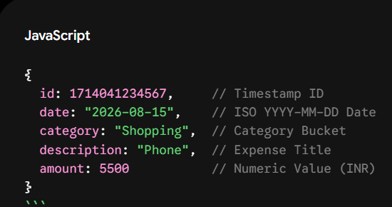
Technical Details
Object Representation, Array Storage & Browser Persistence
Transaction Object Schema:
Array-Based In-Memory Storage: Global JS arrays (transactions = []) updated immutably using slice(), map(), and filter().
Browser Persistence via LocalStorage: Serialized data stored under key "expenseGuardTransactions". Wrapped by getTransactions() and saveTransactions() helper functions.
Safe JSON Parsing: JSON.parse() executes inside try...catch blocks to provide fallback arrays if data is corrupted or uninitialized.
Session Lifecycle: Controlled via sessionStorage (expenseGuardLoggedIn === "true"), automatically cleared on logout.

Slide 9
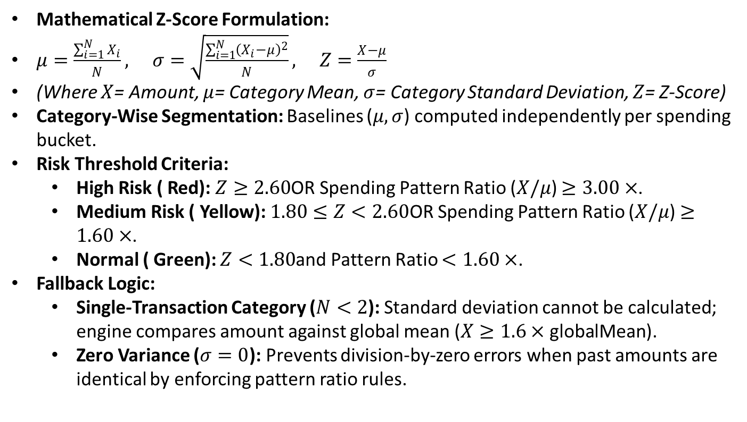
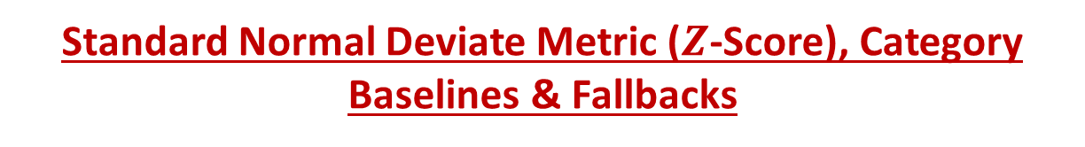
Anomaly Detection
Standard Normal Deviate Metric ($Z$-Score), Category Baselines & Fallbacks
Mathematical Z-Score Formulation:
$μ=\frac{\sum_{i=1}^{N}{X_{i}}}{N}, σ=\sqrt{\frac{\sum_{i=1}^{N}{{\left(X_{i}−μ\right)}^{2}}}{N}}, Z=\frac{X−μ}{σ}$
(Where $X$= Amount, $μ$= Category Mean, $σ$= Category Standard Deviation, $Z$= Z-Score)
Category-Wise Segmentation: Baselines ($μ,σ$) computed independently per spending bucket.
Risk Threshold Criteria:
High Risk ( Red): $Z≥2.60$OR Spending Pattern Ratio ($X/μ$) $≥3.00×$.
Medium Risk ( Yellow): $1.80≤Z<2.60$OR Spending Pattern Ratio ($X/μ$) $≥1.60×$.
Normal ( Green): $Z<1.80$and Pattern Ratio $<1.60×$.
Fallback Logic:
Single-Transaction Category ($N<2$): Standard deviation cannot be calculated; engine compares amount against global mean ($X≥1.6×\text{globalMean}$).
Zero Variance ($σ=0$): Prevents division-by-zero errors when past amounts are identical by enforcing pattern ratio rules.

Slide 10
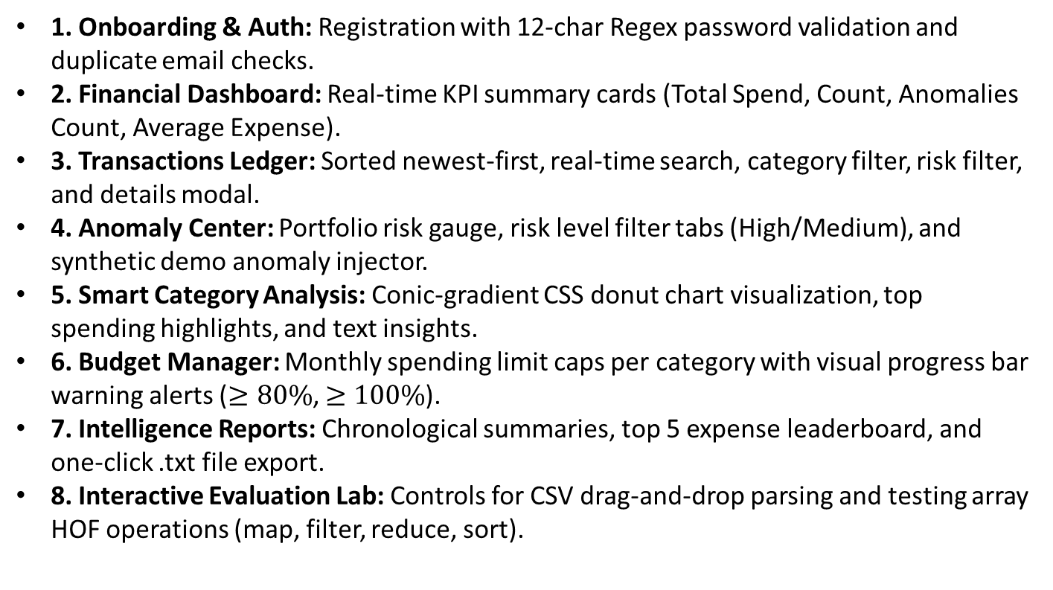
Key Features
Application Modules & Interactive Capabilities
1. Onboarding & Auth: Registration with 12-char Regex password validation and duplicate email checks.
2. Financial Dashboard: Real-time KPI summary cards (Total Spend, Count, Anomalies Count, Average Expense).
3. Transactions Ledger: Sorted newest-first, real-time search, category filter, risk filter, and details modal.
4. Anomaly Center: Portfolio risk gauge, risk level filter tabs (High/Medium), and synthetic demo anomaly injector.
5. Smart Category Analysis: Conic-gradient CSS donut chart visualization, top spending highlights, and text insights.
6. Budget Manager: Monthly spending limit caps per category with visual progress bar warning alerts ($≥80\%$, $≥100\%$).
7. Intelligence Reports: Chronological summaries, top 5 expense leaderboard, and one-click .txt file export.
8. Interactive Evaluation Lab: Controls for CSV drag-and-drop parsing and testing array HOF operations (map, filter, reduce, sort).

Slide 11
Project Highlights
Technical Advantages & Architectural Strengths
100% Dependency-Free Build: Native HTML5, CSS3, and modern ES6+ JS. No external libraries (No React, jQuery, Tailwind, or Chart.js).
Mathematically Sound Statistical Engine: Category-level standard deviation Z-score formulas with zero-variance safeguards.
Real-Time Dynamic DOM Rendering: Dynamic updates for metric cards, tables, and progress indicators execute instantaneously without full reloads.
Privacy-First Offline Execution: Financial records remain entirely local inside browser localStorage.
Embedded Viva Demo Dataset: Integrated demo loader populates realistic test data instantly for demonstration purposes.

Slide 12
Conclusion
Current Client Boundaries vs. Future Roadmap
Current Implementation Boundaries:
Browser-Tied Storage: Clearing browser cache wipes local un-exported records.
Local Authentication: Operational prototype without server-side encryption tokens.
Sample Size Reliance: Z-score requires baseline transaction history per category for statistical accuracy.
Future Roadmap:
Backend API & Database: Node.js / Express REST backend connected to MongoDB / PostgreSQL.
Server Security: bcrypt password hashing and JWT token authentication.
Advanced ML Engine: Machine learning integration (Isolation Forest / Time-Series) for seasonal predict.
Automated Bank Feeds: Plaid / Open Banking API integration for automatic transaction fetching.

Slide 13
References/Links used
Project Links & Documentation Sources
Live Web Application Demo: expense-guard-recurring-expense-ano.vercel.app
GitHub Repository: Bhavyakakkar24/ExpenseGuard-recurring-expense-anomaly-detector
Technical Documentation References:
MDN Web Docs: JavaScript Array Methods (map, filter, reduce, sort)
MDN Web Docs: Web Storage API (Window.localStorage, Window.sessionStorage)
NIST/SEMATECH e-Handbook of Statistical Methods: Z-Score & Outlier Detection Formulas

