Slide 1
EXCEPTIONAL HANDLING
The Exception Handling in Java is one of the powerful mechanism to handle the runtime errors so that the normal flow of the application can be maintained.
It is a mechanism to handle runtime errors such as ClassNotFoundException, IOException, SQLException, RemoteException, etc.
The core advantage of exception handling is to maintain the normal flow of the application. An exception normally disrupts the normal flow of the application; that is why we need to handle exceptions.

Slide 2
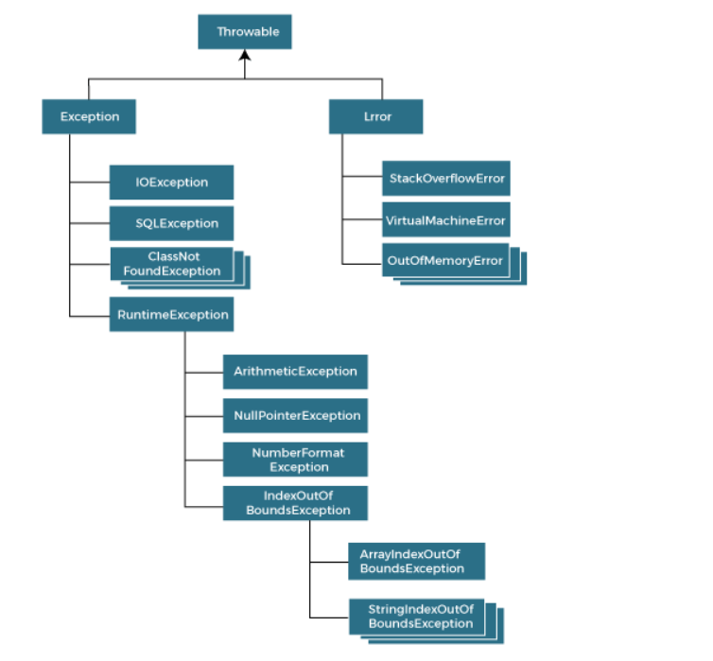
Exception Hierarchy

Slide 3
Types of exceptions
There are mainly two types of exceptions: checked and unchecked. An error is considered as the unchecked exception. However, according to Oracle, there are three types of exceptions namely:
Checked Exception
Unchecked Exception
Error

Slide 4
JAVA Exceptions
Checked Exception
The classes that directly inherit the Throwable class except RuntimeException and Error are known as checked exceptions. For example, IOException, SQLException, etc.
Checked exceptions are checked at compile-time.
Unchecked Exception
The classes that inherit the RuntimeException are known as unchecked exceptions.
For example, ArithmeticException, NullPointerException, ArrayIndexOutOfBoundsException, etc.
Unchecked exceptions are not checked at compile-time, but they are checked at runtime.
Error
Error is irrecoverable. Some example of errors are OutOfMemoryError, VirtualMachineError, AssertionError etc.

Slide 5
JAVA Exception keywords
Try
Catch
Finally
Throw
throws

Slide 6
Throw and throws
Java throw keyword is used throw an exception explicitly in the code, inside the function or the block of code.
Java throws keyword is used in the method signature to declare an exception which might be thrown by the function while the execution of the code.

Slide 7
MULTITHREADING
Multithreading in Java is a process of executing multiple threads simultaneously.
A thread is a lightweight sub-process, the smallest unit of processing. Multiprocessing and multithreading, both are used to achieve multitasking.
Advantages of Java Multithreading
It doesn't block the user because threads are independent and you can perform multiple operations at the same time.
You can perform many operations together, so it saves time.
Threads are independent, so it doesn't affect other threads if an exception occurs in a single thread.

Slide 8
Creation of thread
There are two ways to create a thread:
By extending Thread class
By implementing Runnable interface.

Slide 9
JAVA I/O
Java I/O (Input and Output) is used to process the input and produce the output.
Java uses the concept of a stream to make I/O operation fast. The java.io package contains all the classes required for input and output operations.
A stream is a sequence of data. In Java, a stream is composed of bytes. It's called a stream because it is like a stream of water that continues to flow.
In Java, 3 streams are created for us automatically. All these streams are attached with the console.
System.out: standard output stream
System.in: standard input stream
System.err: standard error stream

