Slide 1
CORE JAVA

Slide 2
CONTENTS
Java Installation, IDE Setup
Datatypes and Operators
Control Flow statements
OOPS Concepts
Static, Constructor, Exceptions
String, Collections, Serialization
Threads and JDBC
Agile and DevOps
Spring Boot
Git, Source Code Management
Jenkins, Jira, DevOps tools
HTML, CSS
Bootstrap
Javascript - (Basics)
Javascript - (Advanced)
Angular
Integrating Frontend with Backend
React

Slide 3
JAVA
Java is object oriented language
James Gosling invented this language at Sun MicroSystems in 1995
Platform independence (write once run anywhere (WORA))
Architecture neutral
Secure (Bytecode, no pointers, security manager)
Java can run:
In a browser as an applet
On the desktop as an application
In a server to provide Services E.g. Database access
Embedded in a device

Slide 4
JAVA EDITIONS
Java Standard Edition (J2SE or JSE)
Basic tools and libraries to build applications and applets (Standalone applications)
It is used to create programs for a desktop computer
Java Enterprise Edition (J2EE or JEE)
Tools and libraries to create servlets, javaServerPages, server based applications etc (Web Applications, can be used by multiple users at a time)
It is used to create large programs that run on the server and manages heavy traffic and complex transactions
Java Micro Edition (J2ME or JME)
Libraries to create application to run in hand-held devices such as PDAs and cellular phones. (Device programs and mobile applications)
It is used to develop applications for small devices such as set-top boxes, phone, and appliances.

Slide 5
JDK
JDK: A jdk is a program development environment for writing java applets and applications
JDK consists of a runtime environment called JRE, which sits in top of the operating system and the tools like interpreter (java) and compiler (javac)
Java programs are translated into an intermediate code called the byte code with the help of a java compiler (javac)
This byte code is platform independent and can run on any operating system.
So to compile and execute, we need JDK, but to run the bytecode alone, JRE is enough, therefore JRE is a subset of JDK
Source file(.java) 🡪 compiler 🡪 converts to .class file (bytecode)

Slide 6
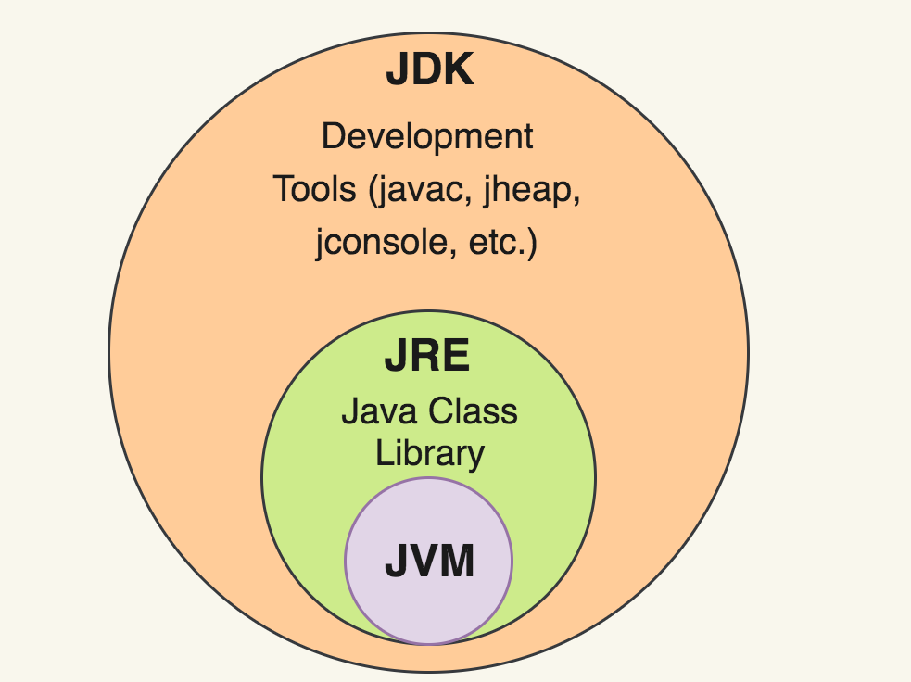
JRE
JRE 🡪 This is a part of JDK.
JRE consists of Java virtual machine (JVM), core classes called libraries (Java API) and supporting files.
JVM converts java byte code into machine language and executes it (depending on OS and target device)
JVM is a runtime interpreter , because it becomes an instance of JRE at run time. Bytecode executed by JVM is platform independent, but JVM is platform dependent
JVM is a subset of JRE

Slide 7
INSTALLATION
Java and Environment variables
Eclipse / IntelliJ IDEA for Java Applications
Visual Studio Code for Frontend applications

Slide 8
INSTALLATIONS

Slide 9
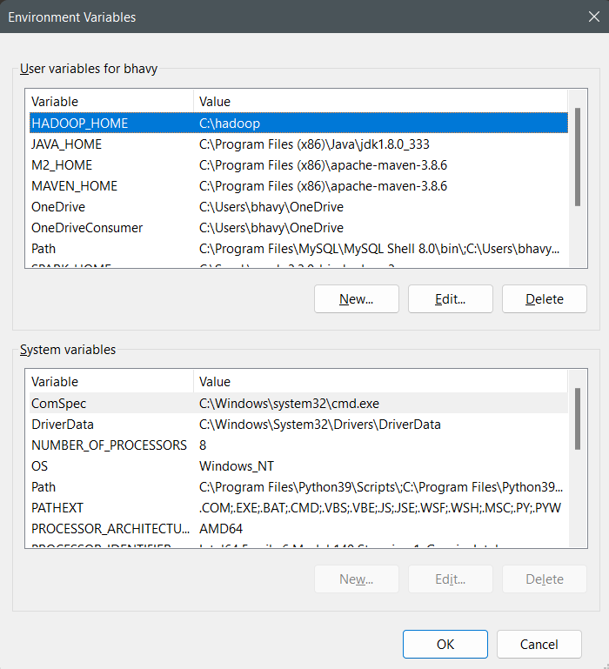
JAVA INSTALLATION
Download Java from below website
https://www.java.com/download/ie_manual.jsp
JDK
https://www.oracle.com/java/technologies/javase/jdk11-archive-downloads.html
Environment Variables

Slide 10
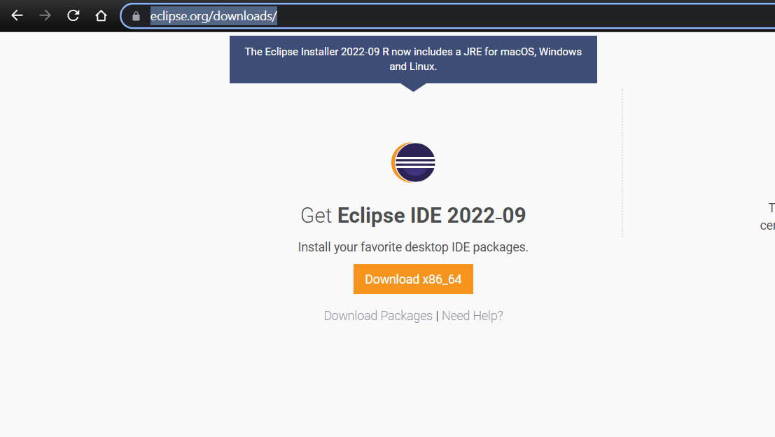
ECLIPSE
Download link: https://www.eclipse.org/downloads/

Slide 11
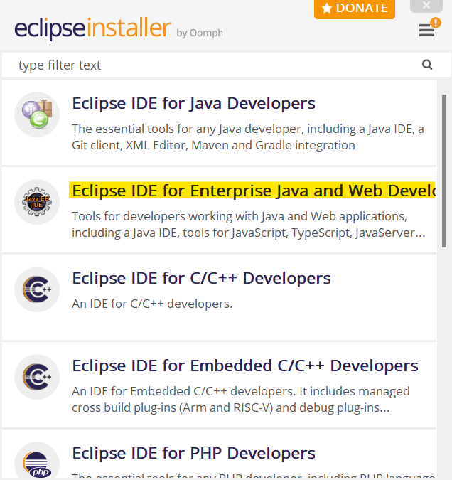
RUN THE INSTALLER
And select Eclipse IDE for Enterprise Java and Web Developers

Slide 12
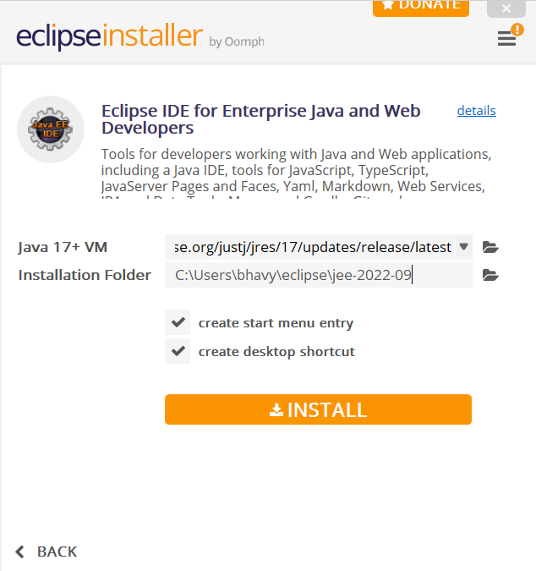
INSTALL
Leave the settings as default and click Install

Slide 13
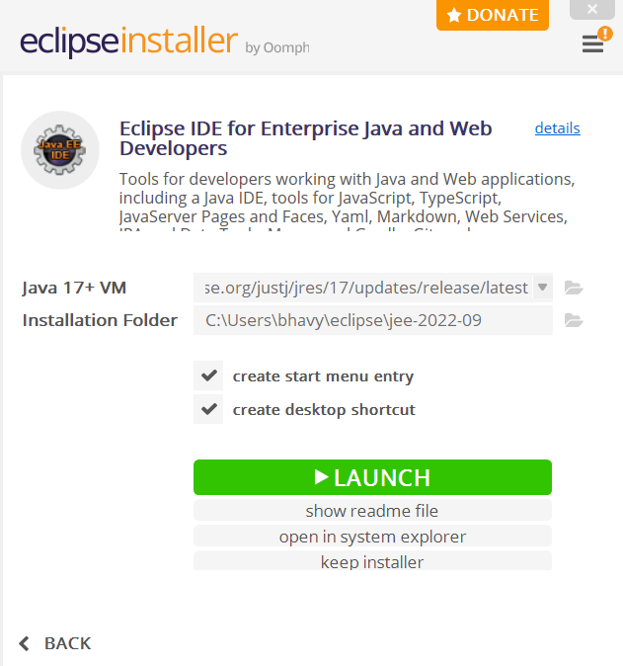
LAUNCH AND OPEN
Click launch to open the IDE

Slide 14
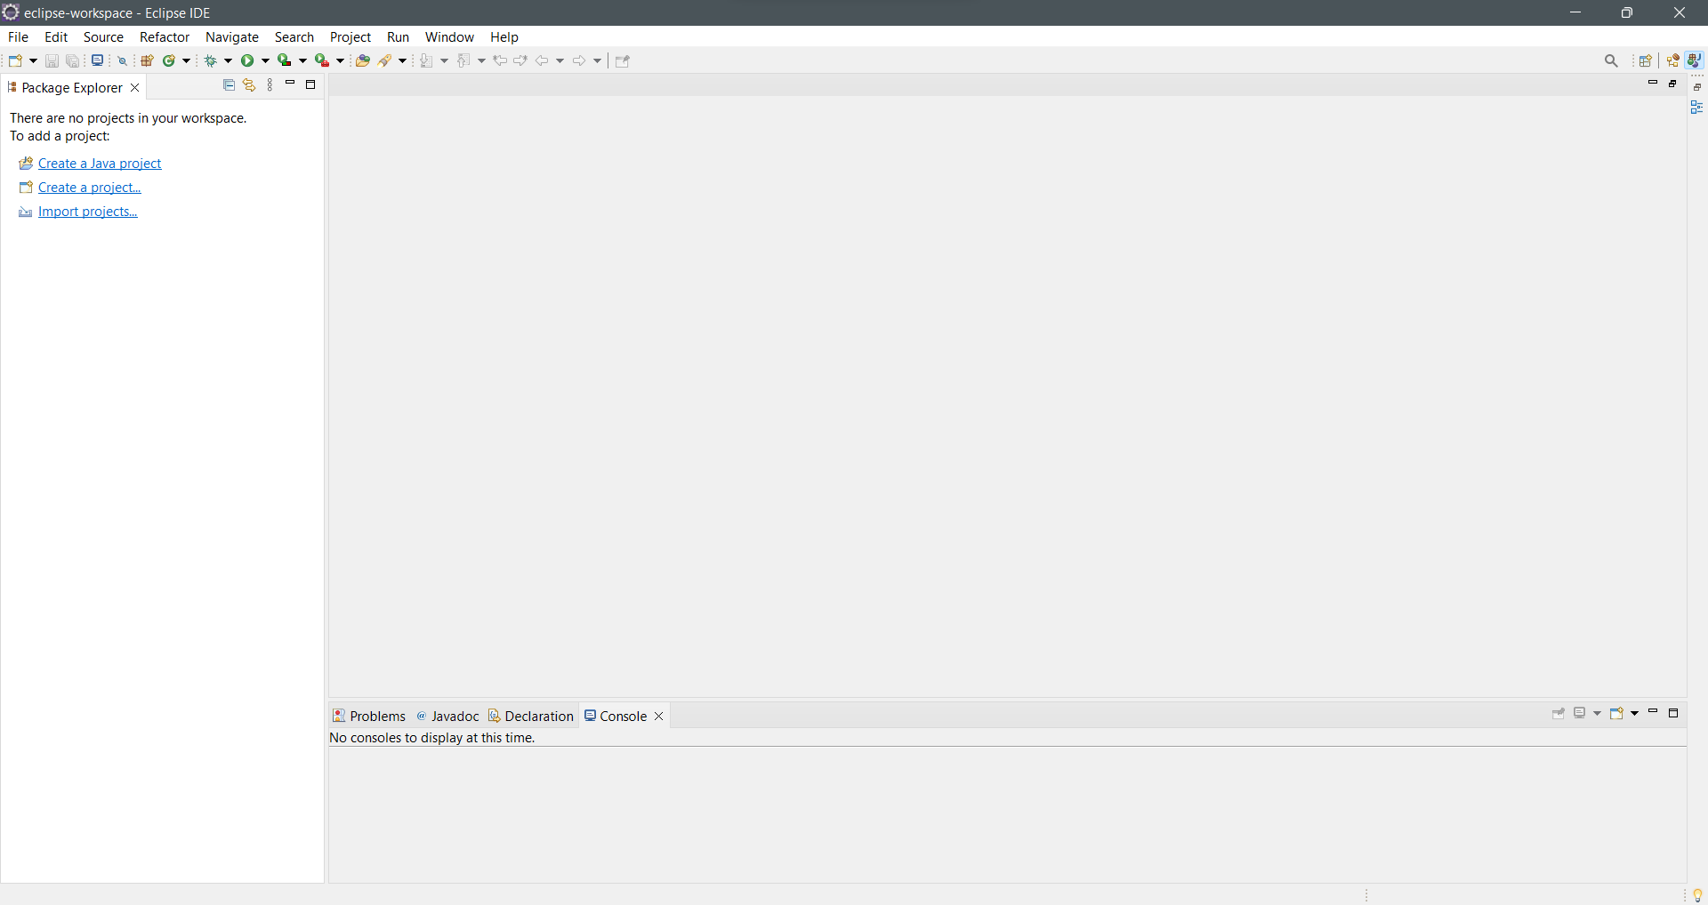
ECLIPSE WINDOW
Once launched, this type of window is seen.
Projects can be created and imported.

Slide 15
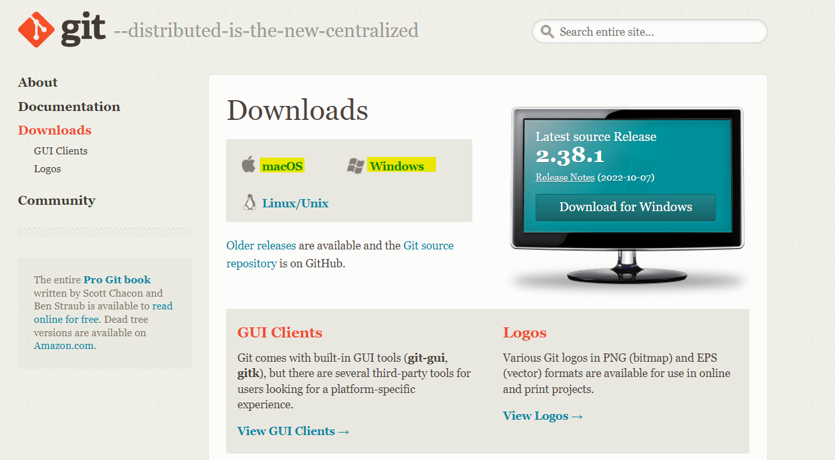
GIT
Download Link: https://git-scm.com/downloads
Choose Windows / Mac / Linux based on operating system

Slide 16
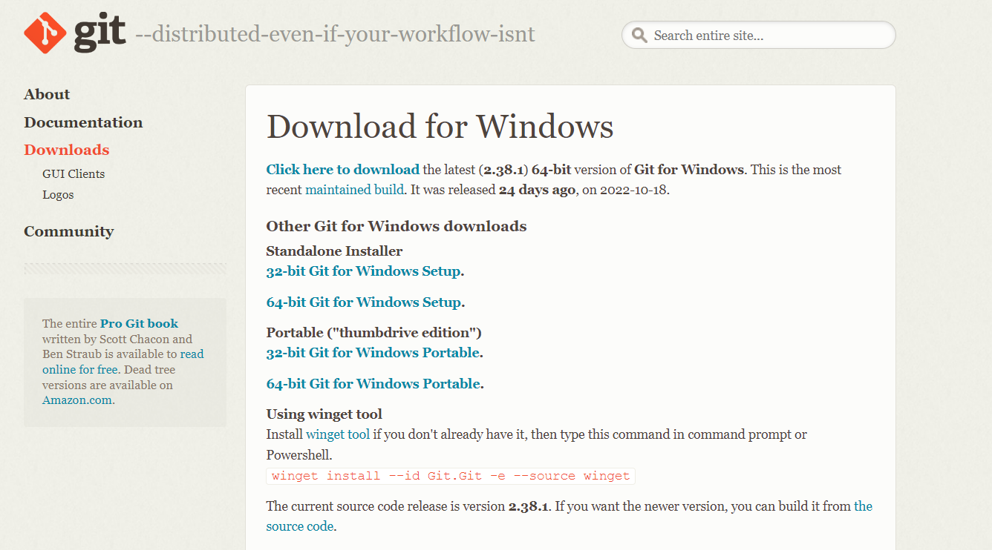
INSTALLERS
For windows – select the configuration of the system and choose the standalone installer

Slide 17
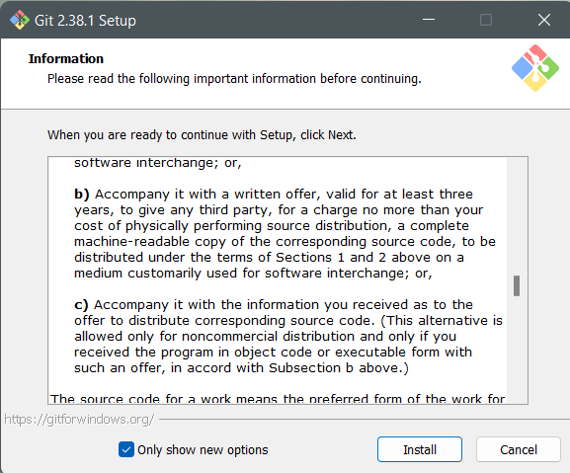
RUN THE INSTALLER
Run the installer
Click install

Slide 18
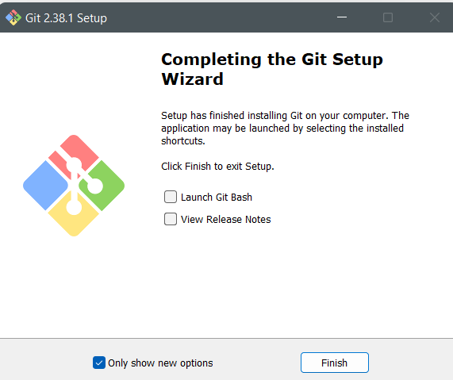
FINISHING INSTALLATION
Click finish to finish installation

Slide 19
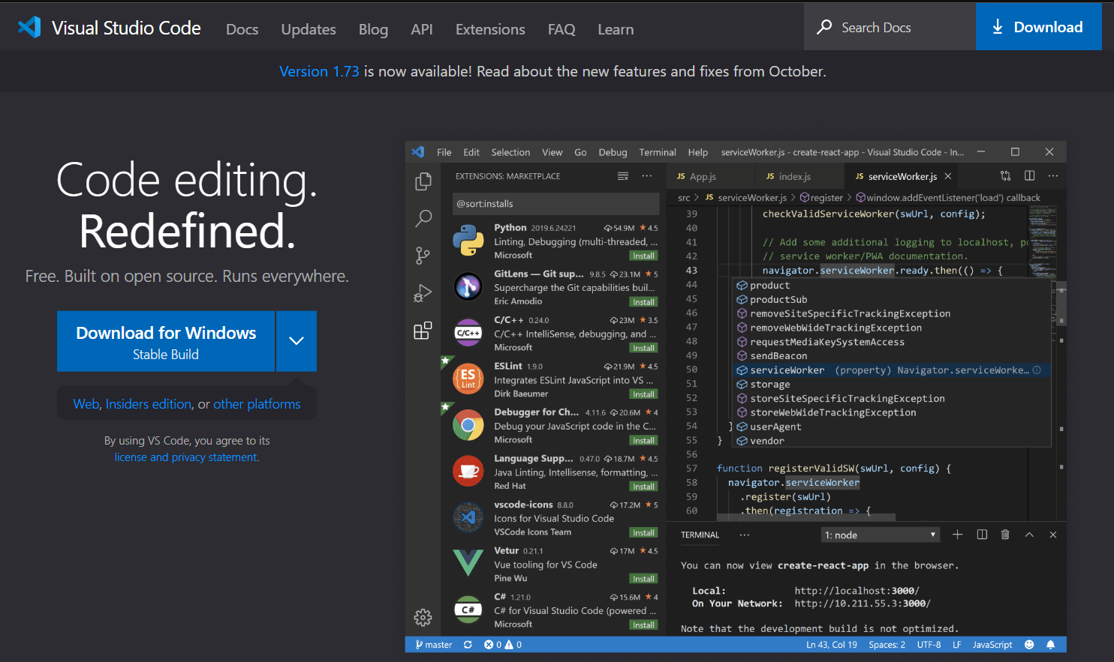
VISUAL STUDIO CODE
Download link: https://code.visualstudio.com/
Download the installer based on PC configurations

Slide 20
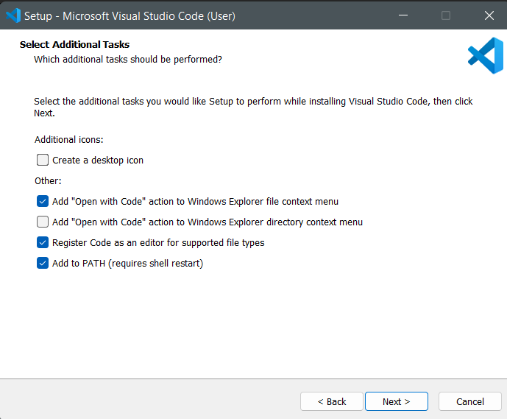
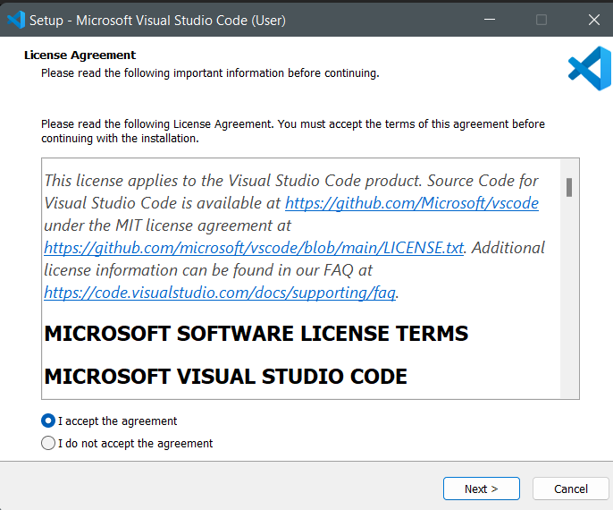

Slide 21
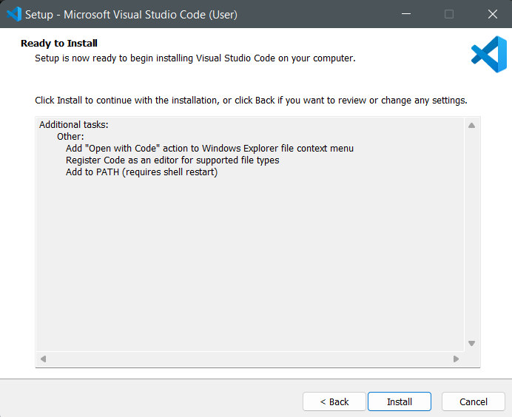
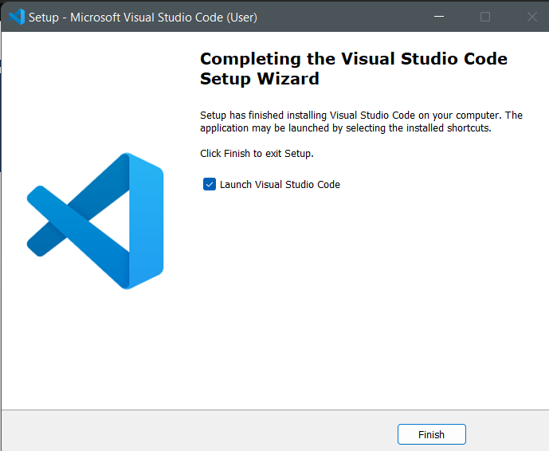
CLICK INSTALL AND LAUNCH

Slide 22
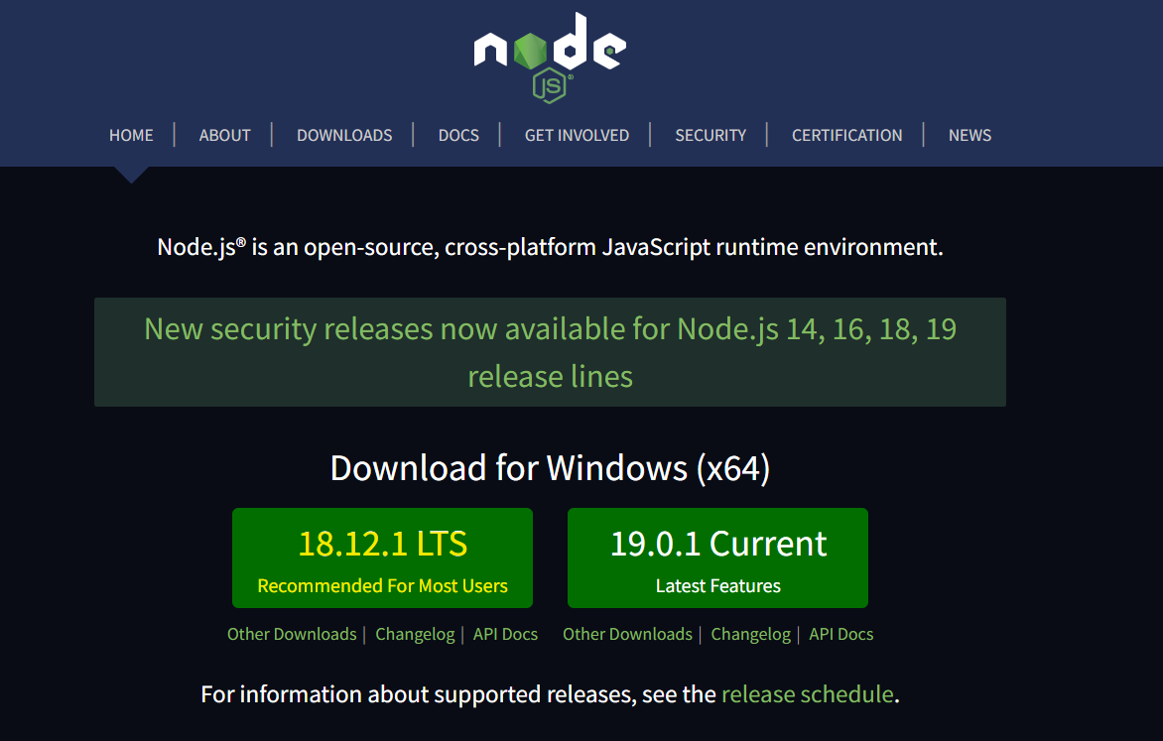
NODE JS
Download link: https://nodejs.org/en/
Use 18.12.1 LTS version

Slide 23
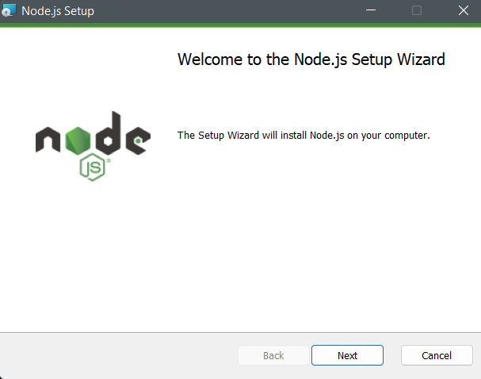
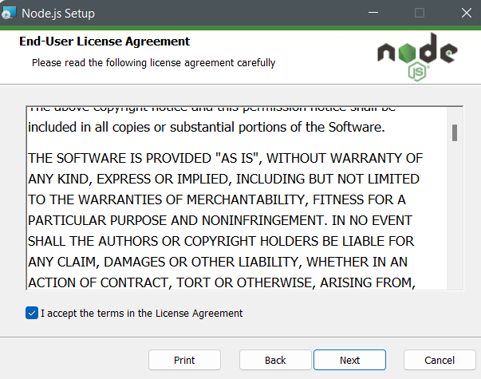
RUN THE INSTALLER

Slide 24
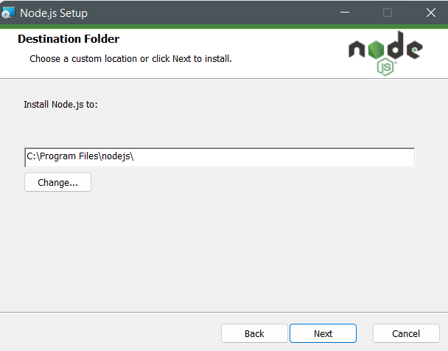
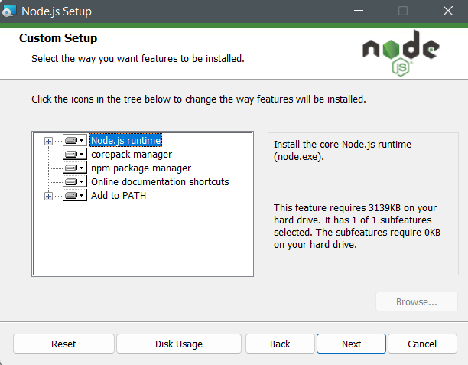

Slide 25
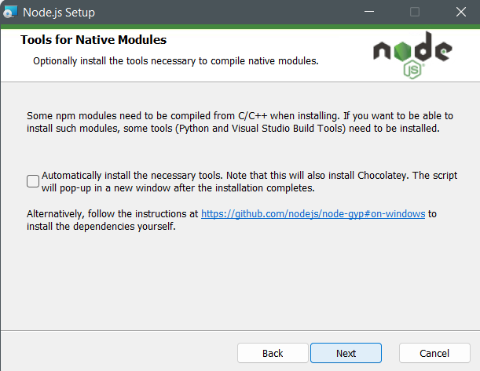
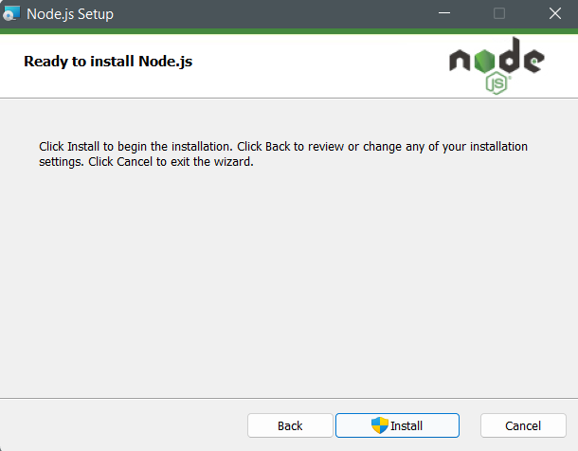

Slide 26
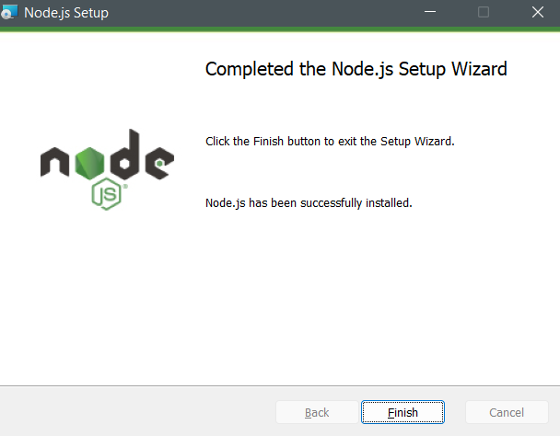
FINISHING INSTALLATION

Slide 27
GIT AND SOURCE CODE

Slide 28
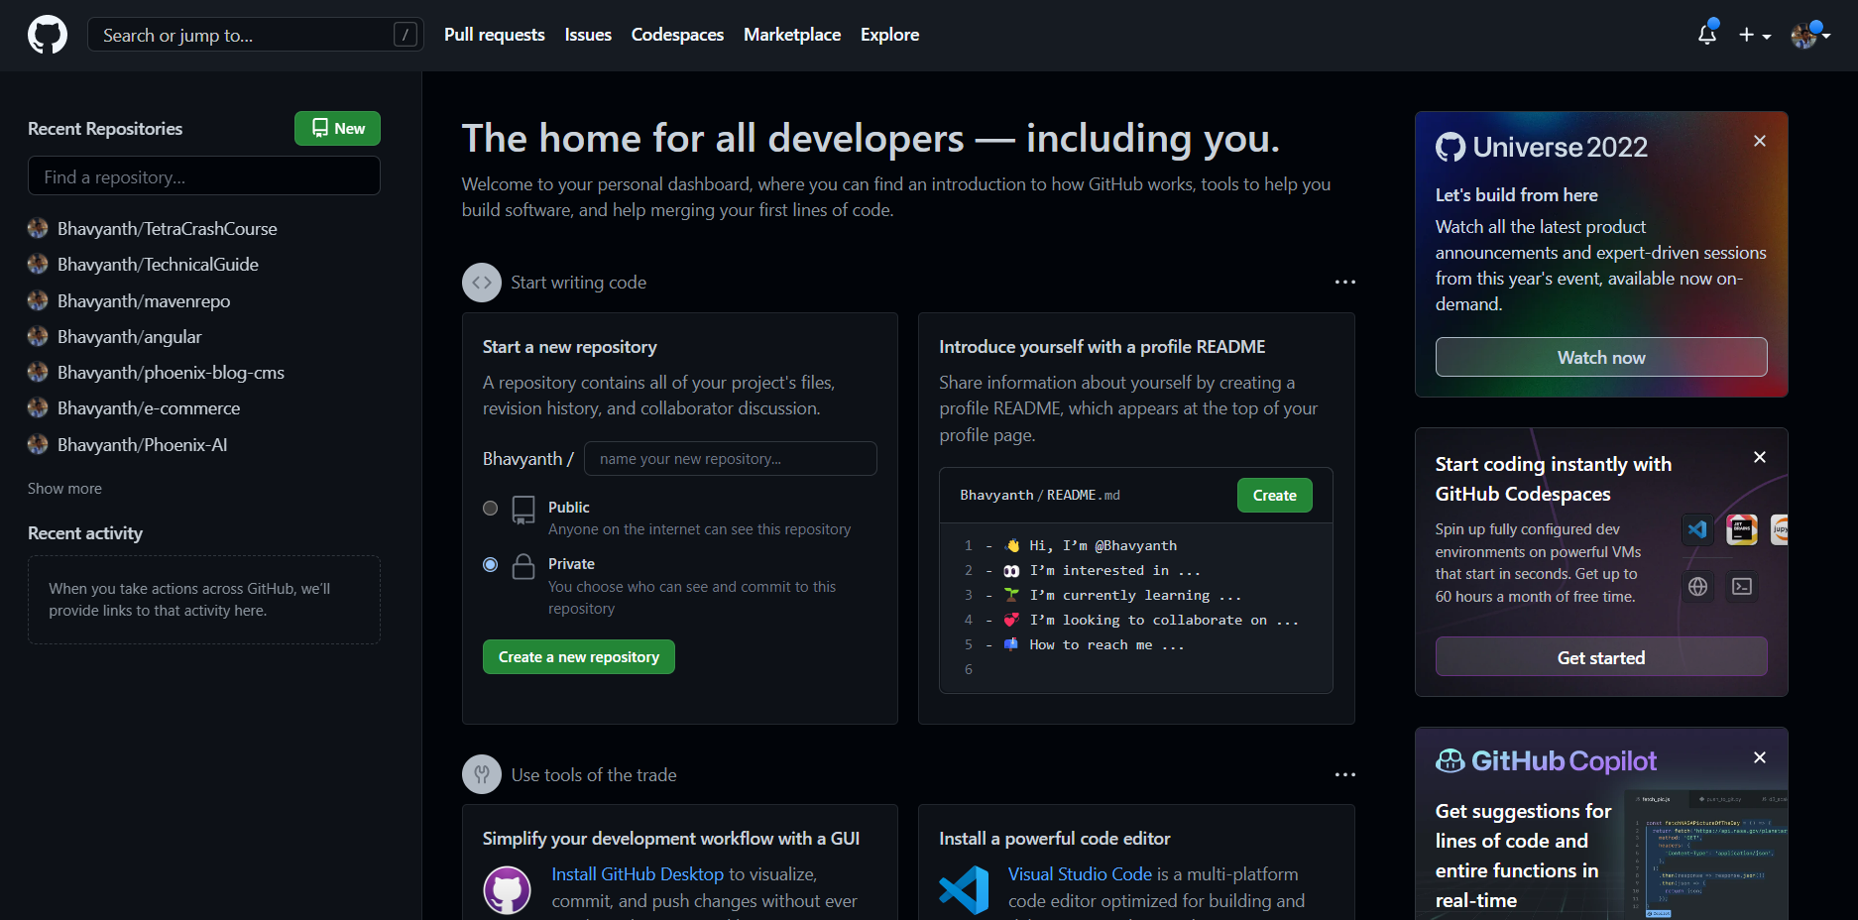
GITHUB
Open Github at: https://github.com/
Signin – if already registered
Signup – if not registered
Home page is visible upon login

Slide 29
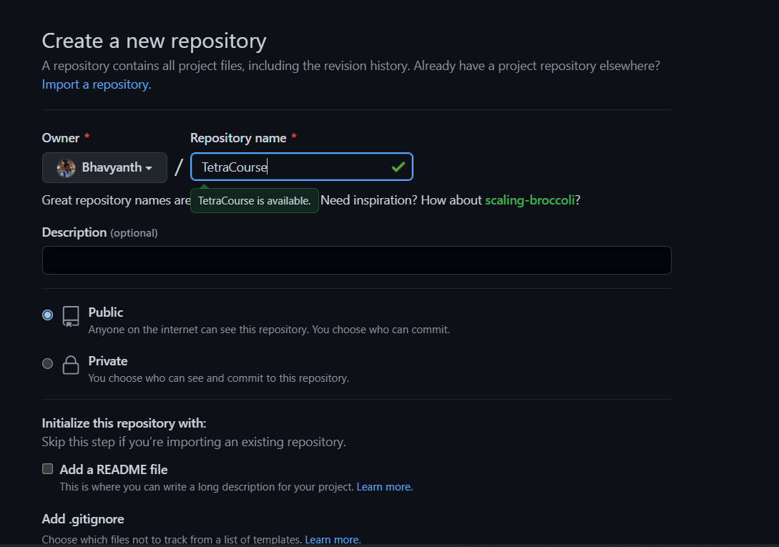
CREATE REPOSITORY
Create new repository in the homepage and provide repository name
Click create new repository

Slide 30
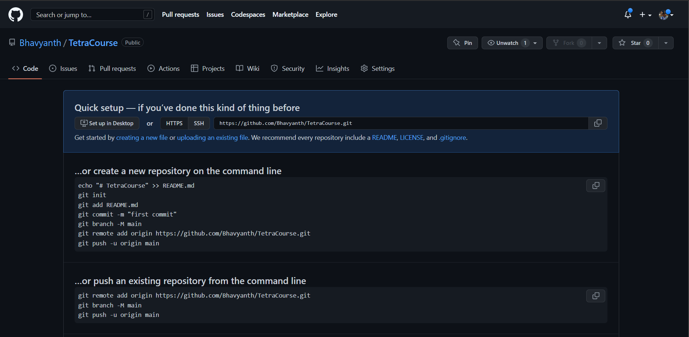
New link is generated to clone the source code
https://github.com/Bhavyanth/TetraCourse.git

Slide 31
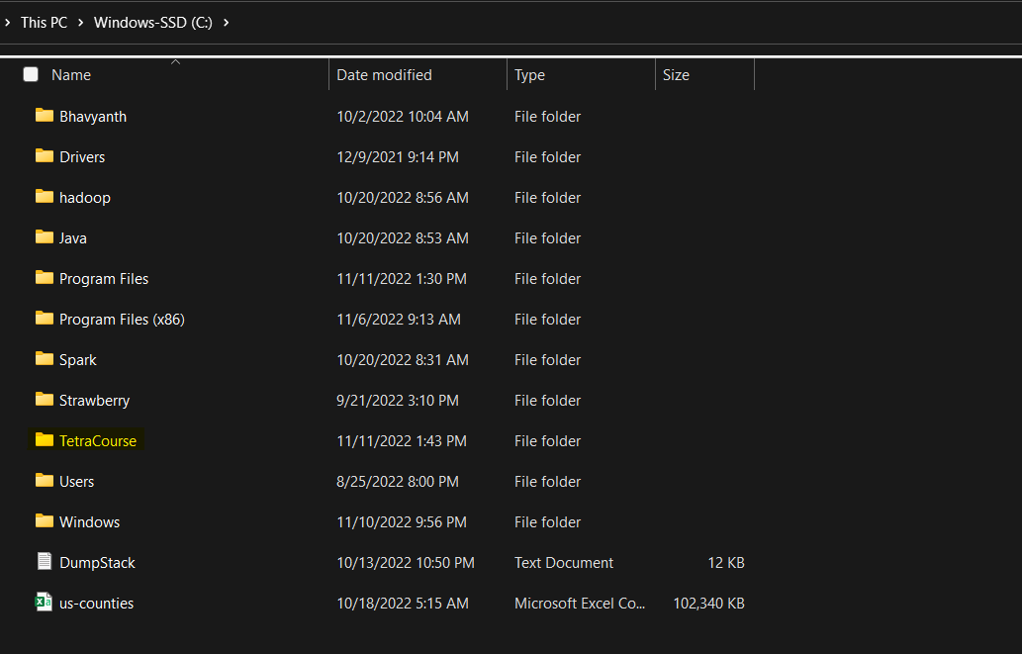
CLONE SOURCE CODE
Create a new folder in your desired directory to clone the source code

Slide 32
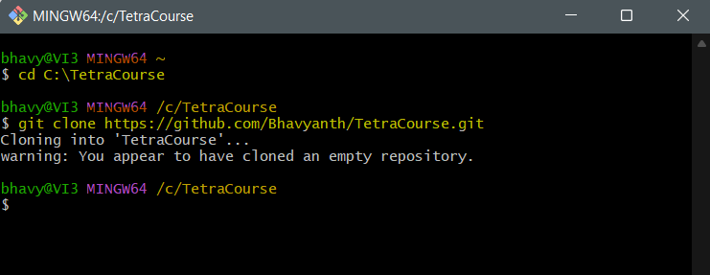
CLONE
Open git bash from the list of installed programs
Navigate to newly created folder using ‘cd’ command
Use ‘git clone <gitURL>’ to clone the source code which we have created in the earlier slide

Slide 33
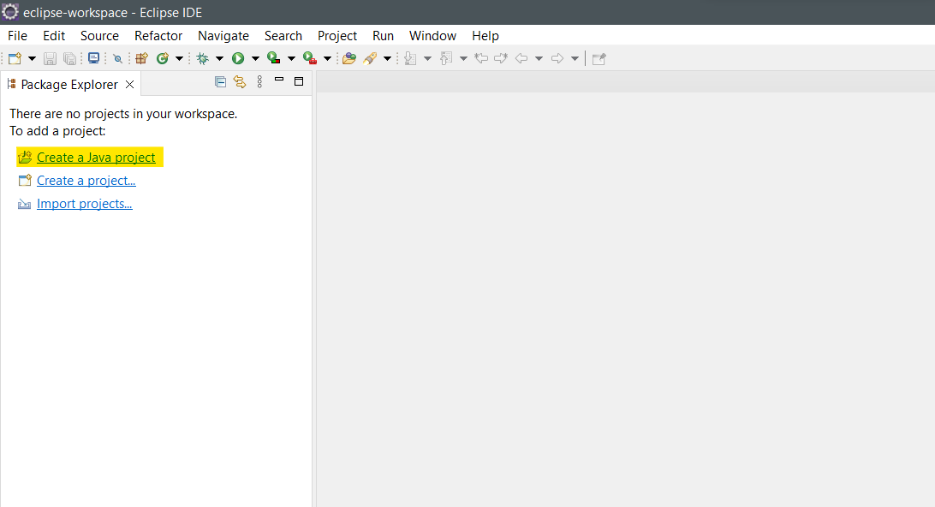
CREATE A PROJECT
Open eclipse and click on create new java project

Slide 34
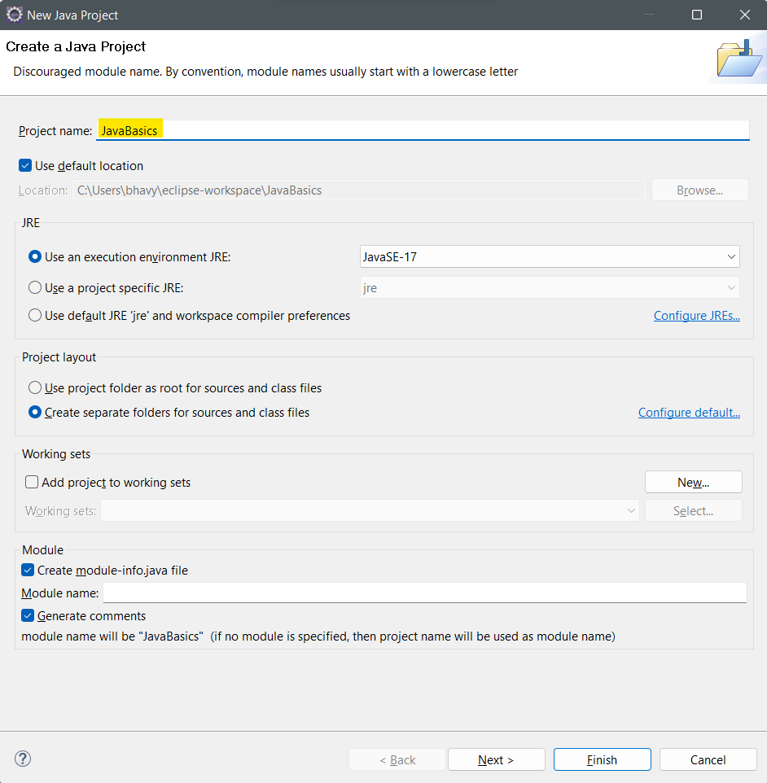
Provide a project name and click finish to create a project

Slide 35
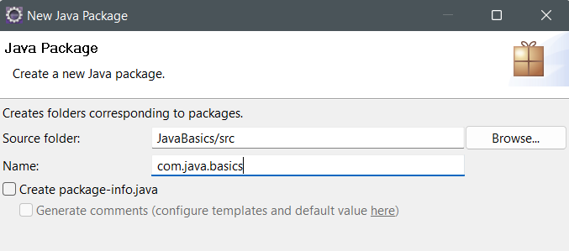
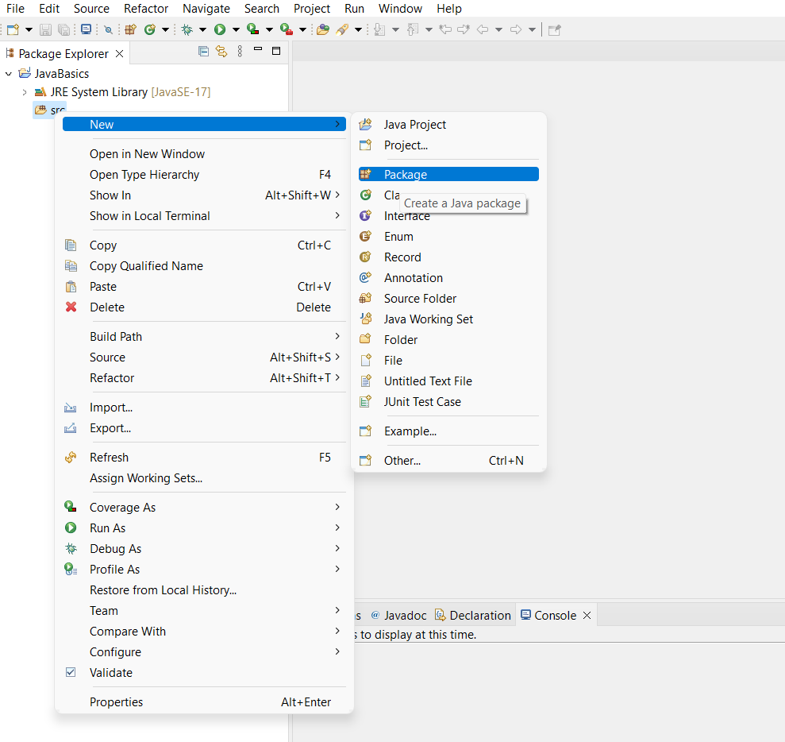
CREATING A NEW PACKAGE
RIGHT CLICK ON SRC AND CREATE A NEW PACKAGE AS SHOWN

