Slide 1
OBJECT ORIENTED PROGRAMMING - OOPS
Object means a real-world entity such as a pen, chair, table, computer, watch, etc.
Object-Oriented Programming is a methodology or paradigm to design a program using classes and objects. It simplifies software development and maintenance by providing some concepts:
Object
Class
Inheritance
Polymorphism
Abstraction
Encapsulation

Slide 2
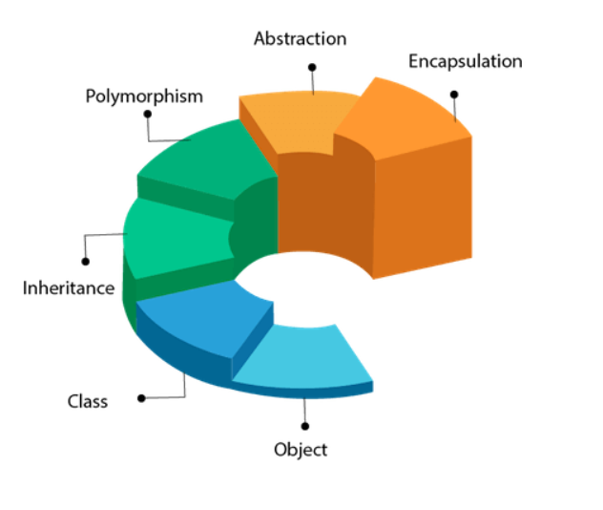
OOPS DESIGN

Slide 3
CLASS AND OBJECT
Object
Any entity that has state and behavior is known as an object. For example, a chair, pen, table, keyboard, bike, etc. It can be physical or logical.
Class
Collection of objects is called class. It is a logical entity.
A class can also be defined as a blueprint from which you can create an individual object. Class doesn't consume any space.

Slide 4
INHERITANCE
When one object acquires all the properties and behaviors of a parent object, it is known as inheritance.
It provides code reusability. It is used to achieve runtime polymorphism.

Slide 5
ABSTRACTION
Abstraction
Hiding internal details and showing functionality is known as abstraction.
It is the process of hiding certain details and showing only essential information to the user. Abstraction can be achieved with either abstract classes or interfaces.

Slide 6
ABSTRACTION
Must be declared with an abstract keyword
Can have abstract and non-abstract methods
Classes cannot be instantiated
They can have constructors and static methods
They can have final methods
A class can extend a class
An interface extends an interface
A class can implement an interface

Slide 7
CONSTRUCTORS
A constructor in Java is a special method that is used to initialize objects.
The constructor is called when an object of a class is created. It can be used to set initial values for object attributes.
Rules:
Constructors must have the same name as the class within which it is defined while it is not necessary for the method in Java.
Constructors do not return any type while method(s) have the return type or void if does not return any value.
Constructors are called only once at the time of Object creation while method(s) can be called any number of times.
A constructor in Java can not be abstract, final, static, or Synchronized

Slide 8
POLYMORPHISM
Polymorphism
If one task is performed in different ways, it is known as polymorphism.
Ex: Speak something – dogs bark, cats meow

Slide 9
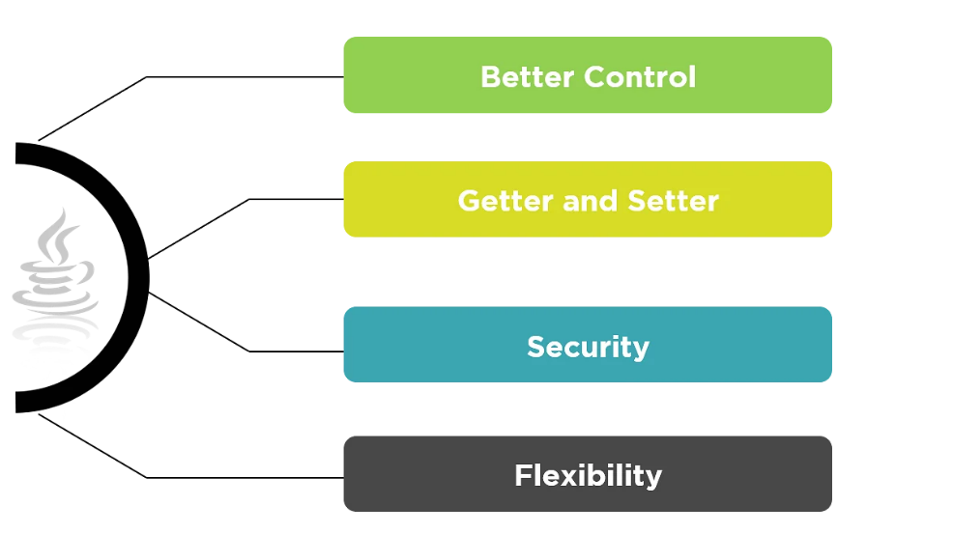
ENCAPSULATION
Binding (or wrapping) code and data together into a single unit are known as encapsulation.
For example, a capsule, it is wrapped with different medicines.
A java class is the example of encapsulation. Java bean is the fully encapsulated class because all the data members are private here.

Slide 10
DATA HIDING IN JAVA
Data hiding is a procedure done to avoid access to the data members and data methods and their logical implementation.
Data hiding can be done by using the access specifiers.
Default, public, private, protected

Slide 11
DEFAULT AND PUBLIC
Default is the first line of data hiding. If any class in Java is not mentioned with an access specifier, then the compiler will set ‘default’ as the access specifier.
The access specifications of default are extremely similar to that of the public access specifier.
Public
The public access specifier provides the access specifications to a class so that it can be accessed from anywhere within the program.

Slide 12
PRIVATE AND PROTECTED
Private
The private access specifier provides access to the data members, and the data methods limit to the class itself.
Protected
The protected access specifier protects the class methods and members similar to the private access specifier. The main difference is that the access is limited to the entire package, unlike only a class with the private access specifier.

Slide 13
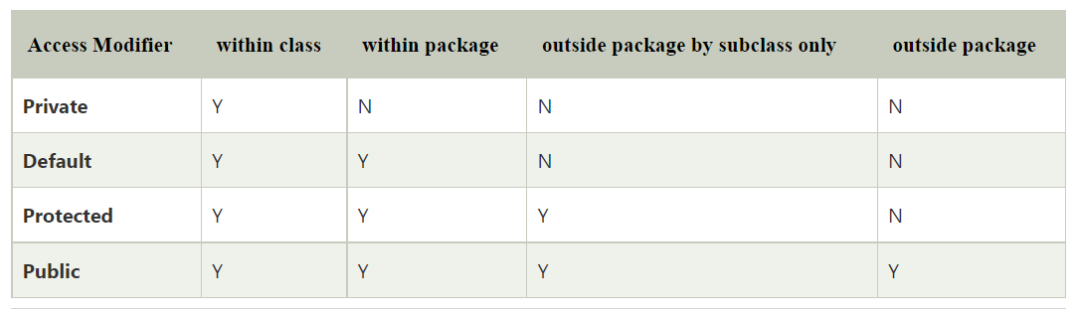

Slide 14
