Slide 1
JAVA

Slide 2
Variables
A variable is a container, which holds the value when the java program executes
We have 3 types of variables
Local, Static, Instance variables
Variable is the name of the reserved area allocated in the memory.
Local Variables: A variable declared inside the body of the method is called local variable.
Instance Variable: A variable declared inside the class but outside the body of the method, is called an instance variable. It is not declared as static.
Static Variable: A variable that is declared as static is called a static variable. It cannot be local. You can create a single copy of the static variable and share it among all the instances of the class.

Slide 3
DATA TYPES
Data types specify the different sizes and values that can be stored in the variable. There are two types of data types in Java:
Primitive data types: The primitive data types include boolean, char, byte, short, int, long, float and double.
Non-primitive data types: The non-primitive data types include Classes, Interfaces, and Arrays.
Primitive data types are the building blocks of data manipulation.

Slide 4
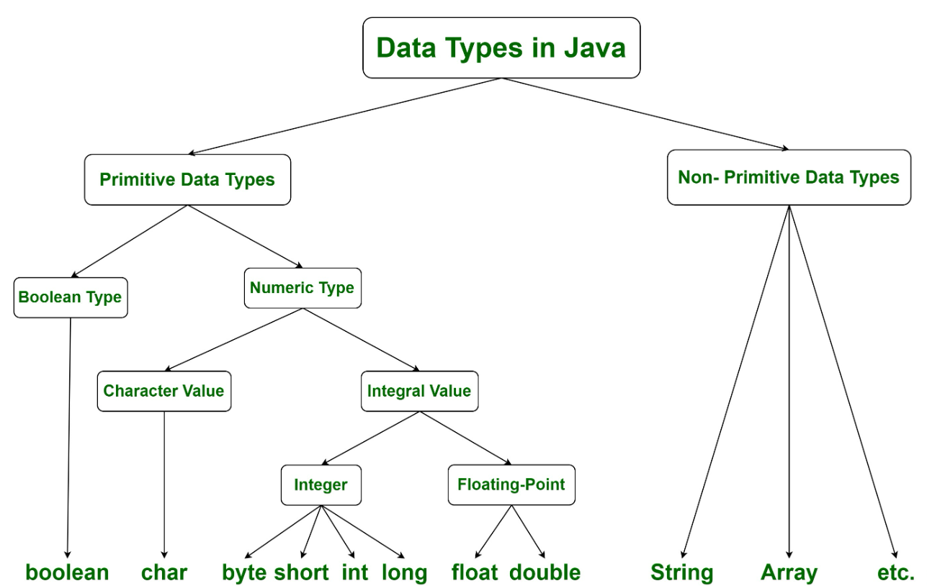

Slide 5
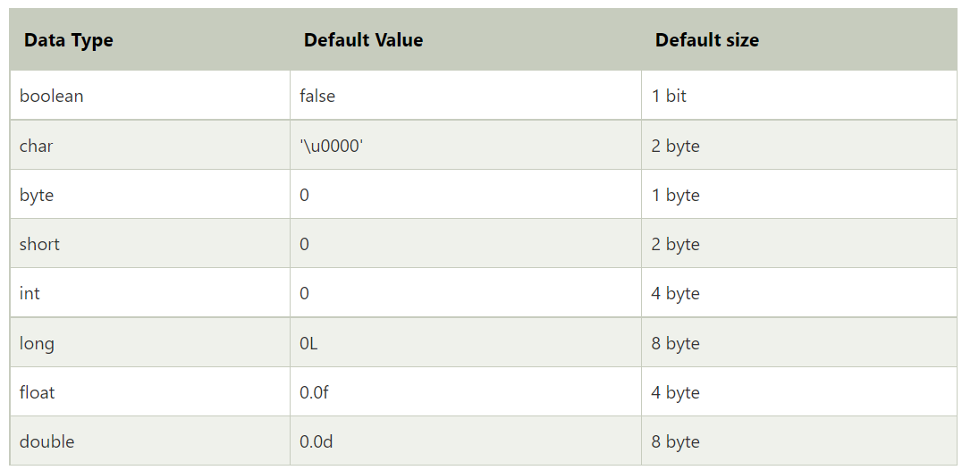
DATA TYPES And their sizes

Slide 6
DATA TYPES
Boolean data type: The Boolean data type is used to store only two possible values: true and false.
boolean x = true;
Byte data type: The byte data type is an example of primitive data type. It is an 8-bit signed two's complement integer.
Range lies between -128 to 127 (inclusive).
Minimum value: -128
Maximum value is 127.
Default value is 0.
Byte p = 10;

Slide 7
DATA TYPES
Short data type: The short data type is a 16-bit signed two's complement integer.
Range lies between -32,768 to 32,767 (inclusive).
Minimum value is -32,768
Maximum value is 32,767.
Its default value is 0.
short a = 1000;

Slide 8
DATA TYPES
Int data type: The int data type is a 32-bit signed two's complement integer. Its value-range lies between - 2,147,483,648 (-2^31) to 2,147,483,647 (2^31 -1) (inclusive).
Minimum value is - 2,147,483,648
Maximum value is 2,147,483,647.
Default value is 0.
int number = 100000
int num = -200000

Slide 9
DATA TYPES
Long data type: The long data type is a 64-bit two's complement integer. Its value-range lies between -9,223,372,036,854,775,808(-2^63) to 9,223,372,036,854,775,807(2^63 -1)(inclusive).
Minimum value is - 9,223,372,036,854,775,808
Maximum value is 9,223,372,036,854,775,807.
Its default value is 0

Slide 10
OPERATORS
Operator in Java is a symbol that is used to perform operations. For example: +, -, *, / etc.
There are many types of operators in Java which are given below:
Unary Operator,
Arithmetic Operator,
Shift Operator,
Relational Operator,
Bitwise Operator,
Logical Operator,
Ternary Operator and
Assignment Operator.

Slide 11
Operators
Unary Operators: The Java unary operators require only one operand. Unary operators are used to perform various operations i.e.:
incrementing/decrementing a value by one
negating an expression
inverting the value of a Boolean
Arithmetic Operators: Java arithmetic operators are used to perform addition, subtraction, multiplication, and division. They act as basic mathematical operations.

Slide 12
KEYWORDS
Java keywords are also known as reserved words.
Keywords are particular words that act as a key to a code. These are predefined words by Java so they cannot be used as a variable or object name or class name.

Slide 13
KEYWORDS
abstract: Java abstract keyword is used to declare an abstract class. An abstract class can provide the implementation of the interface. It can have abstract and non-abstract methods.
boolean: Java boolean keyword is used to declare a variable as a boolean type. It can hold True and False values only.
break: Java break keyword is used to break the loop or switch statement. It breaks the current flow of the program at specified conditions.
Byte: Java byte keyword is used to declare a variable that can hold 8-bit data values.
case: Java case keyword is used with the switch statements to mark blocks of text.
catch: Java catch keyword is used to catch the exceptions generated by try statements. It must be used after the try block only.
char: Java char keyword is used to declare a variable that can hold unsigned 16-bit Unicode characters
class: Java class keyword is used to declare a class.

Slide 14
KEYWORDS
Continue: Java continue keyword is used to continue the loop. It continues the current flow of the program and skips the remaining code at the specified condition.
default: Java default keyword is used to specify the default block of code in a switch statement.
do: Java do keyword is used in the control statement to declare a loop. It can iterate a part of the program several times.
double: Java double keyword is used to declare a variable that can hold 64-bit floating-point number.
else: Java else keyword is used to indicate the alternative branches in an if statement.
enum: Java enum keyword is used to define a fixed set of constants. Enum constructors are always private or default.
extends: Java extends keyword is used to indicate that a class is derived from another class or interface.
final: Java final keyword is used to indicate that a variable holds a constant value. It is used with a variable. It is used to restrict the user from updating the value of the variable.
finally: Java finally keyword indicates a block of code in a try-catch structure. This block is always executed whether an exception is handled or not.

Slide 15
KEYWORDS
float: Java float keyword is used to declare a variable that can hold a 32-bit floating-point number.
for: Java for keyword is used to start a for loop. It is used to execute a set of instructions/functions repeatedly when some condition becomes true. If the number of iteration is fixed, it is recommended to use for loop.
if: Java if keyword tests the condition. It executes the if block if the condition is true.
implements: Java implements keyword is used to implement an interface.
import: Java import keyword makes classes and interfaces available and accessible to the current source code.
instanceof: Java instanceof keyword is used to test whether the object is an instance of the specified class or implements an interface.
int: Java int keyword is used to declare a variable that can hold a 32-bit signed integer.
interface: Java interface keyword is used to declare an interface. It can have only abstract methods.
long: Java long keyword is used to declare a variable that can hold a 64-bit integer.
native: Java native keyword is used to specify that a method is implemented in native code using JNI (Java Native Interface).

Slide 16
KEYWORDS
new: Java new keyword is used to create new objects.
null: Java null keyword is used to indicate that a reference does not refer to anything. It removes the garbage value.
package: Java package keyword is used to declare a Java package that includes the classes.
private: Java private keyword is an access modifier. It is used to indicate that a method or variable may be accessed only in the class in which it is declared.
protected: Java protected keyword is an access modifier. It can be accessible within the package and outside the package but through inheritance only. It can't be applied with the class.
public: Java public keyword is an access modifier. It is used to indicate that an item is accessible anywhere. It has the widest scope among all other modifiers.
return: Java return keyword is used to return from a method when its execution is complete.
short: Java short keyword is used to declare a variable that can hold a 16-bit integer.
static: Java static keyword is used to indicate that a variable or method is a class method. The static keyword in Java is mainly used for memory management.
strictfp: Java strictfp is used to restrict the floating-point calculations to ensure portability.
super: Java super keyword is a reference variable that is used to refer to parent class objects. It can be used to invoke the immediate parent class method.

Slide 17
KEYWORDS
switch: The Java switch keyword contains a switch statement that executes code based on test value. The switch statement tests the equality of a variable against multiple values.
synchronized: Java synchronized keyword is used to specify the critical sections or methods in multithreaded code.
this: Java this keyword can be used to refer the current object in a method or constructor.
throw: The Java throw keyword is used to explicitly throw an exception. The throw keyword is mainly used to throw custom exceptions. It is followed by an instance.
throws: The Java throws keyword is used to declare an exception. Checked exceptions can be propagated with throws.
transient: Java transient keyword is used in serialization. If you define any data member as transient, it will not be serialized.
try: Java try keyword is used to start a block of code that will be tested for exceptions. The try block must be followed by either catch or finally block.
void: Java void keyword is used to specify that a method does not have a return value.
volatile: Java volatile keyword is used to indicate that a variable may change asynchronously.
while: Java while keyword is used to start a while loop. This loop iterates a part of the program several times. If the number of iteration is not fixed, it is recommended to use the while loop.

Slide 18
CONTROL STATEMENTS
Java compiler executes the code from top to bottom.
The statements in the code are executed according to the order in which they appear. However, Java provides statements that can be used to control the flow of Java code.
Such statements are called control flow statements. It is one of the fundamental features of Java, which provides a smooth flow of program.

Slide 19
CONTROL STATEMENTS
Java provides three types of control flow statements.
Decision Making statements
if statements
switch statement
Loop statements
do while loop
while loop
for loop
for-each loop
Jump statements
break statement
continue statement

Slide 20
JAVA COMMENTS
We have 3 types of comments
Comments are used to make the program more readable by adding the details of the code.
It makes easy to maintain the code and to find the errors easily.
There are three types of comments in Java.
Single Line Comment
// this is a single line comment
Multi Line Comment
/* This is multi-line comment */
Documentation Comment
/** This is a documentation comment */

