Slide 1



EARLY WARNING SYSTEM FOR STUDENT BURNOUT & DROPOUT RISK
AI-Powered Behavioural Analytics Framework
Behavioural Analytics Hackathon
S.Bhavya sri
Vellore Institution of Technology - Chennai campus
28/2/26 to 1/3/26

Slide 2
PROBLEM STATEMENT
The Problem
  Universities detect burnout only after performance decline.
  Late intervention reduces effectiveness.
  Early behavioural signals often go unnoticed.
Key Challenge
Build a system that:
  Predicts Burnout Risk Level
  Detects Academic Disengagement
  Estimates Dropout Probability
  Suggests Intervention Strategy

Slide 3
PROPOSED SOLUTION
Our Approach
We developed an AI-driven behavioural analytics system that:
  Uses LMS activity patterns
  Monitors attendance trends
  Tracks assignment delays
  Analyzes feedback sentiment
  Generates Risk Score (0–100)
Output
  Risk Score
  Risk Category
  Behavioural Trigger Explanation
  Intervention Recommendation

Slide 4
DATASET DESIGN
Dataset Type: Synthetic
Why?
  Real LMS datasets are private
  Student data is confidential
  Ethical constraints
Dataset Summary
  2000 Students
  7 Behavioural Features
  1 Target Variable

Slide 5
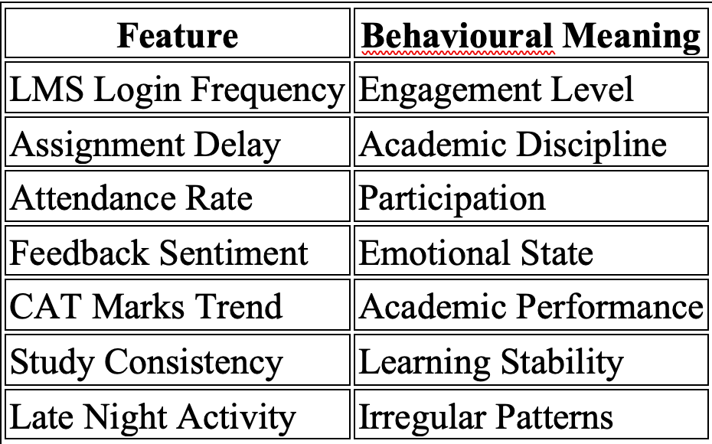
BEHAVIOURAL FEATURES

Slide 6
RISK LABEL LOGIC
Burnout Risk Classification
High Risk:
  Attendance < 70%
  Declining marks trend
  High submission delays
  Negative sentiment
Medium Risk:
  Moderate behavioural decline
Low Risk:
  Stable behaviour & performance

Slide 7
MODEL SELECTION
Model Used: Random Forest Classifier
Why Random Forest?
  Captures nonlinear behavioural patterns
  Handles structured data well
  Robust to noise
  Provides feature importance (Explainable AI)

Slide 8
MODEL PERFORMANCE
Evaluation Metrics
  Accuracy: 98.75%
  Precision
  Recall
  F1-Score
  Confusion Matrix
Observation
  High-risk students detected accurately
  Minimal misclassification
  Strong predictive consistency

Slide 9
BEHAVIOURAL INSIGHTS
Top 3 Behavioural Triggers
  CAT Marks Trend
  Attendance Rate
  Feedback Sentiment Score
Key Insight
  Academic decline is strongest burnout indicator.
  Attendance reduction strongly correlates with disengagement.
  Emotional negativity amplifies risk.

Slide 10
DASHBOARD DEMONSTRATION
System Features
  Real-time Risk Prediction
  Risk Score (0–100)
  Automated Intervention Suggestion
  Top Behavioural Triggers
  Downloadable Risk Report
  Risk Distribution Visualization

Slide 11
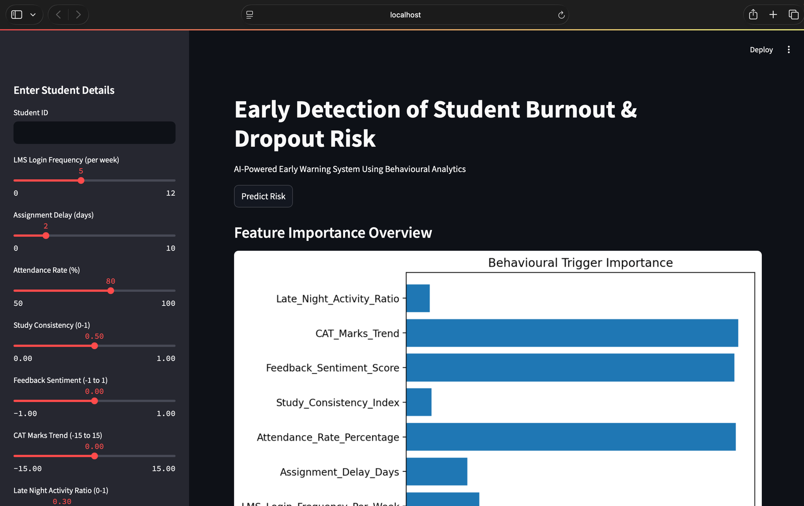
DASHBOARD DEMONSTRATION

Slide 12
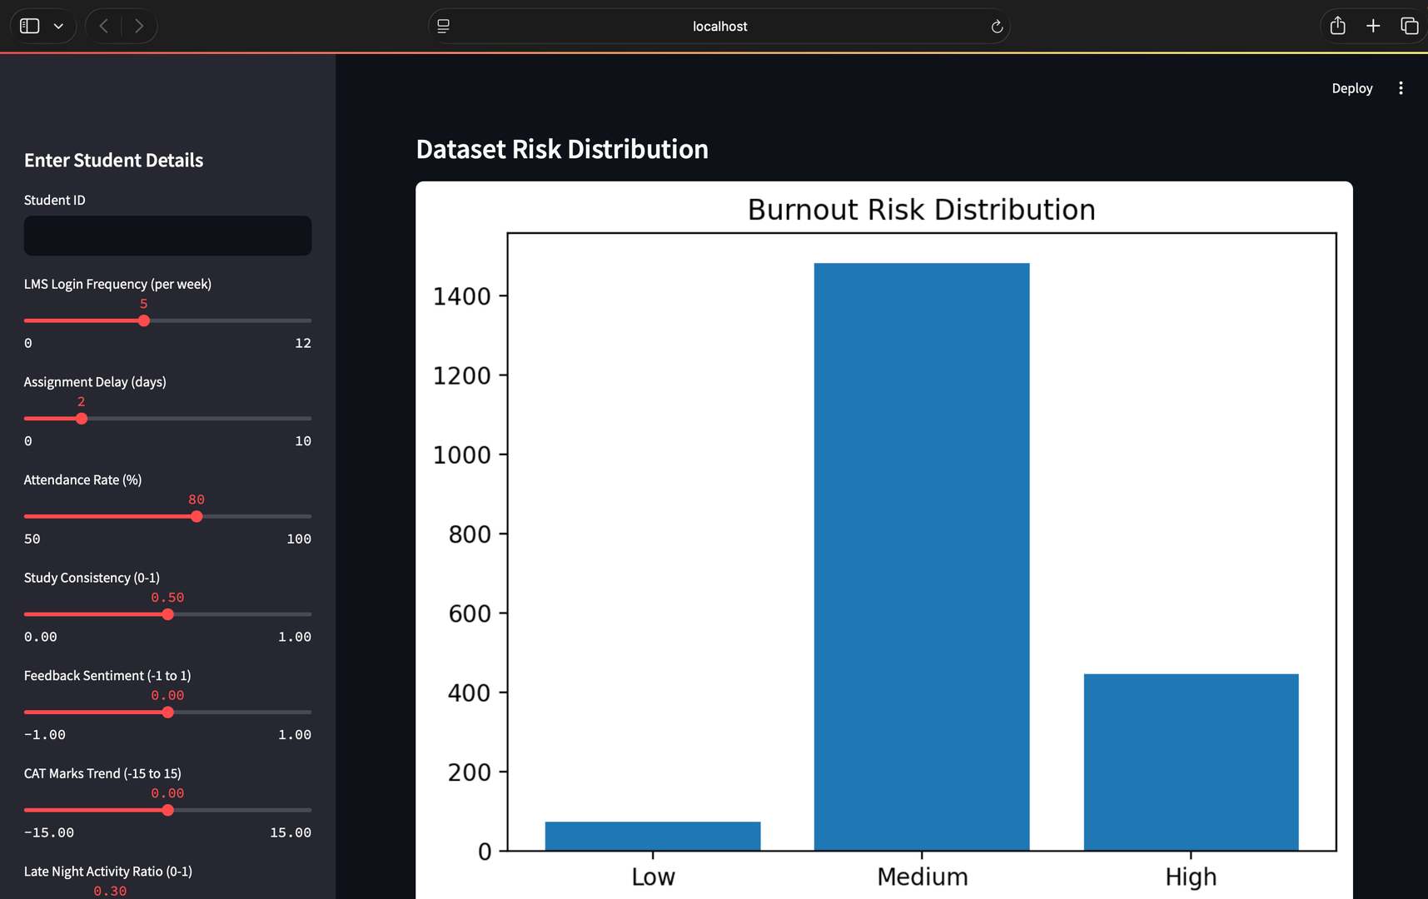
DASHBOARD DEMONSTRATION

Slide 13
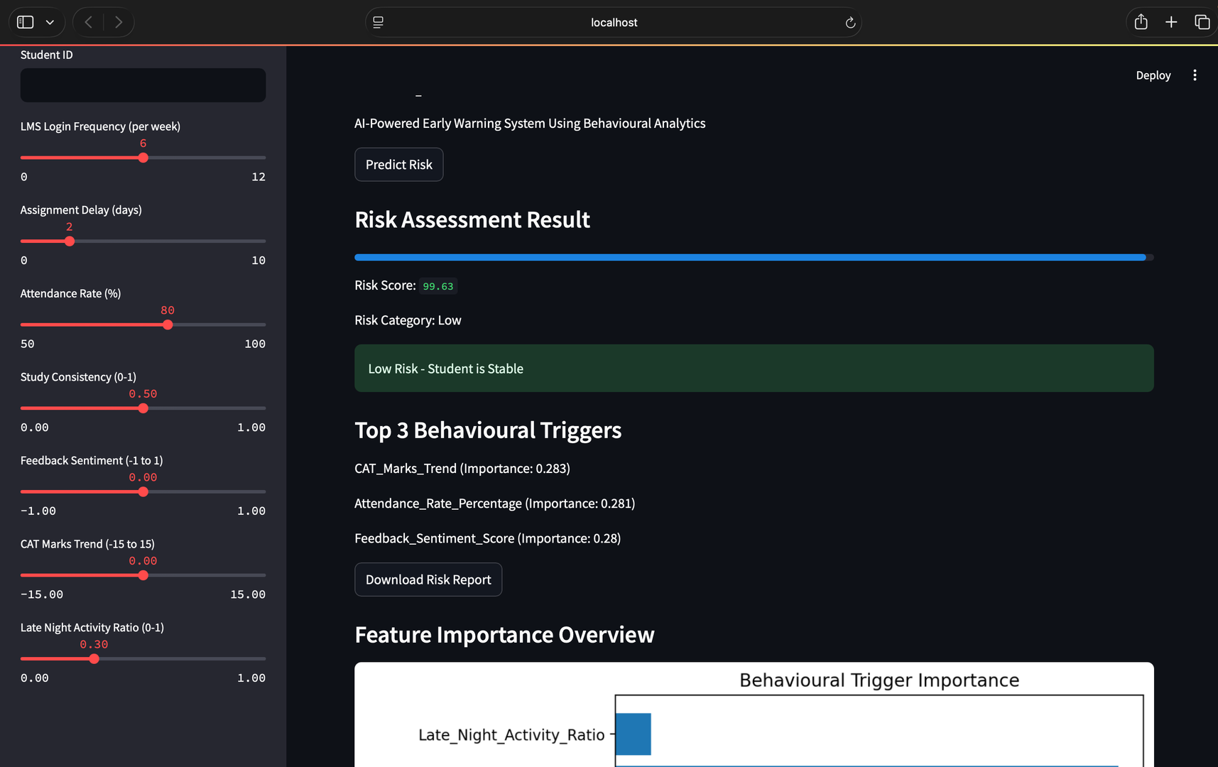
DASHBOARD DEMONSTRATION

Slide 14
INTERVENTION STRATEGY
High Risk:
  Immediate counselling
  Faculty notification
  Weekly monitoring
Medium Risk:
  Academic reminders
  Peer mentoring
Low Risk:
  Stable monitoring

Slide 15
PRACTICAL FEASIBILITY
This system can be integrated into:
  University LMS platforms
  Academic monitoring systems
  Student counselling dashboards
  Institutional analytics frameworks
Benefits:
  Early intervention
  Reduced dropout rates
  Improved student wellbeing
  Data-driven decision-making

Slide 16
FUTURE ENHANCEMENTS
  Real LMS integration
  Time-series behavioural tracking
  Deep learning sentiment analysis
  Faculty alert automation
  Cloud deployment

Slide 17
CONCLUSION
This project demonstrates how behavioural analytics combined with machine learning can:
  Detect burnout early
  Provide explainable risk insights
  Enable proactive intervention
  Transform reactive monitoring into predictive intelligence

Slide 18

THANK
YOU

