Slide 1
Employee Wellness Management Analytics
AI & ML Powered Corporate Health Diagnostics Portal

Slide 2
Employee Wellness Management Analytics
Project Overview & Objectives
Project Overview ◀
Problem Statement
Lack of a centralized system to monitor employee health and wellness.
Difficulty in identifying health risks and providing personalized wellness support.
Limited real-time insights for HR to improve employee well-being and productivity.
1. Health Data
2. Risk Prediction
3. Recommendations
The Solution
AI-based Employee Wellness Monitoring and Health Management.
Personalized Wellness Recommendations with Risk Prediction and Sentiment Analysis.
Interactive HR Analytics Dashboard with an AI Wellness Chatbot for Employee Engagement.
4. Sentiment Logs
5. BI Dashboards
6. AI Chatbot UI
Concluion

Slide 3
System Architecture & Technology Stack
Employee Wellness Management Analytics
Project Overview
ML & NLP Engine
• Data Validation (Isolation Forest): Detects unusual or incorrect employee data automatically.
• Risk Prediction (Decision Tree, Random Forest, XGBoost & Neural Networks): Predicts employee health risks such as stress, burnout, and obesity
• Sentiment Analysis (TextBlob): Analyzes employee feedback to identify positive, negative, or neutral sentiments.
Frontend & AI
Frontend: HTML, CSS, JavaScript with Chart.js for interactive dashboards.
AI Chatbot: Ollama with the Qwen2.5 model for intelligent responses.
Communication: REST API for seamless connection between the application and AI model.
Backend & DB
Backend: Python Flask
Database: SQLite with SQLAlchemy
Task Processing: Handles user requests and background tasks efficiently
System Architecture ◀
1. Health Data
2. Risk Prediction
3. Recommendations
4. Sentiment Logs
5. BI Dashboards
6. AI Chatbot UI
Conclusion

Slide 4
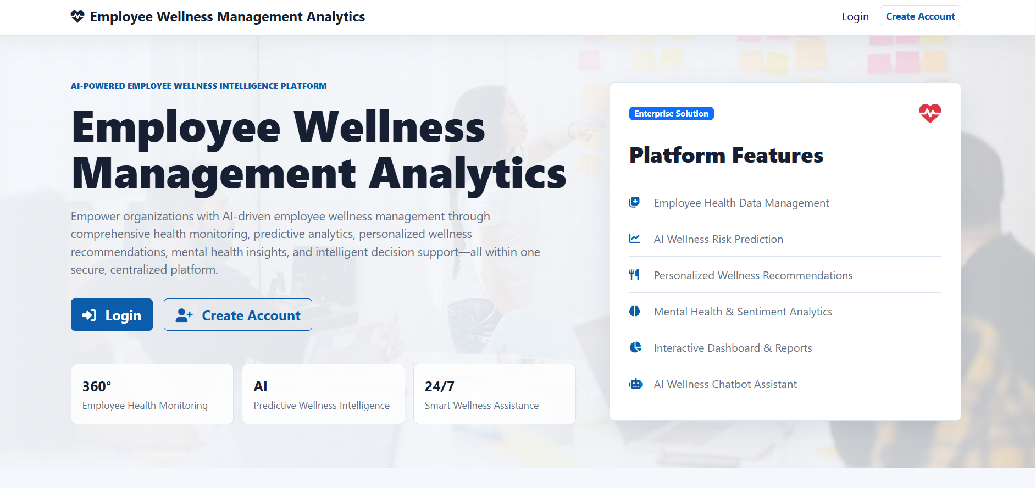
Employee Wellness Management Analytics
Module 1: Security Infrastructure and Login
Employee & Admin Authentication – Separate login portals with role-based access.
Create Account – Secure employee registration with duplicate email validation.
Login Security – Account lockout after multiple failed login attempts.
Password Recovery – OTP-based password reset and recovery.
Secure Sessions – Bcrypt password encryption and protected session management.
Project Overview
Login Page
1. Health Data
2. Risk Prediction
3. Recommendations
4. Sentiment Logs
5. BI Dashboards
6. AI Chatbot UI
Conclusion

Slide 5
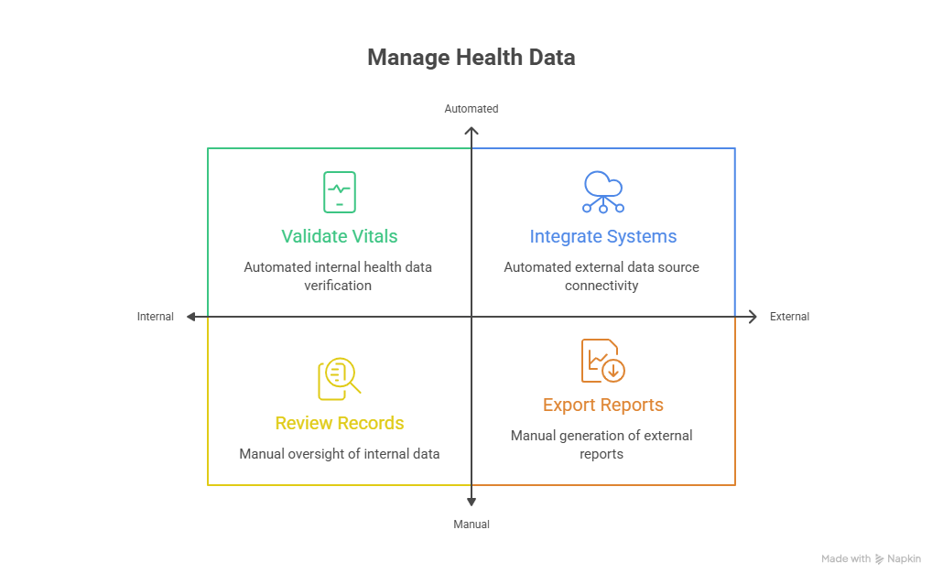
Employee Wellness Management Analytics
1. Employee Health Data Management
System Architecture
1. Health Data ◀
2. Risk Prediction
3. Recommendations
4. Sentiment Logs
5. BI Dashboards
6. AI Chatbot UI
Conclusion

Slide 6
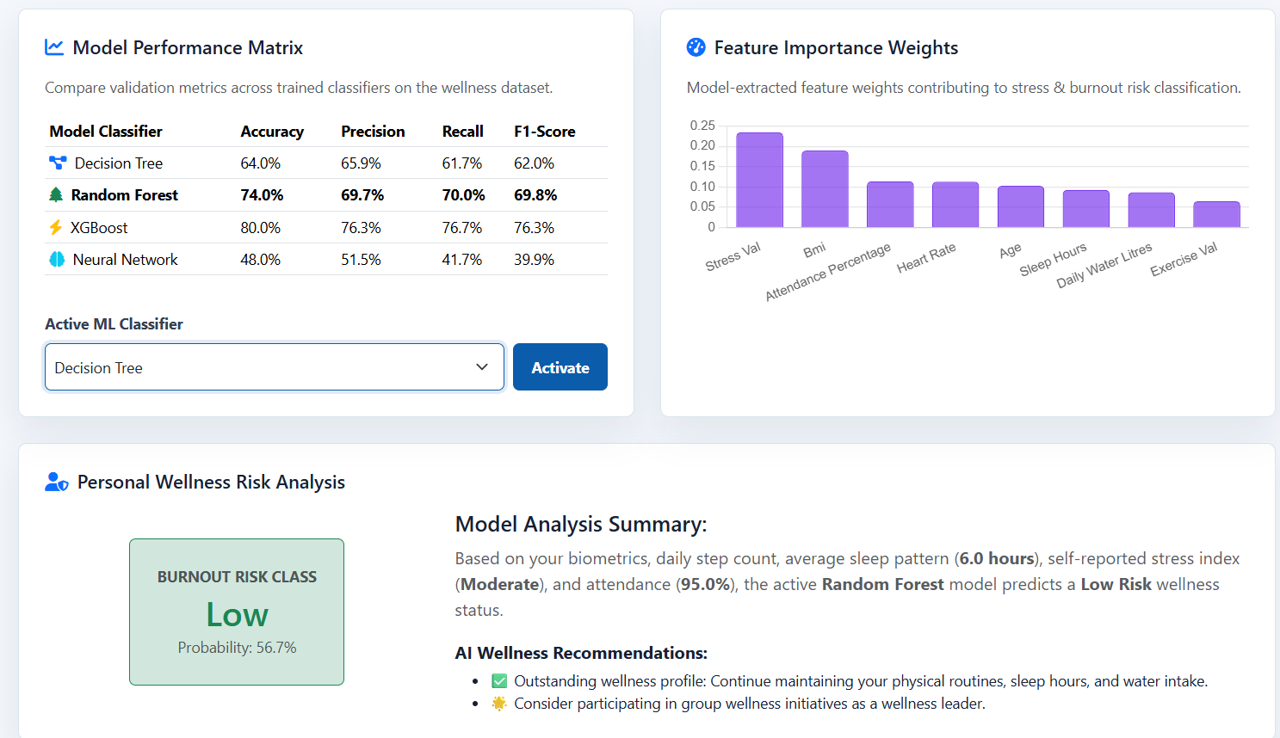
Employee Wellness Management Analytics
2. AI-Based Wellness Risk Prediction
ML Classification Models
Decision Tree & Random Forest: Predict employee health risks using decision-based models.
XGBoost: Improves prediction accuracy for wellness risk analysis.
Neural Network (MLP): Learns complex health patterns to provide better risk predictions.
System Architecture
1. Health Data
2. Risk Prediction ◀
3. Recommendations
4. Sentiment Logs
5. BI Dashboards
6. AI Chatbot UI
Conclusion

Slide 7
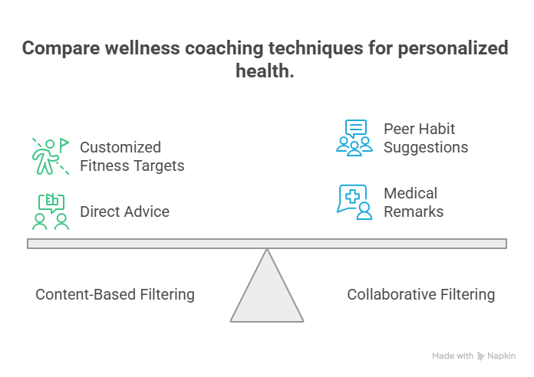
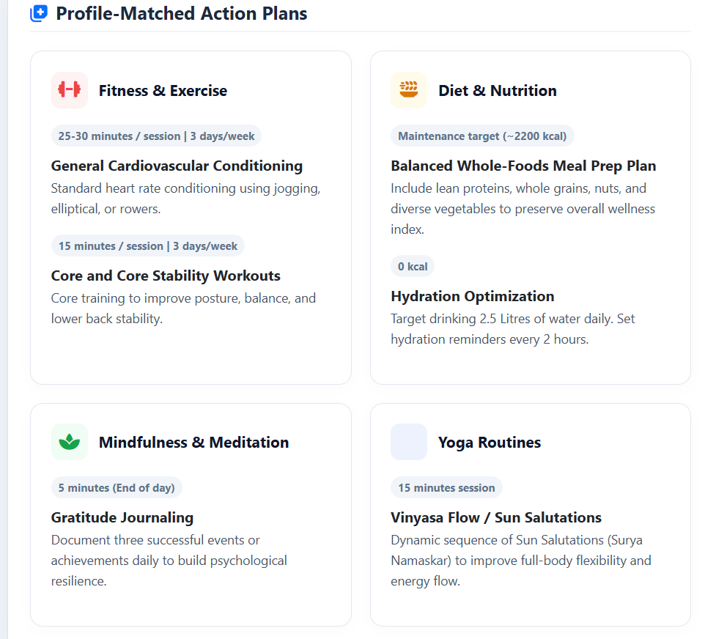
Employee Wellness Management Analytics
3. Personalized Recommendation System
Project Overview
System Architecture
1. Health Data
2. Risk Prediction
3. Recommendations ◀
Generative Wellness Coach
AI Health Assistant: Uses the Qwen AI model to analyze employee health data.
Personalized Recommendations: Suggests workout plans, diet tips, yoga, and wellness advice.
Interactive Responses: Displays recommendations in a clear and user-friendly format.
4. Sentiment Logs
5. BI Dashboards
6. AI Chatbot UI
Conclusion

Slide 8
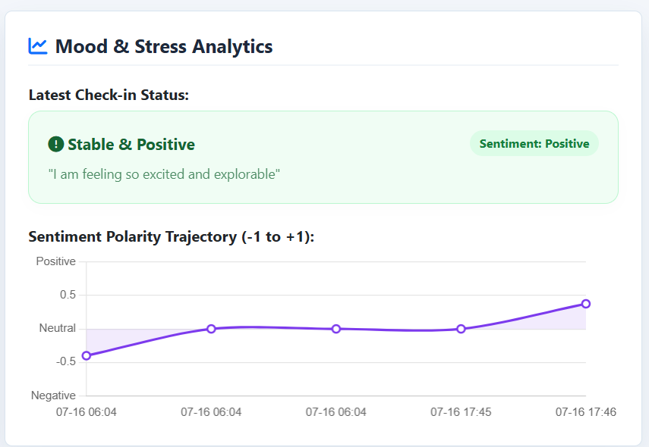
Employee Wellness Management Analytics
4. Mental Health & Sentiment Analytics
Project Overview
NLP & Sentiment Scoring
Sentiment Analysis: Analyzes employee feedback to identify stress and emotions.
Risk Detection: Detects signs of anxiety, burnout, and negative emotions.
Mood Tracking: Monitors employee mood trends over time.
System Architecture
1. Health Data
2. Risk Prediction
3. Recommendations
4. Sentiment Logs ◀
Reports & Analytics
Mood Dashboard: Visualizes employee sentiment trends with interactive charts.
Anonymous Feedback: Displays employee feedback while protecting privacy.
Stress Analytics: Shows department-wise stress levels to support HR decision-making.
5. BI Dashboards
6. AI Chatbot UI
Conclusion

Slide 9
Employee Wellness Management Analytics
5. Wellness Dashboard & Analytics
Project Overview
Corporate KPI Diagnostics
Real-Time KPIs: Tracks participation, attendance, and productivity.
Interactive Charts: Visualizes stress levels and wellness trends.
HR Insights: Helps management make data-driven wellness decisions.
System Architecture
1. Health Data
2. Risk Prediction
Predictive Analytics Forecasts
Wellness Forecasting: Predicts future employee wellness trends.
Forecast Dashboard: Displays wellness predictions using interactive charts.
Role-Based Access: Admins view organization-wide data, while employees view their personal health information.
3. Recommendations
4. Sentiment Logs
5. BI Dashboards ◀
6. AI Chatbot UI
Conclusion

Slide 10
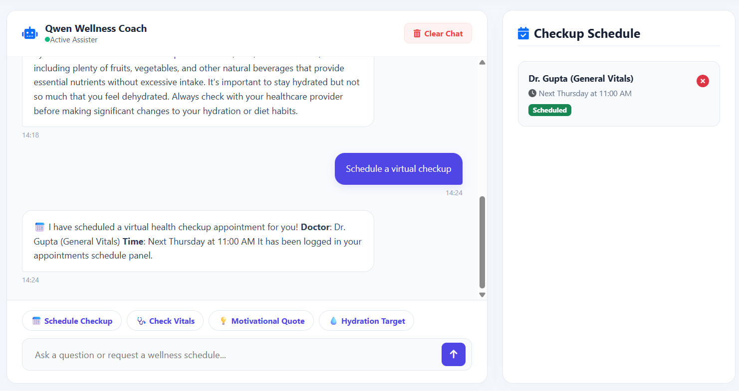
Employee Wellness Management Analytics
6. AI Wellness Chatbot & Engagement
Project Overview
Conversational AI Interface
AI Wellness Chatbot
Interactive Chatbot: Provides a simple and user-friendly chat interface.
Smart Assistance: Answers wellness questions, schedules checkups, and offers personalized health advice.
Chat Management: Saves and allows users to clear chat history when needed.
System Architecture
1. Health Data
2. Risk Prediction
3. Recommendations
4. Sentiment Logs
5. BI Dashboards
6. AI Chatbot UI ◀
Conclusion

Slide 11

Employee Wellness Management Analytics
Conclusion
Project Overview
Key Project Takeaways
Improves employee health and well-being through AI-driven monitoring and recommendations.
Helps HR make informed decisions with real-time analytics and predictive insights.
Enhances productivity and employee engagement using personalized wellness support and an AI chatbot.
System Architecture
1. Health Data
2. Risk Prediction
3. Recommendations
4. Sentiment Logs
5. BI Dashboards
6. AI Chatbot UI
Conclusion ◀

