Slide 1
Pandas Introduction: Series, Dataframes, dtypes
Evan Carey
https://www.slu.edu/slucor/faculty/carey-evan.php

Slide 2
Pandas data types: Series
Age
56
24
35
42
Age
Age[1]
Homogenous 1-D object
Age[2]
Age[3]
Age[4]

Slide 3
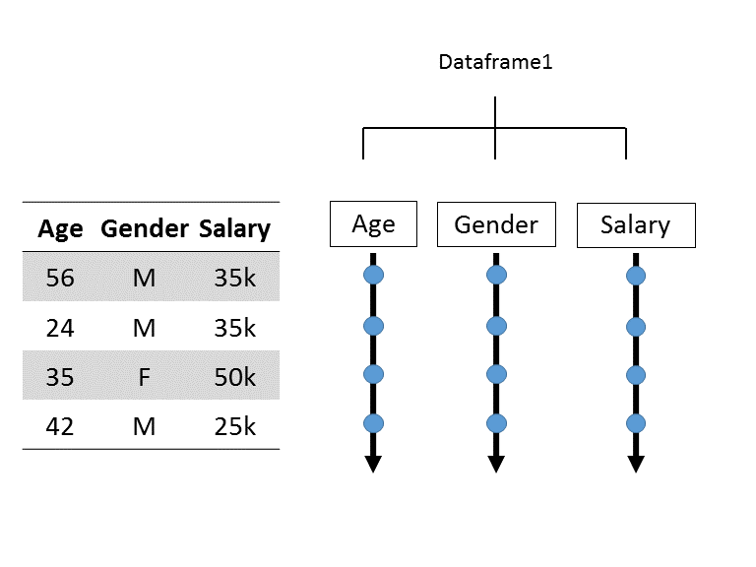
Pandas data types: Dataframe
2D Object
Each Column is one data type

Slide 4
Pandas data types (dtypes)
Numeric
Integer, float
Object (text)
Category
Date
Bool (true/false)

