Slide 1
Pandas: Merging and Reshaping
Evan Carey
https://www.slu.edu/slucor/faculty/carey-evan.php

Slide 2
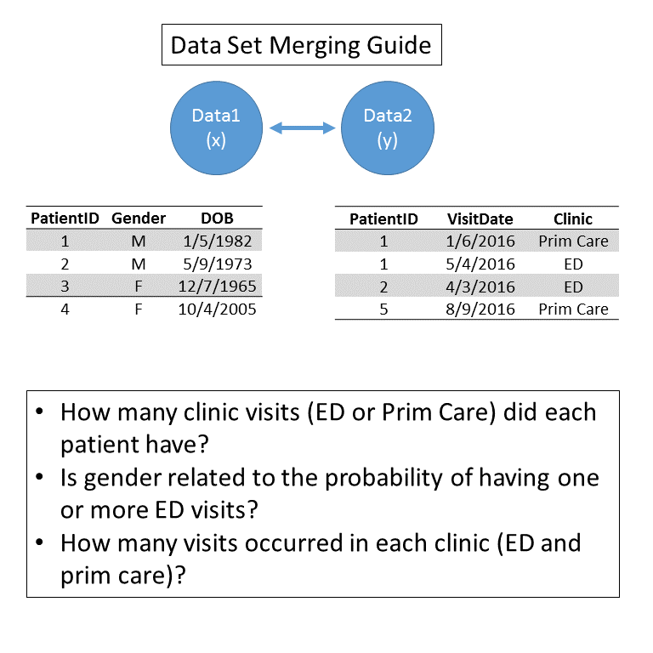

Slide 3
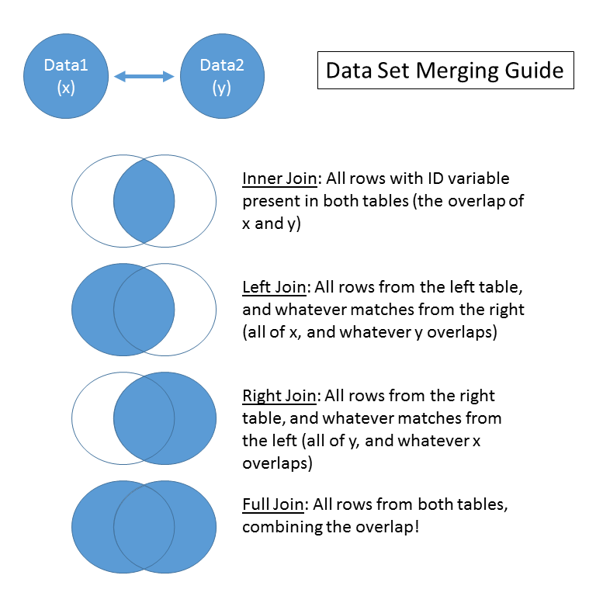

Slide 4
