Slide 1

Structured Query Language
Business Context
A retail store would like to understand customer behavior using their point of sale data (POS)

Slide 2
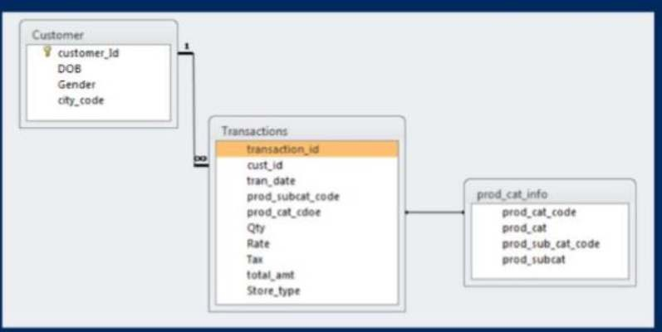
Data Availability
The data set we will be using for this project comprises of 3 tables:
Customer: Customer demographics
Transactions: Customer transaction details
Product category: Product category and sub category information
The following diagram explains the relationship between tables.
PROJECT DATA | SQL

Slide 3
DATA PREPARATION AND UNDERSTANDING
What is the total number of rows in each of the 3 tables in the database?
What is the total number of transactions that have a return?
As you would have noticed, the dates provided across the datasets are not in a correct format. As first steps, pls convert the date variables into valid date formats before proceeding ahead.
What is the time range of the transaction data available for analysis? Show the output in number of days, months and years simultaneously in different columns.
Which product category does the sub-category “DIY” belong to?
PROJECT DATA | SQL

Slide 4
DATA ANALYSIS
Implementing SQL queries for following business scenarios
Which channel is most frequently used for transactions?
What is the count of Male and Female customers in the database?
From which city do we have the maximum number of customers and how many?
How many sub-categories are there under the Books category?
What is the maximum quantity of products ever ordered?
What is the net total revenue generated in categories Electronics and Books?
How many customers have >10 transactions with us, excluding returns?
What is the combined revenue earned from the “Electronics” & “Clothing” categories, from “Flagship stores”?
What is the total revenue generated from “Male” customers in “Electronics” category? Output should display total revenue by prod sub-cat.
What is percentage of sales and returns by product sub category; display only top 5 sub categories in terms of sales?
For all customers aged between 25 to 35 years find what is the net total revenue generated by these consumers in last 30 days of transactions from max transaction date available in the data?
Which product category has seen the max value of returns in the last 3 months of transactions?
Which store-type sells the maximum products; by value of sales amount and by quantity sold?
What are the categories for which average revenue is above the overall average.
Find the average and total revenue by each subcategory for the categories which are among top 5 categories in terms of quantity sold.
PROJECT DATA | SQL

Slide 5
INSIGHTS FROM DATA
E-shop store type is the frequently used channel for transactions, sells the maximum products by value of sales amount and by quantity sold.
Footwear section has seen the max value of returns in the last 3 months of transactions.
Bath, Furnishing, Kitchen Tools, Cameras are the top achievers in terms of Sales.
Sub-categories such as Books, Electronics, Footwear, Clothing are top in terms of Quantity sold.
Average Spent of Males is more than Females.
SUMMARY
Data analysts are not only required to prepare data. but also collaborate with other teams in decision-making.
SQL can manage very large volumes of data in various fields.
In conducting data analysis, starting from the general to the specific. Then slice into more detailed parts.
The skills needed are not only from SQL but also from problem solving and storytelling.

Slide 6
Structured Query Language
Business Scenario: The database “Cellphones Information” contains details on cell phone sales or transactions.

Slide 7
Data Availability
Assume that you do not have access to the data. Hence, create a schema based on the representation below to work on the case study.
Detailes stored are:
Dim_manufacturer
Dim_model
Dim_customer
Dim_Location
Fact_Transactions.
The first four store entries for the respective elements and Fact_Transactions stores all the information about sales of specific cellphones.

Slide 8
Create SQL Syntaxes for following queries:
Write queries to find out the following:
List all the states in which we have customers who have bought cellphones from 2005 till today.
What state in the US is buying more 'Samsung' cell phones?
Show the number of transactions for each model per zip code per state.
Show the cheapest cellphone
Find out the average price for each model in the top5 manufacturers in terms of sales quantity and order by average price.
List the names of the customers and the average amount spent in 2009, where the average is higher than 500
List if there is any model that was in the top 5 in terms of quantity, simultaneously in 2008, 2009 and 2010
Show the manufacturer with the 2nd top sales in the year of 2009 and the manufacturer with the 2nd top sales in the year of 2010.
Show the manufacturers that sold cellphone in 2010 but didn’t in 2009.
Find top 100 customers and their average spend, average quantity by each year. Also find the percentage of change in their spend.

