Slide 1

Short Cake Cafe

Slide 2
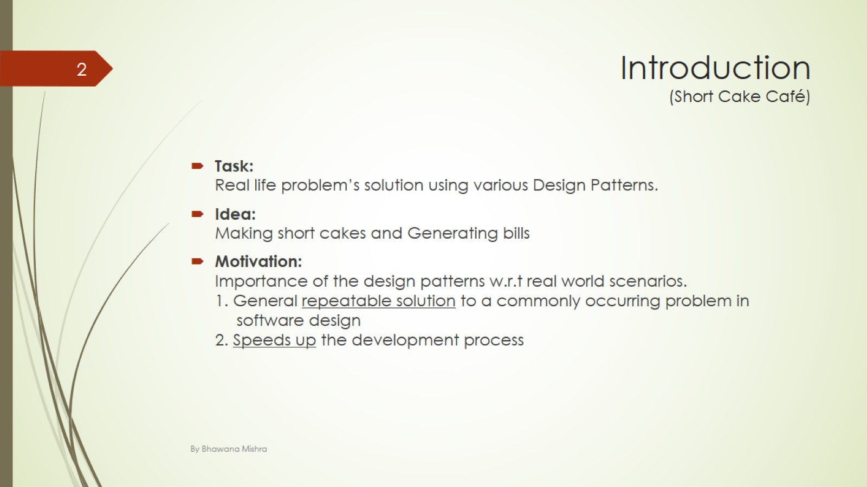
Introduction (Short Cake Café)

Slide 3
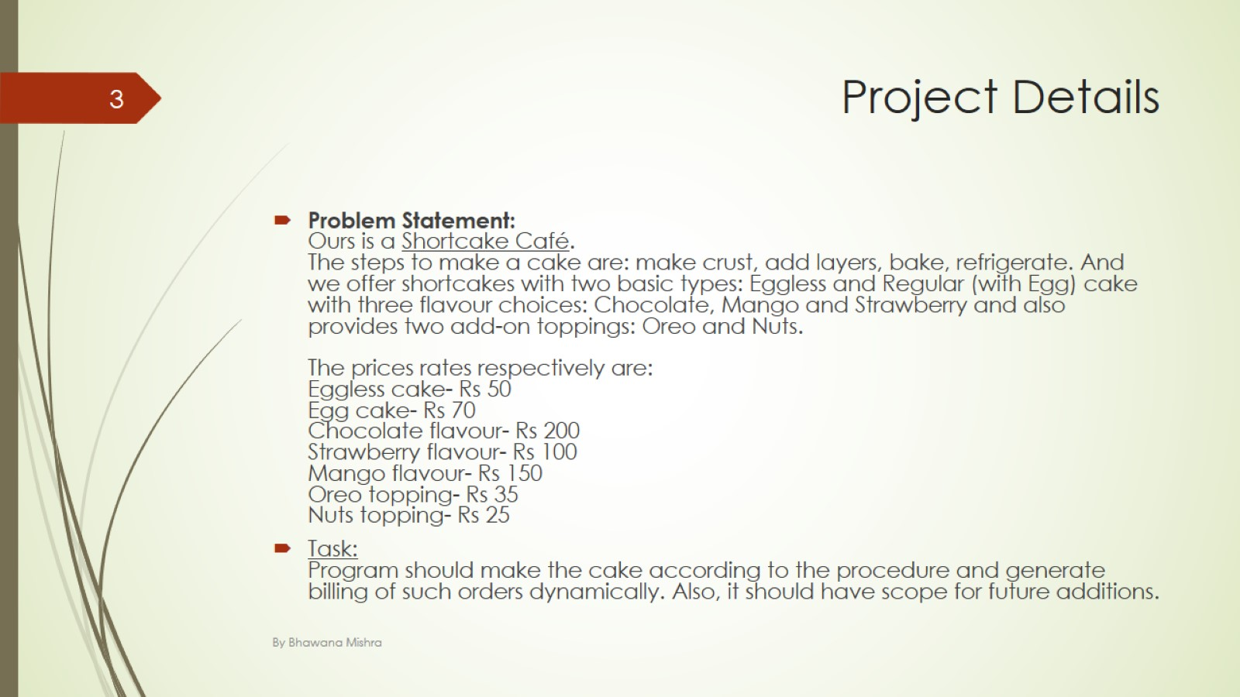
Project Details

Slide 4
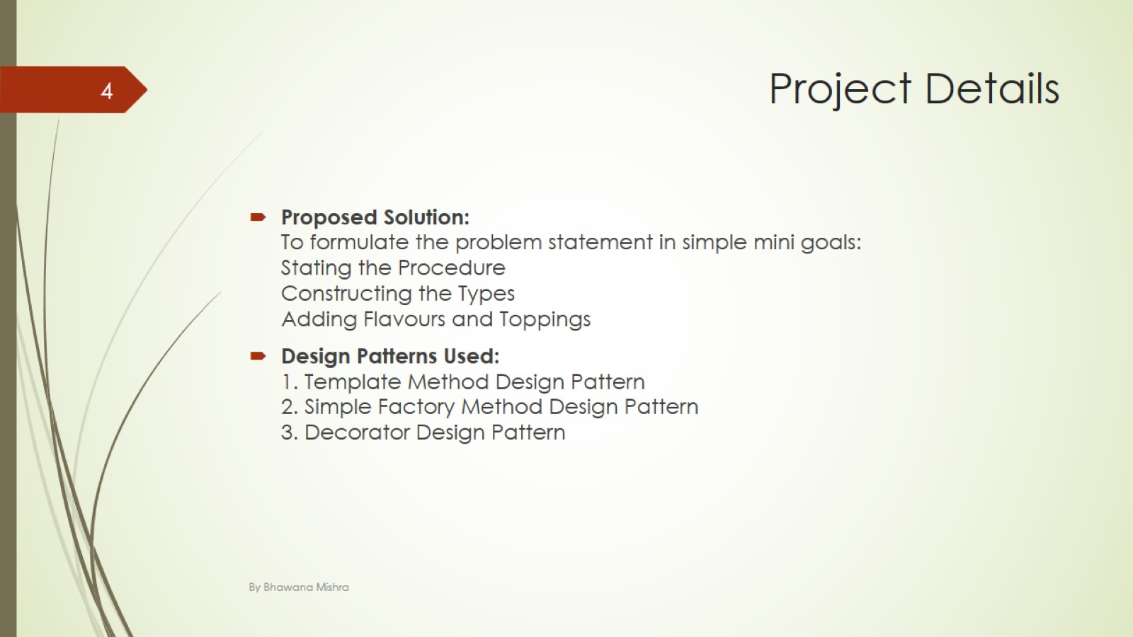
Project Details

Slide 5
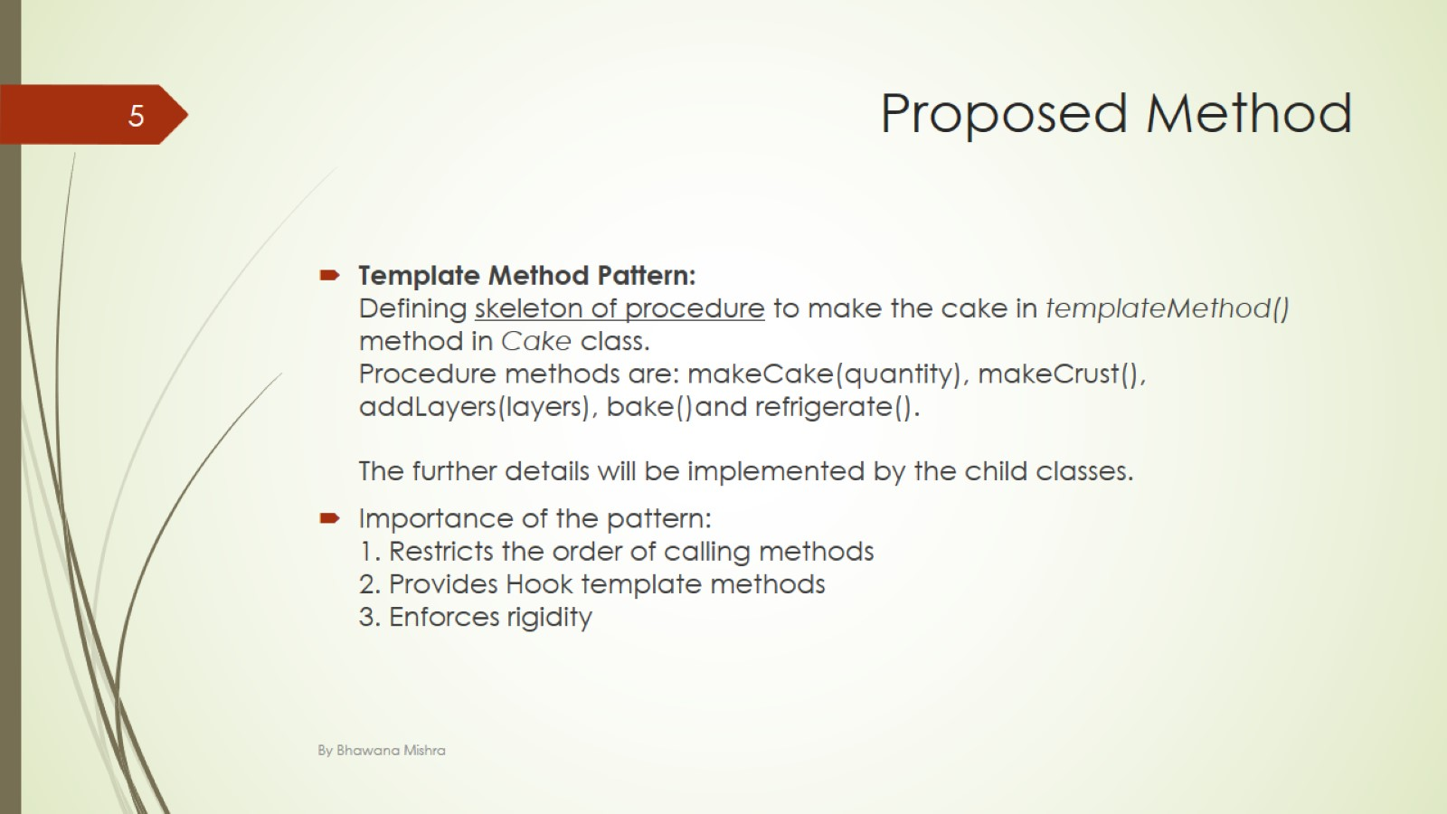
Proposed Method

Slide 6
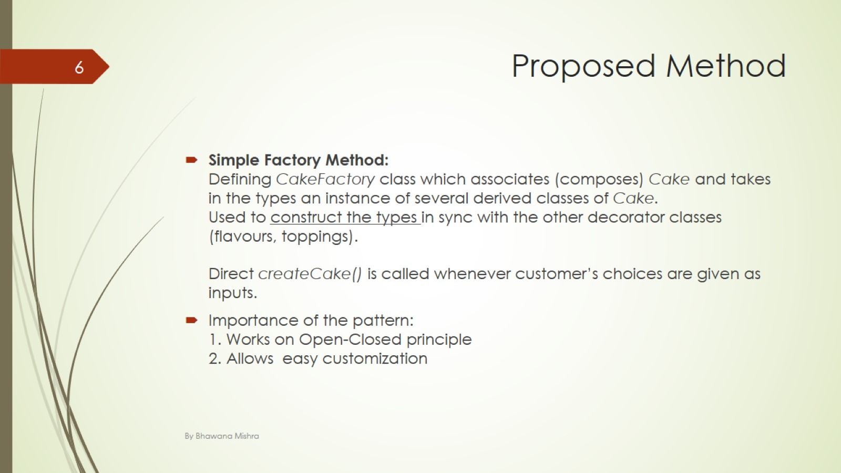
Proposed Method

Slide 7
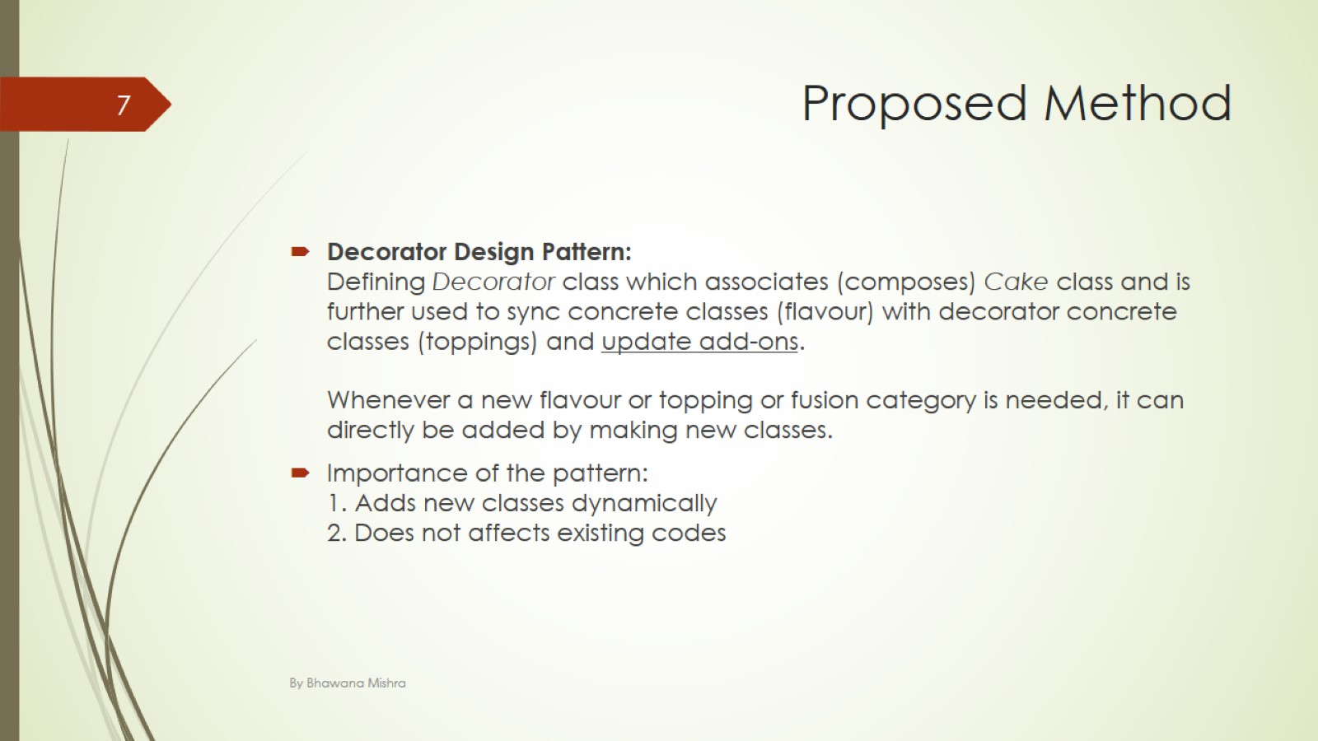
Proposed Method

Slide 8
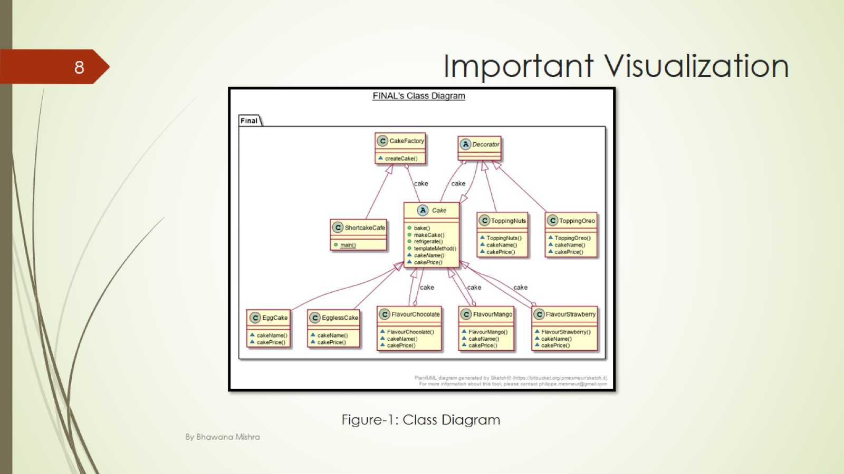
Important Visualization

Slide 9
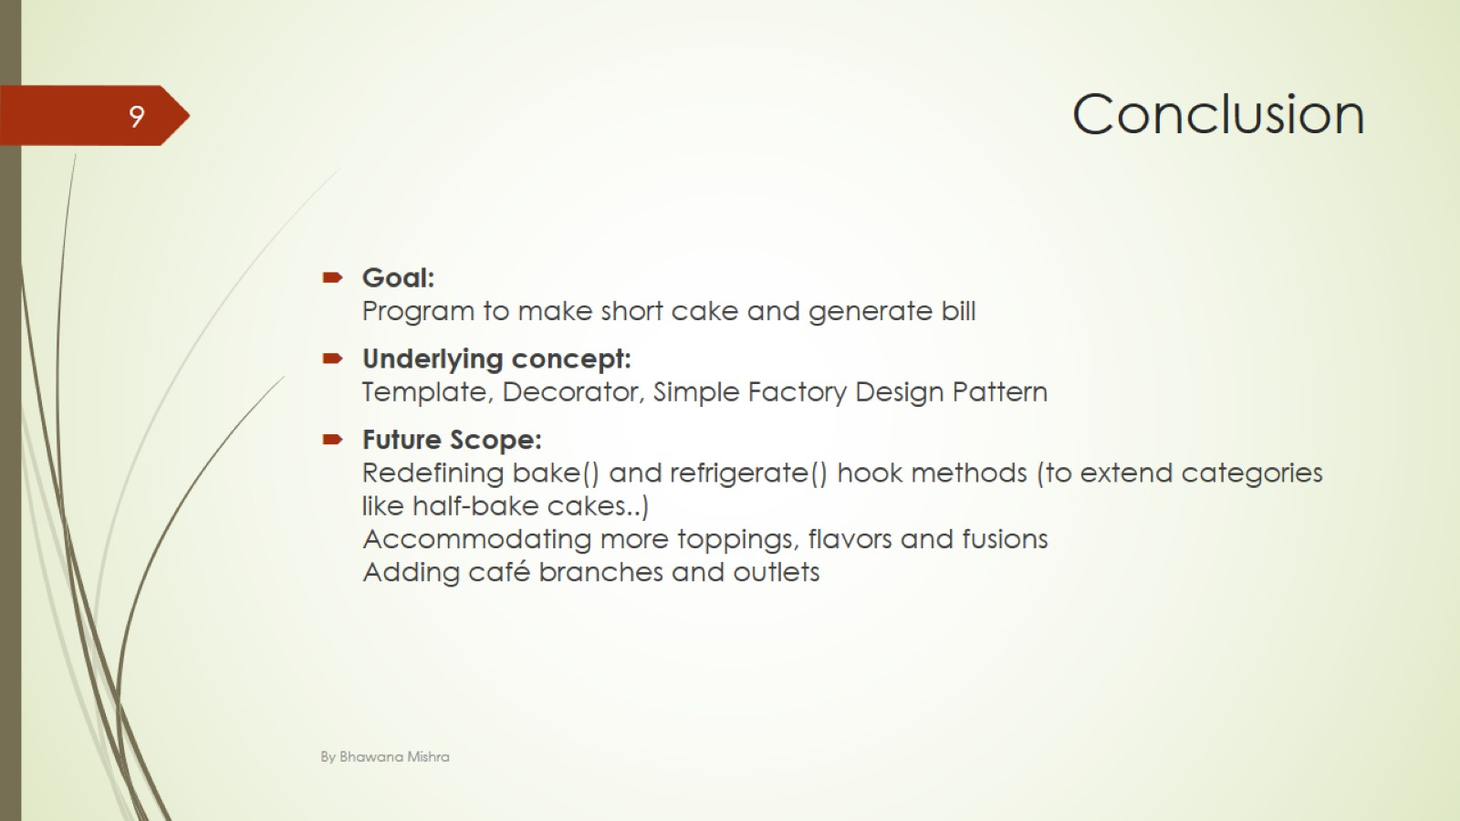
Conclusion

Slide 10
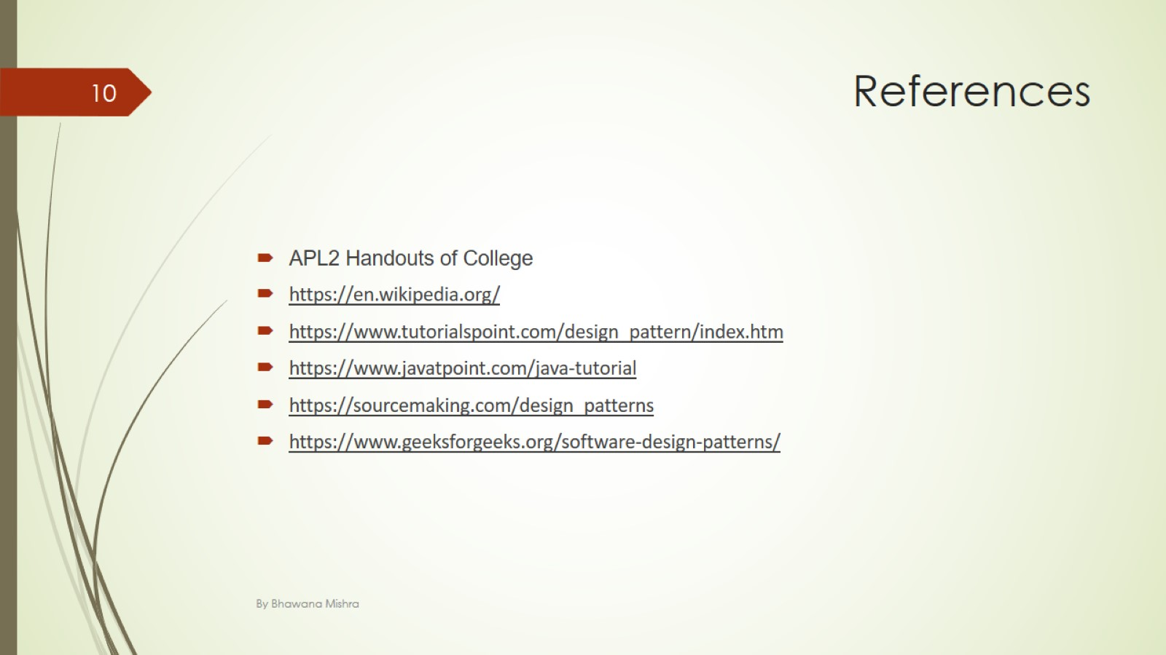
References

Slide 11

Thank You! (:

