Slide 1


Consumer Goods
Ad-hoc insights

Slide 2

=
Company – One of the computer hardware producers in India.
Background- The management noticed they do not get enough insights to make quick and smart data-inform decisions.
Getting familiar with Atliq’s business- Their Markets and product lines
Ad-hoc ,requests queried results, insights and visualization

Slide 3
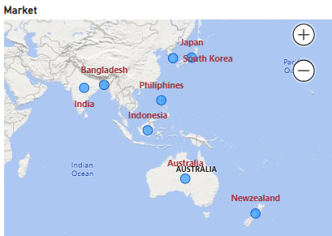
Provide the list of markets in which customer "Atliq Exclusive" operates its business in the APAC region.
SELECT distinct(market) FROM gdb023.dim_customer
WHERE region = "APAC" and customer = "Atliq Exclusive"
Market
India
Indonesia
Japan
Philippines
South Korea
Australia
New Zealand
Bangladesh

Slide 4
What is the percentage of unique product increase in 2021 vs. 2020? The final output contains these fields, unique_products_2020, unique_products_2021, percentage_change
Unique_Product_2020 | Unique_Product_2021 | PCT
245 | 334 | 36.33%
36%
It’s a good sign that we are continuously innovating and introduction new products to the market. In FY 2020,we had a total of 245 product, but in FY2021, our count increased by 36% to 334 products.

Slide 5
Provide a report with all the unique product counts for each segment and sort them in descending order of product counts. The final output contains 2 fields, segment product_count
Segment | Product_count
Notebook | 129
Accessories | 116
Peripherals | 84
Desktop | 32
Storage | 27
Networking | 9
Avg = 110
We provide a wide range of products under the segments Notebook, Peripherals, and Accessories, with an average of 110 products in each segment. However, we still need to diversity our production in Desktop, Networking, and storage segments, where there are just an average of only 23 products per segment

Slide 6
Which segment had the most increase in unique products in 2021 vs 2020? The final output contains these fields, segment product_count_2020 product_count_2021 difference
Segment | Product_count_2020 | Product_count_2021 | Difference
Accessories | 69 | 103 | 34
Peripherals | 59 | 75 | 16
Notebook | 92 | 108 | 16
Desktop | 7 | 22 | 15
Storage | 12 | 17 | 5
Networking | 6 | 9 | 3
In 2021, we were mainly focusing on diversifying our accessories segment. We introduced new products to the market in accessories.

Slide 7
Get the products that have the highest and lowest manufacturing costs. The final output should contain these fields, product_code, product manufacturing_cost
Product | Product_code | Manufacturing_cost
AQ HOME Allin1 Gen 2 | A6120110206 | 240.5364
AQ Master wired x1 Ms | A2118150101 | 0.892
Highest manufacturing cost products AQ HOME Allin1 Gen 2 and Lowest manufacturing cost products AQ Master wired x1 Ms

Slide 8
Generate a report which contains the top 5 customers who received an average high pre_invoice_discount_pct for the fiscal year 2021 and in the Indian market. The final output contains these fields, customer_code customer average_discount_percentage
Customer_Code | Customer | Average_Discount_percent
90002009 | Flipkart | 0.31
90002006 | Viveks | 0.3
90002002 | Croma | 0.3
90002003 | Ezone | 0.3
90002016 | Amazon | 0.29
In 2021, we offered nearly equal pre-invoice discount percentages to each of our top 5 customers, given that Flipkart is the most discounted customer in the India market, which equals 30.83%

Slide 9
Get the complete report of the Gross sales amount for the customer “Atliq Exclusive” for each month. This analysis helps to get an idea of low and high-performing months and take strategic decisions. The final report contains these columns: Month Year Gross sales Amount
Months | Years | Gross_Sales_Amount
9 | 2019 | 4.5
10 | 2019 | 5.14
11 | 2019 | 7.52
12 | 2019 | 4.83
1 | 2020 | 4.74
2 | 2020 | 4
3 | 2020 | 0.38
4 | 2020 | 0.4
5 | 2020 | 0.78
6 | 2020 | 1.7
7 | 2020 | 2.55
8 | 2020 | 2.79
9 | 2020 | 12.35
10 | 2020 | 13.22
11 | 2020 | 20.46
12 | 2020 | 12.94
1 | 2021 | 12.4
2 | 2021 | 10.13
3 | 2021 | 12.14
4 | 2021 | 7.31
5 | 2021 | 12.15
6 | 2021 | 9.82
7 | 2021 | 12.09
8 | 2021 | 7.18

Slide 10
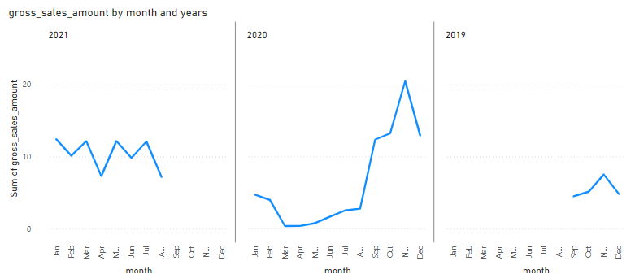

Months | Years | Gross_Sales_Amount
9 | 2019 | 4.5
10 | 2019 | 5.14
11 | 2019 | 7.52
12 | 2019 | 4.83
1 | 2020 | 4.74
2 | 2020 | 4
3 | 2020 | 0.38
4 | 2020 | 0.4
5 | 2020 | 0.78
6 | 2020 | 1.7
7 | 2020 | 2.55
8 | 2020 | 2.79
9 | 2020 | 12.35
10 | 2020 | 13.22
11 | 2020 | 20.46
12 | 2020 | 12.94
1 | 2021 | 12.4
2 | 2021 | 10.13
3 | 2021 | 12.14
4 | 2021 | 7.31
5 | 2021 | 12.15
6 | 2021 | 9.82
7 | 2021 | 12.09
8 | 2021 | 7.18
For AtliQ Exclusive, November 2020 marked the highest sales, and March 2020 marked the lowest gross sales. It’s very evident that the lower sales between March and August are because of COVID-19. However, It’s a very good sign that sales increased quickly after August and reached the highest level since the last two year in November.

Slide 11
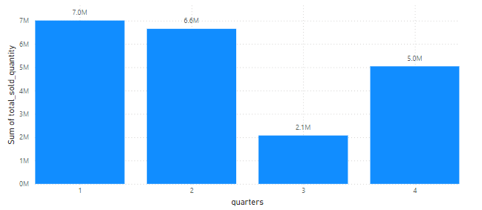
In which quarter of 2020, got the maximum total_sold_quantity? The final output contains these fields sorted by the total_sold_quantity, Quarter
Total_Sold_Quantity | Quarters
7005619 | Q1
6649642 | Q2
5042541 | Q4
2075087 | Q3
That is the effect of effect of COVID-19 on our sales The sold quantity decreased to 2.1 million in quarter 3 of FY 2020,which was actually March, April, and May when COVID-19 was at its peak.
But we started recovery very early despite the continuance of the pandemic. This early recovery during quarter 4 is probably because of the increase need for hardware like desktops and notebook as majority of the student began or continued to do their coursework online during this time, and there was a huge demand for computer accessories during this period.

Slide 12
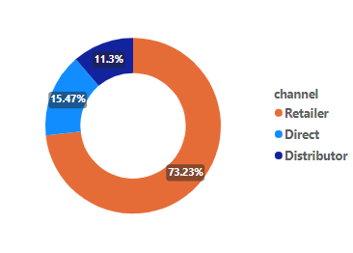
Which channel helped to bring more gross sales in the fiscal year 2021 and the percentage of contribution? The final output contains these fields, channel ,gross_sales_mln, percentage
Channel | Gross_Sales_ml | Percentage
Retailer | 1219.08 | 73.23
Direct | 257.53 | 15.47
Distributor | 188.03 | 11.3
The majority of our sale took place via retailer, which are 74% of total sales. Only a very small percentage of other sales happened through direct and distributor channels.

Slide 13
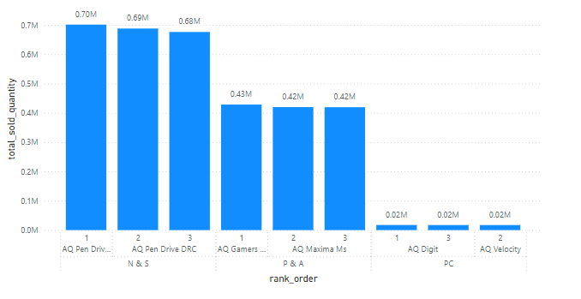
Get the Top 3 products in each division that have a high total_sold_quantity in the fiscal_year 2021? The final output contains these fields :- division, Product_code, product, total_sold_quantity, rank_order
Division | Product _code | Product | Total_sold_quantity | Rank_order
N & S | A6720160103 | AQ Pen Drive 2 IN 1 | 701373 | 1
N & S | A6818160202 | AQ Pen Drive DRC | 688003 | 2
N & S | A6819160203 | AQ Pen Drive DRC | 676245 | 3
P & A | A2319150302 | AQ Gamers Ms | 428498 | 1
P & A | A2520150501 | AQ Maxima Ms | 419865 | 2
P & A | A2520150504 | AQ Maxima Ms | 419471 | 3
PC | A4218110202 | AQ Digit | 17434 | 1
PC | A4319110306 | AQ Velocity | 17280 | 2
PC | A4218110208 | AQ Digit | 17275 | 3
Even though P&A accounts for the division with maximum quantities sold, the product with highest quantities sold belongs to N&S. Quantities sold in PC division are significantly lower than other two divisions.

