Slide 1



WELCOME TO WSCUBETECH
PYTHON PROGRAMMING
Object Oriented Programming
WWW.WSCUBETECH.COM

Slide 2
What to learn in OOP?
Class
Object
Constructor (__init__)
Functions vs Methods
Polymorphism
Abstraction
Encapsulation (public , private and protected methods)

Slide 3
TYPES OF PROGRAMMING METHODOLOGIES/
PROGRAMMING PARADGISM
Sequential Programming
Functional Programming
Object Oriented Programming
Event Oriented Programming

Slide 4
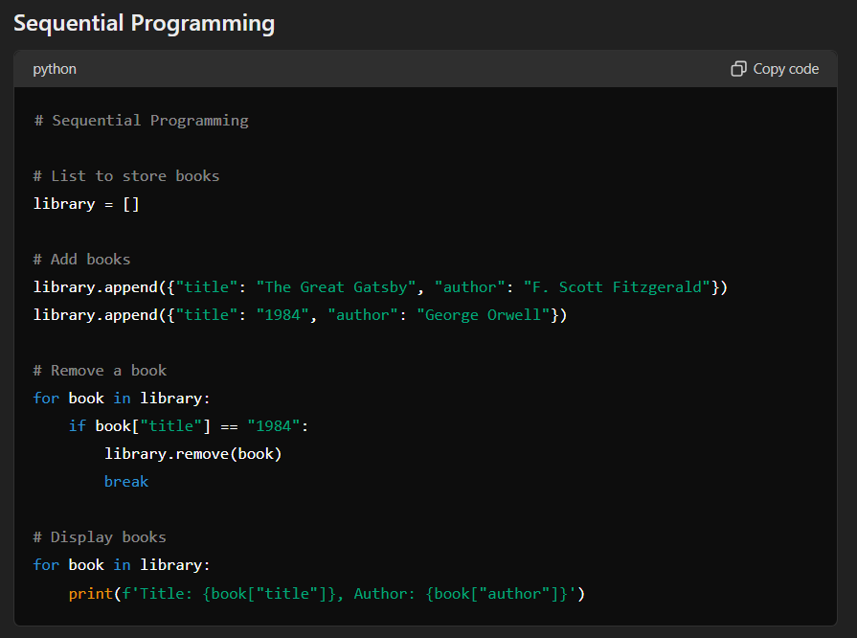

Slide 5
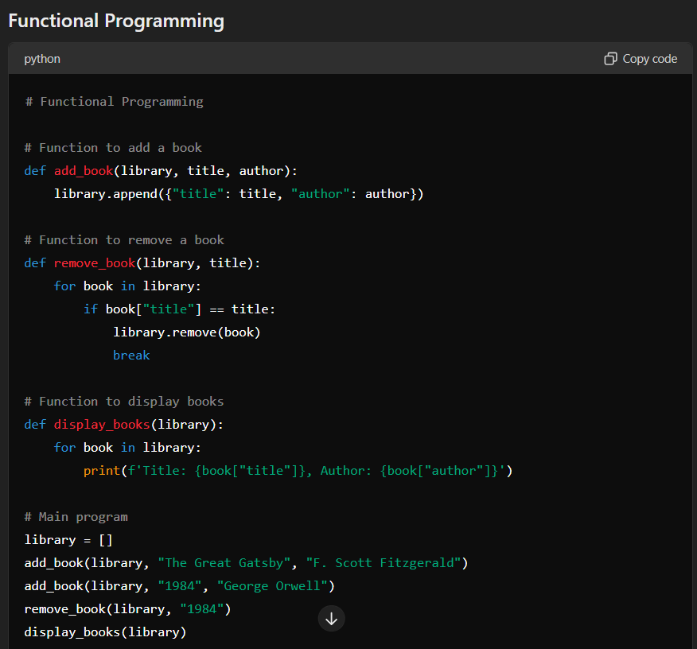

Slide 6
# Object-Oriented Programming
class Book:
def __init__(self, title, author):
self.title = title
self.author = author
def __str__(self):
return f'Title: {self.title}, Author: {self.author}'
class Library:
def __init__(self):
self.books = []
def add_book(self, title, author):
new_book = Book(title, author)
self.books.append(new_book)
def remove_book(self, title):
self.books = [book for book in self.books if book.title != title]
def display_books(self):
for book in self.books:
print(book)
# Main program
my_library = Library()
my_library.add_book("The Great Gatsby", "F. Scott Fitzgerald")
my_library.add_book("1984", "George Orwell")
my_library.remove_book("1984")
my_library.display_books()

Slide 7
# Object-Oriented Programming
class Book:
def __init__(self, title, author):
self.title = title
self.author = author
def __str__(self):
return f'Title: {self.title}, Author: {self.author}'
class Library:
def __init__(self):
self.books = []
def add_book(self, title, author):
new_book = Book(title, author)
self.books.append(new_book)
def remove_book(self, title):
self.books = [book for book in self.books if book.title != title]
def display_books(self):
for book in self.books:
print(book)
# Main program
my_library = Library()
my_library.add_book("The Great Gatsby", "F. Scott Fitzgerald")
my_library.add_book("1984", "George Orwell")
my_library.remove_book("1984")
my_library.display_books()

Slide 8
What is a class?
In Object-Oriented Programming (OOP), a class is a blueprint or prototype for creating objects. It defines a set of attributes and methods that the created objects will have. Attributes are the data members (variables) of the class, and methods are the functions that operate on these data members.
A class is generally of two types.
Built In Classes (pre-defined)
User Defined Classes

Slide 9
Basic outline of a class
class ClassName:
var1 = Value #class atrriubtes
var2 = Value
self.var3 = value #Instance attributes
def __init__(self):
#code
def method1(parameter/s):
#code
def method2(parameter/s):
#code
.
.
.
def methodn(parameter/s):
#code
object = ClassName() #class calling object.method1() #method acess with a class

Slide 10
Basic outline of a class
class Car:
wheels = 4 # Class attribute
def __init__(self, color, brand): # Initializer / Instance Attributes
self.color = color
self.brand = brand
def description(self): # Method
return f"This car is a {self.color} {self.brand} with {Car.wheels} wheels."
my_car = Car("red", "Toyota") # Creating an instance of the Car class
# Accessing instance attributes and methods
print(my_car.color) # Output: red
print(my_car.description()) # Output: This car is a red Toyota with 4 wheels.

Slide 11
POLYMORPHISM
Polymorphism in Python is the ability of different objects to be accessed through the same interface, allowing the same method to operate on objects of different classes. This enables methods to work on objects of various types in a uniform manner.

Slide 12
class Bird:
def fly(self):
print("Bird is flying")
class Sparrow(Bird):
def fly(self):
print("Sparrow is flying")
class Airplane:
def fly(self):
print("Airplane is flying")
def make_it_fly(entity):
entity.fly()
bird = Bird()
sparrow = Sparrow()
airplane = Airplane()
make_it_fly(bird)
make_it_fly(sparrow)
make_it_fly(airplane)

Slide 13
FUNCTION OVERLOADING IN C++
#include <iostream>
using namespace std; class Math {
public:
int add(int a, int b) {
return a + b;
} int add(int a, int b, int c) {
return a + b + c;
} // Method to add two doubles
double add(double a, double b) {
return a + b;
}
}; int main() {
Math math;
cout << "Sum of 2 and 3: " << math.add(2, 3) << endl;
cout << "Sum of 2, 3, and 4: " << math.add(2, 3, 4) << endl;
cout << "Sum of 2.5 and 3.5: " << math.add(2.5, 3.5) << endl; return 0;
}

Slide 14
ENCAPSULATION
Encapsulation in Python refers to the bundling of data and the methods that operate on that data within a single unit or class, and restricting access to some of the object's components. This is a fundamental principle of object-oriented programming (OOP) that helps to protect the internal state of an object and prevent unauthorized access or modification.

Slide 15
class BankAccount:
def __init__(self, owner, balance):
self.owner = owner # Public attribute
self.__balance = balance # Private attribute
def deposit(self, amount):
if amount > 0:
self.__balance += amount
print(f"${amount} deposited. New balance is ${self.__balance}.")
else:
print("Deposit amount must be positive.")
def withdraw(self, amount):
if 0 < amount <= self.__balance:
self.__balance -= amount
print(f"${amount} withdrawn. New balance is ${self.__balance}.")
else:
print("Insufficient funds or invalid amount.")
def get_balance(self):
return self.__balance
# Usage
account = BankAccount("Alice", 1000)
print(account.owner) # Accessing public attribute
# print(account.__balance) # Accessing private attribute (this will raise an AttributeError)
account.deposit(500)
account.withdraw(200)
# Accessing private attribute through a public method
print(f"Balance: ${account.get_balance()}")

Slide 16
ABSTRACTION
Abstraction in Python is the concept of hiding the complex details and showing only the essential features of an object or a function. It allows you to focus on what an object does instead of how it does it.

