Slide 1
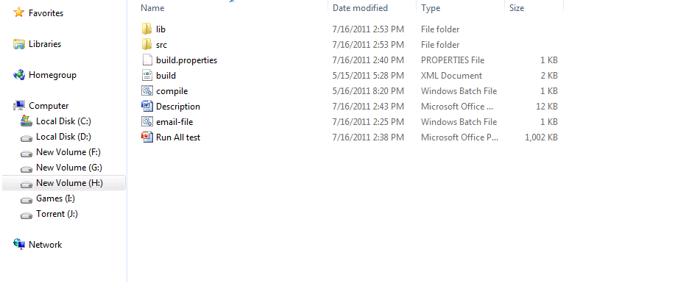
Download complete code from code share and extract it to a local directory

Slide 2
Path Setup:
Setup your java and ant path in compile.bat and email-file.bat file.

Slide 3
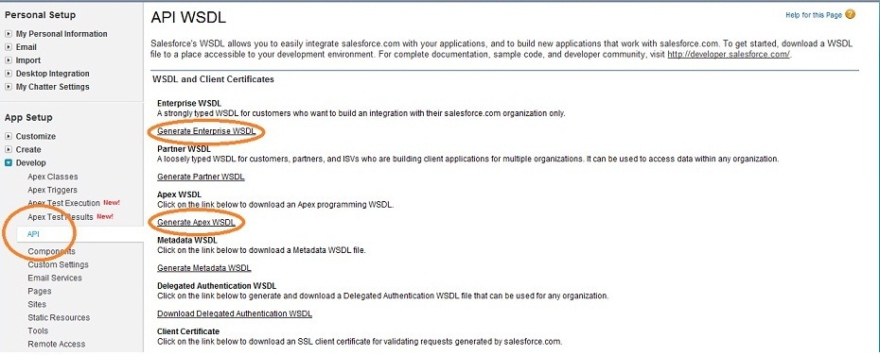
Get your organization Wsdl files

Slide 4
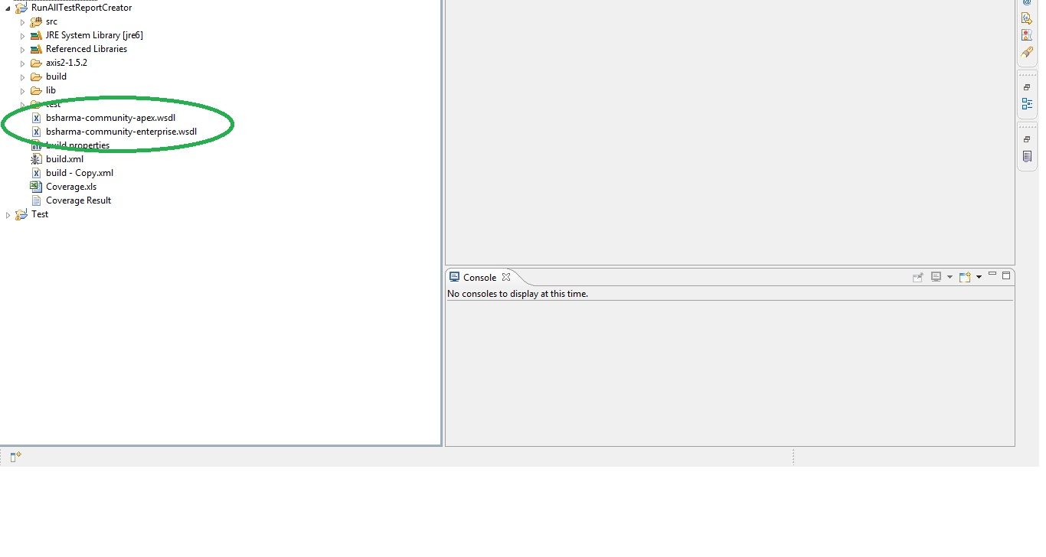
PUT WSDL FILES IN ECLIPSE WORKSPACE

Slide 5
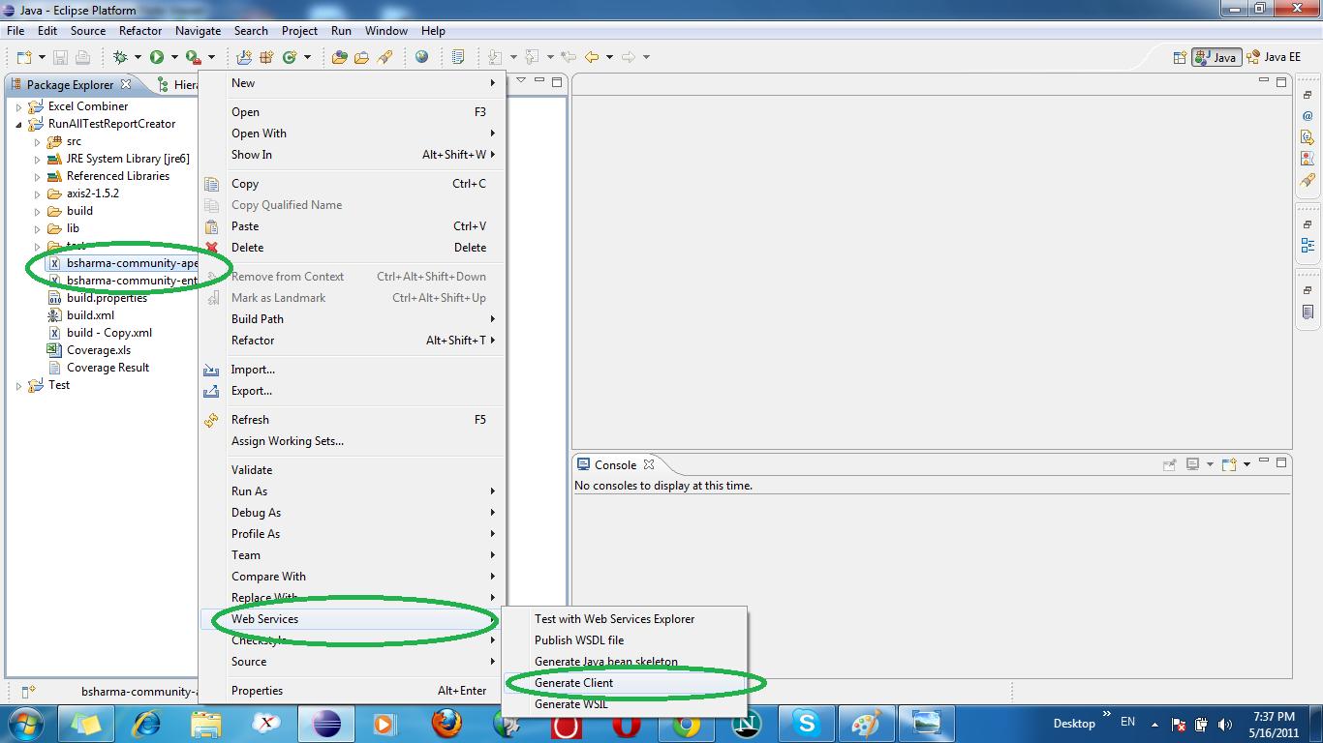
GENERATE CLIENT FROM WSDL FILES(You can use the other tools as well, but I used eclipse as it is much) easier to use)

Slide 6
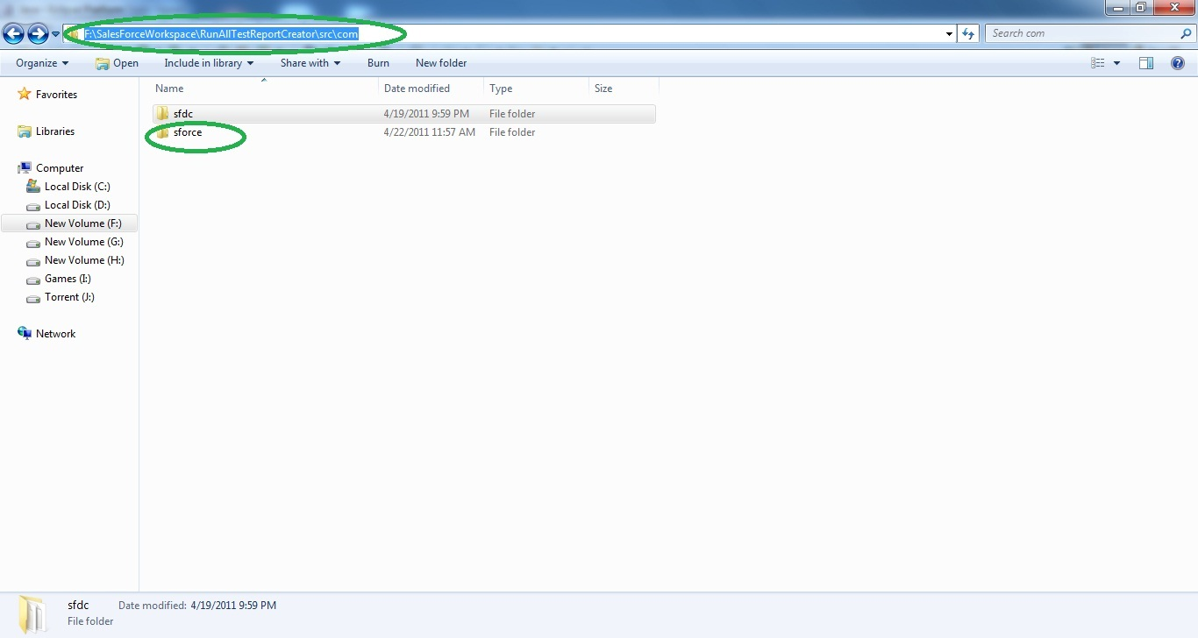
OPEN WORKSPACE AND COPY SRC->COM->SFORCE FOLDER

Slide 7
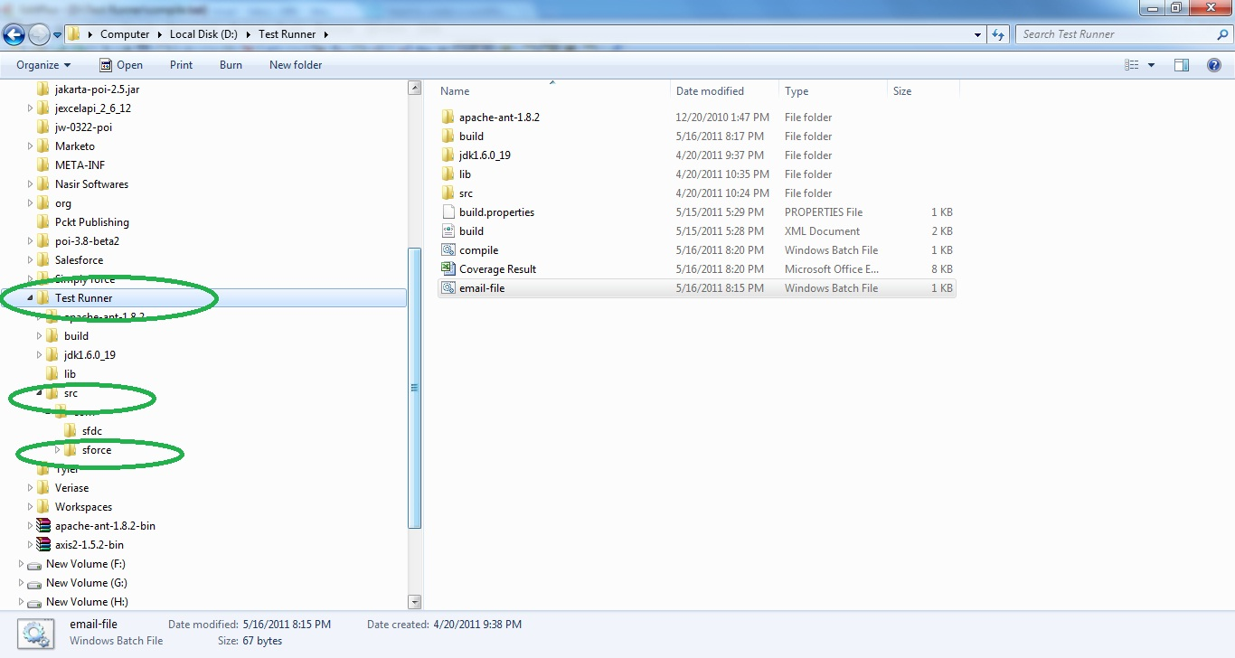
PASTE SFORCE FOLDER IN TEST RUNNER-> SRC -> COM

Slide 8
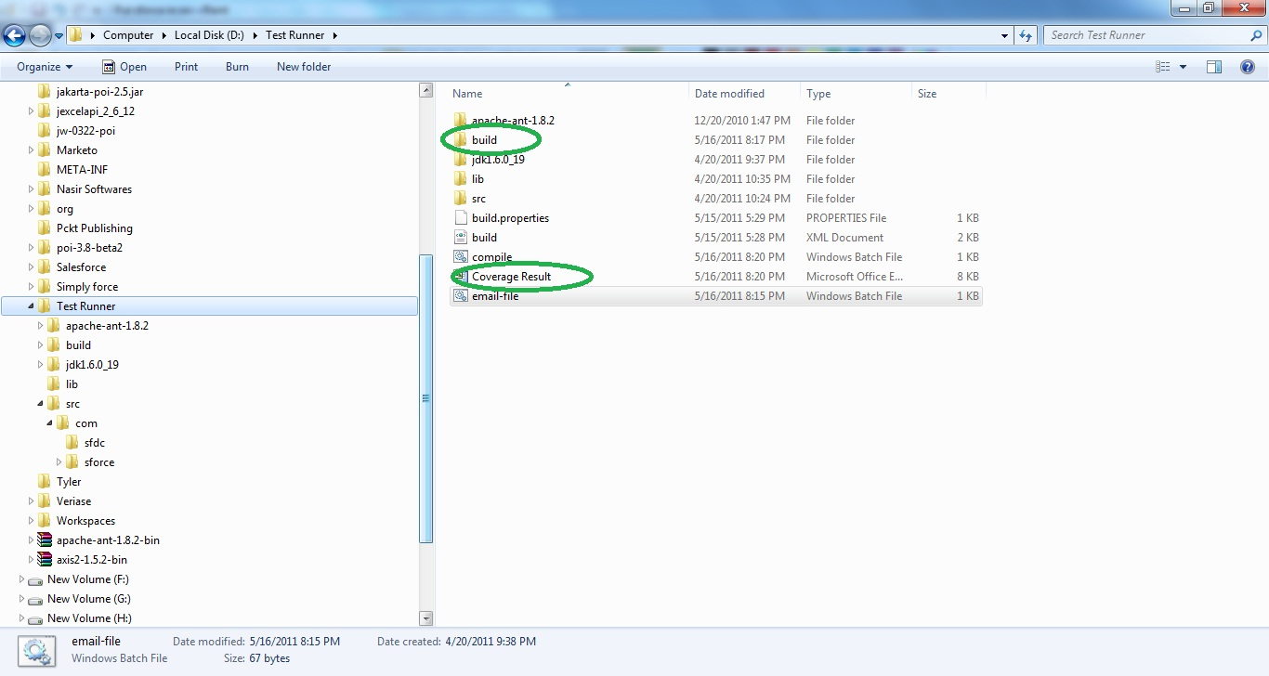
EXECUTE compile.bat

Slide 9
Update build.properties file with the salesforce credentials and email addresses on which execution result supposed to be sent.

Slide 10
Now project has been set up and you can execute email-file.bat to execute the code. It will create a file Coverage result in your local base directory and will send the same file as an attachment to the addresses defined in batch file . This is an executable file so can also be scheduled for daily basis. A sample result file is already there in a folder named “Sample”.

