Slide 1
CML1001 – Structural Insights into Atoms and Molecules
Lecture 2: Time-Independent Schrödinger Equation
Department of Chemistry
Indian Institute of Technology Delhi

Slide 2
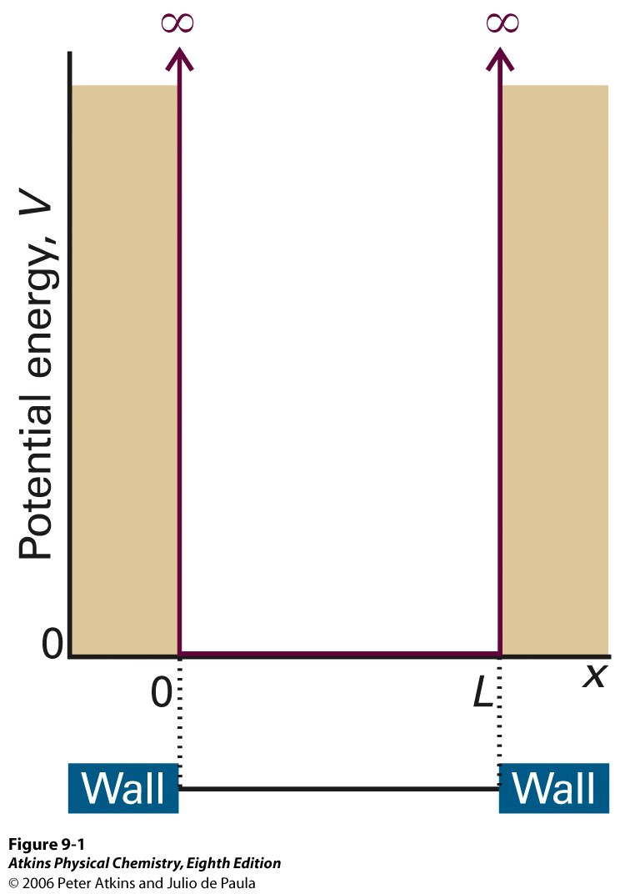



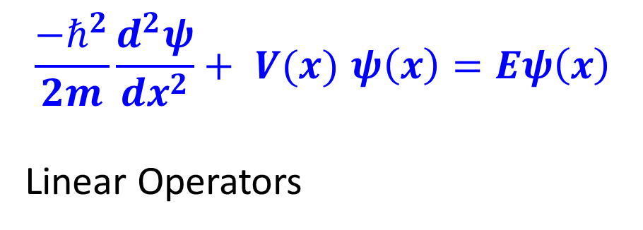
Particle in a Box – One Dimension (PIB-1D)
$$\frac{−ℏ^{2}}{2m}\frac{d^{2}ψ}{dx^{2}}+ V(x) ψ\left(x\right)=Eψ\left(x\right)$$
Linear Operators

Slide 3




Linear Operators

Slide 4
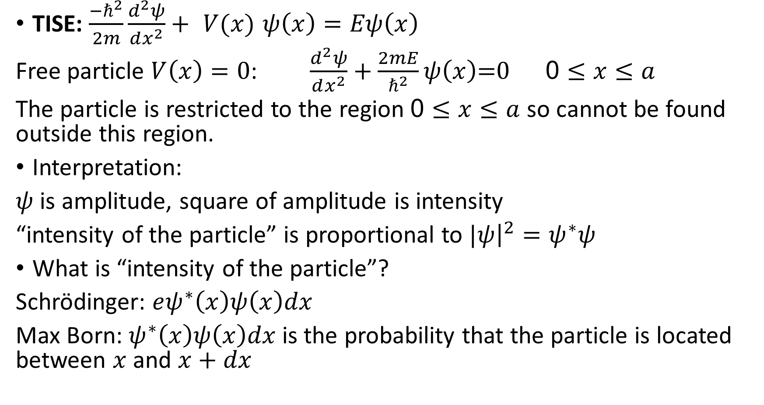
Probability
TISE: $\frac{−ℏ^{2}}{2m}\frac{d^{2}ψ}{dx^{2}}+ V(x) ψ\left(x\right)=Eψ\left(x\right)$
Free particle $V\left(x\right)=0$: $\frac{d^{2}ψ}{dx^{2}}+\frac{2mE}{ℏ^{2}}ψ\left(x\right)\text{=0} \text{ 0}≤x≤a$
The particle is restricted to the region $\text{0}≤x≤a$ so cannot be found outside this region.
Interpretation:
$ψ$ is amplitude, square of amplitude is intensity
“intensity of the particle” is proportional to $|ψ{\left.​\right|}^{2}=ψ^{∗}ψ$
What is “intensity of the particle”?
Schrödinger: $eψ^{∗}\left(x\right)ψ\left(x\right)dx$
Max Born: $ψ^{∗}\left(x\right)ψ\left(x\right)dx$ is the probability that the particle is located between $x$ and $x+dx$

Slide 5






PIB-1D
$$\frac{d^{2}ψ}{dx^{2}}+\frac{2mE}{ℏ^{2}}ψ\left(x\right)\text{=0} \text{ 0}≤x≤a$$

Slide 6






B.C.

Slide 7
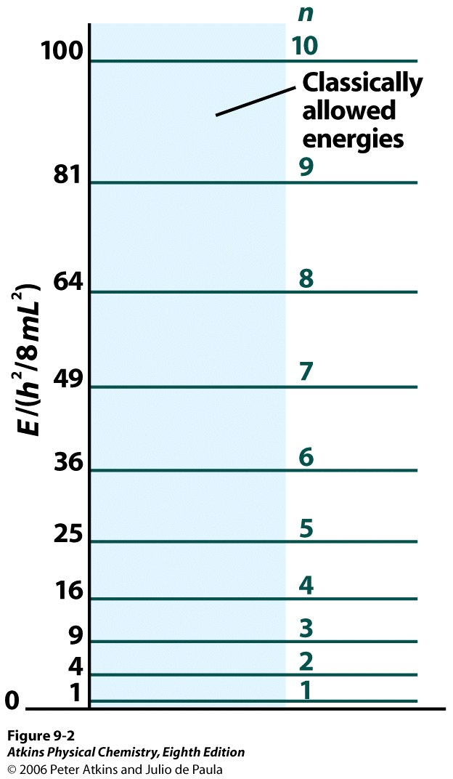

Energy Levels
In this communication I wish to show that the usual rules of quantization can be replaced by another postulate (the S.E.) in which there occurs no mention of whole numbers. Instead, the introduction of integers arises in the same natural way as, for example, in a vibrating string, for which the number of nodes is integral. The new conception can be generalized, and I believe that it penetrates deeply into the true nature of the quantum rules. [from Annalen. Der Physik 79, 361 (1926)]

Slide 8
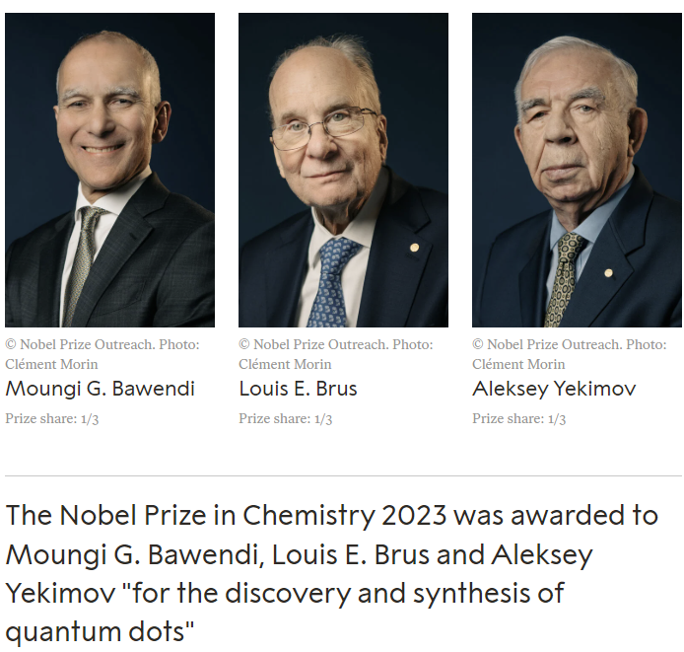
Nobel Chemistry 2023

Slide 9
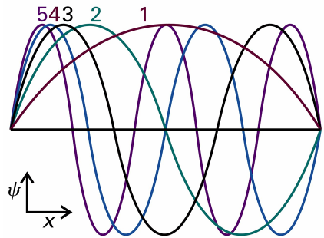




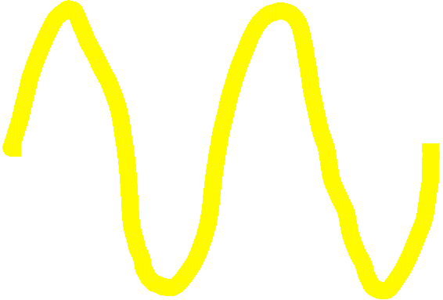

Wavefunctions
Nodes

Slide 10
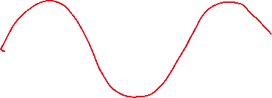


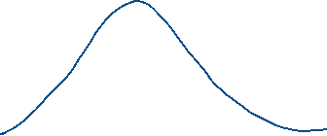
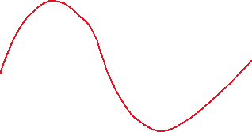


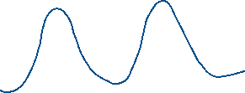

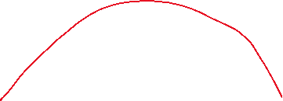

Bohr Correspondence

Slide 11





1,4-butadiene
C-C 154 pm, C=C 135 pm, radius C on 2 ends 2x77=154 pm

Slide 12
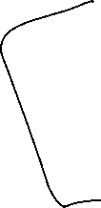





Wavefunctions - Normalized

