Slide 1
CML1001 – Structural Insights into Atoms and Molecules
Lecture 5: PIB – Position and Momentum
Department of Chemistry
Indian Institute of Technology Delhi

Slide 2
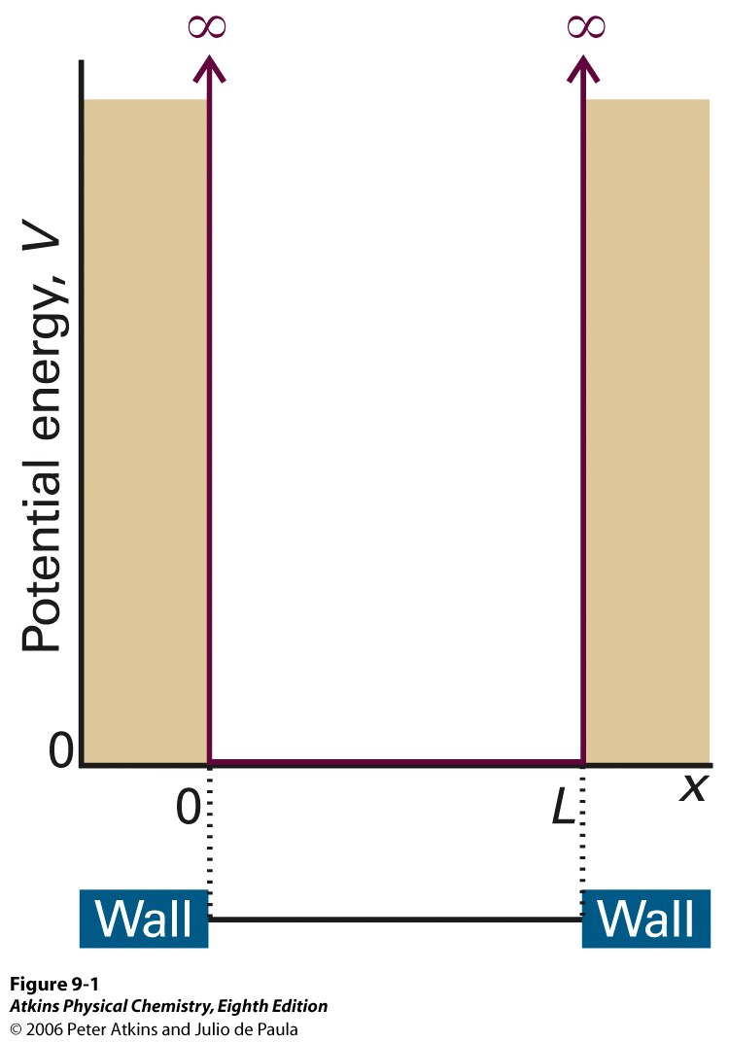



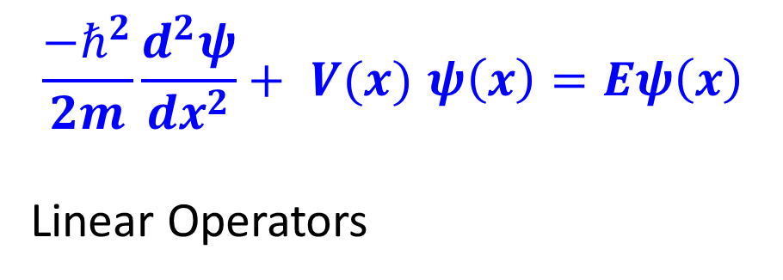
Particle in a Box – One Dimension (PIB-1D)
$$\frac{−ℏ^{2}}{2m}\frac{d^{2}ψ}{dx^{2}}+ V(x) ψ\left(x\right)=Eψ\left(x\right)$$
Linear Operators

Slide 3
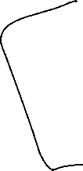





Wavefunctions - Normalized

Slide 4

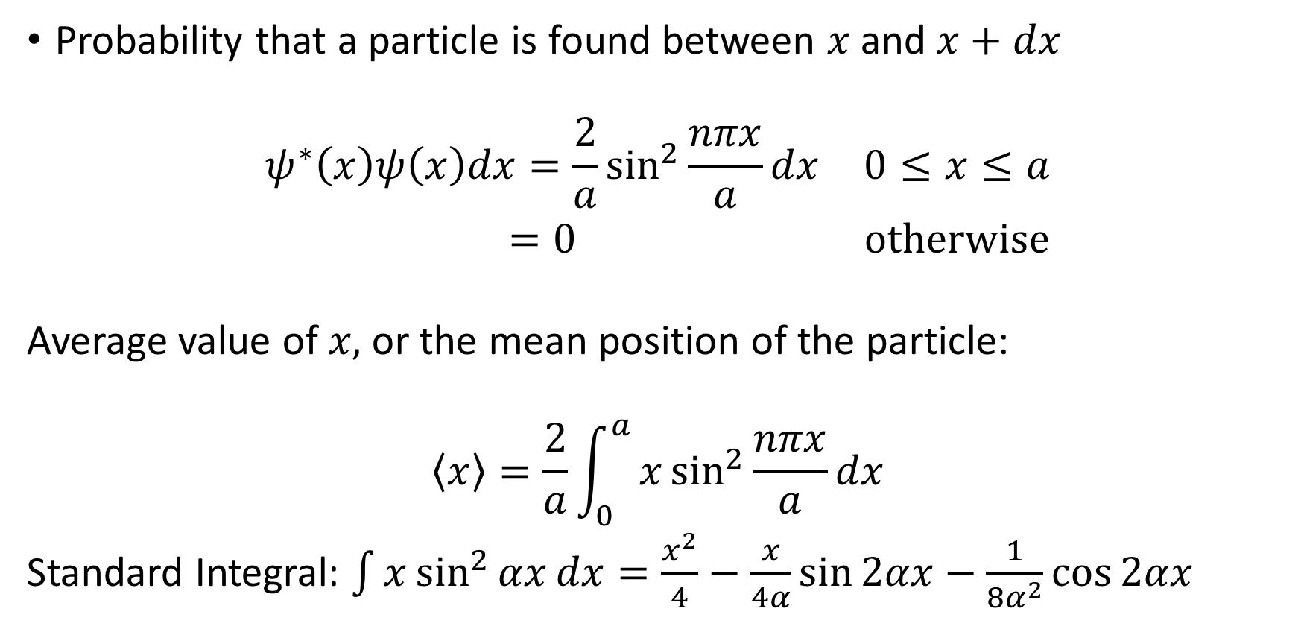

Average Position
Probability that a particle is found between $x$ and $x+dx$
$$\begin{matrix}ψ^{∗}\left(x\right)ψ\left(x\right)dx=\frac{2}{a}\sin^{2}{\frac{nπx}{a}}dx & 0≤x≤a \\ =0 & otherwise\end{matrix}$$
Average value of $x,$ or the mean position of the particle:
$$\left\langle x\right\rangle =\frac{2}{a}\int_{0}^{a}{x\sin^{2}{\frac{nπx}{a}}dx}$$
Standard Integral: $\int{x\sin^{2}{αx}dx}=\frac{x^{2}}{4}−\frac{x}{4α}\sin{2αx}−\frac{1}{8α^{2}}\cos{2αx}$

Slide 5




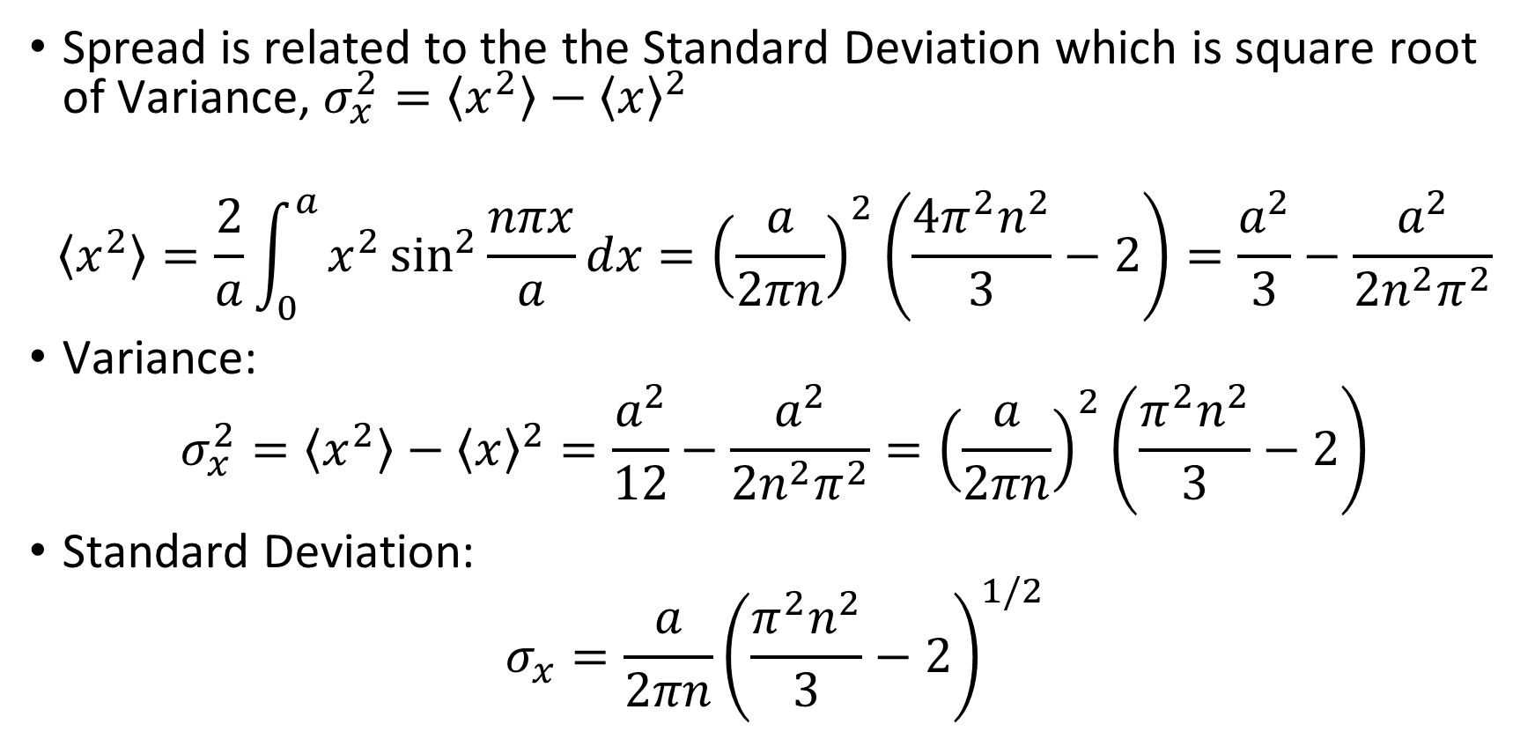
Spread about $\left\langle x\right\rangle$
Spread is related to the the Standard Deviation which is square root of Variance, $σ_{x}^{2}=\left\langle x^{2}\right\rangle −{\left\langle x\right\rangle }^{2}$
$$\left\langle x^{2}\right\rangle =\frac{2}{a}\int_{0}^{a}{x^{2}\sin^{2}{\frac{nπx}{a}}dx}={\left(\frac{a}{2πn}\right)}^{2}\left(\frac{4π^{2}n^{2}}{3}−2\right)=\frac{a^{2}}{3}−\frac{a^{2}}{2n^{2}π^{2}}$$
Variance:
$$σ_{x}^{2}=\left\langle x^{2}\right\rangle −{\left\langle x\right\rangle }^{2}=\frac{a^{2}}{12}−\frac{a^{2}}{2n^{2}π^{2}}={\left(\frac{a}{2πn}\right)}^{2}\left(\frac{π^{2}n^{2}}{3}−2\right)$$
Standard Deviation:
$$σ_{x}=\frac{a}{2πn}{\left(\frac{π^{2}n^{2}}{3}−2\right)}^{1/2}$$

Slide 6


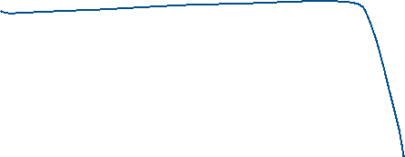
Average Properties
How to calculate average of energy or momentum?
$\left\langle s\right\rangle =\int{ψ^{∗}\left(x\right)\hat{S}ψ\left(x\right)dx}$

Slide 7



Average Momentum

Slide 8







Spread in Momentum
$$\left\langle p^{2}\right\rangle =\int{ψ_{n}^{∗}\left(x\right){\hat{P_{x}}}^{2}ψ_{n}\left(x\right)dx}=\frac{n^{2}π^{2}ℏ^{2}}{a^{2}}$$
(see energy)
$$σ_{p}=\frac{nπℏ}{a}$$
$$σ_{x}σ_{p}=\frac{ℏ}{2}{\left(\frac{π^{2}n^{2}}{3}−2\right)}^{1/2}$$

