Slide 1
Structural Insights into Atoms and Molecules Lecture 6
CML1001
August 22, 2025

Slide 2



Slide 3




Operators are Linear in Nature

Slide 4
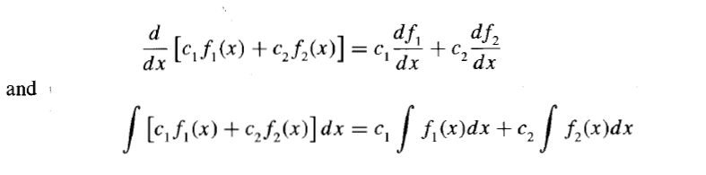
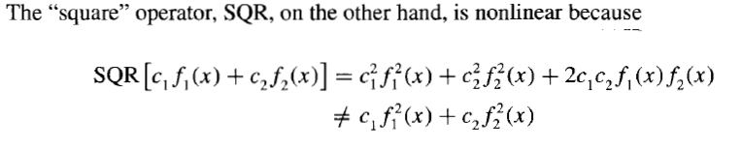
Linear
Operators
Non-
Linear
Operators

Slide 5
Postulates of Quantum Mechanics

Slide 6
POSTULATE 1
The state of a quantum mechanical particle is completely specified by a wave function Ψ (x). To simplify the notation, only one spatial coordinate is considered. The probability that the particle will be found in a spatial interval of width dx centered at x₀ is given by Ψ*(x₀) Ψ (x₀)dx.
All dynamical information is contained in the wavefunction Ψ for the system, which is a mathematical function found by solving the Schrödinger equation for the system. By 'dynamical information' is meant information about all aspects of the particle's motion, such as its location, momentum, and energy.

Slide 7


















Normalization

Slide 9
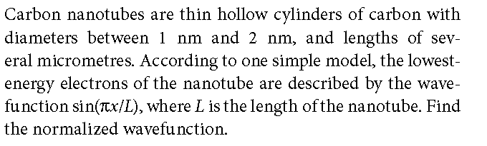
Normalization:

Slide 10
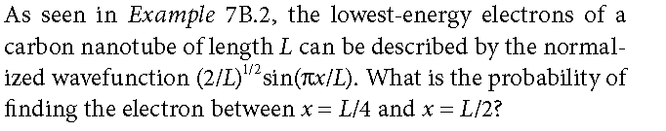
Practice Problem:

Slide 12
A wavefunction must not be infinite over a finite range because it is then not square integrable
Not Acceptable

Slide 13
Wavefunction has to be single-valued everywhere
Wavefunction that is not
single-valued everywhere
Not Acceptable

Slide 14
A discontinuous wavefunction
sinx is a continuous function of x while tanx has discontinuity at x = π/2

Slide 15
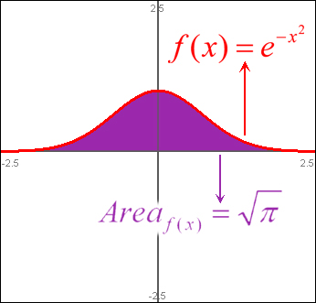

Slide 16
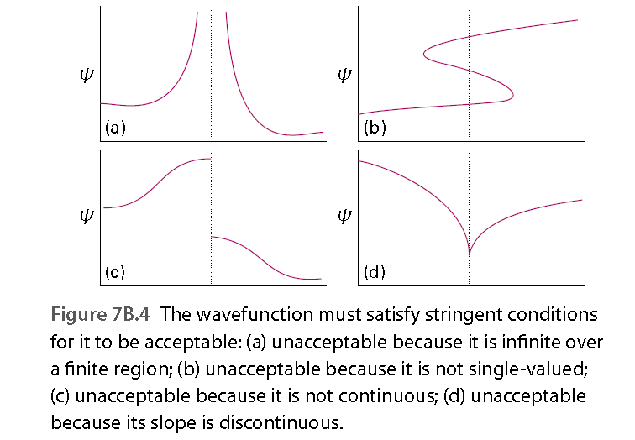

Slide 17
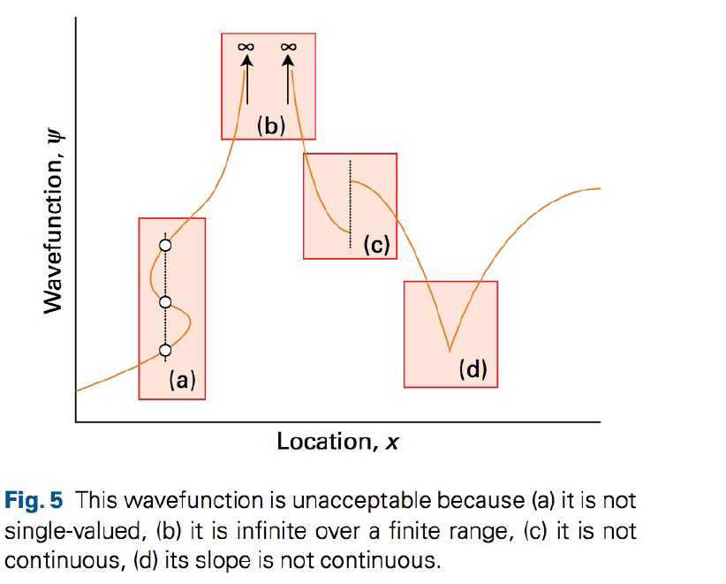

Slide 18
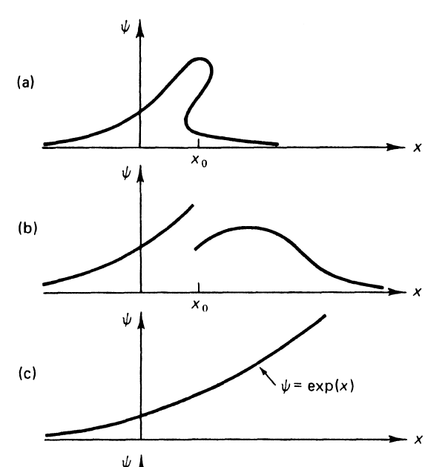


Slide 19
Quantization
The constraints just noted are so severe that acceptable solutions
of the Schrödinger equation do not in general exist for arbitrary values of the energy E.
In other words, a particle may possess only certain energies, for otherwise its wavefunction would be physically unacceptable. That is,
As a consequence of the restrictions on its wavefunction, the energy of a particle is quantized.
These acceptable energies are found by solving the Schrödinger equation for motion of various kinds, and selecting the solutions that conform to the restrictions listed above.

Slide 20
OPERATOR
POSTULATE 2
For every measurable property of a system such as position, momentum, and energy, there exists a corresponding operator in quantum mechanics.
An experiment in the laboratory to measure a value for such an observable is simulated in the theory by operating on the wave function of the system with the corresponding
operator.

Slide 21




POSTULATE 3
In any single measurement of the observable that corresponds to the operator Ậ, the only values that will ever be measured are the eigenvalues of that operator.
The eigenvalues satisfy the equation
Ậ ψ = aψ

Slide 22










Slide 23


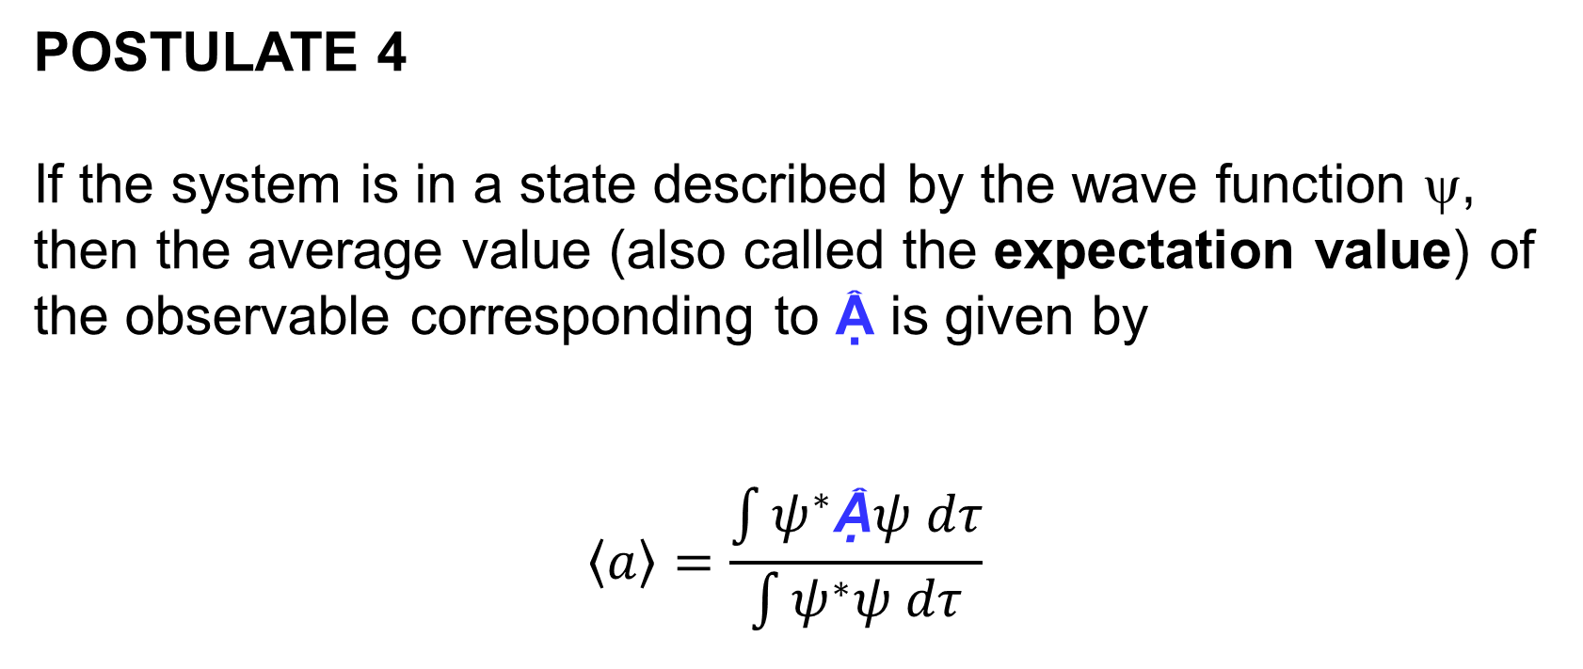



POSTULATE 4
If the system is in a state described by the wave function ψ, then the average value (also called the expectation value) of the observable corresponding to Ậ is given by
$$\left\langle a\right\rangle =\frac{\int{ψ^{∗}\text{Ậ}ψ dτ}}{\int{ψ^{∗}ψ dτ}}$$

Slide 24








Slide 25
2

Slide 26
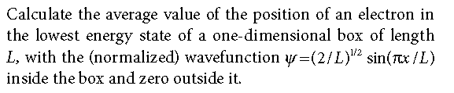
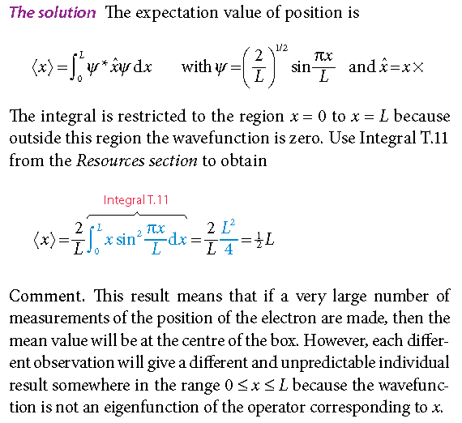
Example of Postulate 4:

Slide 27
Example of Postulate 4

Slide 28
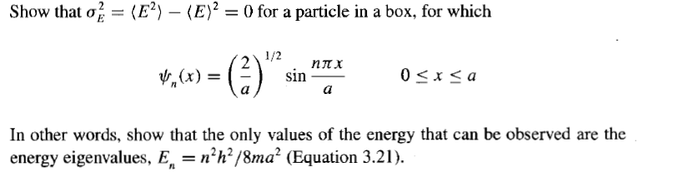
Problem:
Solution on next page!

Slide 29
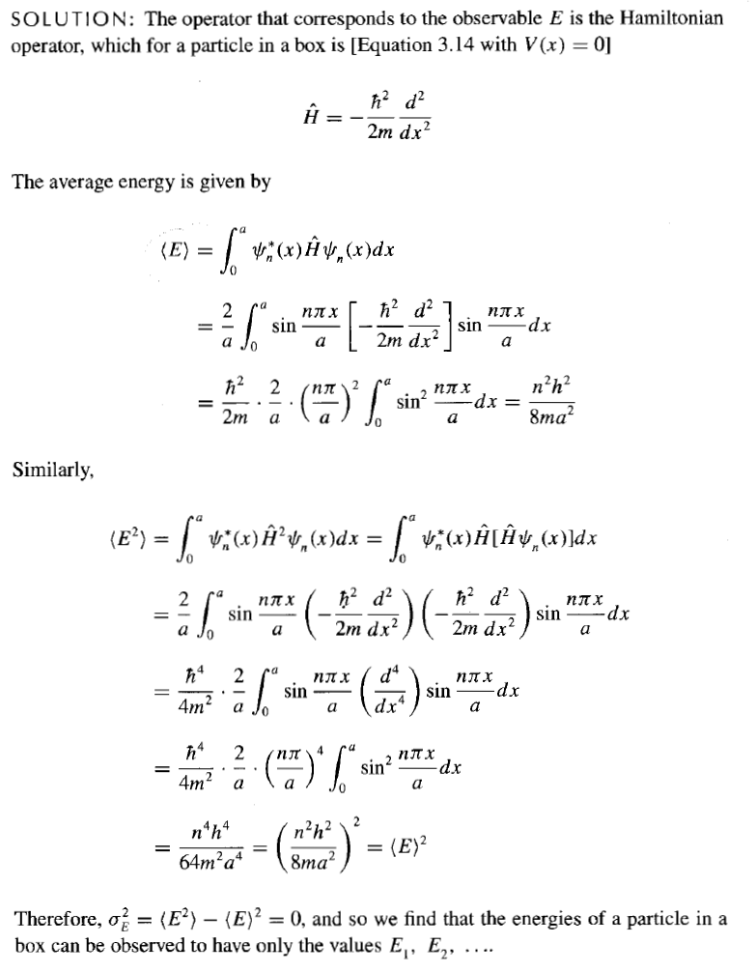

Slide 30













Slide 31
























