Slide 1
CML1001 – Structural Insights into Atoms and Molecules
Lecture 7: Postulates, Commutation and Hermitian Operators
Department of Chemistry
Indian Institute of Technology Delhi

Slide 2






Slide 3
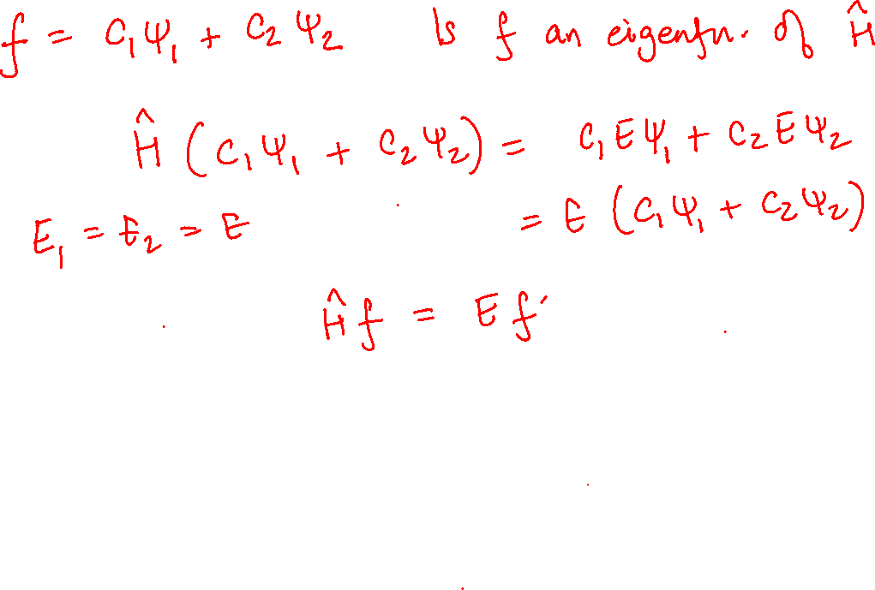

Slide 4
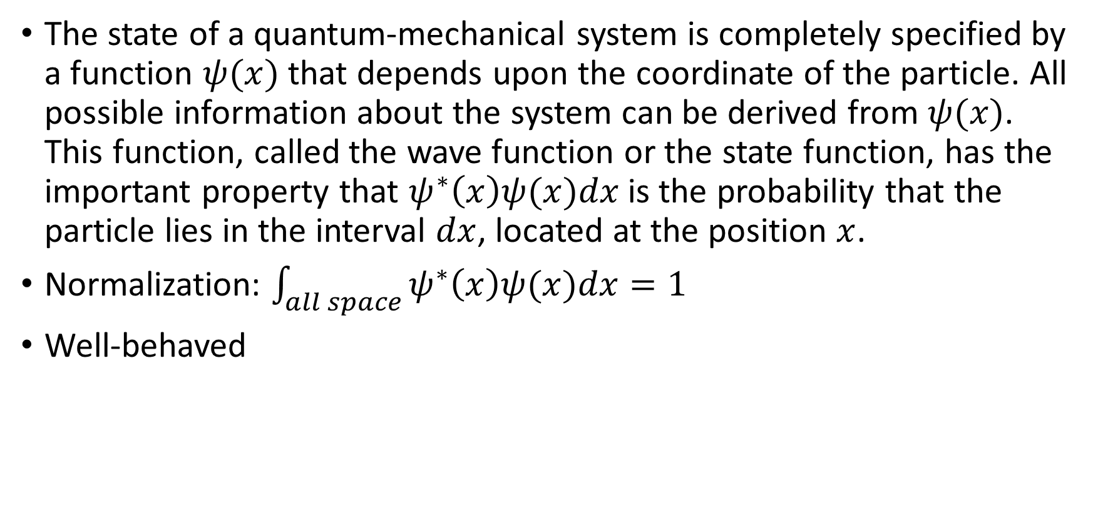
Postulate 1
The state of a quantum-mechanical system is completely specified by a function $ψ(x)$ that depends upon the coordinate of the particle. All possible information about the system can be derived from $ψ(x)$. This function, called the wave function or the state function, has the important property that $ψ^{∗}\left(x\right)ψ(x)dx$ is the probability that the particle lies in the interval $dx$, located at the position $x$.
Normalization: $\int_{all space}{ψ^{∗}\left(x\right)ψ(x)dx}=1$
Well-behaved

Slide 5
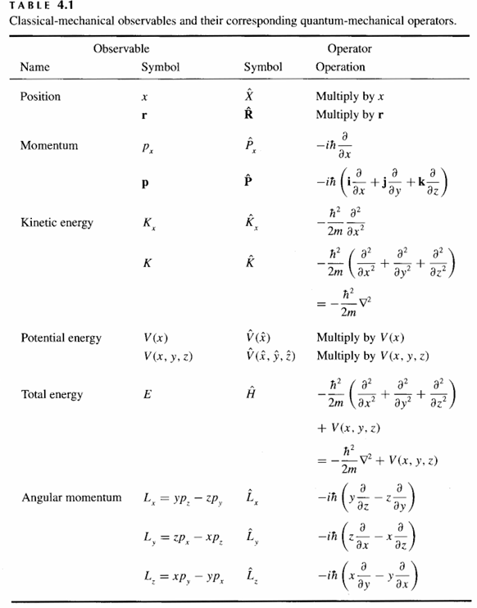
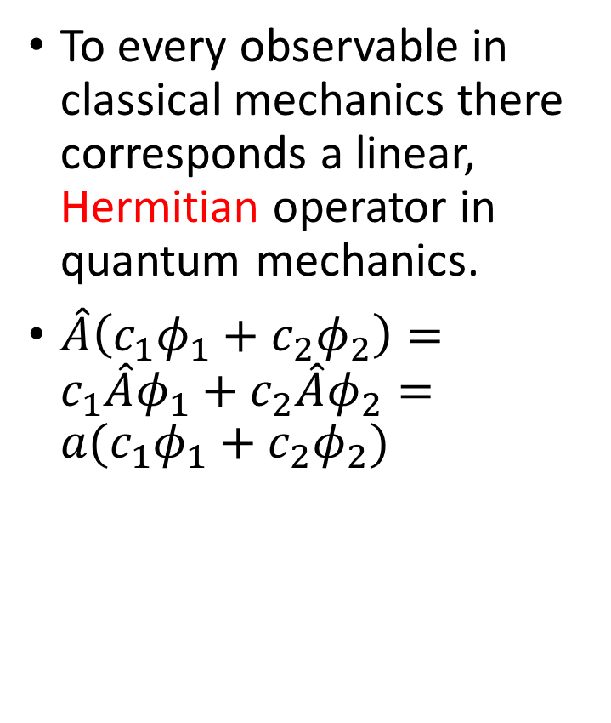
Postulate 2
To every observable in classical mechanics there corresponds a linear, Hermitian operator in quantum mechanics.
$\hat{A}\left(c_{1}φ_{1}+c_{2}φ_{2}\right)=c_{1}\hat{A}φ_{1}+c_{2}\hat{A}φ_{2}=a(c_{1}φ_{1}+c_{2}φ_{2})$

Slide 6

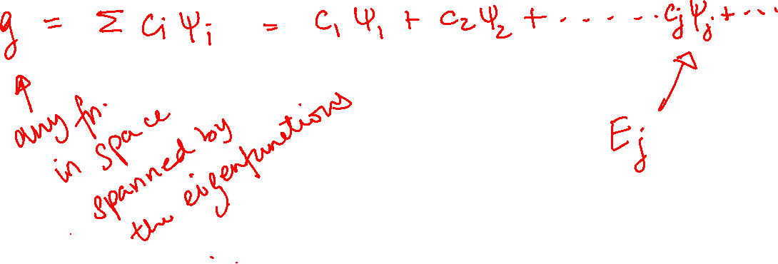
Postulate 3
In any measurement of the observable associated with the operator $\hat{A}$, the only values that will ever be observed are the eigenvalues $a_{n}$, which satisfy the eigenvalue equation
$$\hat{A}ψ_{n}=a_{n}ψ_{n}$$

Slide 7


Postulate 4
If a system is in a state described by a normalized wave function $ψ$, then the average value of the observable corresponding to $\hat{A}$ is given by
$$\left\langle a\right\rangle =\int_{all space}{ψ^{∗}\hat{A}ψdτ}$$

Slide 8
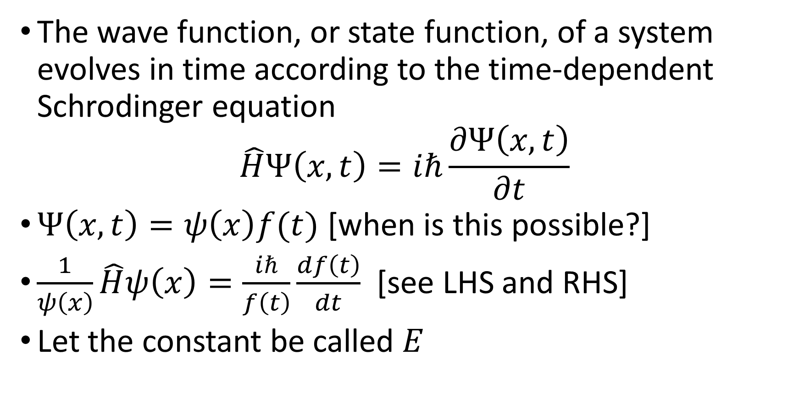
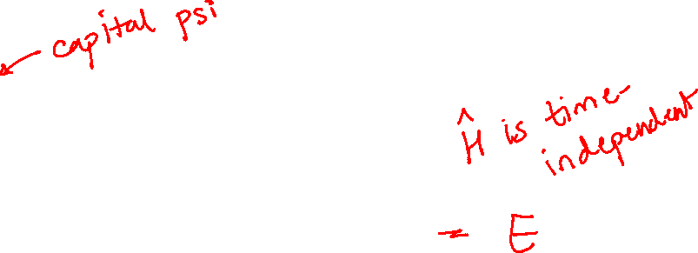
Postulate 5
The wave function, or state function, of a system evolves in time according to the time-dependent Schrodinger equation
$$\hat{H}Ψ\left(x,t\right)=iℏ\frac{∂Ψ\left(x,t\right)}{∂t}$$
$Ψ\left(x,t\right)=ψ\left(x\right)f(t)$ [when is this possible?]
$\frac{1}{ψ\left(x\right)}\hat{H}ψ\left(x\right)=\frac{iℏ}{f\left(t\right)}\frac{df\left(t\right)}{dt}$ [see LHS and RHS]
Let the constant be called $E$

Slide 9
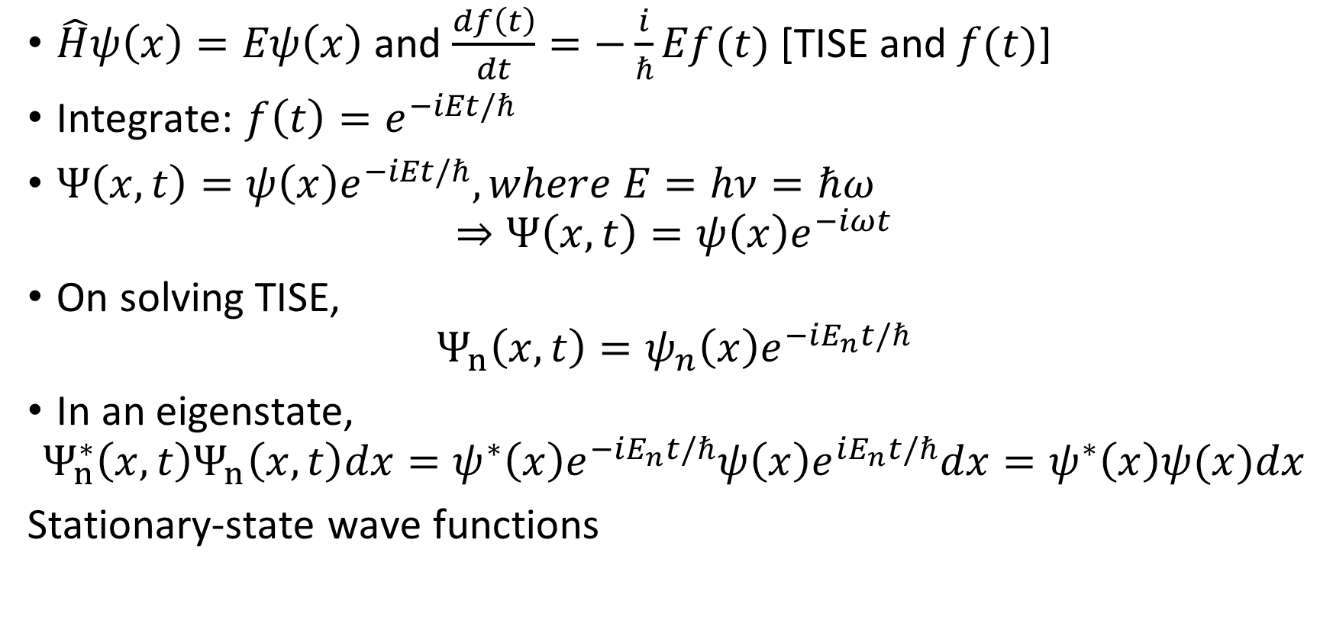

Postulate 5 contd…
$\hat{H}ψ\left(x\right)=Eψ\left(x\right)$ and $\frac{df\left(t\right)}{dt}=−\frac{i}{ℏ}Ef(t)$ [TISE and $f(t)$]
Integrate: $f\left(t\right)=e^{−iEt/ℏ}$
$Ψ\left(x,t\right)=ψ\left(x\right)e^{−iEt/ℏ}, where E=hν=ℏω$
$$⇒Ψ\left(x,t\right)=ψ\left(x\right)e^{−iωt}$$
On solving TISE,
$$Ψ_{n}\left(x,t\right)=ψ_{n}\left(x\right)e^{−iE_{n}t/ℏ}$$
In an eigenstate,
$$Ψ_{n}^{∗}\left(x,t\right)Ψ_{n}\left(x,t\right)dx=ψ^{∗}\left(x\right)e^{−iE_{n}t/ℏ}ψ\left(x\right)e^{iE_{n}t/ℏ}dx=ψ^{∗}\left(x\right)ψ(x)dx$$
Stationary-state wave functions

Slide 10
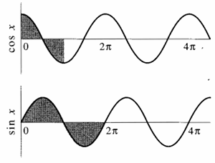
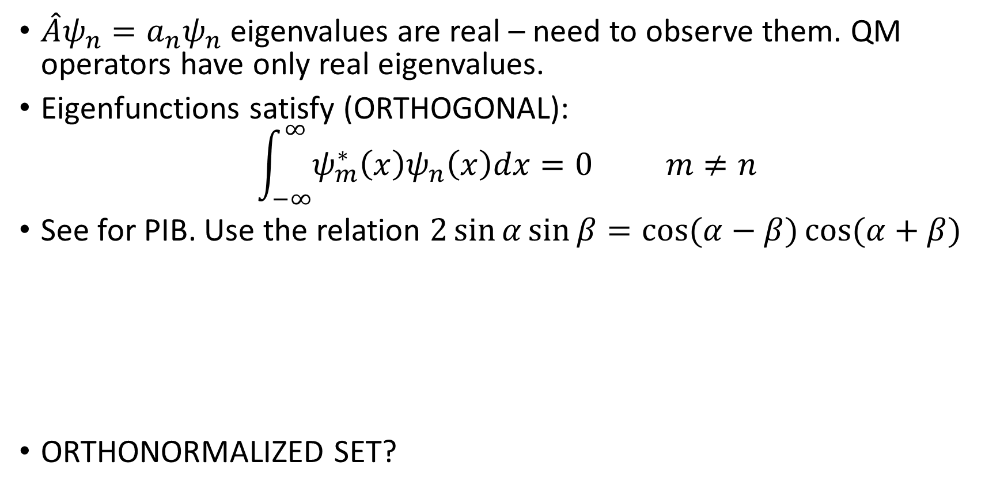

Real Eigenvalues, Orthogonal Eigenfunctions
$\hat{A}ψ_{n}=a_{n}ψ_{n}$ eigenvalues are real – need to observe them. QM operators have only real eigenvalues.
Eigenfunctions satisfy (ORTHOGONAL):
$$\int_{−∞}^{∞}{ψ_{m}^{∗}\left(x\right)ψ_{n}\left(x\right)dx=0} m≠n$$
See for PIB. Use the relation $2\sin{α}\sin{β}=\cos{(α−β)}\cos{(α+β)}$
ORTHONORMALIZED SET?

Slide 11

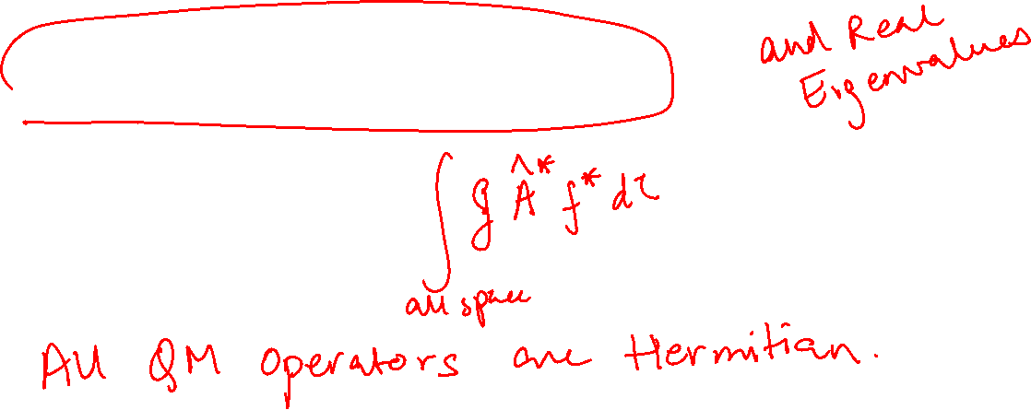
Hermitian Operators Guarantee Orthogonal $ψ_{n}$
$\int_{all space}{f^{∗}\hat{A}g dτ}=\int_{all space}{g{\left[\hat{A}f\right]}^{∗} dτ}$

Slide 12
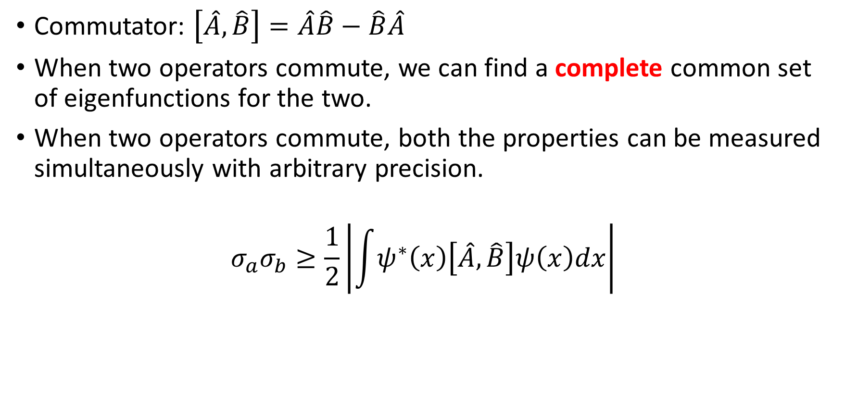
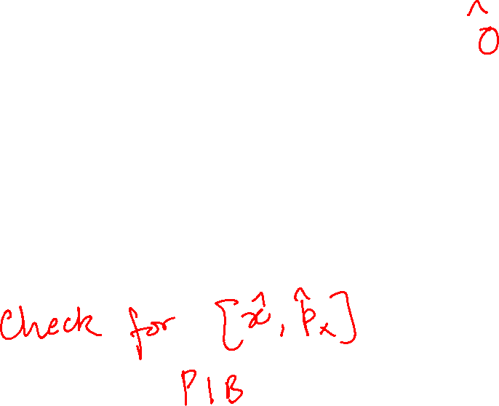
Commutation
Commutator: $\left[\hat{A},\hat{B}\right]=\hat{A}\hat{B}−\hat{B}\hat{A}$
When two operators commute, we can find a complete common set of eigenfunctions for the two.
When two operators commute, both the properties can be measured simultaneously with arbitrary precision.
$$σ_{a}σ_{b}≥\frac{1}{2}\left|\int{ψ^{∗}\left(x\right)\left[\hat{A},\hat{B}\right]ψ\left(x\right)dx}\right|$$

