Slide 1

Final Project – MSCS 634
Bhawesh Shrestha
University of the Cumberlands
Notes:
Welcome to my final project presentation for MSCS 634. I will walk through the dataset, methods, models, and insights gained.

Slide 2
Introduction
Overview of project integrating preprocessing, EDA, feature engineering, regression, classification, clustering, and association rules.
Notes:
This project integrates preprocessing, EDA, feature engineering, regression, classification, clustering, and association rule mining.

Slide 3
Dataset Description
Online Retail I dataset (2010–2011). Includes invoice, product, quantity, price, and customer data.
Chosen for its suitability for all data mining tasks.
Notes:
The Online Retail I dataset was chosen because it supports many data mining tasks: forecasting, segmentation, classification, and pattern mining.

Slide 4

Data Preprocessing
Removed cancelled transactions, filtered negative quantities, cleaned CustomerID, and created TotalPrice.
Scaled numeric features for modeling.
Notes:
Here I explain how we cleaned the dataset by removing cancellations, filtering negative values, and creating new variables like TotalPrice.

Slide 5
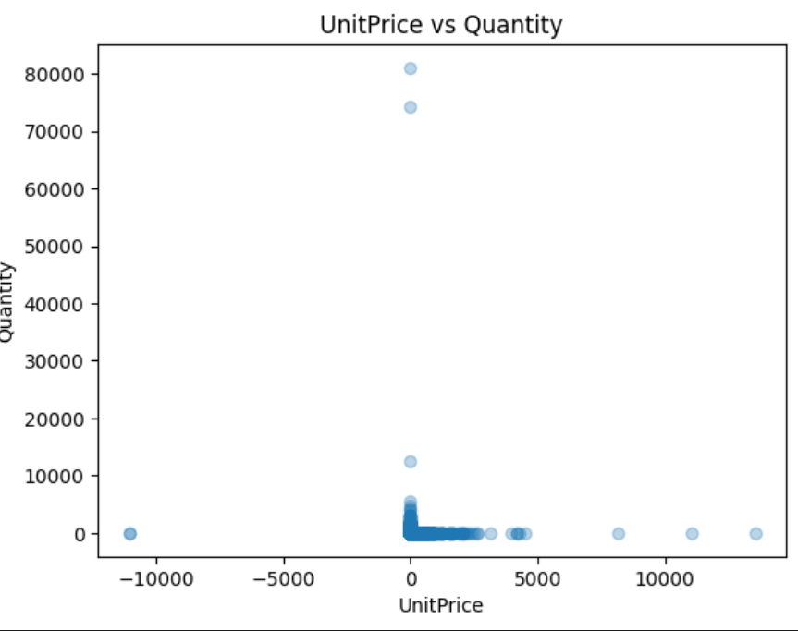
Key EDA Insights
Clear presence of outliers in Quantity and UnitPrice, indicating unusual or high-volume purchases.
Most transactions involve low-priced items purchased in small quantities, as shown by dense clustering near the origin.
A few extreme points represent high-quantity or high-unit-price outliers, which required preprocessing.
EDA helped uncover customer purchasing patterns and guided decisions for scaling and feature engineering.
These insights improved downstream models such as RidgeCV, Decision Tree, and K-Means.
Notes:
This slide highlights key exploratory insights including outliers, sales trends, and high-volume customers or products.

Slide 6
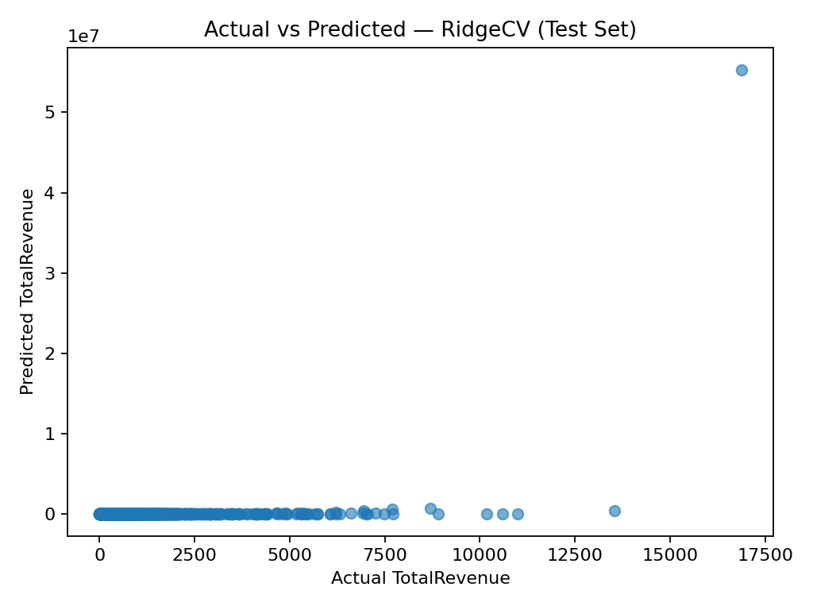
Regression Model – RidgeCV
RidgeCV selected to address multicollinearity among features and improve model stability.
Automatically tunes the regularization strength using cross-validation, ensuring optimal performance.
Evaluated using RMSE and R², which measure prediction error and the proportion of variance explained.
Actual vs Predicted plot helps assess how closely model predictions align with real values.
Points near the diagonal line indicate strong predictive accuracy and low residual error.
Demonstrates that engineered features (such as TotalPrice and date-based variables) effectively explain customer spending behavior.
Notes:
RidgeCV was used for regression because it handles multicollinearity well. The model showed how features predict customer spending.

Slide 7
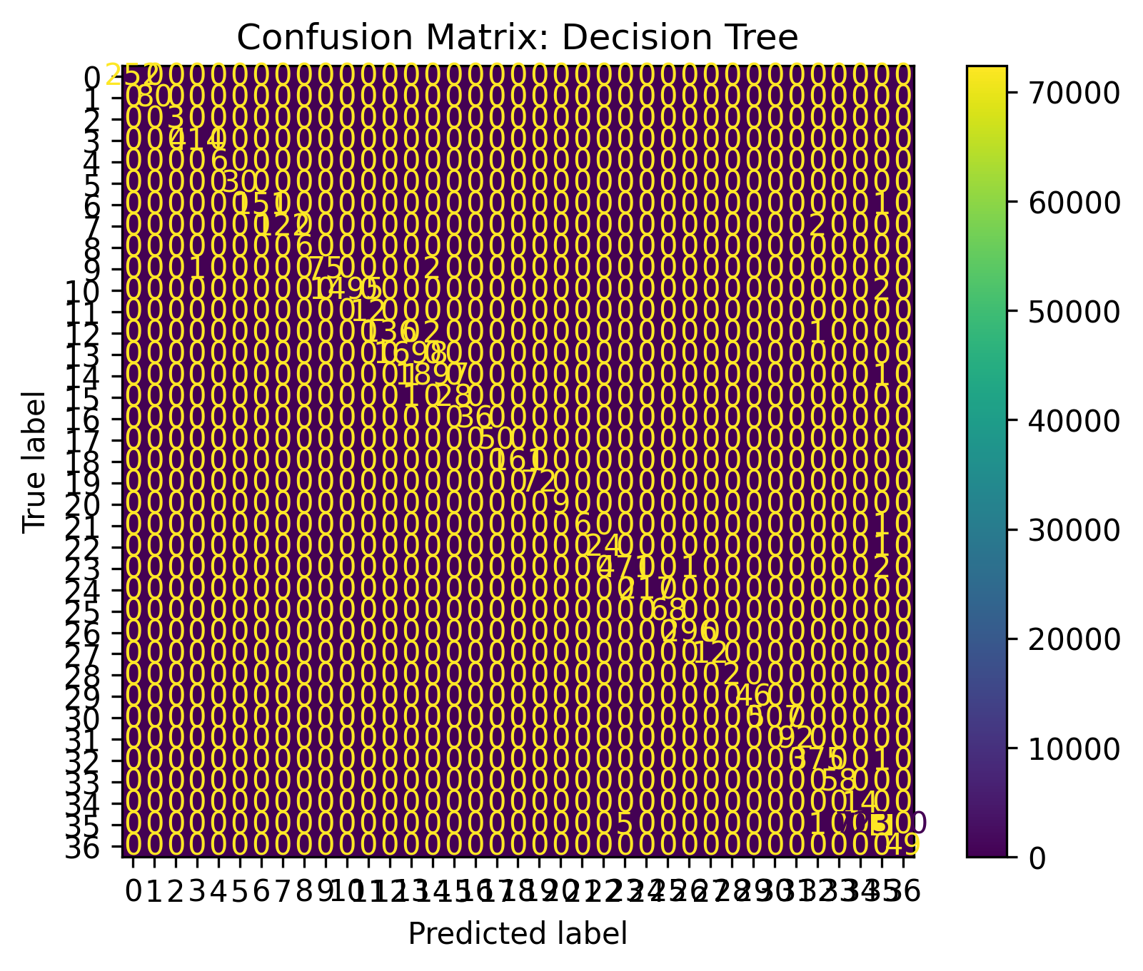
Classification – Decision Tree
Decision Tree model trained on a sampled subset of the dataset.
Evaluated using Accuracy, Precision, Recall, and F1-score.
Confusion matrix shows strong diagonal dominance, indicating high correct classification rates.
Misclassifications are relatively low, showing the model captured meaningful patterns in the data.
The model is easy to interpret, making it useful for understanding decision paths.
Notes:
The Decision Tree classifier is easy to interpret and reveals important decision rules used for classifying customer behaviors.

Slide 8
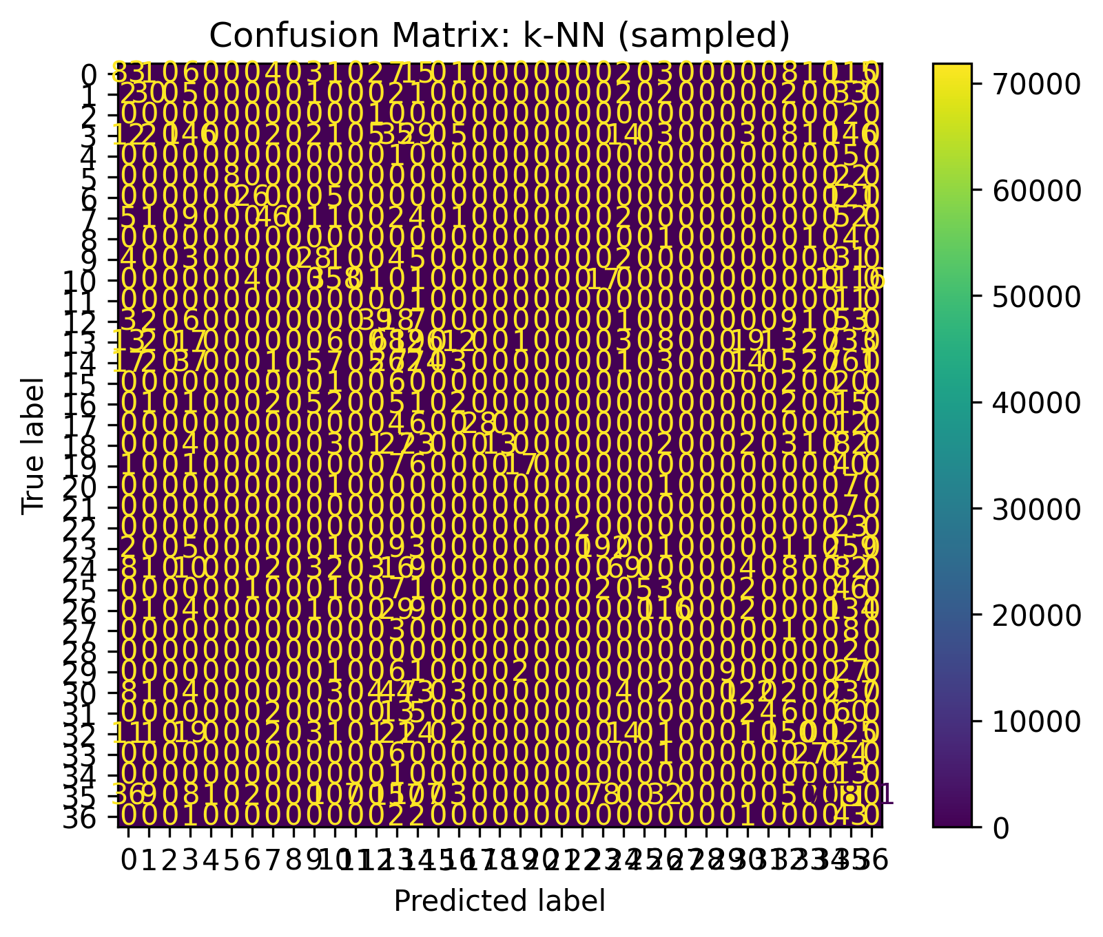
Classification – KNN (Sampled)
KNN classifier trained on a sampled subset of the dataset.
Captures local neighborhood patterns to classify customer behavior.
Confusion matrix shows moderate diagonal alignment, indicating correct predictions in many classes.
Some misclassifications occur due to overlapping feature values and sensitivity to scaling.
Useful for comparison against the Decision Tree model.
Notes:
KNN captures local structure in the data. The sampled dataset allowed faster computation while maintaining accuracy.

Slide 9
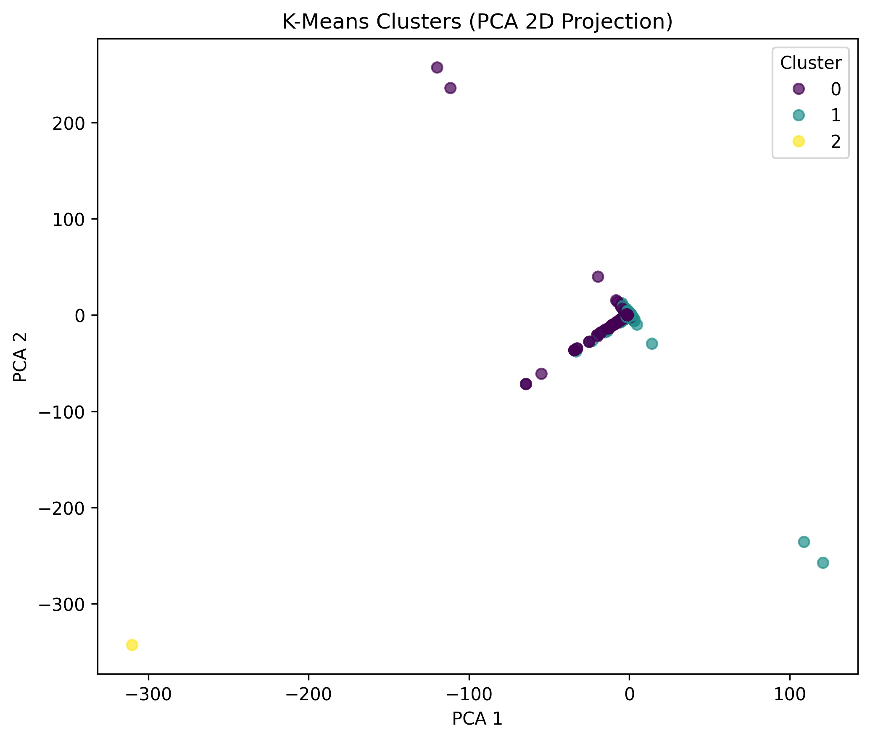
Clustering – K-Means
Performed customer segmentation using scaled numerical features.
PCA was applied for 2D visualization of clusters.
K-Means identified three distinct customer groups based on their purchasing patterns.
Silhouette score confirmed that the clusters have reasonable separation.
Helps in understanding customer types for targeted marketing and personalization.
Notes:
K-Means clustering grouped customers by behavior, helping identify marketing segments and actionable clusters.

Slide 10
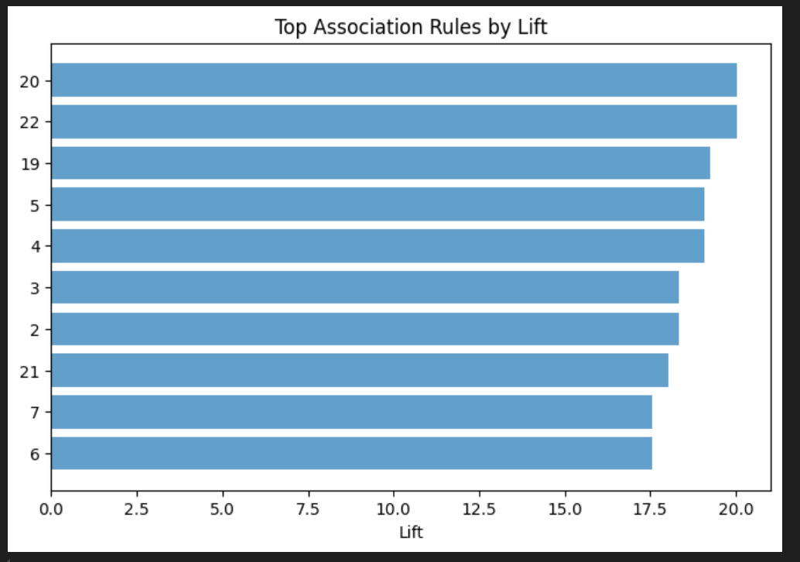
Association Rule Mining – Apriori
Apriori algorithm discovered frequent item combinations in customer transactions.
Rules evaluated using support, confidence, and lift, identifying strong product relationships.
High-lift rules (shown in the chart) reveal items that are commonly purchased together.
Provides insights for cross-selling, product placement, and bundle recommendations.
Notes:
Apriori helped identify frequent product combinations. Lift and confidence values guide cross-selling strategies.

Slide 11

Ethical Considerations
- Data privacy (CustomerID handling)
- Bias due to geographic imbalance
- Avoiding discriminatory modeling
- Ensuring transparency and fairness
Notes:
Ethical considerations include privacy, fairness, avoiding discriminatory modeling, and maintaining transparency.

Slide 12
Practical Recommendations
- Use clusters for targeted marketing
- Use association rules for product bundling
- Apply regression for demand forecasting
- Classification for identifying high-value customers
Notes:
Recommendations include targeted marketing, product bundling improvements, and using models for forecasting and customer identification.

Slide 13

Conclusion
The complete data mining workflow generated actionable business insights.
Supports segmentation, forecasting, and cross-selling optimization.
Notes:
In conclusion, this project demonstrates a full data mining workflow leading to insights useful for decision-making and optimization.

