Slide 1

Heart Disease Exploratory Data
Analysis
By – Bhawesh Sinha
(Data Scientist)

Slide 2
Introduction
Heart disease remains one of the leading causes of mortality worldwide, imposing a significant burden on public health systems and individuals alike. With its multifaceted nature and diverse risk factors, understanding the epidemiology and patterns of heart disease is crucial for effective prevention, diagnosis, and management strategies. In this exploratory data analysis (EDA) project, we delve into a comprehensive dataset to uncover insights into various aspects of heart disease. By leveraging statistical techniques and data visualization, we aim to elucidate patterns, correlations, and potential predictive factors associated with heart disease. Through this endeavor, we seek to contribute valuable insights that could inform healthcare professionals, policymakers, and individuals in their efforts to combat this pervasive and debilitating condition.

Slide 3
Details about the Data.
Age
Sex (1= Male, 0=Female)
Cp = Chest pain type: Type 0 Angina - Stable Angina Type 1 Angina - Ustable Angina Type 2 Angina - Variant Angina Type 3 Angina - Refractory angina
Trestbps = Resting blood pressure
Chol = Serum Cholestoral in mg/dl
Fbs = fasting blood sugar > 120 mg/dl
Restecg = Resting Electrocardiographic Results: Class 0 - Normal Class 1 - Slightly Abnormal Class 2 - Abnomal
Thalach = Maximum Heart Rate Achieved
Exang = exercise induced angina
Oldpeak = ST depression caused by activity in comparison to rest.
Slope = Slope of the peak exercise ST Segment.
Ca = Calcium Score.
Thal = Thalassemia: Value 0 - Normal Value 1 - Fixed Defect Value 2 - Reversable Defect
Target = Having Disease or Not: Value 0 - Not Having Heart Disease Value 1 - Having Heart Disease

Slide 4
Main KPIs
Age – Average age group having the heart disease.
Sex – Gender distribution in terms of heart disease.
Chest pain type – Type of pain they have suffered.
Target – Are they having the disease or not.

Slide 5
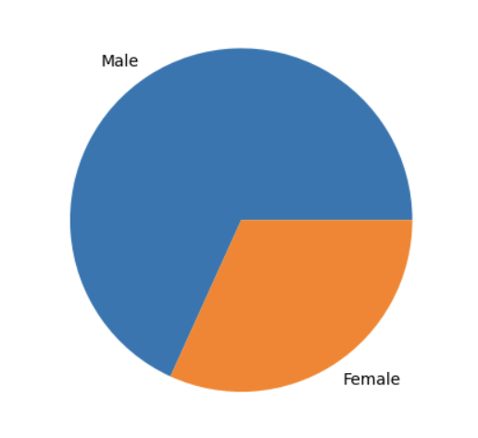
Mock up dashboard
70% of the entire survey are Male.
30% of the entire survey are Female.

Slide 6
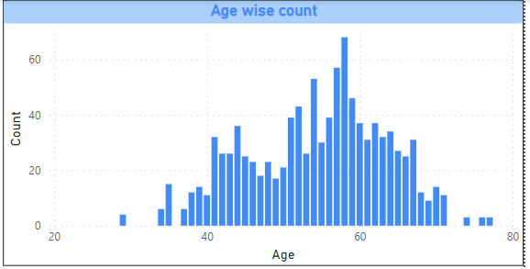
Age Wise Count among the population.
Maximum people are suffering from the heart disease are falls between age of 50 to 60 years.
Disease also got captured among the youngster of age less than 30.

Slide 7
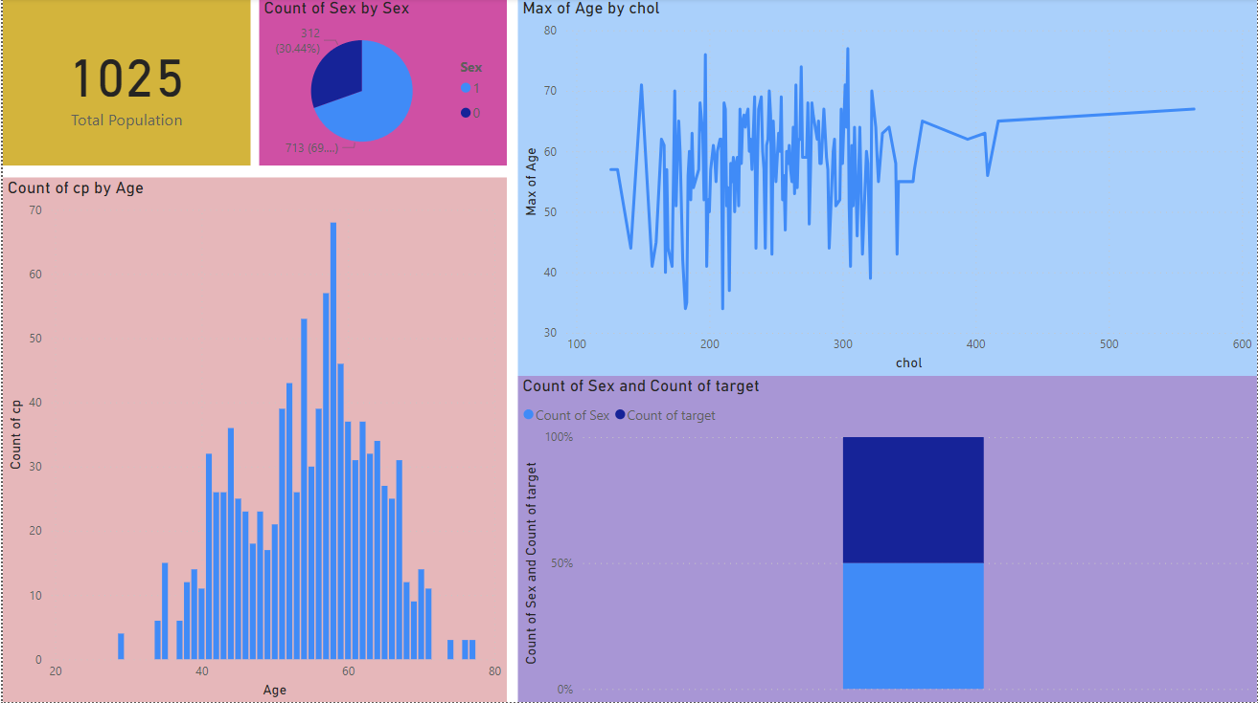
My Design

Slide 8
Thank you

