Slide 1
Elasticsearch Assessment
Team: Basis for Belief
Members: Mounika, Bhawini, Taraka, Mark

Slide 2
Project Description
Elasticsearch is an enterprise level distributed RESTful search engine
Provides real time searching on many different document types
Around 2.5 million lines of code from about 2,000 contributors
Java / Apache 2.0 license (mostly)
Notes:
OSS project overview
System functions: indexing and searching

Slide 3
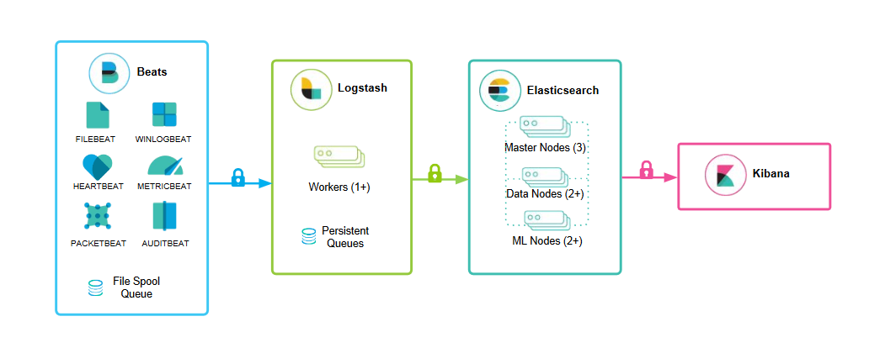
Project Description
Notes:
Quick overview of architecture and how data flows work in the system.

Slide 4
Project Description
Environment
Fraud Monitoring Department at a bank or credit card company using Elasticsearch to store customer information, threat data, and transaction metadata
The system is critical to the organization's ability to prevent credit card fraud and protect their cardholders
Critical Security Requirements
Authentication and role based access control
Strong encryption of all communication channels
Detailed audit logging
Notes:
Define the environment for our project

Slide 5
Assurance Claims
Claim 1: Elasticsearch prevents unauthorized access to the elastic cluster based on user role
Claim 2: Elasticsearch is sufficiently protected against resource injection
Claim 3: Elasticsearch defends against suspicious login activity
Claim 4: Elasticsearch minimizes the possibility of network eavesdropping attacks.
Claim 5: Elasticsearch's audit logging functions prevents tampering.

Slide 6
Assurance Claims
Elasticsearch has fairly good documentation with a fair amount of detail, which was very useful when writing our claims and citing evidence to support those claims.
We found to project to be quite mature in its offerings of security features.

Slide 7
Gaps
Owing to the extensible plugin infrastructure there is no control over the third-party code and there is no guarantee of their compliance with X-pack security.
Multi get and Multi term vector API throw IndexNotFoundException if the user tries to access not existing indices that he is not authorized for. This reveals information that the index doesn’t exist while the user is not authorized to know anything about those indices.
LDAP Realm doesn’t support discovery of nested LDAP groups.

Slide 8
Findings – Automated
PMD
16,000 findings, but none in the “Security” category
Mostly code style and documentation type findings
Findbugs
Security findings included 40 medium and 558 low severity issues
Included possible cryptographic, credentials management, path traversal, injection, etc. type issues
Notes:
Give results of automated scanning

Slide 9
Findings – Manual Review
Elasticsearch has large code base so we approached our manual code review based on the checklist review strategy:
CWE-284: Improper Access Control
Access Controls based on user role and document level privileges are handled in the code carefully.
CWE-798: Use of Hard-coded Credentials
Hard coded value found in the code is used to decrypt the private key file
Contents in the private key file can be viewed and the algorithm pattern can be cracked.
CWE-502: Deserialization of Untrusted Data
No way of knowing what is being deserialized before it has been decoded.
This flaw could be exploited to effect a complete remote command execution
Notes:
Give results of manual code review

Slide 10
Findings – Manual Review
CWE-300: Channel Accessible by Non-Endpoint
In our analysis, the vulnerability related to the CWE-300 is Mitigated
Elasticsearch verifies the incoming certificates before giving access.
CWE-22: Improper Limitations of a Pathname to a restricted Directory
CWE-22 is one of the SANS top-25 vulnerabilities. This vulnerability could lead to code-execution, data loss and DOS attack
This vulnerability is remediated in Elasticsearch code
CVE-2015-8131
The vulnerability such as CSRF, session hijacking, CORS, etc. related to the above CVE is mitigated in the Elasticsearch
Elasticsearch mitigated this by implementing the tokens which are validated based on time basis
New tokens are created once old token expired
Notes:
Give results of manual code review

Slide 11
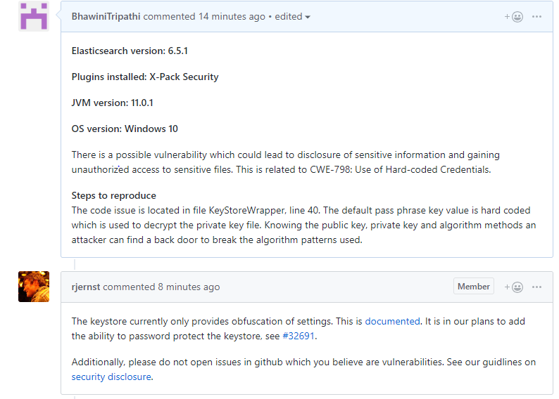
Contributions
Effort to open an issue and potentially a pull request in progress
CWE-798: Use of Hard-coded Credentials
https://github.com/elastic/elasticsearch/issues/36395#issue-388858623
CWE-502: Deserialization of Untrusted Data

Slide 12
Questions/Comments?
Thank you!

