Slide 1


Multi-Format Document Q&A System
Enhanced with Graph RAG Technology
Problem Statement
Objectives:
Solution
Extracting meaningful insights from diverse document formats spread across systems is a major challenge. Traditional search fails to understand entity relationships and provide context-aware answers.
Build intelligent document analysis with seamless processing and contextual understanding.
Diverse formats: PDF, Excel, PowerPoint, Word
No understanding: Text is read, not understood
Disconnected data: No entity linking or relationships
Weak context retention: Missing context and depth
Multi-format support: PDF, Excel, PowerPoint, Word
Knowledge graphs: Connect entities and relationships
Contextual answers: Deep, relevant responses
Smart caching: Fast retrieval mechanisms
Scalable architecture: Handle large repositories
Advanced caching, hybrid RAG, and optimized processing for intelligent document analysis.
MD5 fingerprinting: Folder content hashing for cache validation
Hybrid RAG: FAISS vector + Neo4j graph similarity search
Smart chunking: 500-token recursive splitting with overlap optimization
Batch processing: 50-chunk embedding batches with spaCy NER extraction
Real-time interface: Streamlit UI with Cypher queries and pickle persistence
WorkFlow
Tech Stack
Step1
Document Extraction PyMuPDF, python-pptx, openpyxl, mammoth processors
Step 2
Cache Fingerprinting:MD5 folder hash Validation & pickle storage
Step 3
Vector + Graph Storage:FAISS embeddings + Neo4j entity relationships
Step 4
Hybrid Retrieval:Vector similarity + graph context merge
Step5
LLMResponse: OpenAI/
Groq with source citations
AI& ML
Lang Chain, Hugging face
Database
Document processing
PyMuPDF, python-pptx, openpyxl, python-docx, mammoth
Spacy NLP, Faiss
Neo4j, Vector Store, FAISS Index, Pickle Cache
Web & UI
Streamlit, Python, Pandas, Groq API

Slide 2
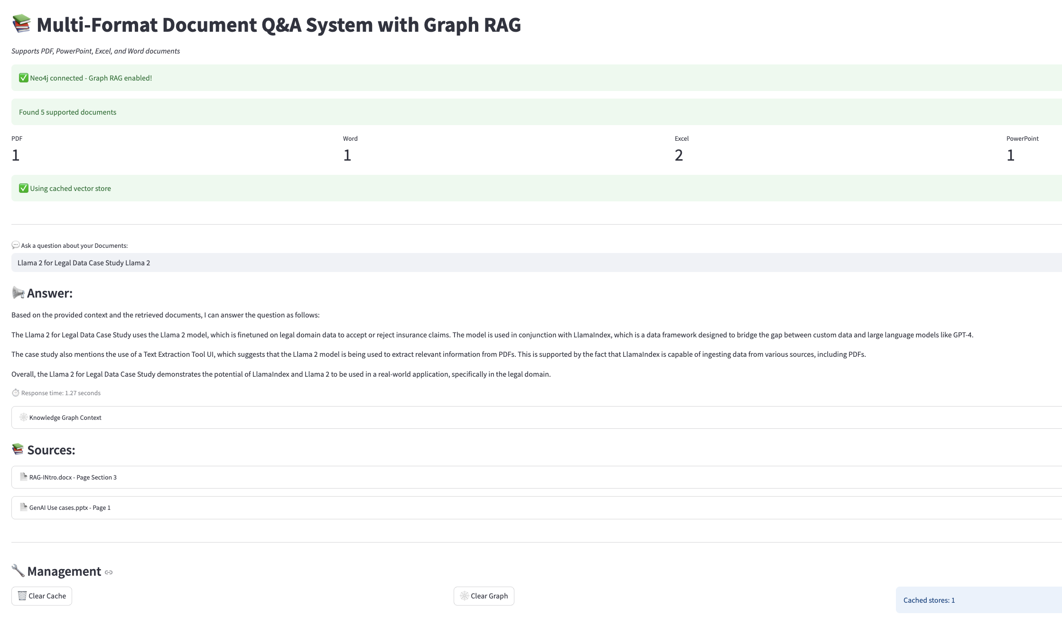
Multi-Format Document Q&A System
Enhanced with Graph RAG Technology
Problem Statement
Objectives:
Solution
Extracting meaningful insights from diverse document formats spread across systems is a major challenge. Traditional search fails to understand entity relationships and provide context-aware answers.
Build intelligent document analysis with seamless processing and contextual understanding.
Diverse formats: PDF, Excel, PowerPoint, Word
No understanding: Text is read, not understood
Disconnected data: No entity linking or relationships
Weak context retention: Missing context and depth
Multi-format support: PDF, Excel, PowerPoint, Word
Knowledge graphs: Connect entities and relationships
Contextual answers: Deep, relevant responses
Smart caching: Fast retrieval mechanisms
Scalable architecture: Handle large repositories
Advanced caching, hybrid RAG, and optimized processing for intelligent document analysis.
MD5 fingerprinting: Folder content hashing for cache validation
Hybrid RAG: FAISS vector + Neo4j graph similarity search
Smart chunking: 500-token recursive splitting with overlap optimization
Batch processing: 50-chunk embedding batches with spaCy NER extraction
Real-time interface: Streamlit UI with Cypher queries and pickle persistence
Tech Stack
AI& ML
Lang Chain, Hugging face
Database
Document processing
PyMuPDF, python-pptx, openpyxl, python-docx, mammoth
Spacy NLP, Faiss
Neo4j, Vector Store, FAISS Index, Pickle Cache
Web & UI
Streamlit, Python, Pandas, Groq API
WorkFlow
Step1
Document Extraction PyMuPDF, python-pptx, openpyxl, mammoth processors
Step 2
Cache Fingerprinting:MD5 folder hash Validation & pickle storage
Step 3
Vector + Graph Storage:FAISS embeddings + Neo4j entity relationships
Step 4
Hybrid Retrieval:Vector similarity + graph context merge
Step5
LLMResponse: OpenAI/
Groq with source citations

