Slide 1
Project Presentation of Industry Oriented Hands on Experience (22CS422)
On
Integrated Multi Approach Recommendation System for Book Discovery
Bhawna , Deepansh , Deepanshu Aggarwal , Guransh
2210990223 , 2210990251 , 2210990254 , 2210990335
Supervised By
Dr. Gifty Gupta
Department of Computer Science and Engineering,
Chitkara University, Punjab

Slide 2
Introduction
Rapid growth of online platforms like Amazon and Flipkart has led to a massive increase in available books.
Users face information overload, making it difficult to find relevant books.
Traditional recommendation systems struggle to provide accurate and personalized suggestions.
Cold-start problem: New users or books lack sufficient data for recommendations.
Data sparsity: Limited user ratings reduce system effectiveness.
Popularity bias: Systems tend to recommend only highly popular books.
Lack of balance between accuracy, diversity, and fairness in recommendations.
2

Slide 3
Objective
To develop a multi-approach recommendation system that improves personalized book discovery for users.
To integrate content-based and collaborative filtering techniques in order to leverage both item features and user behavior.
To design hybrid and dynamic weighted models that can adapt recommendations based on user preferences.
To enhance accuracy, ranking quality, and personalization for more relevant and useful book suggestions.
To address key challenges such as the cold-start problem, data sparsity, and popularity bias, while ensuring fair and diverse recommendations.

Slide 4
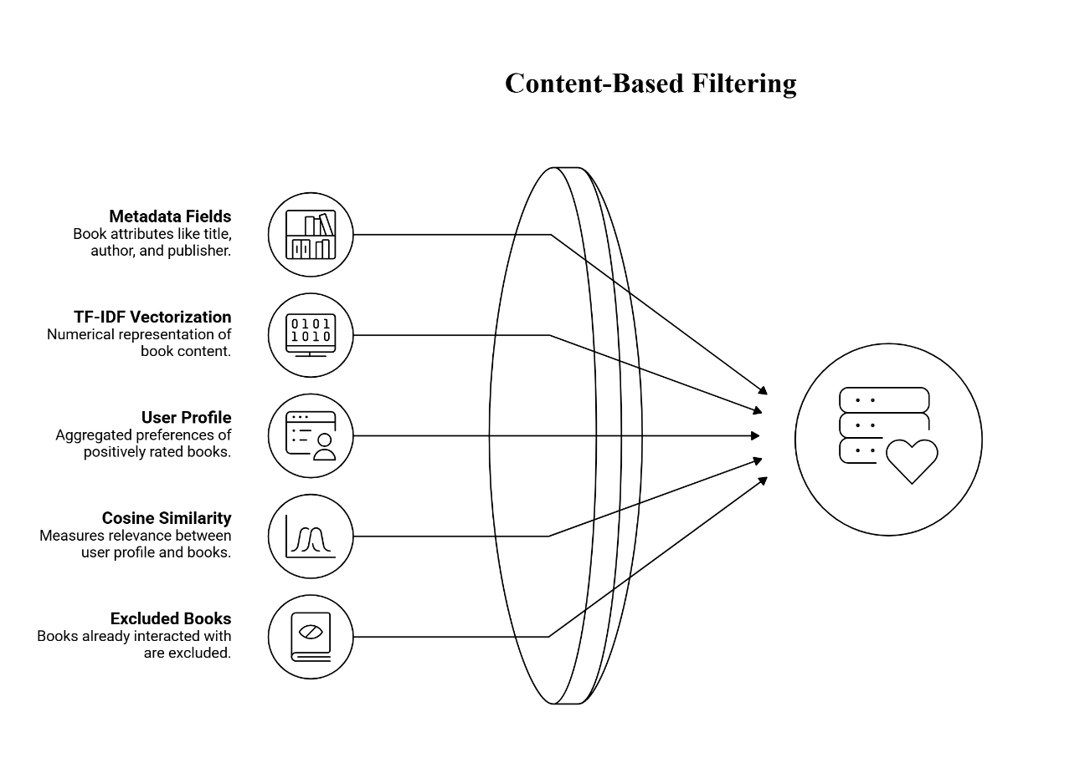
Methodology
Dataset Selection: The system uses the Book-Crossing dataset, which includes book details, user information, and rating data for building and testing the recommendation models.
Data Preprocessing: The dataset is cleaned by handling missing values, removing irrelevant features, and reducing sparsity to improve data quality and model efficiency.
Content-Based Filtering: This method recommends books based on similarity in metadata using TF-IDF vectorization and cosine similarity.

Slide 5
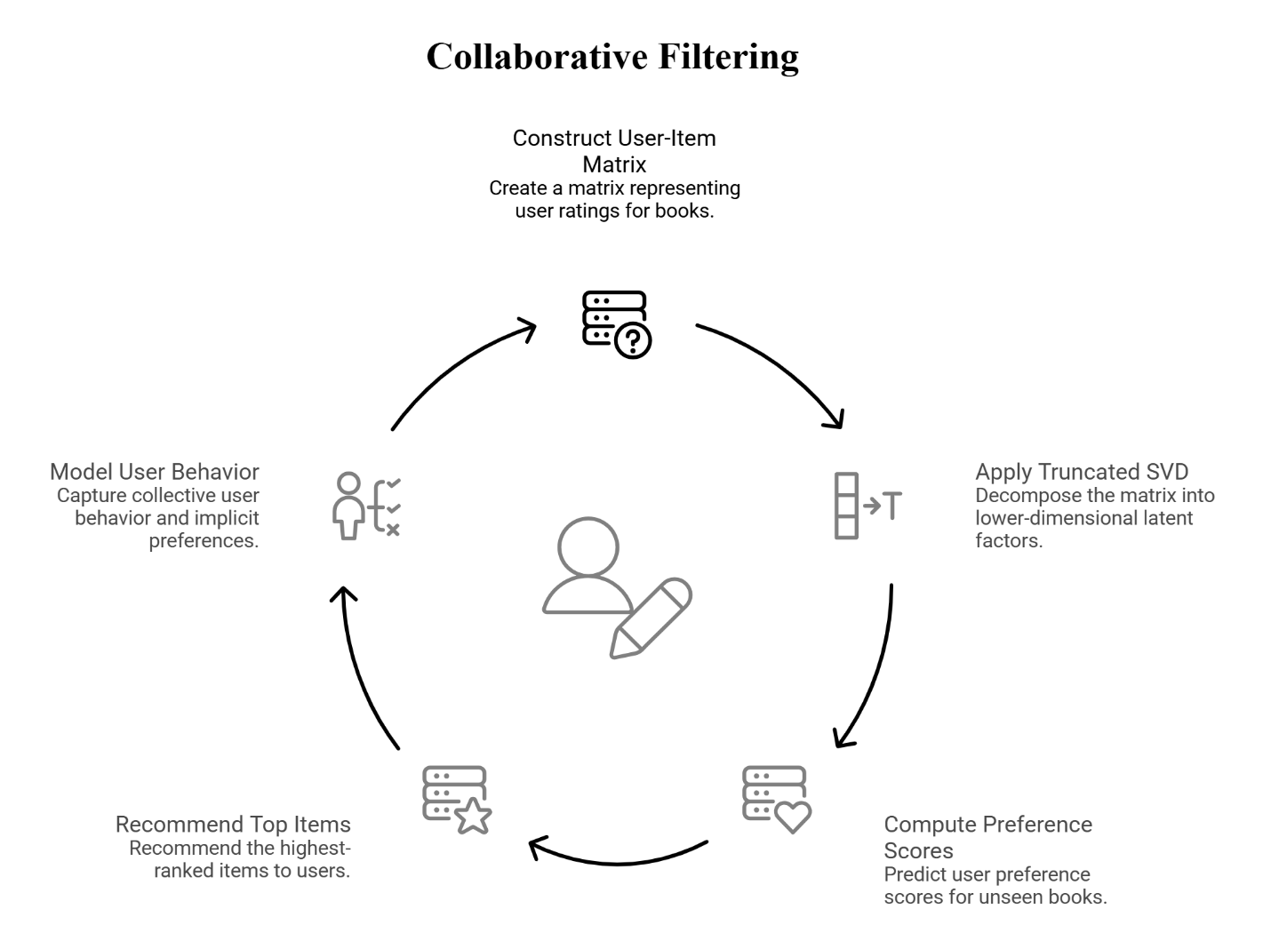
Collaborative Filtering: User-item interaction data is used to identify patterns, and SVD is applied to reduce sparsity and improve prediction accuracy.

Slide 6
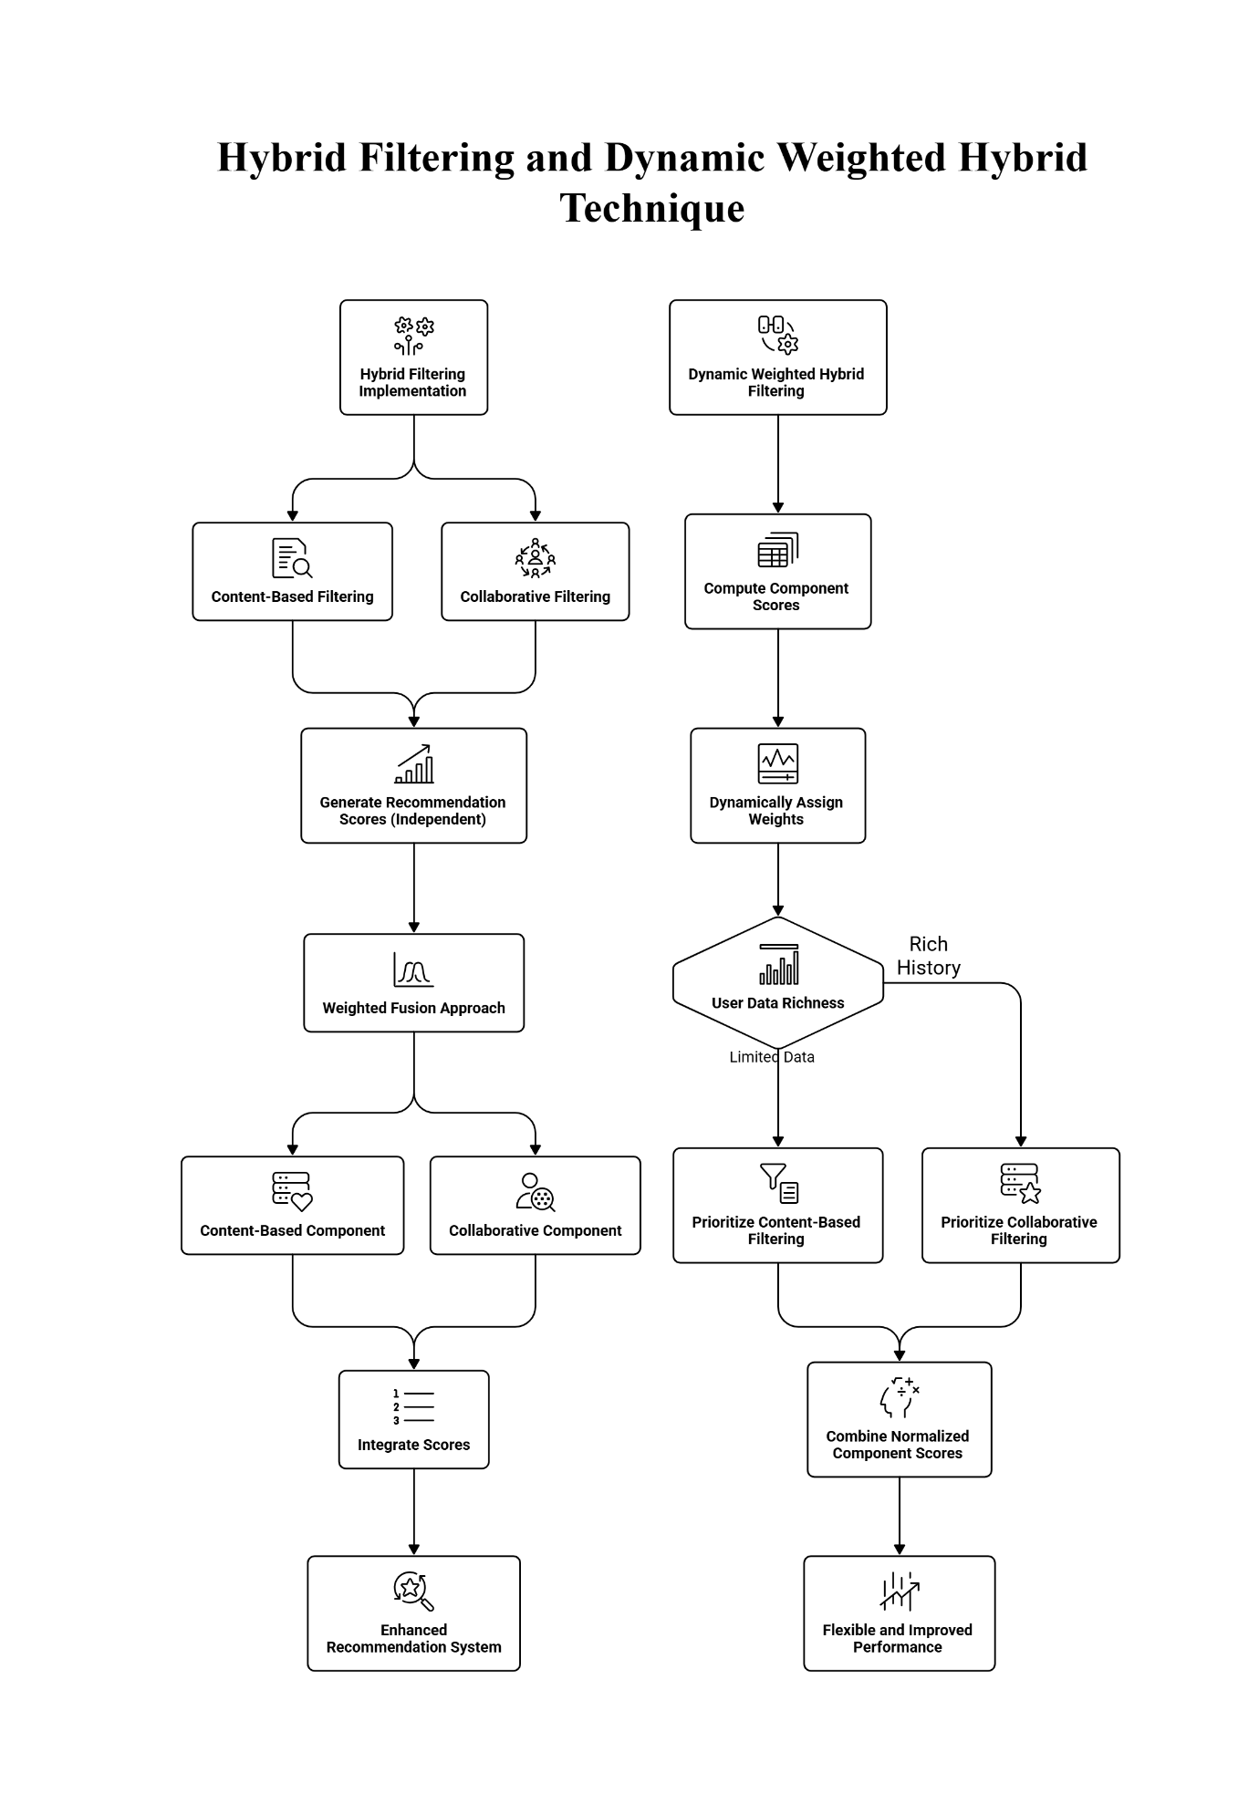
Hybrid & Dynamic Models: A hybrid approach combines content-based and collaborative methods, while a dynamic weighted model adjusts their contribution based on user preferences for better personalization.

Slide 7
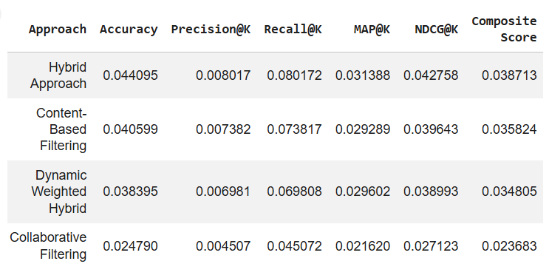
Result
The experimental results show that the hybrid model achieved the best overall performance among all the approaches.
It obtained the highest scores in accuracy, precision, recall, MAP, and NDCG, indicating better recommendation quality and ranking effectiveness.

Slide 8
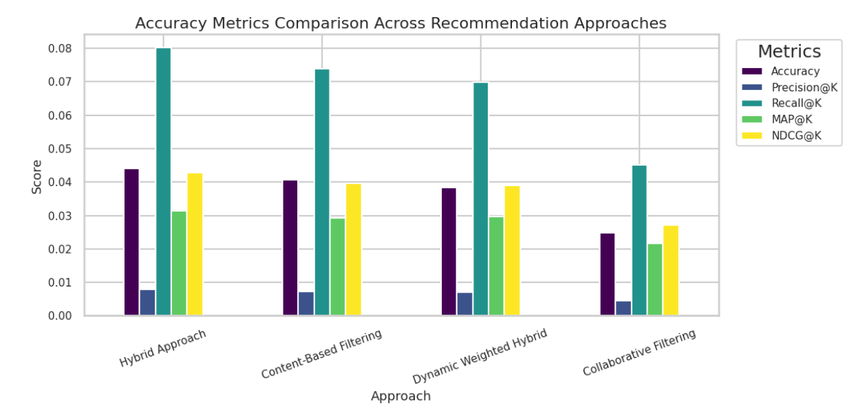
The content-based filtering model performed well in terms of coverage and personalization, but its ranking performance was comparatively lower. The collaborative filtering model showed the lowest performance due to data sparsity in user-item interactions.
The dynamic weighted hybrid model achieved moderate results but did not outperform the standard hybrid approach.
Overall, the results demonstrate that combining multiple techniques improves the accuracy and reliability of recommendations.

Slide 9
Conclusion
The proposed multi-approach recommendation system effectively addresses key challenges in book recommendation such as cold-start problem, data sparsity, and popularity bias.
The hybrid model demonstrated the best overall performance, achieving higher accuracy, precision, recall, MAP, and NDCG compared to individual approaches.
Content-based filtering contributed to strong personalization and diversity, while collaborative filtering helped capture user behavior patterns.
Although the dynamic hybrid model showed adaptability, the standard hybrid approach provided a more stable and balanced performance.
Overall, integrating multiple recommendation techniques results in more accurate, fair, and personalized recommendations, enhancing user experience in real-world e-commerce platforms.

Slide 10
Thank You
10

