Slide 1
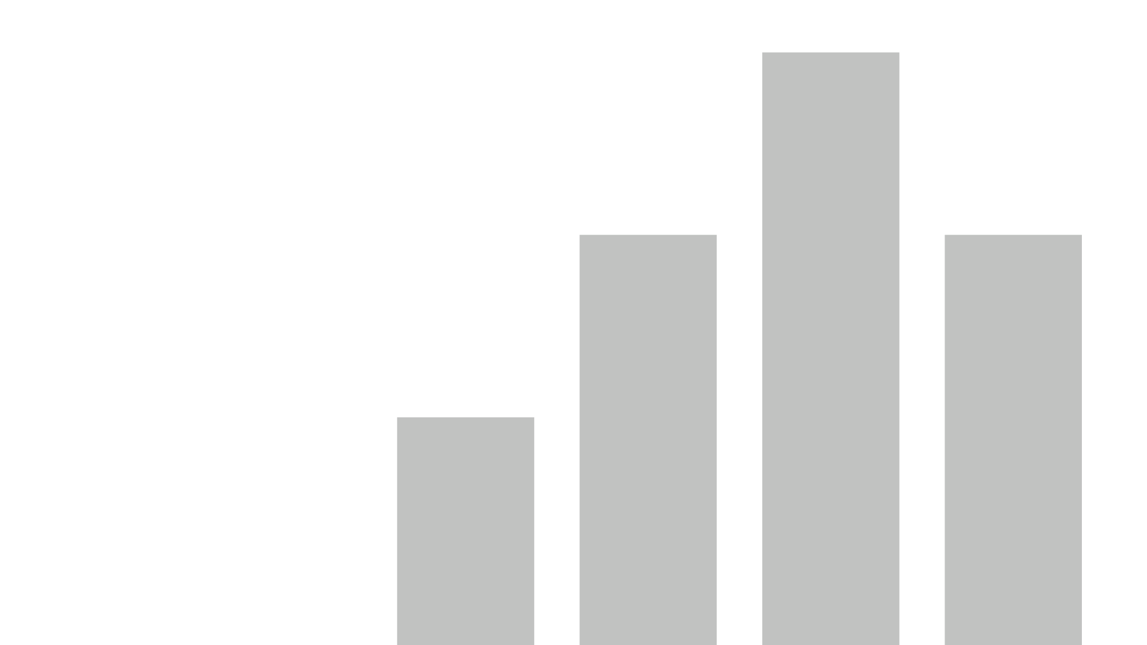


market_analytics
View in Power BI
Last data refresh:
4/26/2025 5:16:23 AM UTC
Downloaded at:
4/26/2025 7:08:13 AM UTC

Slide 2
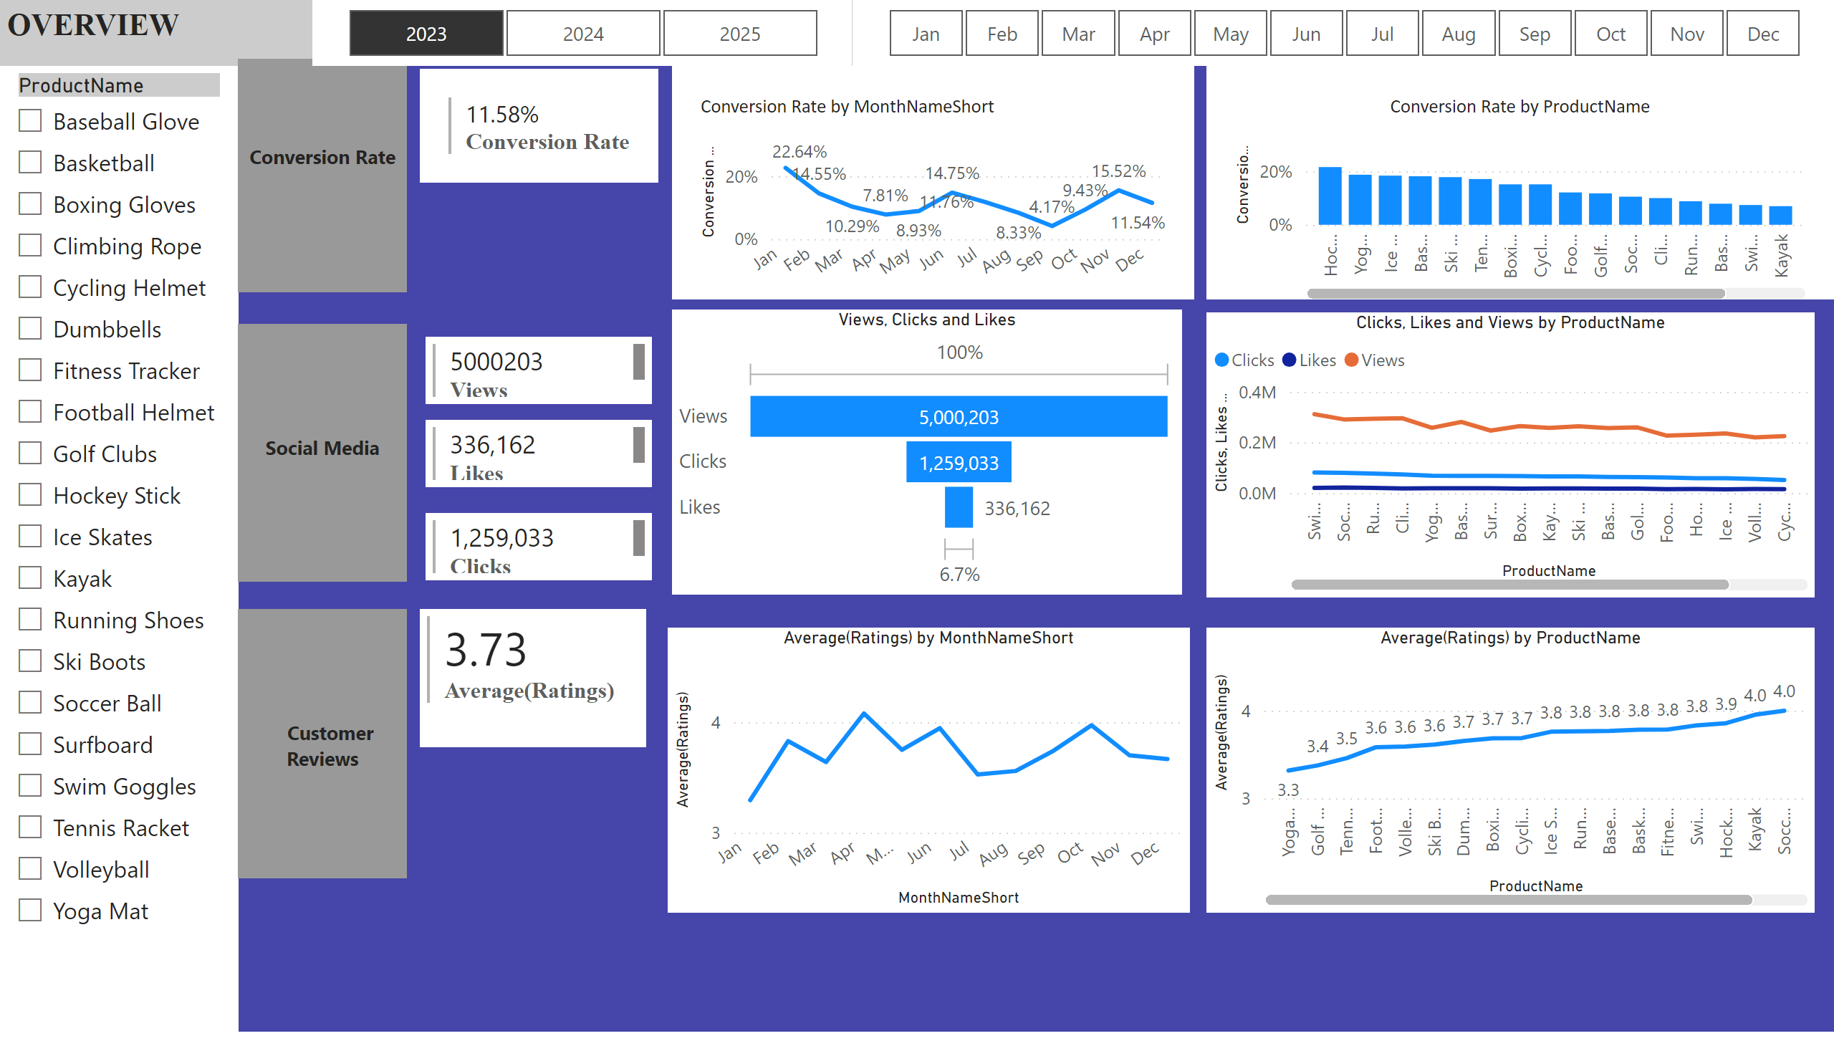
OVerview
Notes:
textbox
No alt text provided
slicer
No alt text provided
textbox
No alt text provided
textbox
No alt text provided
textbox
No alt text provided
multiRowCard
No alt text provided
multiRowCard
No alt text provided
multiRowCard
No alt text provided
multiRowCard
No alt text provided
multiRowCard
No alt text provided
slicer
No alt text provided
slicer
No alt text provided
lineChart
No alt text provided
clusteredColumnChart
No alt text provided
lineChart
No alt text provided
funnel
No alt text provided
lineChart
No alt text provided
lineChart
No alt text provided

Slide 3
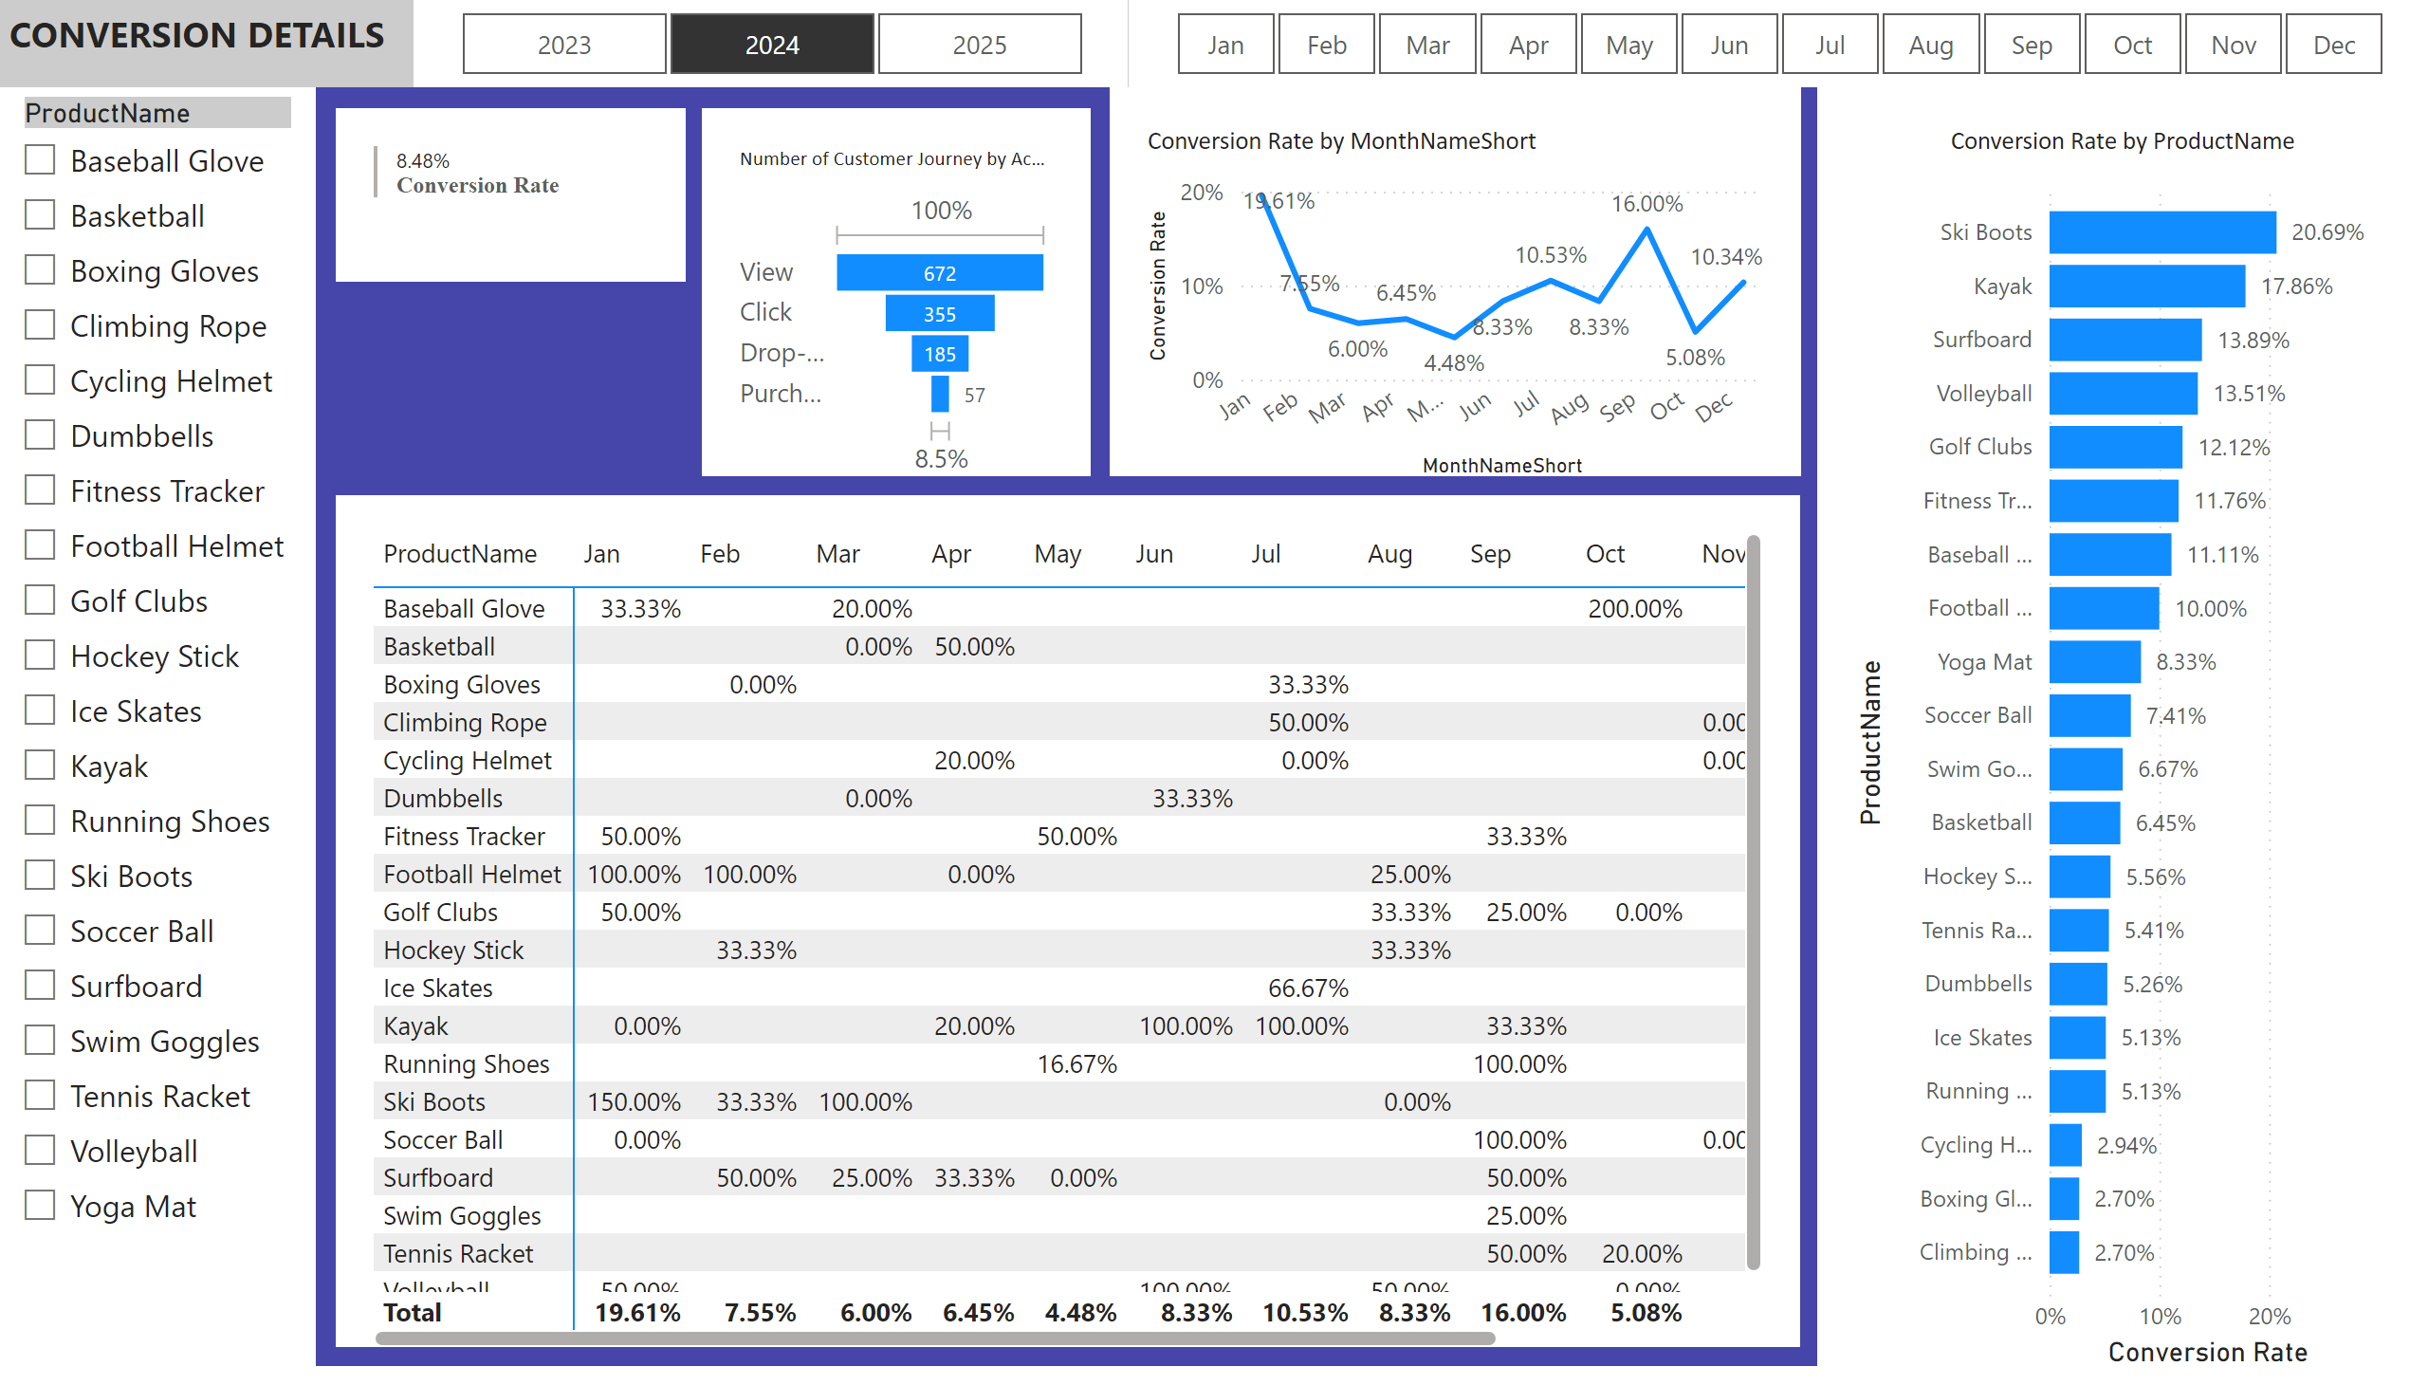
Conversion_details
Notes:
textbox
No alt text provided
slicer
No alt text provided
multiRowCard
No alt text provided
slicer
No alt text provided
slicer
No alt text provided
lineChart
No alt text provided
clusteredBarChart
No alt text provided
pivotTable
No alt text provided
funnel
No alt text provided

Slide 4
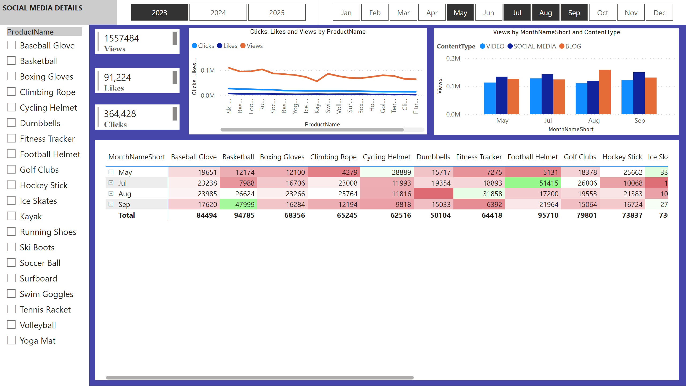
Social media
Notes:
textbox
No alt text provided
slicer
No alt text provided
multiRowCard
No alt text provided
multiRowCard
No alt text provided
multiRowCard
No alt text provided
slicer
No alt text provided
slicer
No alt text provided
lineChart
No alt text provided
clusteredColumnChart
No alt text provided
pivotTable
No alt text provided

Slide 5
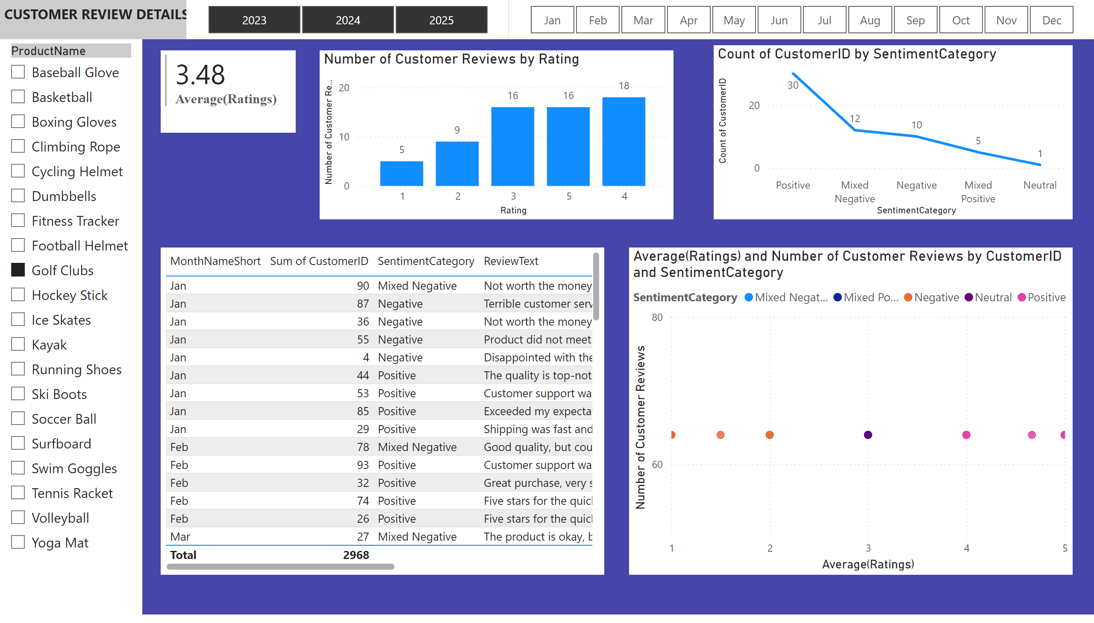
Customer Review
Notes:
textbox
No alt text provided
slicer
No alt text provided
multiRowCard
No alt text provided
slicer
No alt text provided
slicer
No alt text provided
clusteredColumnChart
No alt text provided
lineChart
No alt text provided
tableEx
No alt text provided
scatterChart
No alt text provided

