Slide 2
.NET Framework was language neutral.
.NET Core is platform neutral.

Slide 3
.NET Framework
It is old framework enhanced that we have been using for more than a decade.
It is not open source.
It can target only windows OS.
It has all the components like Console Application, Windows Application, ASP.NET Forms, ASP.NET MVC, ASP.NET Web API, ASP.NET signalR, ASP.NET Web Pages, WPF, WCF etc.

Slide 4
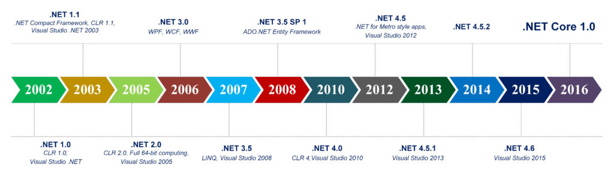
Release History of .NET Framework

Slide 5
ASP.NET Core
It is redesigned of ASP.NET.
It is open source and light-weight.
It can target Windows, LINUX & Mac OS.
A unified way of building web UI and web APIs.
Easy to integrate with client-side frameworks, including Angular, React etc.
It just has two components i.e. ASP.NET Core and Universal Windows App.
There is NO ASP.NET Forms ☹

Slide 6
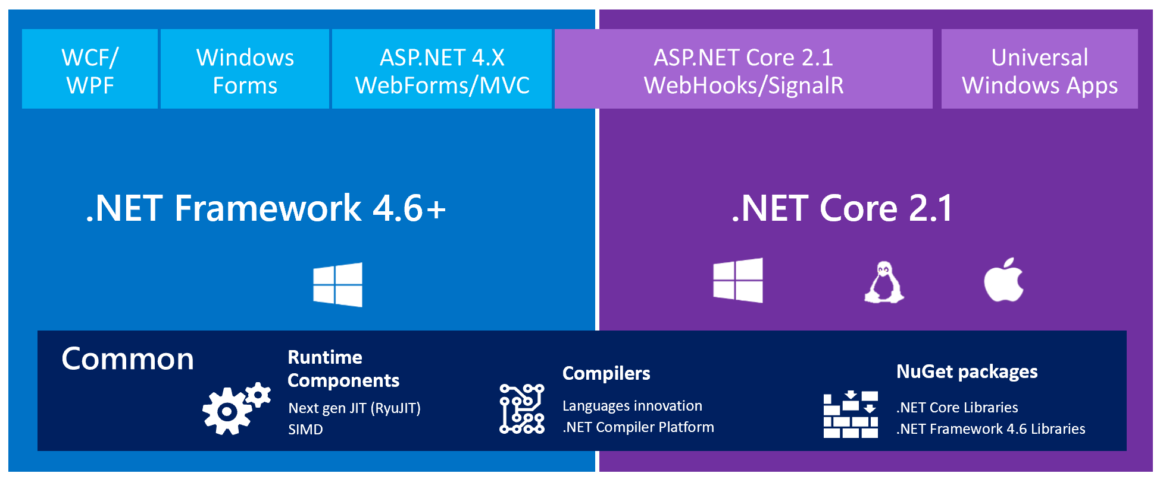
.NET Framework Vs. .NET Core

Slide 7
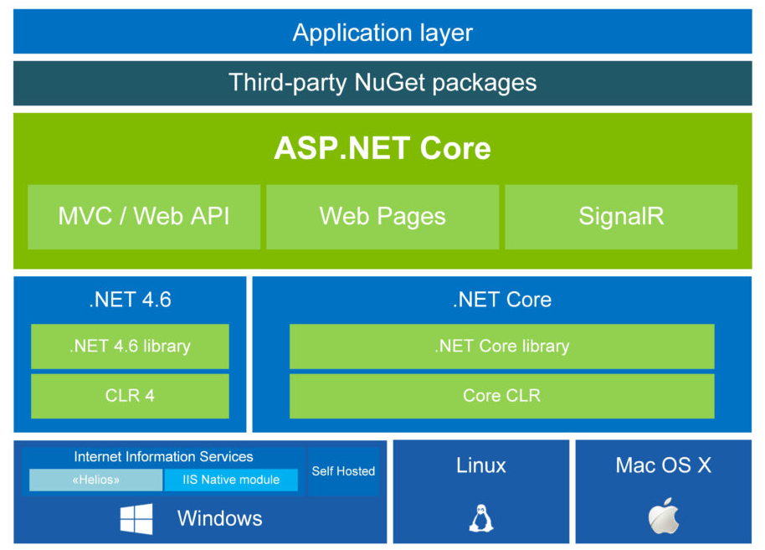
ASP.NET Core Application Model

Slide 8
ASP.NET Core Version History
Version | Release Date
ASP.NET Core 2.1 | May 2018
ASP.NET Core 2.0 | August 2017
ASP.NET Core 1.1 | November 2016
ASP.NET Core 1.0 | June 2016

Slide 9
ASP.NET Core Anatomy
In ASP.NET Core everything starts with Program.cs

Slide 10
Understanding The Main() Method
CreateDefaultBuilder(): Use Kestrel, Set the ContentRootPath etc.
UseStartup<Startup>(): ConfigureServices(), Configure()
Build(): Makes the server running.
Run(): Starts Listing
Note: Kestrel is a cross-platform web server for ASP.NET Core.

Slide 11
Understanding the Startup Class
ConfigureServices() Vs. Configure()
ConfigureServices(): Adding services to IServiceCollection container will make them available for dependency injection.
Configure(): It is middleware i.e. pipeline to handle requests and responses.
Note: Ordering is important in Configure method.

