Slide 1

Presented By: Bhawna Goyal Data Analyst Intern, Unified Mentors
Crop Production Analysis in India

Slide 2
About Agriculture Industry
The agriculture industry, a crucial component of the supply chain, is likely to undergo significant changes in the next years due to advancements in the future internet.
This article introduces a new business-to-business collaboration platform for the agri-food sector.
It enables effective and flexible collaboration among stakeholders across many business domains.

Slide 3
Goal :
Predict crop production and gain valuable insights by identifying critical indicators and metrics.

Slide 4

About Crop Data
There’s number of features & factors on which crop production depends.
Dataset contains :
State
District
Crop Year
Season
Crop
Area
Production
Input Features
Target Feature

Slide 5

Process
Data Gathering
Data Preparation
EDA & Visualization
Feature Selection
Data Splitting
ML Modelling
Evaluation of prediction

Slide 6
Tool used:
Python
Goggle Colab
ML Modelling & EDA technique

Slide 7
INSIGHTS

Slide 8
Where crop Production is more ?
Which crop Production is more ?
Top 5 States
Top 5 Crop
Kerala
Andhra Pradesh
Tamil Nadu
Uttar Pradesh
Assam
Coconut
Sugarcane
Rice
Wheat
Potato

Slide 9
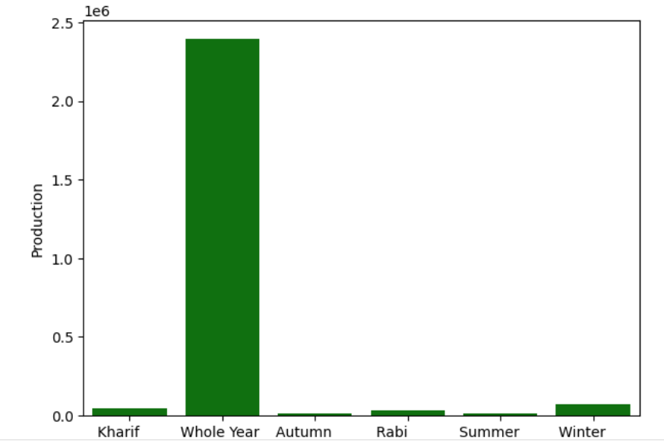
Key Factors on which Crop Production Depend
Seasonality Geographical Location Production Hotspots Historical Production Trends Demand Dynamics Growth Factors Market Trends
In India, whole year there’s crop production but of different crops based on soil fertility & region. Because in India from north to south, east to west there’s huge difference of weather & climate conditions

Slide 10
Predict Crop Production
To predict crop based on given conditions, here’s some ML approaches that we can prefer:
Random Forest Regressor --------- 0.87 R2 Score
Gradient Booster --------- 0.87 R2 Score
Decision Tree --------- 0.84 R2 Score

Slide 11
Project Link :
https://colab.research.google.com/drive/1c2YSeJNfmoFo3tO4L0JRFWzl2rgFwDCc?usp=sharing

Slide 12
Thank you

