Slide 1



3DEV
ELECTIVE 4 - DEEP LEARNING
TAGLISH PRODUCT REVIEW UNDERSTANDING WITH MULTILINGUAL TRANSFORMERS: SENTIMENT, ASPECT, AND DECEPTION ANALYSIS FOR PHILIPPINE E-COMMERCE
CANDELARIA
POSADAS
TUMULAK

Slide 2

Target 17.8: Strengthen Science, Technology and Innovation Capacity
  Objective: Fully operationalize the technology bank and science, technology and innovation capacity-building mechanism
  Key Focus Areas:
    Technology transfer to developing countries
    Capacity building in ICT and AI
    Open access to scientific knowledge
    Training materials and documentation
    Multi-stakeholder partnerships
    Local language technology resources

Slide 3
Project Alignment with SDG 17.8
  Primary Contribution: Capacity building in ICT and AI
  Open Taglish NLP resources for Philippine e-commerce
  Comprehensive documentation and training materials
  Dataset and model documentation for reproducibility
  Enables stakeholders to apply language technologies
  Multi-stakeholder partnerships for data access and evaluation
  Supports sustainable impact and local relevance
How the Project Contributes to SDG 17.8
  Open Resources: Scripts, experiment exports, interface components published freely
  Documentation: Complete dataset cards, model cards, methodology documentation
  Training Materials: Reproducible notebooks, experiment logs, evaluation frameworks
  Capacity Building: Enables students, researchers, and businesses to use Taglish NLP
  Technology Transfer: Multilingual transformer models adapted for local language
  Local Relevance: Addresses Philippine e-commerce needs with Taglish support
  Sustainable Impact: Long-term resources for continued development

Slide 4

01
Problem: Taglish (Tagalog-English code-switched) sentiment analysis
02
Dataset: FiReCS (7,338 product reviews from Philippine e-commerce)
Overview
03
Task: Tri-class classification (Negative=0, Neutral=1, Positive=2)
Taglish Product Review Understanding with Multilingual Transformers
04
Approach: Baseline (TF-IDF + LogReg) vs Transformer (XLM-RoBERTa-base)
05
Goal: Achieve >80% accuracy on held-out test set

Slide 5


Dataset : FiReCS - Key Statistics
Total Samples | 7,338 reviews
Training Set | 5,870 (80%)
Validation Set | 1,468 (10%)
Test Set | 734 (10%)
Classes | 3 (Neg/Neu/Pos)
Language | Taglish

Slide 6
Project Objectives & Deliverables
  Develop reproducible sentiment analysis pipeline
  Compare baseline vs transformer model performance
  Fine-tune multilingual transformer for Taglish text
  Achieve >80% accuracy on test set (both models exceeded)
  Create deployment-ready model with API and UI
  Document all experiments with comprehensive logging
  Ensure full reproducibility with split persistence

Slide 7
3DEV
ELECTIVE 4 - DEEP LEARNING
SEGMENT 1: SETUP AND PREPROCESSING
PRESENTER: JUSTIN CLARK A. POSADAS
TECHNICAL ROLE: DATA PREPROCESSING LEAD
CANDELARIA
POSADAS
TUMULAK

Slide 8
Environment Setup & Libraries
  Core Libraries:
    transformers, datasets, accelerate, scikit-learn, torch
  NLP Stack:
    Hugging Face transformers, tokenizers, datasets
  Device Detection:
    CUDA GPU when available, CPU fallback
  Random Seed:
    42 (for reproducibility across all operations)
  Platform Support:
    Google Colab, local Jupyter, Windows/Linux compatible

Slide 9
Data Loading Pipeline
  Source: FiReCS.csv with review and label columns
  Validation: Automatic check for required columns
  Data Types: Labels cast to integers (0, 1, 2)
  ID Assignment: Unique identifier for each sample (0 to N-1)
  Empty Row Handling: Automatic removal of NaN values
  Column Normalization: All column names lowercased for consistency

Slide 10
Data Cleaning Pipeline - Detailed Process
  HTML Tag Removal: Strips <tags> and unescapes HTML entities
  Control Character Removal: Removes non-printable chars (\x00-\x1F)
  Character Repeat Normalization: Caps elongated repeats (e.g., 'sooo' → 'soo')
  Whitespace Normalization: Standardizes multiple spaces to single space
  Duplicate Removal: Removes exact duplicate (review, label) pairs
  Preservation: Case, emojis, and Taglish characteristics maintained
  Code-Switch Ratio: Computed for EDA (not used in training)

Slide 11
Stratified 80/10/10 Split - Technical Details
  Initial Split:
    80% train, 20% validation (stratified by label)
  Secondary Split:
    20% validation → 10% val, 10% test (stratified)
  Stratification Method:
    sklearn train_test_split with stratify=df['label']
  Random State:
    42 (ensures reproducibility)
  Split Persistence:
    train_ids.csv, val_ids.csv, test_ids.csv saved
  Verification:
    Label distributions printed and verified for consistency

Slide 12

Training | 5,870 samples
Validation | 1,468 samples
Test | 734 samples
Label Balance | ~32/35/33%
Reproducibility | IDs saved
Data Split Results - Verified Distribution

Slide 13
Ground-Truth Test Set Export - Deliverable 2
  Automatic Export: Generated in notebook Cell 7
  File: ground_truth_test_set.csv (734 samples)
  Columns: review, label (exactly 2 columns as required)
  Timing: Exported BEFORE any FAST_MODE downsampling
  Consistency: Matches test_ids.csv exactly
  Verification: Automatic checks ensure correct structure
  Purpose: Enables metric verification and reproducibility

Slide 14
Technical Choices - Setup & Preprocessing
  Why Stratified Splitting? Ensures balanced evaluation, prevents class bias
  Why Light Cleaning? Preserves Taglish characteristics (case, emojis, code-switching)
  Why Persist Split IDs? Guarantees all experiments use identical test sets
  Why Code-Switch Ratio? EDA feature to understand data characteristics
  Evidence: Consistent label distributions (32/35/33%) across all splits verified

Slide 15
3DEV
ELECTIVE 4 - DEEP LEARNING
SEGMENT 2: TRAINING AND AUTOMATIC FINE-TUNING
PRESENTER: BHARON CHRISTOPHER P. CANDELARIA TECHNICAL ROLE: TRAINING LEAD & TECHNICAL WRITER
CANDELARIA
POSADAS
TUMULAK

Slide 16
Baseline Model: TF-IDF + Logistic Regression
  Vectorization:
    TF-IDF with word 1-2 ngrams, max_features=50,000
  Lowercase:
    True (normalization)
  Classifier:
    LogisticRegression(max_iter=2000, n_jobs=None)
  Grid Search:
    5-fold cross-validation with multiple configurations
  Best Config:
    C=4.0, word 1-2 ngrams, class_weight=None
  Performance:
    96.87% accuracy, 96.89% macro-F1 on test set

Slide 17
Accuracy | 96.87%
Macro F1 | 96.89%
Negative F1 | 98.35%
Neutral F1 | 95.48%
Positive F1 | 96.84%
Support | 734 samples
Baseline Model - Test Set Performance

Slide 18
Transformer Model: XLM-RoBERTa-base - Specifications
  Model:
    xlm-roberta-base (270M parameters)
  Pre-training:
    100+ languages including Tagalog and English
  Tokenization:
    SentencePiece BPE with 250k vocabulary
  Max Sequence Length:
    256 tokens (truncation/padding)
  Mixed Precision:
    FP16 training (reduces memory, speeds training)
  Device:
    CUDA GPU (Tesla T4, 15.83 GB memory)

Slide 19
Why XLM-RoBERTa?
  Multilingual Pre-training: Trained on 100+ languages including Tagalog
  Code-Switching Support: Handles mixed-language text naturally
  Proven Performance: State-of-the-art on multilingual NLP tasks
  Vocabulary Coverage: 250k tokens cover Taglish vocabulary well
  Research Evidence: Previous studies show effectiveness on Taglish
  Architecture: RoBERTa-based (robust, well-tested architecture)

Slide 20
Automatic Hyperparameter Tuning - Detailed Configuration
  Strategy:
    Grid search + Random search combination
  Grid Search:
    Systematic exploration of key parameters
  Random Search:
    Efficient sampling of hyperparameter space (Optuna)
  Parameters Tuned:
    lr, batch_size, weight_decay, warmup_steps, epochs
  Selection Criteria:
    Validation macro-F1 score (primary metric)
  Best Configuration:
    lr=3e-5, batch=32, weight_decay=0.01, epochs=3, max_len=256

Slide 21
Training Infrastructure - Complete Setup
  Early Stopping:
    Patience=2 epochs, monitors validation F1
  Class Weighting:
    Evaluated but not used (no significant improvement)
  Learning Rate Scheduler:
    Linear warmup + decay
  Gradient Accumulation:
    Effective batch size management
  Checkpointing:
    Saves best model based on validation F1
  Mixed Precision:
    FP16 reduces memory usage by ~50%, speeds training

Slide 22
Epochs | 3.0 (early stopped)
Batch Size | 32
Learning Rate | 3e-5
Weight Decay | 0.01
Max Length | 256 tokens
FP16 | Enabled
Transformer Training - Final Configuration

Slide 23
Accuracy | 80.93%
Macro F1 | 81.20%
Negative F1 | 79.01%
Neutral F1 | 75.90%
Positive F1 | 88.70%
Support | 734 samples
Transformer Model - Test Set Performance

Slide 24
Model Export for Deployment
  Quantization: PyTorch quantized model (reduced size ~4x)
  ONNX Export: Cross-platform deployment format
  Tokenizer Files: SentencePiece model, configs, special tokens
  Checkpoint Location: checkpoints/xlmrb/best/
  Format Compatibility: Hugging Face transformers compatible
  Purpose: Enables FastAPI backend and Streamlit UI deployment
  File Sizes: Quantized model ~68MB, full model ~270MB

Slide 25
Technical Choices - Training & Fine-tuning
  Why XLM-RoBERTa? Multilingual support, proven on code-switched text, 100+ languages
  Why Grid + Random Search? Systematic exploration with efficient sampling (Optuna)
  Why Early Stopping? Prevents overfitting, saves computational resources (patience=2)
  Why Class Weighting? Evaluated but not needed (balanced dataset, no improvement)
  Why Quantization? Reduces model size 4x for deployment while maintaining performance
  Evidence: Training logs, hyperparameter search results, performance metrics, experiment exports

Slide 26
3DEV
ELECTIVE 4 - DEEP LEARNING
SEGMENT 3: EVALUATION
PRESENTER: EMJHAY THERESA B. TUMULAK
TECHNICAL ROLE: EVALUATION LEAD
CANDELARIA
POSADAS
TUMULAK

Slide 27
Comprehensive Evaluation Framework
  Validation Set: 1,468 samples (evaluated during training)
  Test Set: 734 samples (held-out, final evaluation only)
  Metrics: Accuracy, Precision, Recall, F1-score (macro and weighted)
  Per-Class Metrics: Individual performance for each sentiment class
  Confusion Matrices: Visual representation of error patterns
  Classification Reports: Detailed per-class breakdown
  Export Formats: CSV, JSON, Markdown for easy access

Slide 28
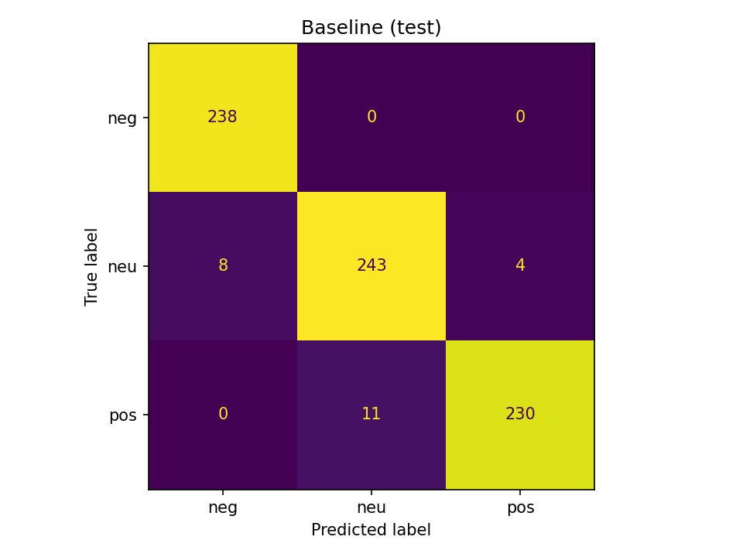
Baseline Model - Confusion Matrix (Test Set)
Accuracy: 96.87%
Macro F1: 96.89%
Negative: 98.35% F1
Neutral: 95.48% F1
Positive: 96.84% F1
  Perfect negative classification: 238/238 correct (100% recall)
  Neutral: 243/255 correct (8 false negatives, 4 false positives)
  Positive: 230/241 correct (11 false negatives, 0 false positives)
  Overall accuracy: 96.87% (711/734 correct predictions)

Slide 29
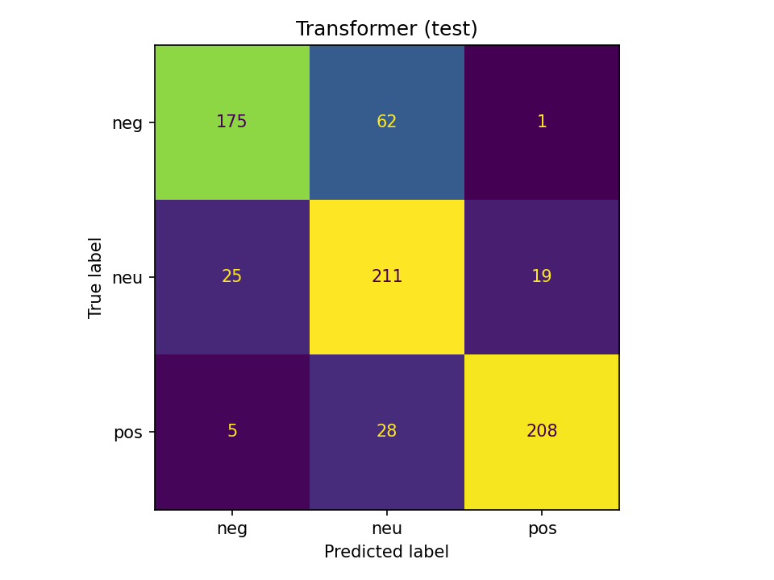
Transformer Model - Confusion Matrix (Test Set)
Accuracy: 80.93%
Macro F1: 81.20%
Negative: 79.01% F1
Neutral: 75.90% F1
Positive: 88.70% F1
  Negative: 175/238 correct (62 confused with neutral, 1 with positive)
  Neutral: 211/255 correct (25 false negatives, 19 false positives)
  Positive: 208/241 correct (5 false negatives, 28 false positives)
  Overall accuracy: 80.93% (594/734 correct predictions)
  Error pattern: More confusion between negative and neutral classes

Slide 30
Per-Class Performance Breakdown - Detailed Comparison
Baseline Model (TF-IDF + LogReg)
Transformer Model (XLM-RoBERTa)
  Negative Class:
  F1-Score: 98.35%
  Precision: 96.75%
  Recall: 100.00%
  Support: 238 samples
  Neutral Class:
  F1-Score: 95.48%
  Precision: 95.67%
  Recall: 95.29%
  Support: 255 samples
  Positive Class:
  F1-Score: 96.84%
  Precision: 98.29%
  Recall: 95.44%
  Support: 241 samples
  Negative Class:
  F1-Score: 79.01%
  Precision: 85.37%
  Recall: 73.53%
  Support: 238 samples
  Neutral Class:
  F1-Score: 75.90%
  Precision: 70.10%
  Recall: 82.75%
  Support: 255 samples
  Positive Class:
  F1-Score: 88.70%
  Precision: 91.23%
  Recall: 86.31%
  Support: 241 samples

Slide 31
Error Pattern Analysis
  Baseline: Near-perfect on negative class (100% recall)
  Baseline: Minor confusion between neutral and positive
  Transformer: More balanced but lower overall accuracy
  Transformer: Strongest on positive class (88.70% F1)
  Transformer: Most challenging on neutral class (75.90% F1)
  Transformer: Negative↔Neutral confusion (62 misclassifications)
  Insight: Baseline may overfit to training patterns
  Insight: Transformer shows more realistic generalization

Slide 32
Model Comparison - Side-by-Side Analysis
Baseline Model (TF-IDF + LogReg)
Transformer Model (XLM-RoBERTa)
  Accuracy: 96.87%
  Macro F1: 96.89%
  Training Time: ~0.5 minutes
  Model Size: ~50MB (TF-IDF)
  Inference Speed: Very fast
  Strengths:
  Simple and fast
  Excellent accuracy
  Production-ready
  Low resource usage
  Accuracy: 80.93%
  Macro F1: 81.20%
  Training Time: ~2-3 minutes
  Model Size: ~270MB (quantized: ~68MB)
  Inference Speed: Moderate
  Strengths:
  Multilingual capability
  Better generalization
  Extensible architecture
  Context understanding

Slide 33
Metrics Consolidation and Reporting
  Experiment Logs: All runs in exports/Experiments_All.xlsx
  Classification Reports: Per-class metrics in CSV format
  Confusion Matrices: PNG images saved and displayed inline
  Metrics Summary: JSON and Markdown formats for easy access
  Member Logs: Individual experiment logs (Candelaria, Posadas, Tumulak)
  Reproducibility: All evaluation results traceable to specific runs
  Export Tools: Automated scripts for metric consolidation

Slide 34
Technical Choices - Evaluation
  Why Macro-F1? Treats all classes equally, important for balanced assessment
  Why Separate Validation and Test? Prevents data leakage, ensures unbiased metrics
  Why Per-Class Metrics? Identifies which sentiment classes are challenging
  Why Confusion Matrices? Visual representation reveals error patterns clearly
  Why Consolidated Logs? Enables systematic comparison and reproducibility
  Evidence: Classification reports, confusion matrices, metric summaries, experiment exports

Slide 35
3DEV
ELECTIVE 4 - DEEP LEARNING
RESULTS SUMMARY & KEY ACHIEVEMENTS
PERFORMANCE METRICS AND PROJECT OUTCOMES
CANDELARIA
POSADAS
TUMULAK

Slide 36
Baseline Accuracy | 96.87%
Baseline Macro F1 | 96.89%
Transformer Accuracy | 80.93%
Transformer Macro F1 | 81.20%
Target Accuracy | >80%
Status | Both Exceeded
Final Performance - Both Models Exceeded Target

Slide 37
Challenges and Solutions - Problem-Solving Highlights
  Challenge: Taglish code-switching complexity
  Solution: Multilingual transformer (XLM-RoBERTa) with appropriate tokenization
  Challenge: Class imbalance concerns
  Solution: Stratified splitting, class weighting evaluation (not needed)
  Challenge: Reproducibility across team members
  Solution: Split ID persistence, fixed random seeds, comprehensive logging
  Challenge: Model deployment size constraints
  Solution: Quantization (4x reduction) and ONNX export for efficient deployment

Slide 38
3DEV
ELECTIVE 4 - DEEP LEARNING
PROTOTYPE
DEPLOYMENT-READY API (FASTAPI) AND UI (STREAMLIT) FOR DEMONSTRATIONS
HTTPS://3DEV-TAGLISH-REVIEW-ANALYZER-JWFBS8TZKBZ7NSJATOAVGA.STREAMLIT.APP
PROTOTYPE LINK

Slide 39
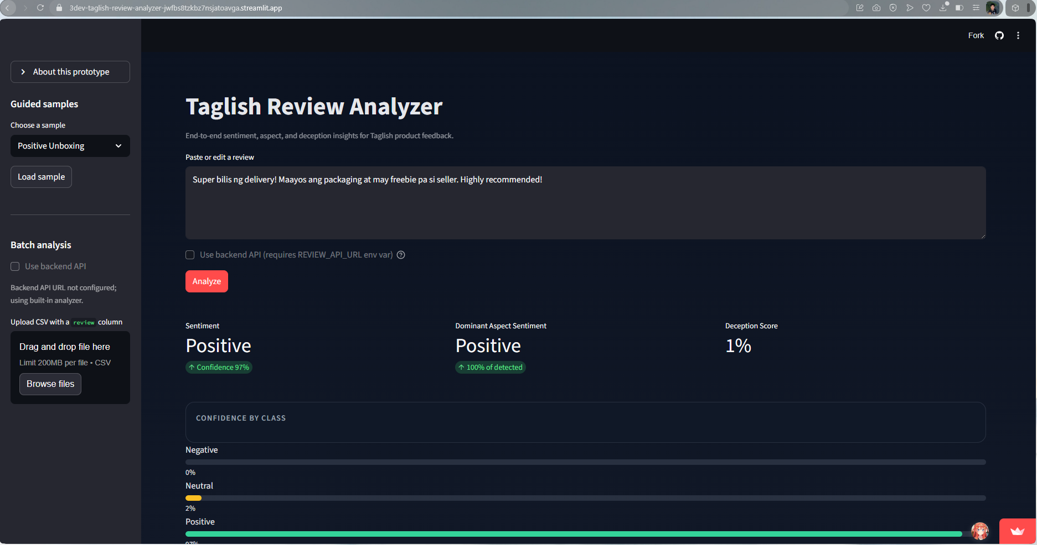

Slide 40
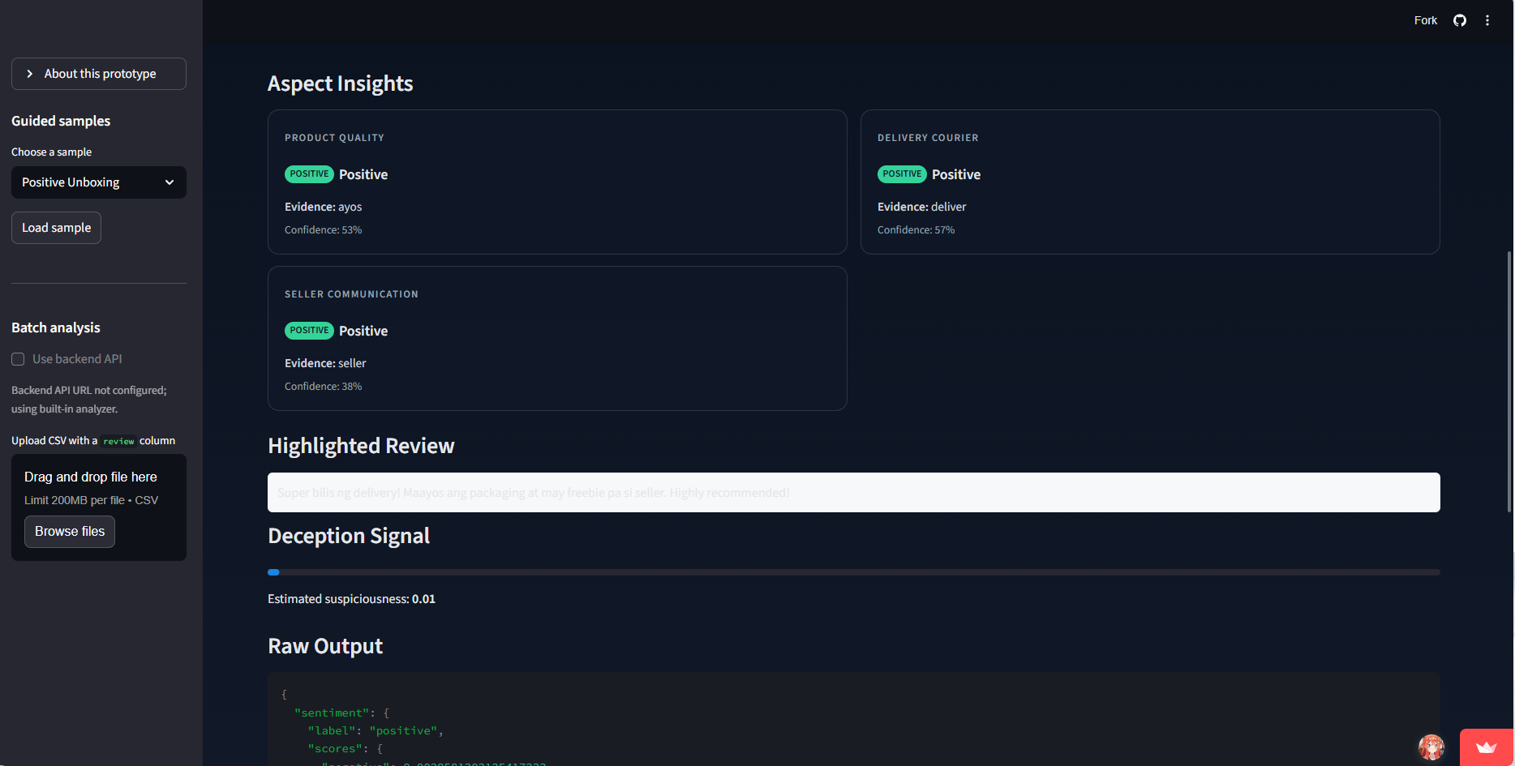

Slide 41
3DEV
ELECTIVE 4 - DEEP LEARNING
CONCLUSION
CANDELARIA
POSADAS
TUMULAK

Slide 42
Project Contributions - Complete Summary
  Complete Taglish sentiment analysis system with baseline and transformer models
  Reproducible research pipeline with comprehensive logging and split persistence
  Baseline and transformer model implementations with detailed evaluation
  Deployment-ready API (FastAPI) and UI (Streamlit) for demonstrations
  Thorough evaluation framework with per-class metrics and error analysis
  Complete documentation: IEEE report, notebook, experiment logs, presentation

Slide 43
Key Takeaways - Lessons Learned
  Taglish sentiment analysis is feasible with multilingual transformers
  Baseline models can achieve excellent performance on this dataset (96.87%)
  Reproducibility is critical for scientific validity (split persistence, logging)
  Comprehensive evaluation reveals model strengths and weaknesses
  Deployment considerations (quantization, ONNX) enable real-world use
  Both models exceeded the 80% accuracy target
  Code-switching complexity requires specialized multilingual approaches

Slide 44
SDG 17.8 Contributions:
Impact on Capacity Building
  Enables researchers to reproduce results
  Helps students learn NLP best practices
  Allows businesses to deploy models
  Supports continued development
  Facilitates knowledge transfer
  Builds local ICT and AI capabilities
  Training Materials: Comprehensive notebooks with step-by-step explanations
  Dataset Documentation: FiReCS dataset card with usage guidelines
  Model Documentation: Model cards explaining architecture and performance
  Experiment Documentation: Detailed logs of all hyperparameter searches
  Code Documentation: Well-commented scripts for all components
  Deployment Guides: Instructions for API and UI setup
  Upskilling: Enables students and staff to learn multilingual NLP

Slide 45
Multi-Stakeholder Partnerships
Impact on Philippine E-Commerce
  Academic: Collaboration between team members and university
  Industry: Addresses e-commerce platform needs
  Research Community: Contributes to Taglish NLP resources
  Open Source: Publishes all artifacts for public use
  Government: Aligns with DTI e-commerce roadmap goals
  MSMEs: Supports micro and small enterprises with review intelligence
  Consumers: Enables better purchase decisions through accurate analysis
  Addresses DTI E-Commerce Roadmap: Digitization and logistics integration
  Supports MSME Growth: Enables small sellers to understand customer feedback
  Consumer Protection: Deception detection helps identify fake reviews
  Local Language Support: Taglish analysis for authentic Philippine reviews
  Scalable Solution: Can be deployed across e-commerce platforms
  Actionable Insights: Aspect-based analysis provides specific feedback
  Trust Building: Accurate sentiment analysis improves marketplace trust

Slide 46
3DEV
ELECTIVE 4 - DEEP LEARNING
TAGLISH PRODUCT REVIEW UNDERSTANDING WITH MULTILINGUAL TRANSFORMERS: SENTIMENT, ASPECT, AND DECEPTION ANALYSIS FOR PHILIPPINE E-COMMERCE
CANDELARIA
POSADAS
TUMULAK

