Slide 1

OFFLINE MOBILE
ADVISORY SYSTEM
FOR FARMERS
Delivering timely agricultural advisories — even without internet
10K+
2
100%
Farmers Targeted
User Roles
Offline Ready
Advanced Application Development 4 • Milestone 1: Project Proposal
Mangosuthu University of Technology • 2026

Slide 2




THE PROBLEM
No Weather Access
Pest Outbreak Delays
Farmers cannot access forecasts to plan planting, irrigation, or harvests effectively.
News of pest and disease outbreaks reaches farmers too late, causing significant crop losses.
Connectivity Gaps
Information Deficit
Rural farming areas have unreliable or no internet, making online-only platforms useless.
Expert advisory content doesn't reach smallholder farmers who need it most.
Impact: Reduced yields, food insecurity, and economic hardship for rural communities across South Africa.

Slide 3





OUR SOLUTION
Offline Mobile Advisory System
A full-stack mobile and web application that delivers agricultural advisories, weather alerts, and pest outbreak notifications directly to farmers — with full offline capability using local SQLite storage.
Offline-First
Real-Time Alerts
Crop Advisories
SQLite syncs when connectivity returns
Push + SMS for critical events
Expert guides, tips & best practices
Secure & Compliant
Role-Based Access
Smart Dashboard
JWT, bcrypt, POPIA compliant
Farmers, Officers, Administrators
AI-powered insights & recommendations

Slide 4
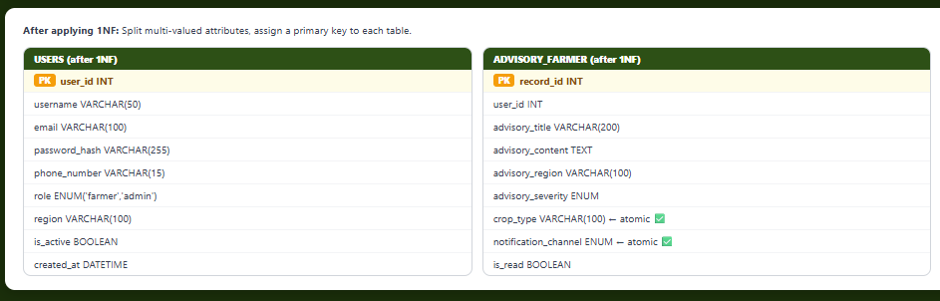
First Normal Form (1NF)
Rule: Each column must contain atomic (indivisible) values. No repeating groups. Each row must be unique (primary key exists).
Problem — Unnormalized table (UNF): We started with one flat table storing all data about a farmer's advisory interaction.
Real-Tie Alerts
Push + SMS for critical events
Role-Based Access
Farmers, Officers, Administrators

Slide 5
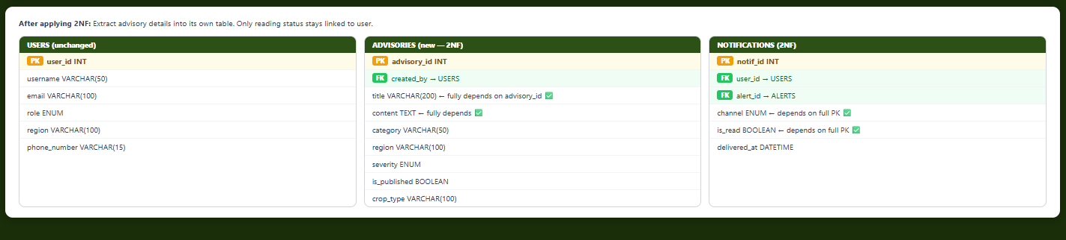
Second Normal Form (2NF)
Rule: Must be in 1NF AND every non-key attribute must be fully functionally dependent on the entire primary key (no partial dependencies). Only applies to composite PKs.
Problem from 1NF: The ADVISORY_FARMER table has a composite key (user_id + record_id). Advisory details (title, content, region) depend only on the advisory — not on which user is reading it. This is a partial dependency.

Slide 6
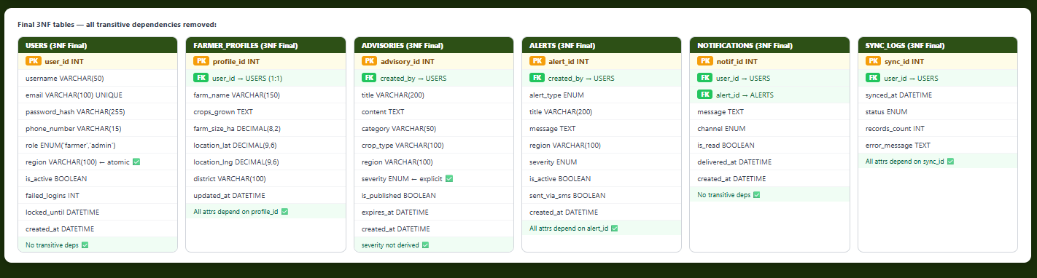
Third Normal Form (3NF)
Rule: Must be in 2NF AND there must be no transitive dependencies — non-key attributes must not depend on other non-key attributes. Problem from 2NF: In USERS, the column region stores a district name AND a province. If region = "Zululand" always maps to province = "KwaZulu-Natal", that is a transitive dependency. Similarly, advisory category used to imply a fixed severity_default.

Slide 7
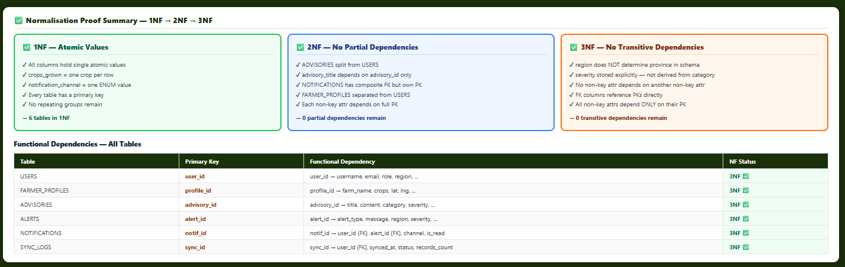
Normalisation Proof Summary — 1NF → 2NF → 3NF

Slide 8
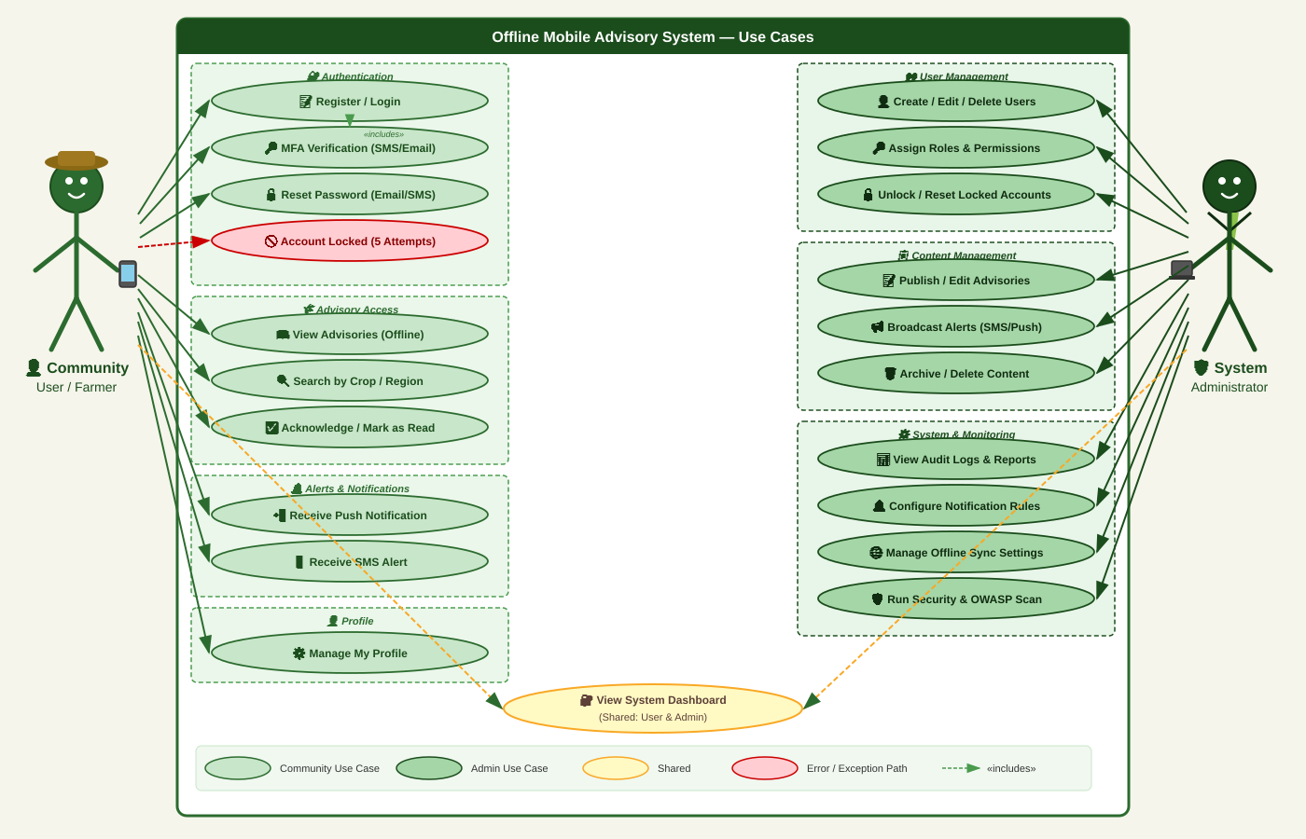
USE CASE DIAGRAM

Slide 9
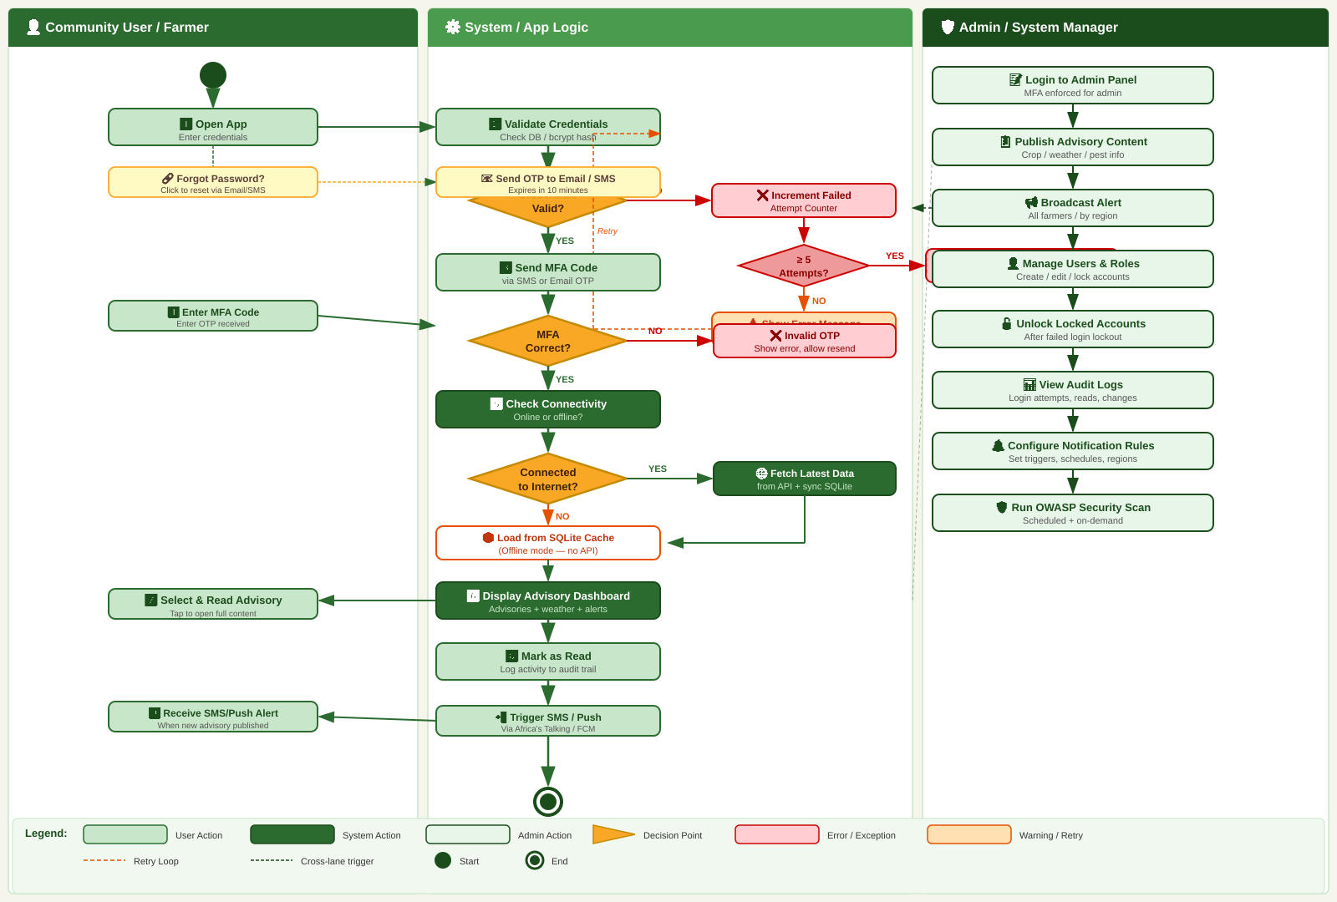
ACTIVITY DIAGRAM — Viewing an Advisory

Slide 10
SYSTEM ARCHITECTURE
EXTERNAL SERVICES
FRONTEND LAYER
Weather API
• React (TypeScript) • Tailwind CSS
OpenWeather / AccuWeather
• SQLite (Offline Store) • Service Worker (PWA)
BACKEND LAYER
SMS Gateway
• Node.js + Express.js • TypeScript
Africa's Talking / Twilio
• JWT Authentication • REST API Endpoints
DATABASE LAYER
Cloud Hosting
• SQLite (Local / Dev) • Syncs to Cloud DB
Render / Railway
• Encrypted at rest • Audit Logging
CI/CD
GitHub Actions

Slide 11



SECURITY ARCHITECTURE
Authentication
Data Protection
✓ JWT access + refresh tokens
✓ AES-256 encryption at rest
✓ bcrypt hashing (cost factor 12)
✓ TLS 1.3 for all API calls (HTTPS)
✓ Account lockout after 5 failed attempts
✓ SQLite file encryption on device
SQL Injection Prevention
OWASP Top 10 Compliance
✓ Parameterised queries only
✓ XSS prevention (CSP headers)
✓ ORM abstraction layer
✓ CSRF tokens on state-changing calls
✓ Input validation on all endpoints
✓ Helmet.js security headers
POPIA Compliant • User data encrypted • Consent-based data collection • Data minimisation principles applied

Slide 12
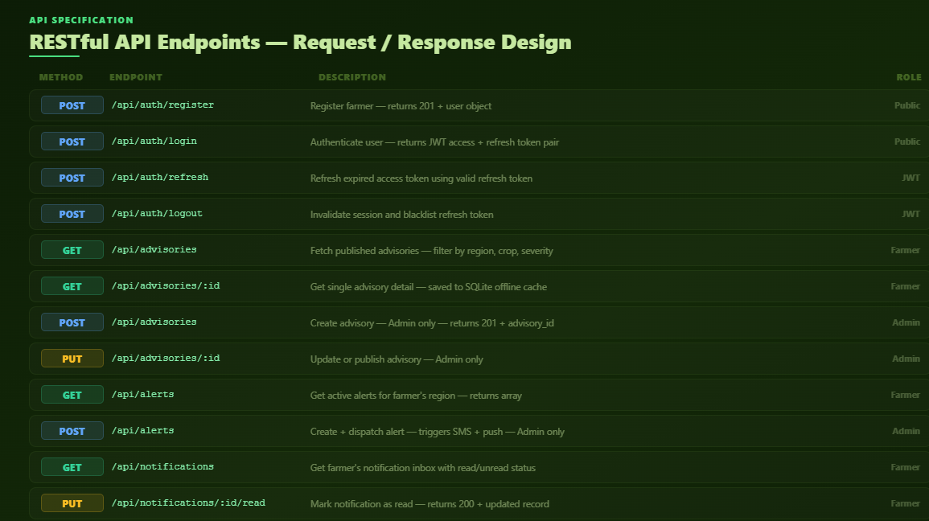
SECURITY ARCHITECTURE
Authentication
Data Protection
✓ JWT access + refresh tokens
✓ AES-256 encryption at rest
✓ bcrypt hashing (cost factor 12)
✓ TLS 1.3 for all API calls (HTTPS)
✓ Account lockout after 5 failed attempts
✓ SQLite file encryption on device
SQL Injection Prevention
OWASP Top 10 Compliance
✓ Parameterised queries only
✓ XSS prevention (CSP headers)
✓ ORM abstraction layer
✓ CSRF tokens on state-changing calls
✓ Input validation on all endpoints
✓ Helmet.js security headers
POPIA Compliant • User data encrypted • Consent-based data collection • Data minimisation principles applied

Slide 13
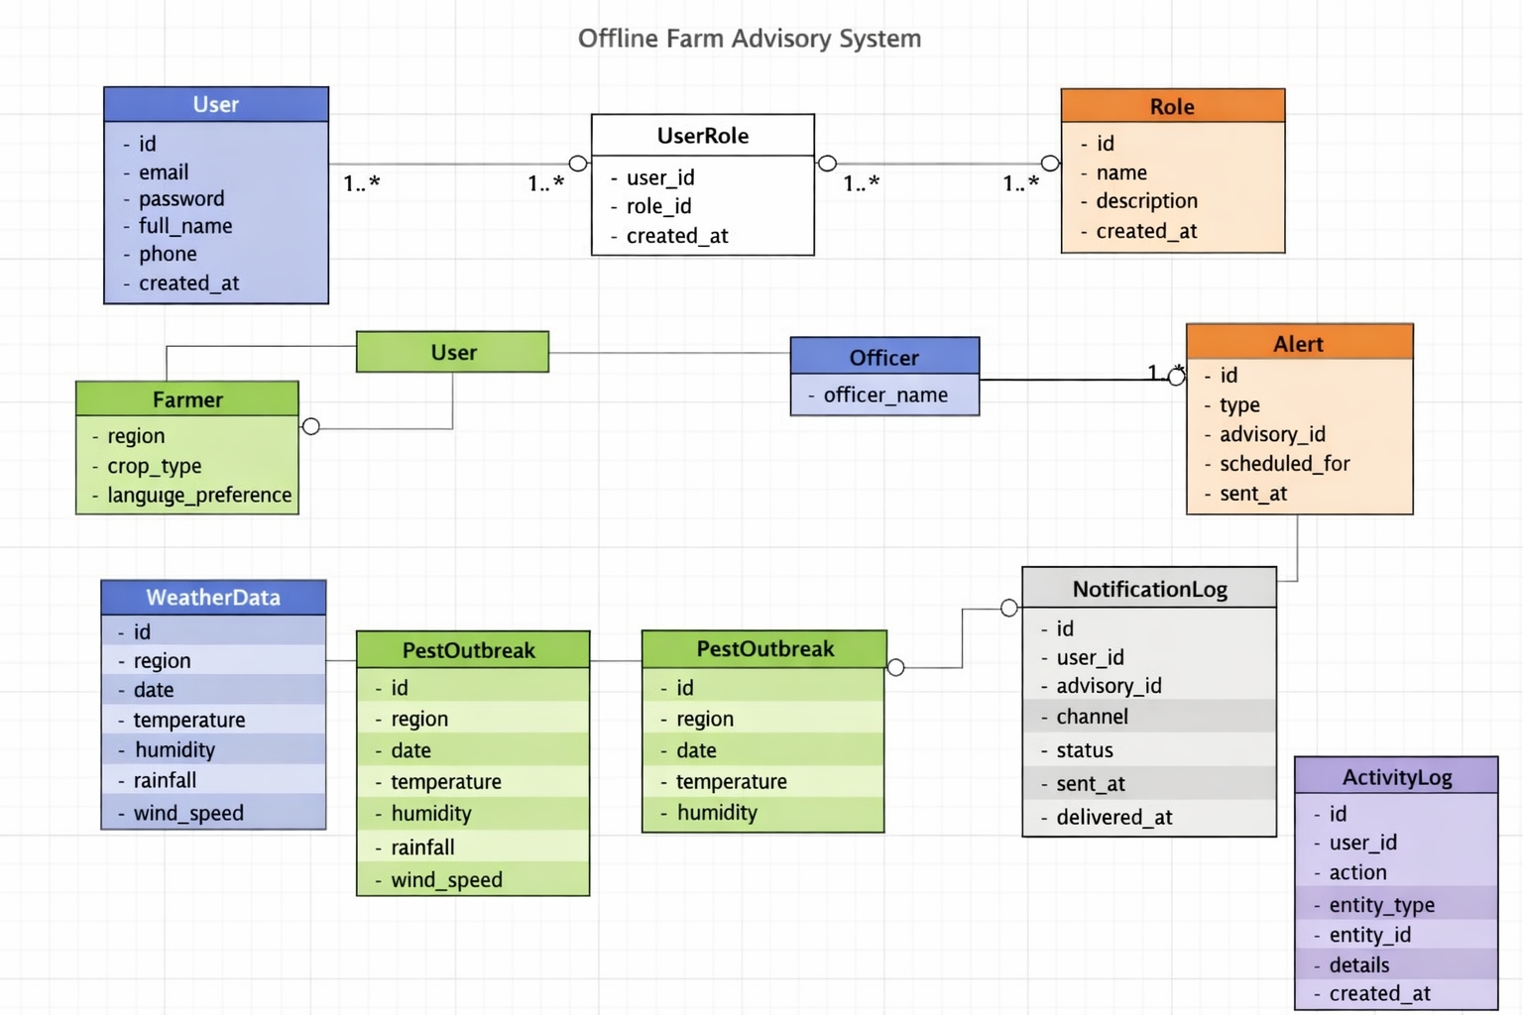
Domain Class Diagram
Authentication
Data Protection
✓ AES-256 encryption at rest
✓ TLS 1.3 for all API calls (HTTPS)
✓ SQLite file encryption on device
SQL Injection Prevention
OWASP Top 10 Compliance
✓ XSS prevention (CSP headers)
✓ CSRF tokens on state-changing calls
✓ Helmet.js security headers
POPIA Compliant • User data encrypted • Consent-based data collection • Data minimisation principles applied

Slide 14
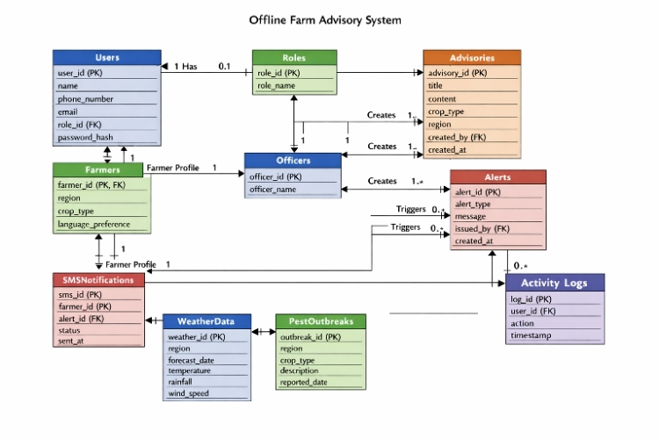
ERD
Authentication
Data Protection
✓ AES-256 encryption at rest
✓ TLS 1.3 for all API calls (HTTPS)
✓ SQLite file encryption on device
SQL Injection Prevention
OWASP Top 10 Compliance
✓ XSS prevention (CSP headers)
✓ CSRF tokens on state-changing calls
✓ Helmet.js security headers
POPIA Compliant • User data encrypted • Consent-based data collection • Data minimisation principles applied

Slide 15
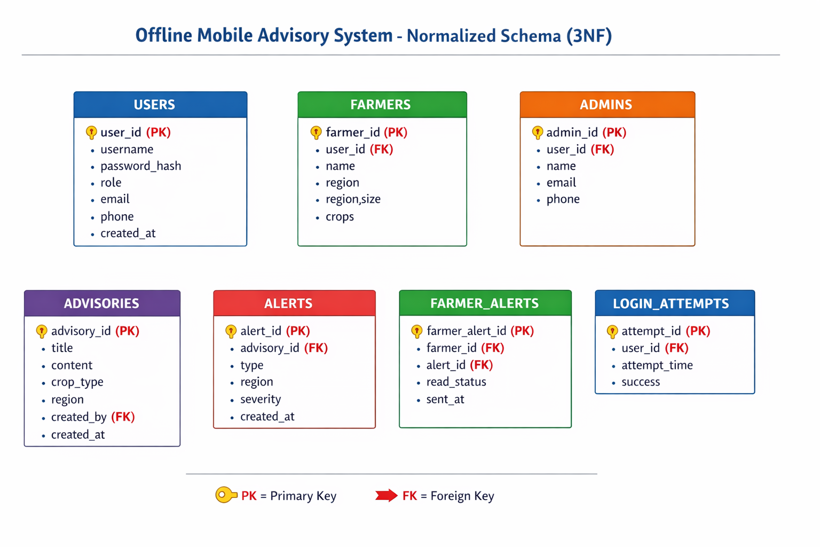
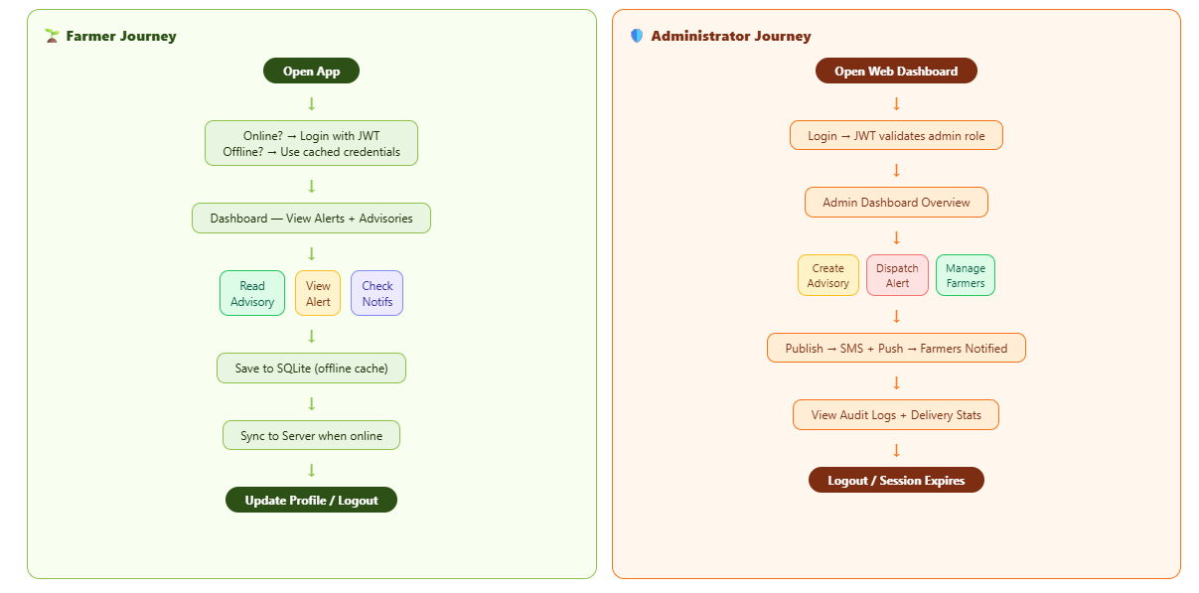
User Flow Diagrams — Farmer & Administrator Journeys - UI/UX Design
Authentication
Data Protection
✓ AES-256 encryption at rest
✓ TLS 1.3 for all API calls (HTTPS)
✓ SQLite file encryption on device
SQL Injection Prevention
OWASP Top 10 Compliance
✓ XSS prevention (CSP headers)
✓ CSRF tokens on state-changing calls
✓ Helmet.js security headers
POPIA Compliant • User data encrypted • Consent-based data collection • Data minimisation principles applied

Slide 16
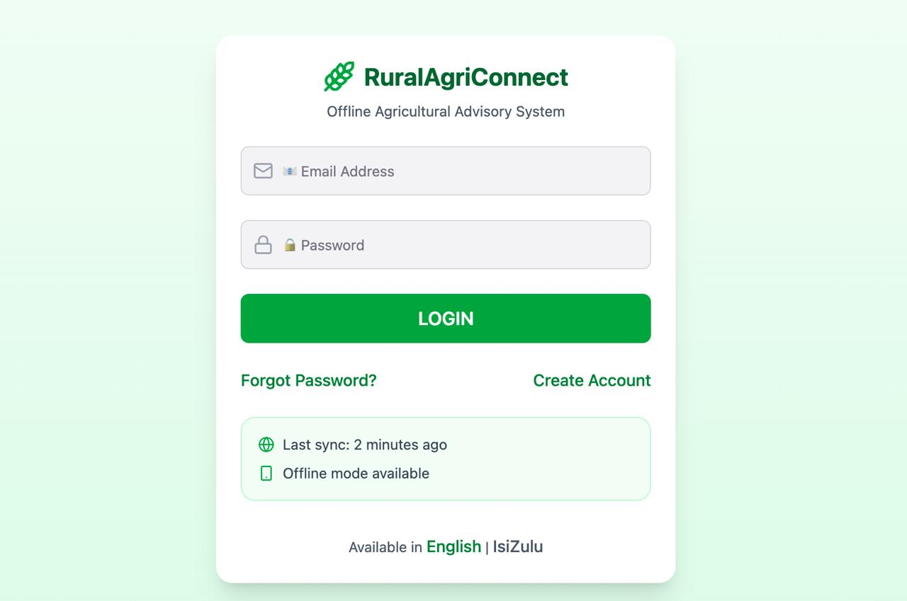
UI/UX Design
Authentication
Data Protection
✓ AES-256 encryption at rest
✓ TLS 1.3 for all API calls (HTTPS)
✓ SQLite file encryption on device
SQL Injection Prevention
OWASP Top 10 Compliance
✓ XSS prevention (CSP headers)
✓ CSRF tokens on state-changing calls
✓ Helmet.js security headers

Slide 17

COMMUNITY
IMPACT
Real problems. Real people. Real solutions.
Transforming
Rural Agriculture
With Technology
40%+
10K+
Crop losses in SA from poor information
Smallholder farmers in KwaZulu-Natal
By bridging the digital divide, this system empowers smallholder farmers with the information they need to protect their crops and livelihoods — regardless of connectivity.
24/7
60s
Advisory access — offline or online
Alert delivery target — publish to farmer

Slide 18

CONCLUSION &
NEXT STEPS
The Offline Mobile Advisory System bridges a critical information gap for rural farming communities in South Africa. By combining offline-first SQLite storage, secure Node.js APIs, role-based access, and SMS alerts — we deliver timely, actionable advisories regardless of connectivity.
1
Finalise system architecture & database ERD (Sprint 3–4)
2
Set up Node.js + Express backend with SQLite (Sprint 5)
3
Implement JWT authentication & RBAC (Sprint 6)
4
Build React frontend with offline capability (Sprint 7)
5
Integrate SMS gateway & complete full-stack demo (Sprint 8–9)
6
AI recommendations module & final deployment (Sprint 10–12)
Thank you • Questions welcome • Mangosuthu University of Technology • 2026

