Slide 1

OPTICAL SMOKE DETECTING SYSTEM
By
Bheemashankar
SAI KIRAN
CHINTAN B.MUDIGOUDRA

Slide 2
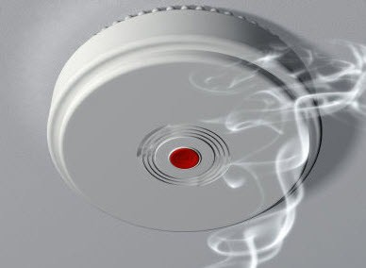
WHAT IS OPTICAL SMOKE DETECTOR??
It is a device which is used in buildings in order to detect smoke/fire accidents by using electrical components such as resistors, capacitors, LED, etc…

Slide 3
APPLICATIONS.
Optical Smoke Detectors are used in work places,hospitals,factories,etc.
OSD’s principle are used in automobiles, to ensure the temperature of the engine parts.
It is used in sophisticated laboratory where harmful chemicals and instruments are used.
It is used in metal and ore industries as high temperatures are reached.

Slide 4
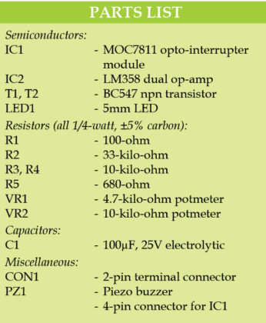
COMPONENTS

Slide 5
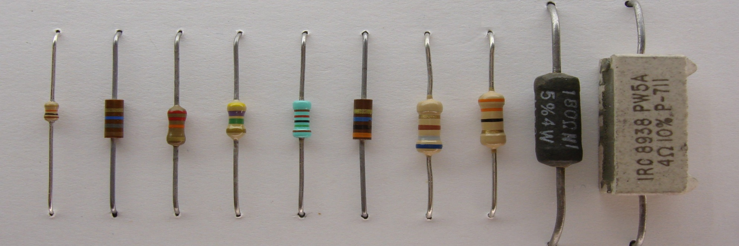
RESISTORS
Resistors are electronic components which obstructs/opposes the flow of current through them and circuit. Measured in ohms(Ω).

Slide 6
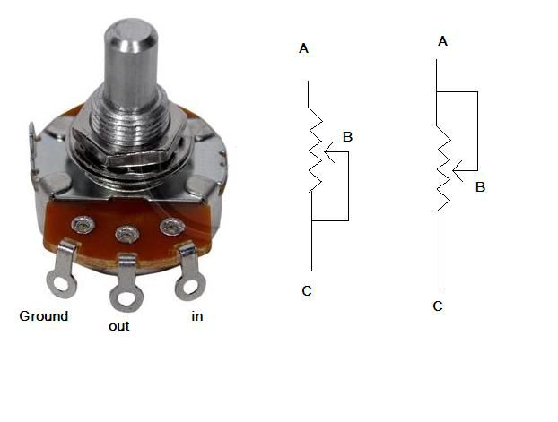
VARIABLE RESISTORS(VR)
These types of resistors allow the user to set the resistance that needs to be offered by the variable resistors according to the requirement of the user.

Slide 7
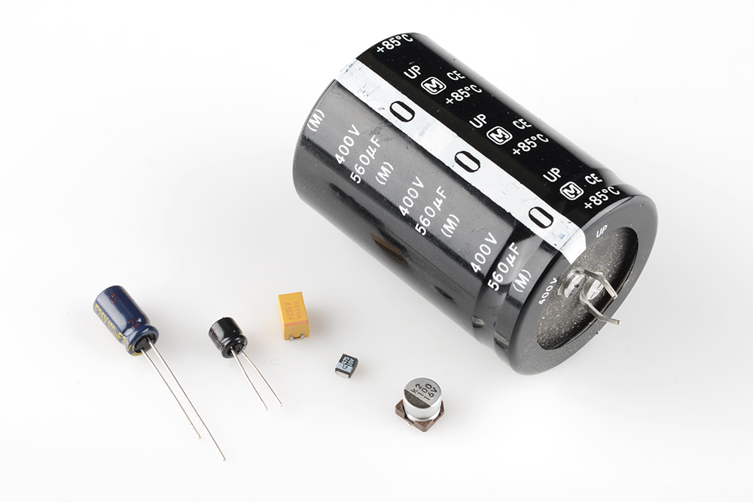
CAPACITORS.
These are the components which store energy in form of electric field. The unit of measurement is Faraday.

Slide 8

PIEZO BUZZER(PZ)
This device gives output in the form of sound. It is used in various places when there is requirement of alerting the user.
Electronic horn to horn the people.

Slide 9
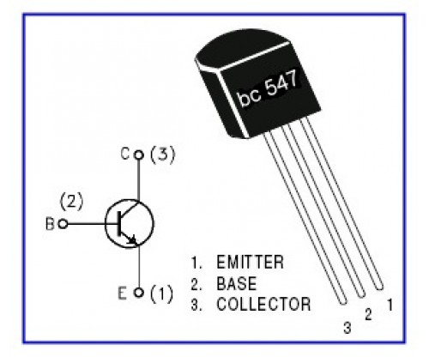
TRANSISTORS
Transistors are 3 terminal solid state semiconductor devices. There are two types of transistors:-
NPN
PNP

Slide 10
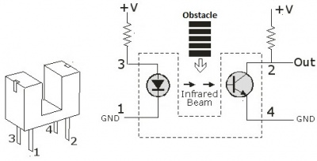
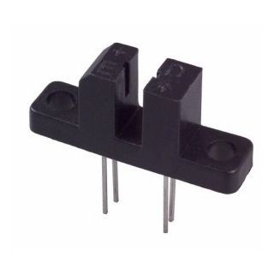
MOC7811(IC1)
MOC7811 is an integrated circuit which consist of an infrared light source and a transistor facing opposite to each other in it. Its function is, it reduces the voltage in the circuit when there is any obstacle(like smoke) between the infrared light path and the transistor. It is one of the main component in Optic Smoke Alarm system.

Slide 11
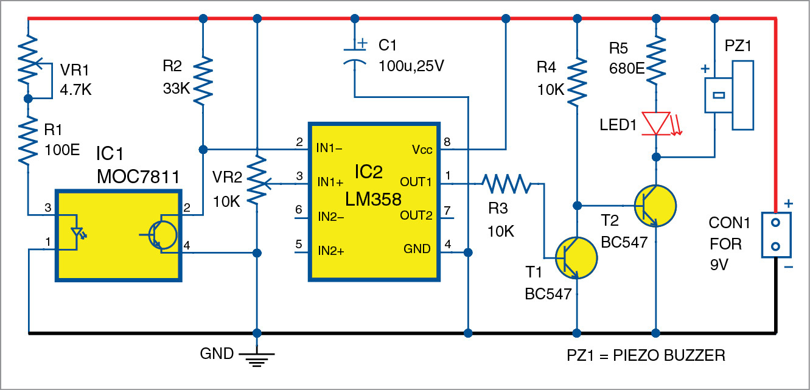
CIRCUIT

Slide 12
WORKING.
This optical smoke alarm is built around opto-interrupter MOC781(IC1) and dual Op-Amp LM358(IC2).
When thick black smoke enters in the gap(slotted area) of the opto-interrupter sensor(IC1),its internal photo transistor stops conduction.
As a result, output of the dual Op-Amp goes low.
So transistor T1 stops conduction and T2 starts conducting.
This makes the piezo buzzer(PZ1) sound an alarm and LED1 to glow.
Potmeter VR1 is used too control intensity of the internal LED of MOC7811. Potmeter VR2 is used to control the reference voltage at pin 3 of IC2.
The circuit works off a 9v battery.

Slide 13

THANK YOU
BYE
BYE!!

