Slide 1



Adaptive Education AI
An AI-Powered Personalised Learning Assistant
Aligned with SDG 4 – Quality Education
CSRBOX – IBM SkillsBuild Applied AI Internship 2025
Name: Bheemraj Paidipelli

Slide 2


Introduction
01
Digital learning platforms are widely used today
02
Many students still struggle with understanding academic concepts
03
Different learners require different explanation depths
04
AI can play a key role in personalized education

Slide 3

Motivation
  Existing educational tools provide generic explanations
  One-size-fits-all learning leads to confusion and gaps
  Academic correctness is not always ensured
  Need for intelligent, adaptive learning support

Slide 4
Problem Context
  Students face difficulty when explanations are not level-appropriate
  Research scholars struggle with complex academic content
  Self-learners lack structured and guided explanations
  Limited personalisation affects learning effectiveness

Slide 5


SDG Alignment
SDG 4 – Quality Education
  Ensures inclusive and equitable education
  Promotes lifelong learning opportunities
  Improves learning quality using AI
  Reduces educational inequality

Slide 6
Project Overview
Adaptive Education AI provides:
  Validation of academic content
  Education-level adaptive explanations
  Academic refinement of responses
  Context-aware learning assistance

Slide 7
High-Level Concept
  ChatGPT for education-level adaptive learning
  Personalized AI tutor for every learner
  Intelligent system that adjusts explanation depth automatically

Slide 8

Target Users & Early Users
Target Users
  School, undergraduate, and postgraduate students
  Educators and tutors
  Self-learners
Early Users
  Students preparing for exams
  Research scholars understanding research papers
  Learners requiring step-by-step explanations

Slide 9
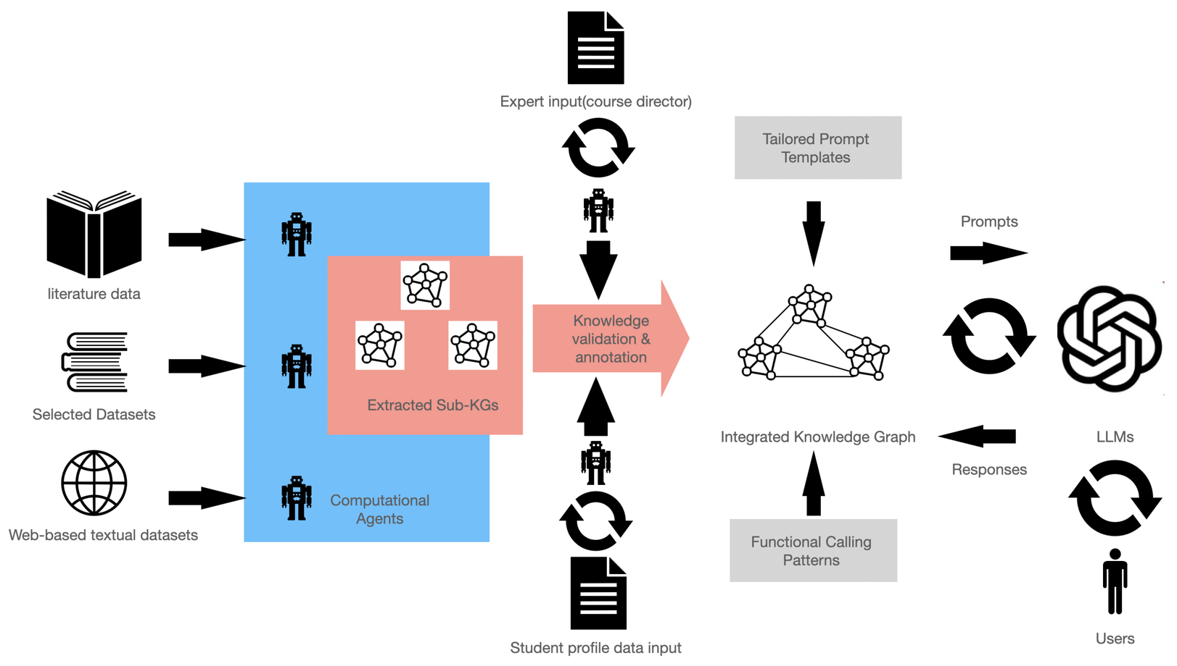
System Workflow
  User submits an academic query
  AI validates content correctness
  Education level is identified
  Explanation depth is adapted
  Refined academic response is generated

Slide 10
Future Enhancements & Conclusion
Future Enhancements
  Cloud-based deployment
  Multi-language learning support
  Subject-specific learning modules
  Integration with educational platforms
Conclusion
  Adaptive Education AI addresses real learning challenges
  Demonstrates applied and agentic AI skills
  Strongly aligned with SDG 4 goals

