Slide 1
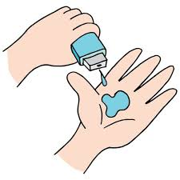
Seasonal Agriculture Performance Analysis
Name : A.Bheeshma Shankar
Collge : Chaitanya Bharathi Institute of Technology
AICTE STU ID : STU6799a56ad83bf1738122602

Slide 2

PROBLEM STATEMENT
Agricultural activities are influenced by seasonal variations in environmental conditions, farming practices, resource availability and market conditions. As a result, agricultural performance may differ from one season to another. However, raw agricultural data does not clearly explain how agricultural performance changes across seasons or what patterns can be observed in different seasonal conditions. The problem is to analyze the given agricultural dataset and investigate seasonal differences in agricultural performance by identifying meaningful patterns, trends, relationships and variations within the available data.

Slide 3
Project Description
This project analyzes 4,000 farm-level records spanning 8 Indian states, 8 major crops and 3 cropping seasons (Kharif, Rabi and Zaid) to understand how agricultural performance changes with the season.
The raw dataset covers environmental conditions (rainfall, temperature, humidity, soil health), farming inputs (fertilizer, irrigation, pesticide) and economic outcomes (cost, revenue, profit) for every farm.
The data was cleaned (duplicates and inconsistent entries removed) and explored using Python to compare yield, cost, revenue, profit, water efficiency and disease/pest risk across seasons.
Statistical summaries, groupwise aggregation and visualizations were used to surface seasonal patterns and relationships between environmental conditions and farm profitability.
The final output is a set of evidence-based insights and recommendations that can support seasonal agricultural planning and decision-making.

Slide 4

WHO ARE THE END USERS?
Farmers and farmer cooperatives — to choose crops and irrigation methods best suited to each season
State agriculture departments and policymakers — for evidence-based seasonal planning
Agri-business and supply chain companies — to plan procurement and pricing around seasonal output
Agricultural researchers and academic institutions — studying seasonal and climatic impact on farming
Crop insurance and lending institutions — to assess seasonal risk when designing products

Slide 5

Technology Used
Python — core language for data cleaning, analysis and automation
Pandas & NumPy — data cleaning, transformation and seasonal aggregation
Matplotlib & Seaborn — statistical charts and seasonal comparison visuals
Jupyter Notebook — end-to-end analysis, documentation and reporting environment
Statistical techniques — groupwise aggregation, correlation analysis and comparison across seasons
GitHub — version control and project submission

Slide 6
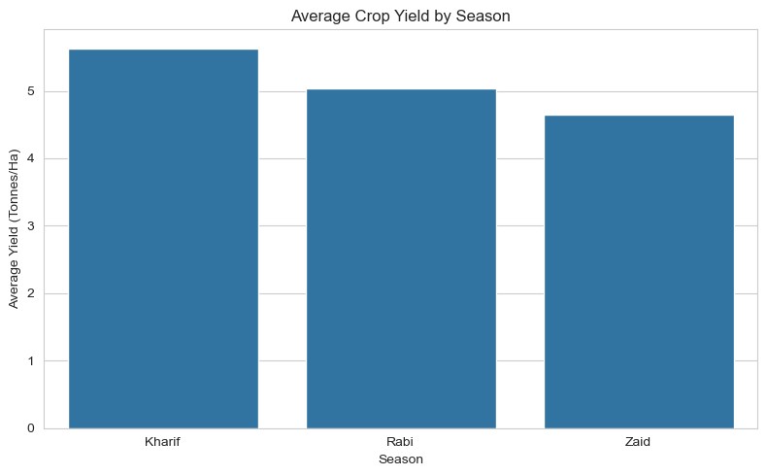
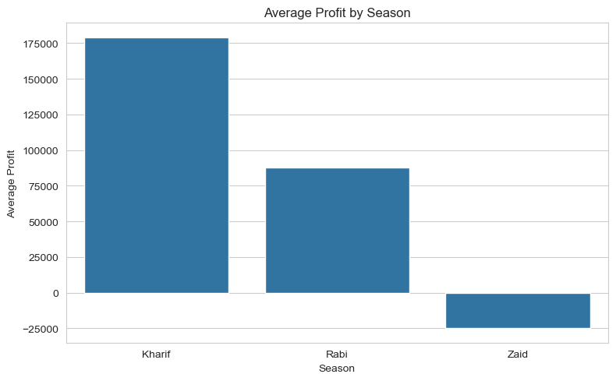
RESULTS
Kharif farms lead on both yield and profit; Zaid farms average a net loss despite similar costs.

Slide 7
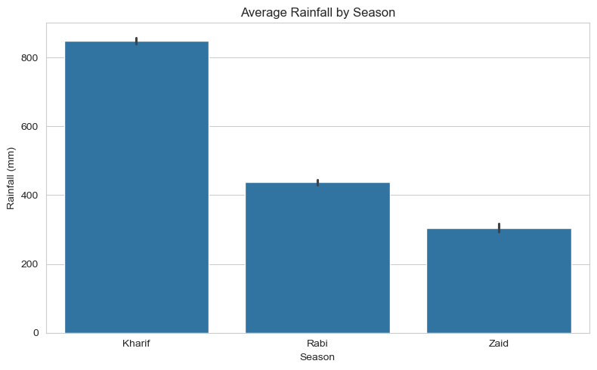
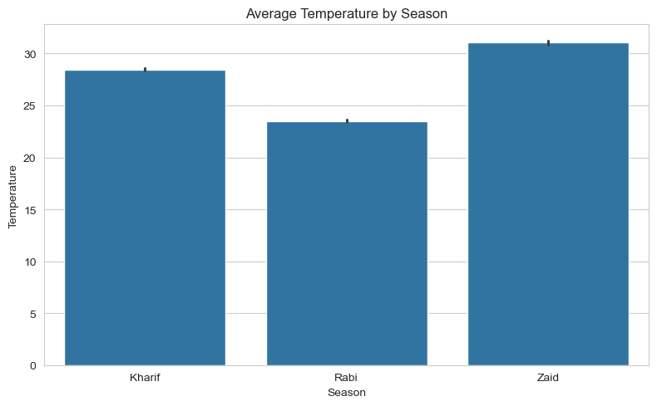
RESULTS
Kharif is the wettest and among the coolest seasons; Zaid is the hottest and driest, straining the crop-water balance.

Slide 8
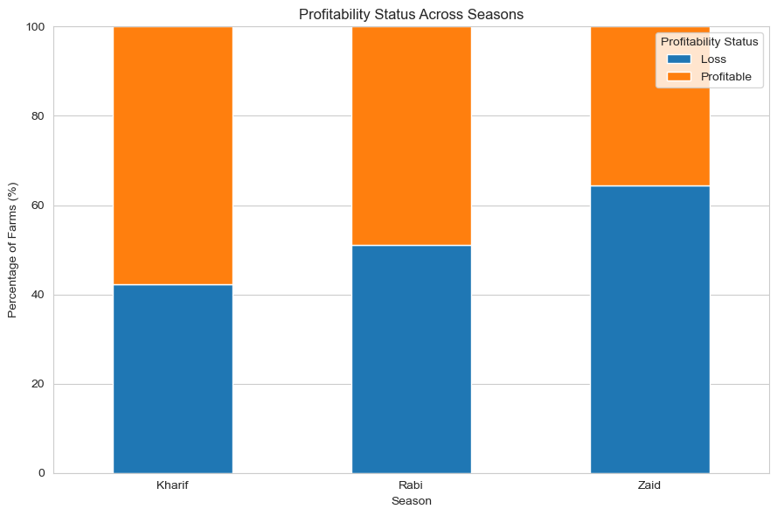
RESULTS
Rabi and Zaid see more loss-making farms than profitable ones; Kharif is the only season with a clear profit majority.

Slide 9
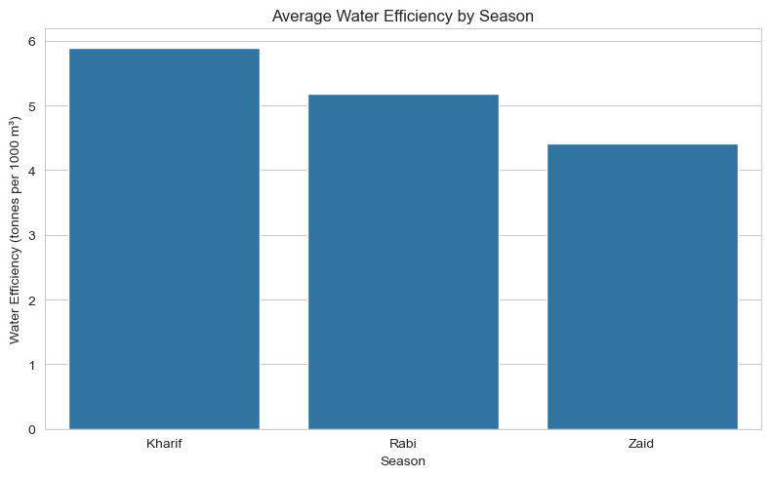
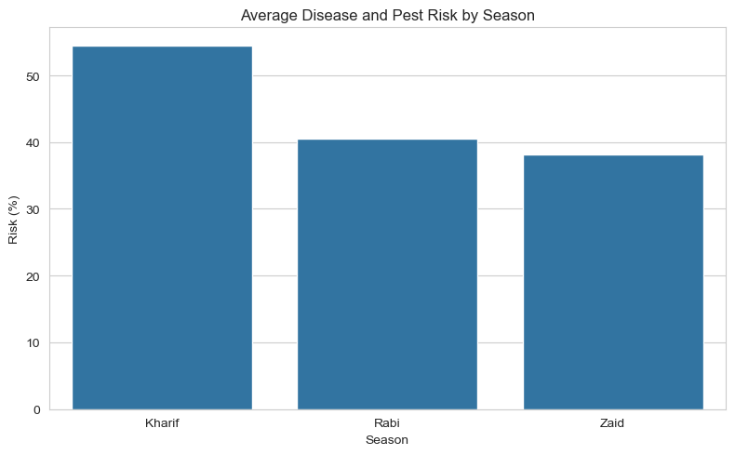
RESULTS
Water-use efficiency and disease/pest risk both fall from Kharif to Zaid, tracking the seasonal drop in profitability.

Slide 10
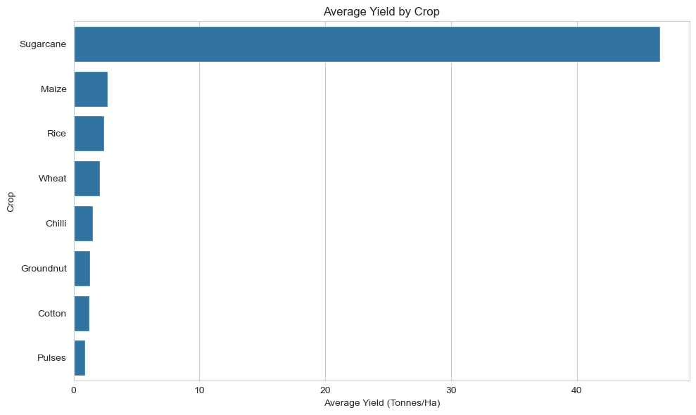
RESULTS
Sugarcane's per-hectare yield dwarfs every other crop, while grains and pulses all average well under 3 t/ha.

Slide 11
Future Scope
Build a machine learning model to predict crop yield and profitability from seasonal and environmental inputs
Integrate real-time weather and market-price feeds for up-to-date seasonal recommendations
Develop a season- and crop-specific irrigation and fertilizer advisory system
Expand the dataset to more states, crops and multiple years to strengthen trend analysis
Build an interactive dashboard so farmers and policymakers can explore seasonal insights themselves

Slide 12
GitHub Link
https://github.com/Bheeshma2234/Seasonal-Agriculture-Performance-Analysis

Slide 13

VOIS Course completion certificate - Course name- Data Visualization

Slide 14
Thank you
.
.

