Slide 1

SMART INDIA HACKATHON VITALS MONITERING SYSTEM
THE CODE CRAFTERS
AAYUSHI PANDEY
ABHINAV KESARI
ASHI GUPTA
BHAGATPREET SINGH NAGI
SAMYAK JAIN
TANMAY GUPTA

Slide 2
ABOUT THE PROJECT
Theme : Healthcare and Bio-Medical Devices
Problem Statement : Notifying Doctor about irregularity in patient’s vitals, prompting to check up on the patient, along with an EMERGENCY mode.

Slide 3
Problem
No one can stay with heart patients all the time.
Heart patients may not receive timely treatment at times of emergency.

Slide 4
Solution
More than 2 million people have to suffer because of delay in response to medical emergencies.
It would be helpful if there is a way for these people to monitor their heart.
We made a product that will notify the patient’s family members or authorities,
who will take action.

Slide 5
Applications
Better and accurate device of measuring heart beat
Reliable device for measuring body temperature
Vitals can be measured at any place
At home
Workplace
Hospital
At times of emergency doctor can be notified

Slide 6
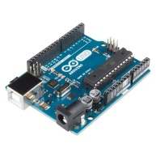
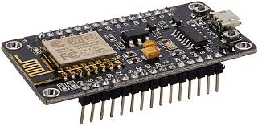
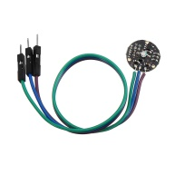
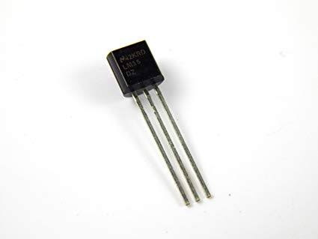
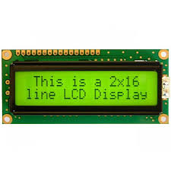
HARDWARE USED
4. Nodemcu ESP8266
5. LM35
1. Arduino Uno
2. Pulse sensor
3. 16x2 LCD Display

Slide 7
Conclusion
Our device is a low cost, quick and effective solution for the victim in emergency situations.

Slide 8
THANK YOU!

