Slide 1
HACKATHON
Team Hack-Verse

Slide 2
INTRODUCTION

Slide 3
TEAM MEMBERS

Slide 4
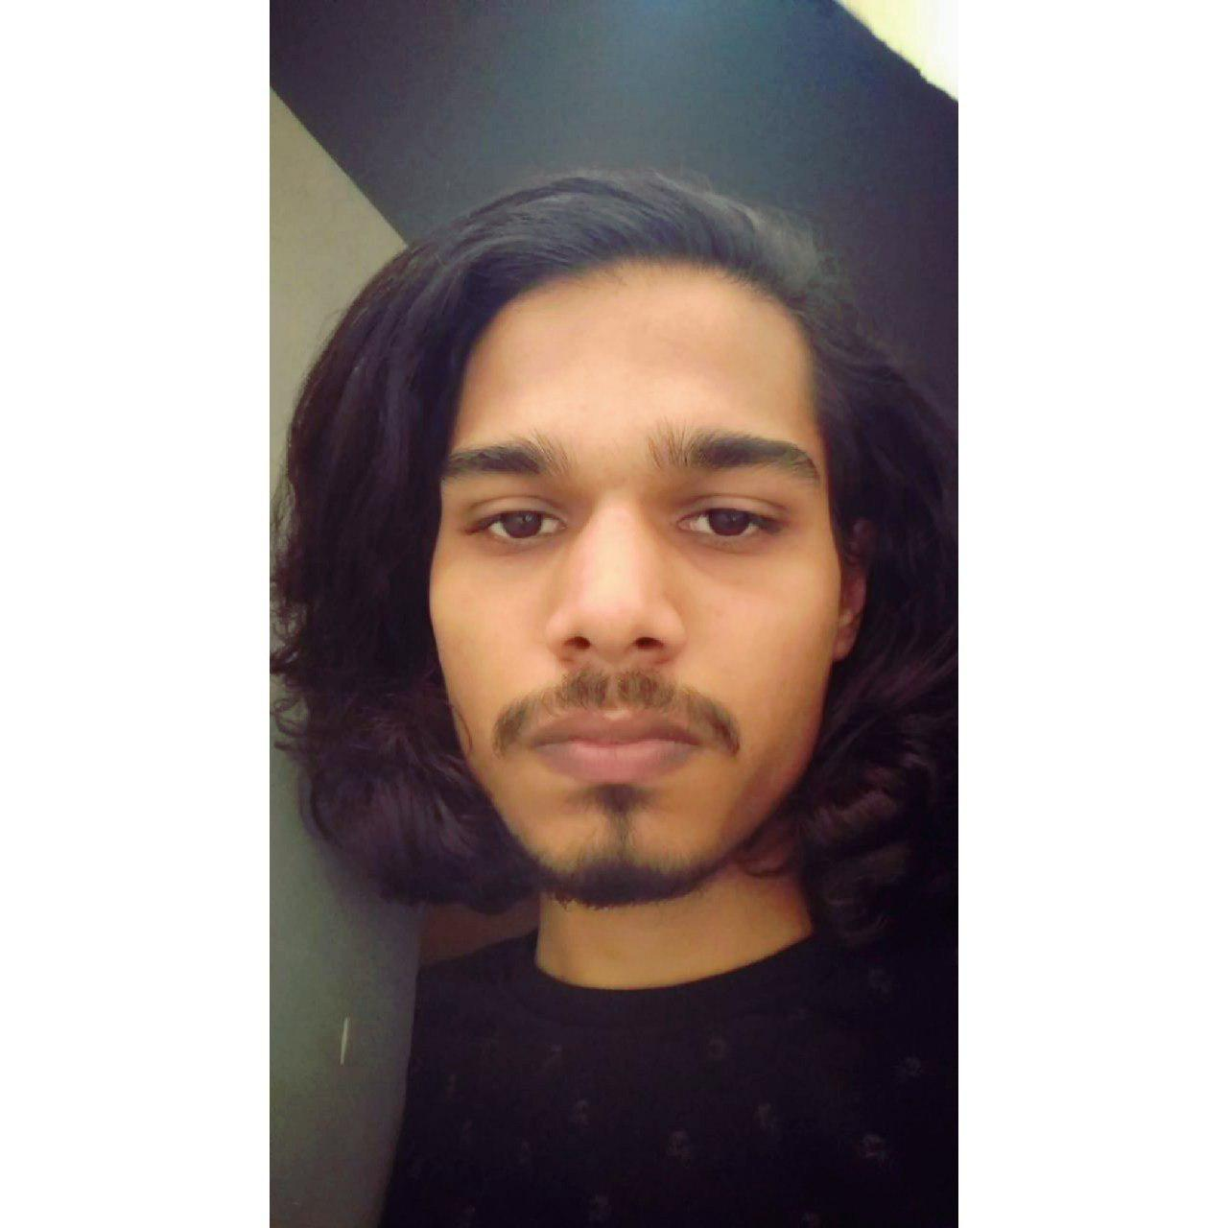
Bhagatpreet Singh Nagi

Slide 5
Ashutosh Singh Dengri

Slide 6
Samyak Jain

Slide 7
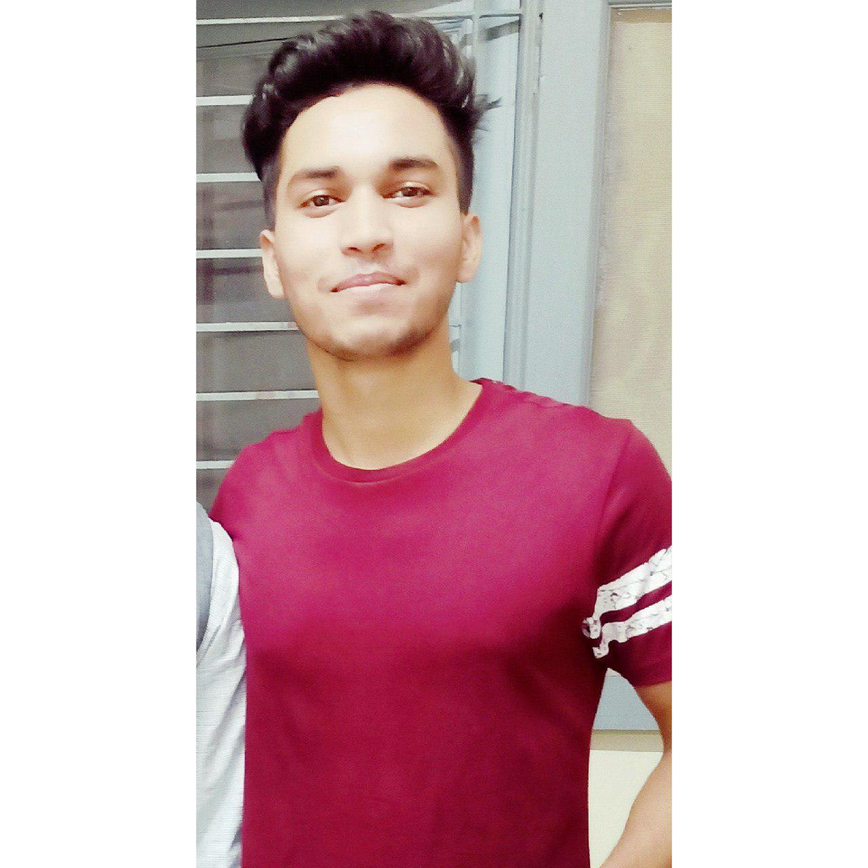
Amit Yadav

Slide 8
Rajeev Kumar

Slide 9
ABOUT THE PROJECT
Theme : Medical
Problem Statement : Notifying Doctor about irregularity in patient’s heart rate, prompting to check up on the patient, along with an EMERGENCY mode.

Slide 10
LANGUAGE AND SOFTWARES USED

Slide 11
HARDWARE USED

Slide 12
APPLICATION

Slide 13
NOTIFICATIONS

Slide 14
TESTING

Slide 15
CONCLUSION

Slide 16
REFERENCES

Slide 17
THANK YOU VERY MUCH !!

