Slide 1
HACKATHON
Team Hack-Verse

Slide 2
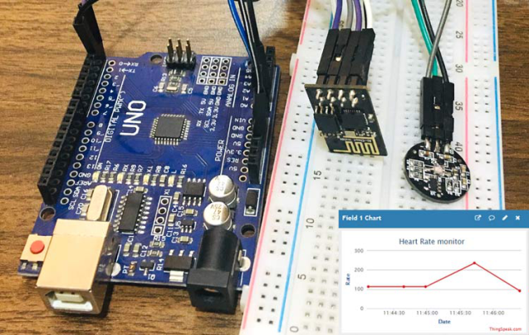
INTRODUCTION
Internet of Things
Heart Rate Monitor System using Arduino and Nodemcu.
Heartbeat Sensor

Slide 3





TEAM MEMBERS
Ashutosh Singh Dengri
Arduino,
Android studio
Amit Yadav
Arduino
Powerpoint
Bhagatpreet Singh Nagi
Arduino
Python
Samyak Jain
Arduino
IOT
Rajeev Kumar
C
C++

Slide 4
ABOUT THE PROJECT
Theme : Medical
Problem Statement : Notifying Doctor about irregularity in patient’s heart rate, prompting to check up on the patient, along with an EMERGENCY mode.

Slide 5



LANGUAGE AND SOFTWARES USED
C++ Ardunio IDE IFTTT

Slide 6
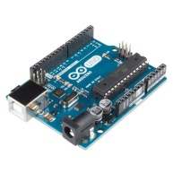
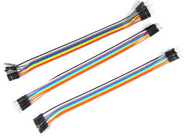
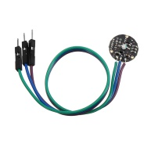

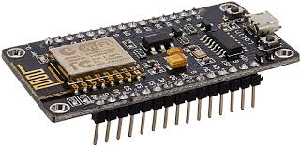
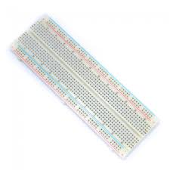
HARDWARE USED
1. Arduino Uno
2. Heart beat sensor
3. Bread Board
4. Jumper Wire
5. 16x2 LCD Display
6. Nodemcu ESP8266

Slide 7

Problem
No one can stay with heart patients all the time.
Heart patients may not receive timely treatment at times of emergency.

Slide 8
Solution
More than 2 million people are at high risk of having heart attack.
It would be helpful if there is a way for these people to monitor their heart.
We made a product that will notify the patient’s family members or authorities, who will take action.

Slide 9
Applications
Better and accurate device of measuring heart beat at any time.
- At homes
- Hospitals

Slide 10

CONCLUSION
Our device low cost, quick and effective solution for the heart patients in emergency situations.

Slide 11
COST
Cost determine by vendor cost.
Based on work instruction tools.

Slide 12
THANK YOU VERY MUCH !!
Fix the cause, not the symptom

