Slide 1
HACKATHON
Team Hack-Verse

Slide 2
INTRODUCTION

Slide 3
TEAM MEMBERS

Slide 4
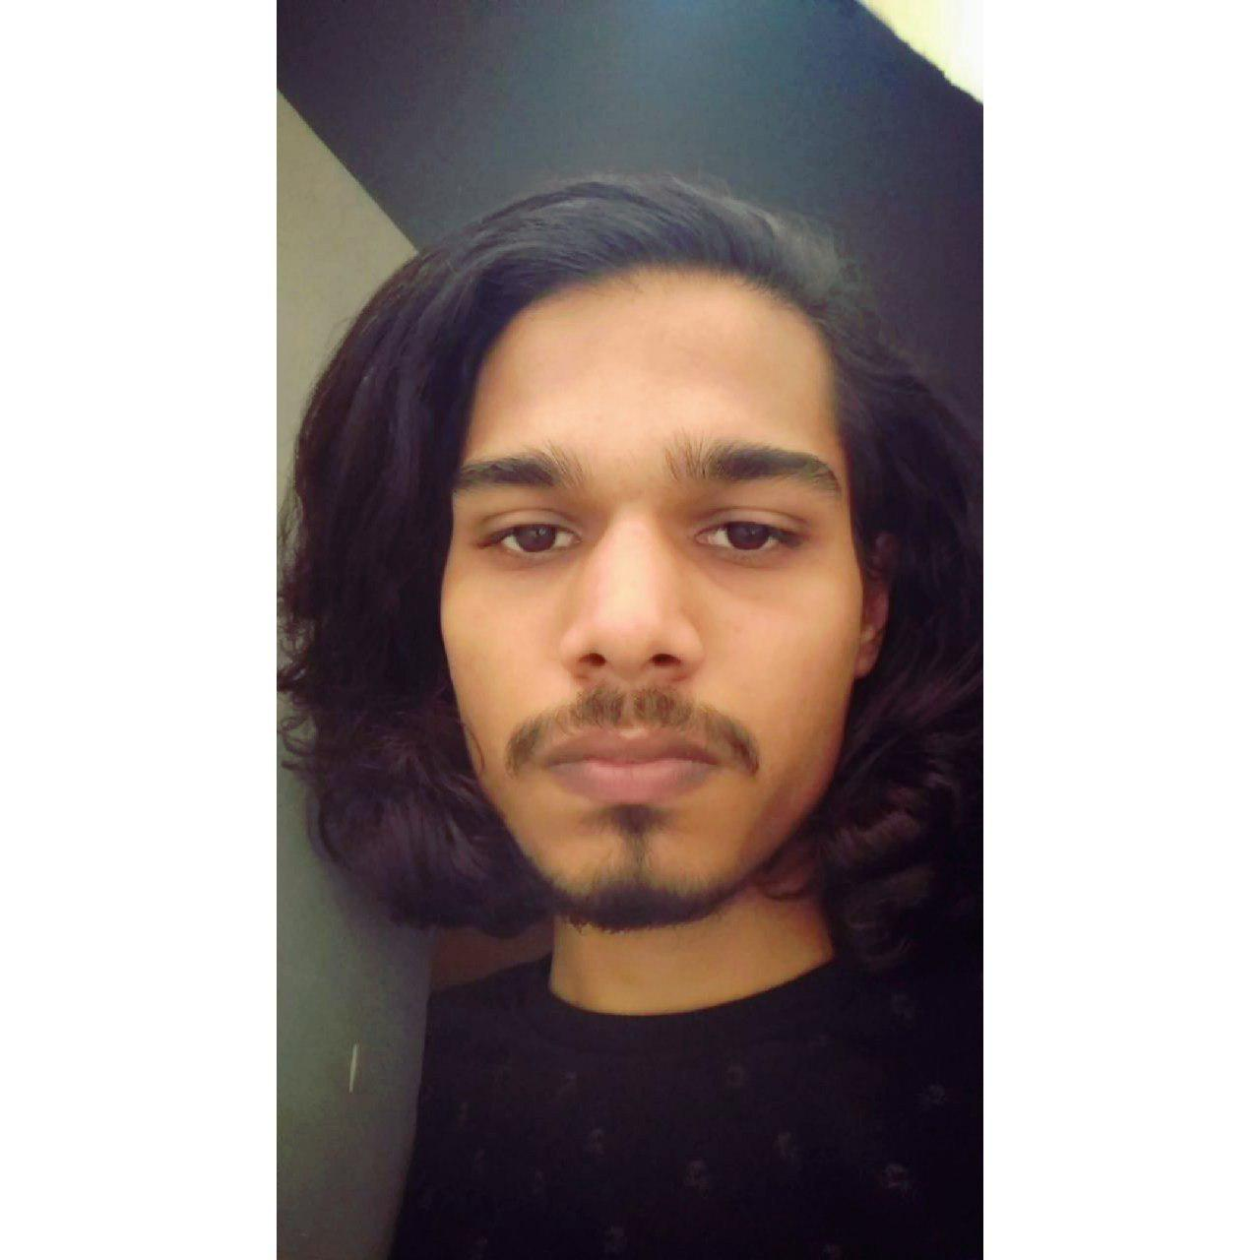
Bhagatpreet Singh Nagi
College: Raj Kumar Goel Institute of Technology
Skills:
GitHub: Bhgt
Instagram:
LinkedIn:

Slide 5
Ashutosh Singh Dengri
College: Raj Kumar Goel Institute of Technology
Skills: C, Python, C++, Web Dev, Designing,
Android Dev, Ethical Hacking.
GitHub: ashsinden9
Instagram: ashsinden9
LinkedIn: ashsinden9

Slide 6
Samyak Jain
College: Raj Kumar Goel Institute of Technology
Skills:
GitHub: samyak989
Instagram:
LinkedIn:

Slide 7
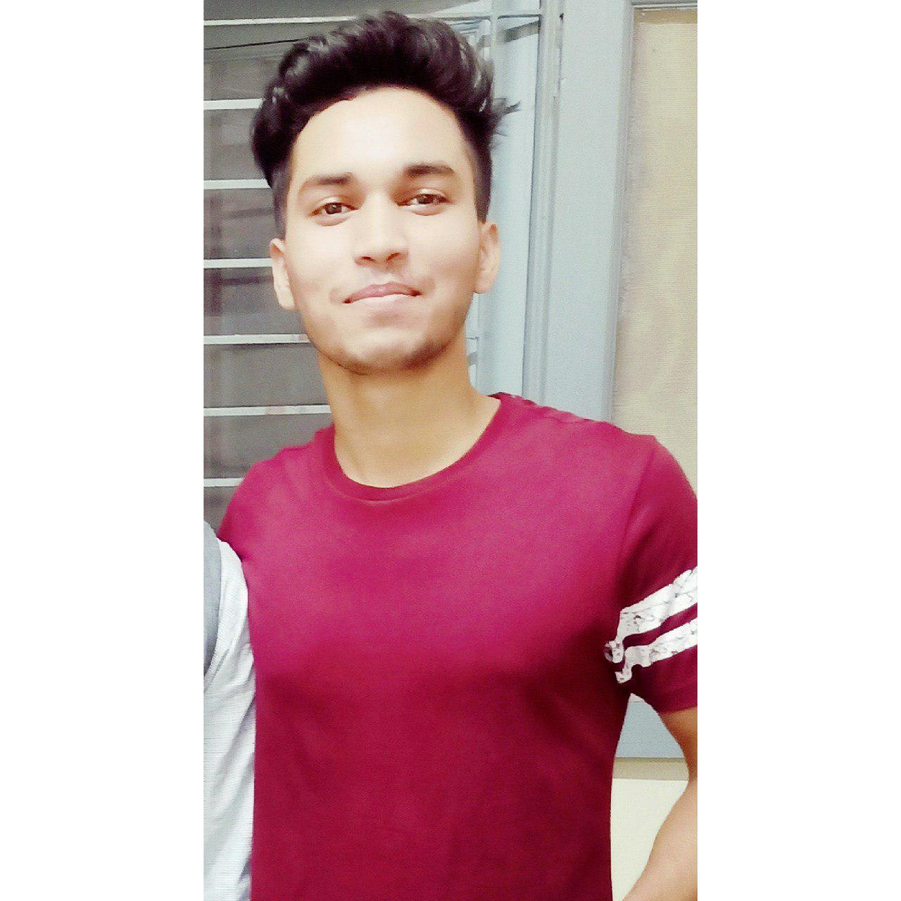
Amit Yadav
College: Raj Kumar Goel Institute of Technology
Skills: C, Python, Web Search.
GitHub: amitgit0304
Instagram:
LinkedIn:

Slide 8
Rajeev Kumar
College: Raj Kumar Goel Institute of Technology
Skills: C , C++, Java, Python.
GitHub: rajeekumarthakur
Instagram:
LinkedIn:

Slide 9
ABOUT THE PROJECT
Theme : Medical
Problem Statement : Notifying Doctor about irregularity in patient’s heart rate, prompting to check up on the patient, along with an EMERGENCY mode.

Slide 10
LANGUAGE AND SOFTWARES USED

Slide 11
HARDWARE USED

Slide 12
APPLICATION

Slide 13
NOTIFICATIONS

Slide 14
TESTING

Slide 15
CONCLUSION

Slide 16
REFERENCES

Slide 17
THANK YOU VERY MUCH !!

