Slide 1
HACKATHON
Team Hack-Verse

Slide 2
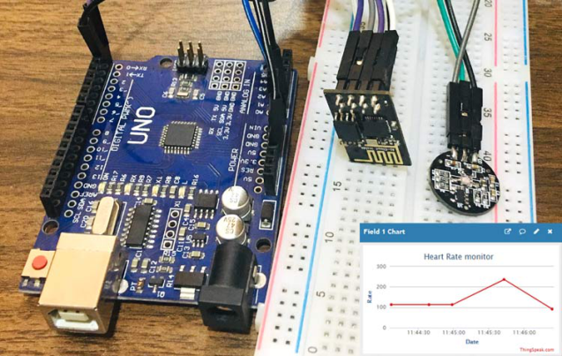
INTRODUCTION
We the member of Hackverse made a Heart rate monitoring Device.
In this project, we have designed a Heart Rate Monitor System using Arduino and Pulserate Sensor.
We introduce you with the of Heartbeat Sensor, working of the Heartbeat Sensor and Arduino based Heart Rate Monitoring System using a practical heartbeat Sensor.

Slide 3





TEAM MEMBERS
Ashutosh Singh Dengri
Arduino,
Android studio
Amit Yadav
Arduino
Powerpoint
Bhagatpreet Singh Nagi
Arduino
Python
Samyak Jain
Arduino
IOT
Rajeev Kumar
C
C++

Slide 4
ABOUT THE PROJECT
Theme : Medical
Problem Statement : Notifying Doctor about irregularity in patient’s heart rate, prompting to check up on the patient, along with an EMERGENCY mode.

Slide 5



LANGUAGE AND SOFTWARES USED
C++ Ardunio IDE IFTTT

Slide 6
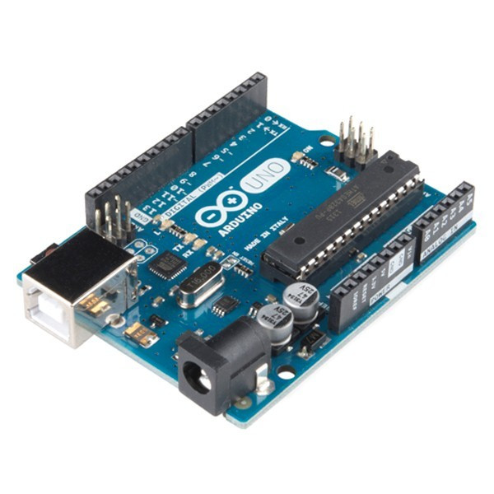
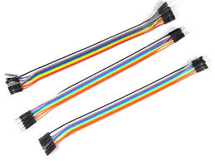
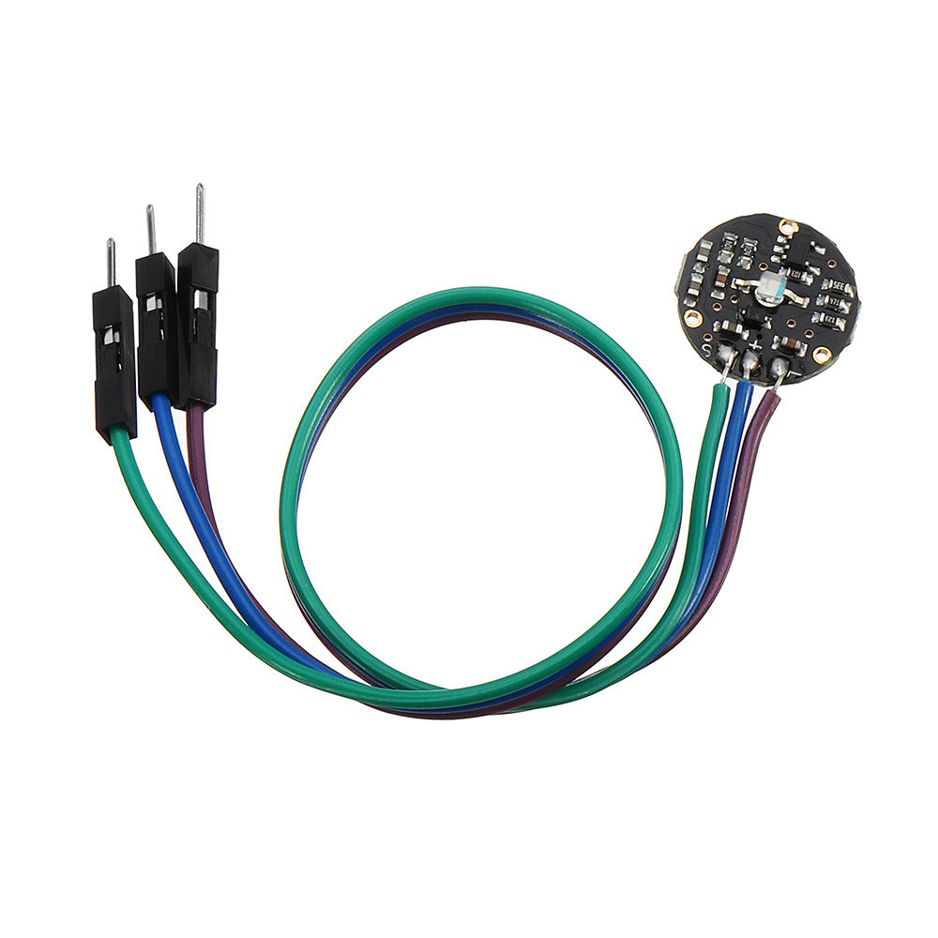

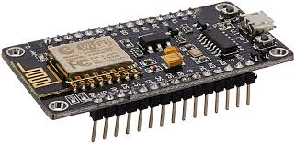
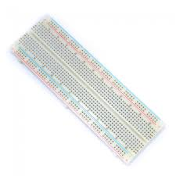
HARDWARE USED
1. Arduino Uno
2. Heart beat sensor
3. Bread Board
4. Jumper Wire
5. 16x2 LCD Display
6. Nodemcu ESP8266

Slide 7
Problem
No one can stay with heart patients all the time.
Heart patients may not receive timely treatment at times of emergency.

Slide 8
Solution
More than 2 million people are at high risk of having heart attack.
It would be helpful if there is a way for these people to monitor their heart.
We made a product that will notify the patient’s family members or authorities, who will take action.

Slide 9
Features

Slide 10
CONCLUSION

Slide 11
REFERENCES

Slide 12
THANK YOU VERY MUCH !!

