Slide 1
Operations on Stack
Push
Adding an item
Pop
Removing an item
Peek
Returns top element of the stack
Display
Displays all elements of the stack
Chapter 2
Overflow and Underflow conditions:
4

Slide 2
Push Operation
initially top=-1
Push(STACK, n, top, value):
if top=n-1
write overflow and return
set top=top+1
set STACK[top]=value
return
Chapter 2
7

Slide 3
Pop Operation
initially top=-1
POP(STACK, n, top):
if top=-1
write under and return
set temp=STACK[top]
set top=top-1
return temp
Chapter 2

Slide 4
Prefix and postfix notations
Polish notation, also known as prefix notation.
RPN=Reverse Polish Notation=Postfix notation
Chapter 2
Advantage: expressions can be written without
parentheses
12

Slide 5
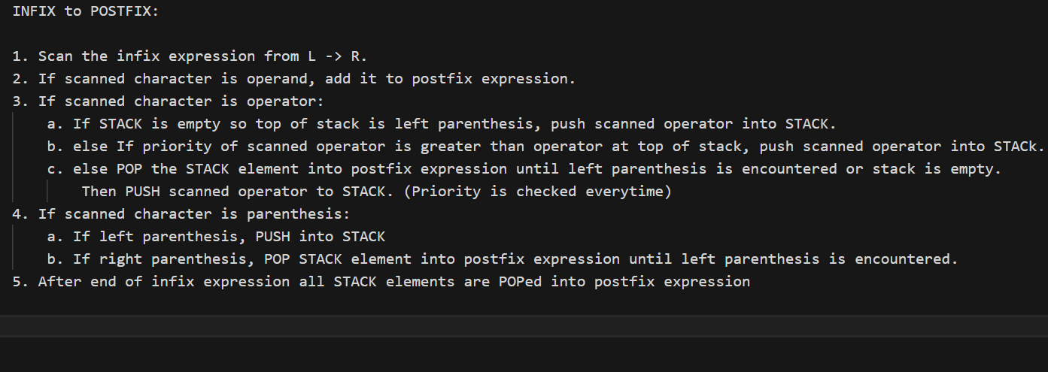
Chapter 2
16

Slide 6
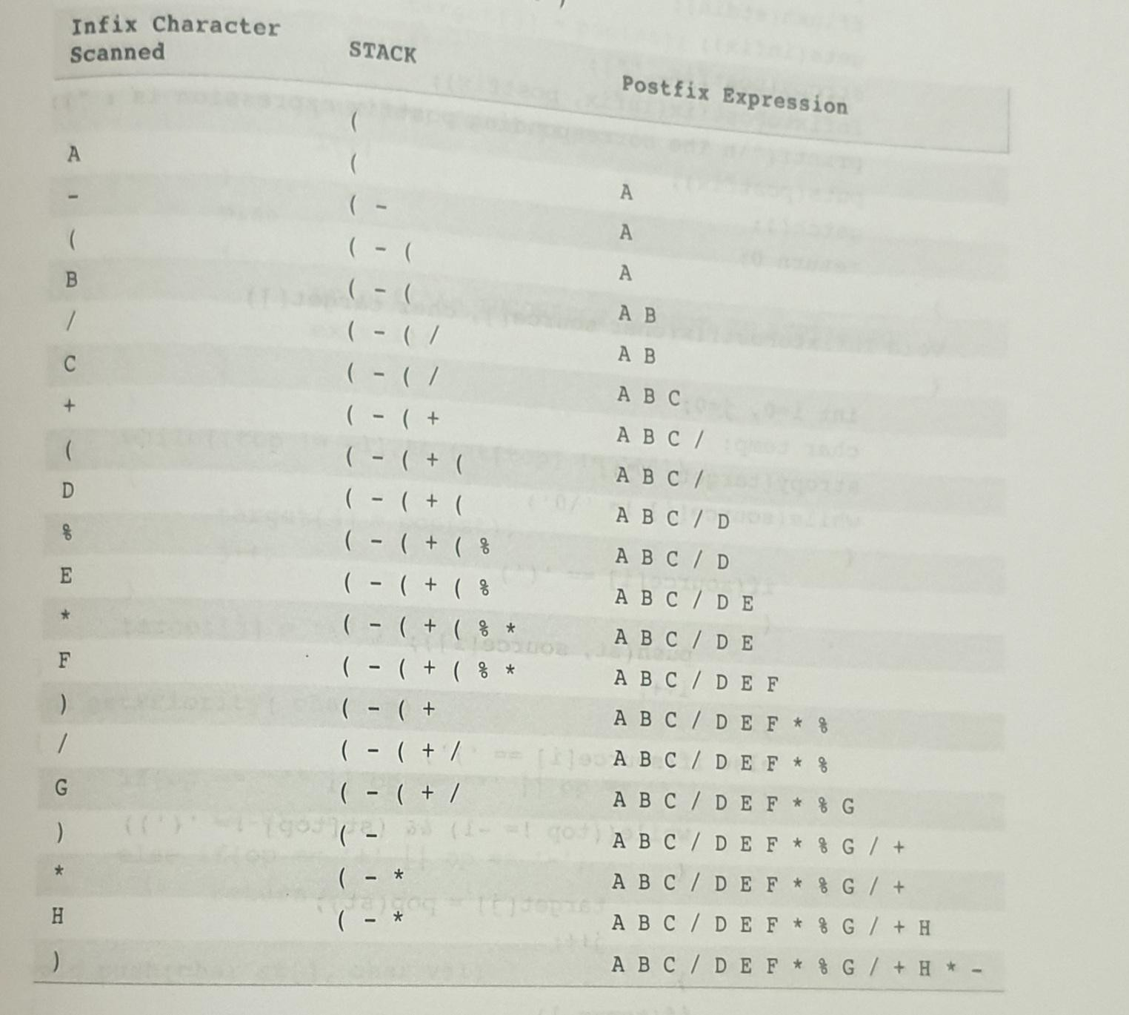
Chapter 2
17

Slide 7
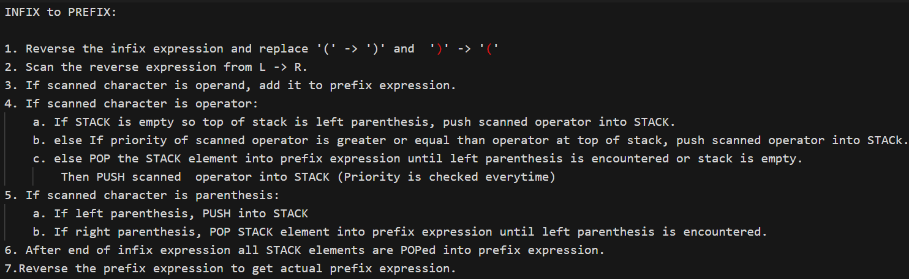
Chapter 2
18

Slide 8
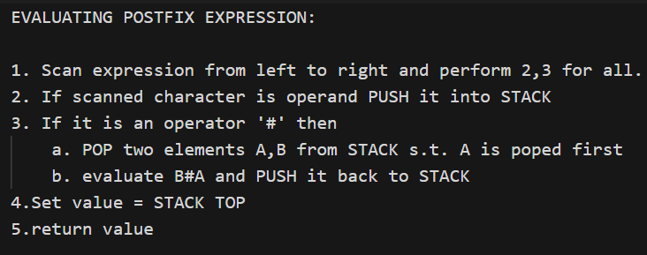
Evaluating Postfix/RPN expressions
Chapter 2
20

Slide 9
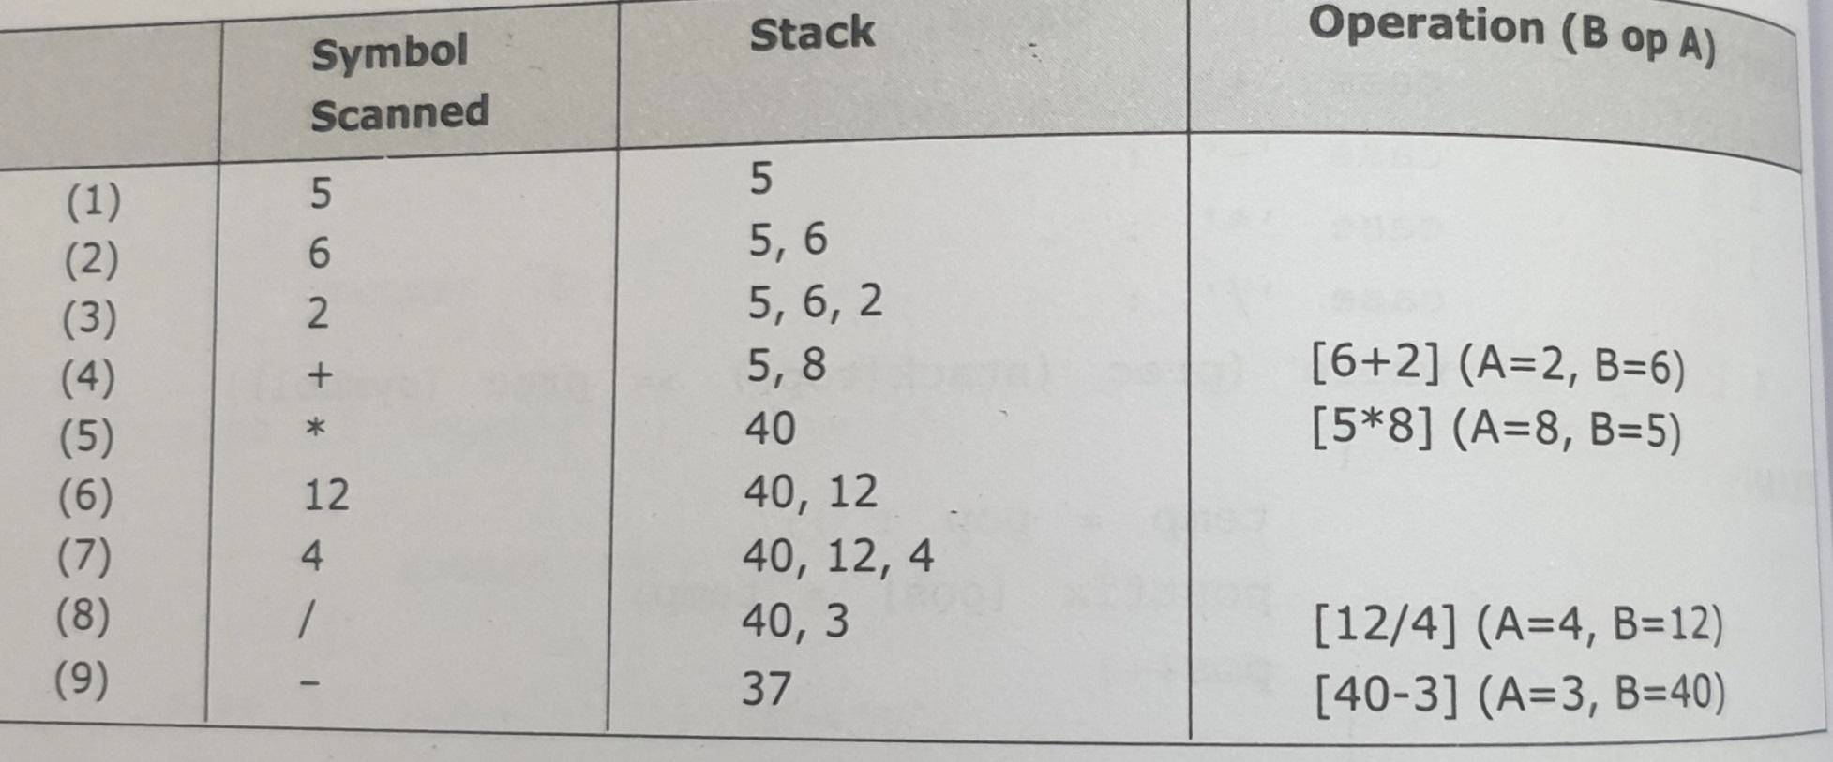
Evaluate postfix expression: 5,6,2,+,*,12,4,/,-
Chapter 2

Slide 10
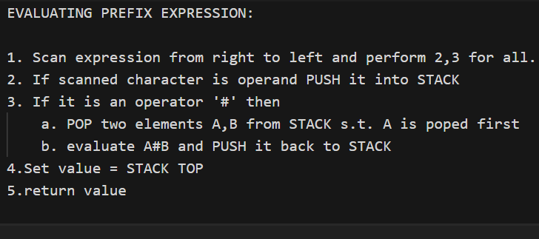
Evaluating Prefix expressions
Chapter 2

Slide 11
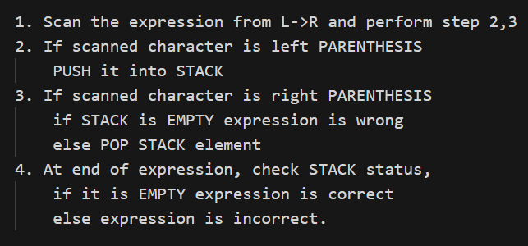
Matching the nested parentheses Algorithm
Chapter 2
25

