Slide 1
Recursion
Recursion is a programming practise, where a function calls itself to solve small instance of the problem.
Each recursion function simplifies the problem bringing it
close to base condition
KEY ELEMENTS
1. Base case 2. Recursive case
Chapter 2
2

Slide 2
Recursive solution
Every recursive solution has two cases:
1. Base case
In which the problem is simple enough to be solved directly without further call to same function
Eg: In factorial, factorial(1)=1 for n=1
2. Recursive case
In which the function calls itself with simpler sub-parts.
Chapter 2
Eg: factorial(n)=n × factorial(n − 1)
7

Slide 3
Recursive Solution
Factorial(3) = 3 × Factorial(2)
Factorial(3) = 3 × 2 = 6
Factorial(2) = 2 × Factorial(1)
Factorial(2) = 2 × 1 = 2
Factorial(1) = 1 × Factorial(0)
Factorial(1) = 1 × 1 = 1
Factorial(0) = 1
6

Slide 4
Variants of recursion
Direct and indirect
Linear and tree
Non-tail and tail recursions
Chapter 2
8

Slide 5
Direct and indirect recursion
Recursion is said to be direct when functions calls itself directly and is said to be indirect when it calls other function that in turn calls it
Chapter 2
9

Slide 6
Tail and Non-Tail recursion
Tail Recursion:
- The recursive call is the **last operation** in the function.
- No computation is done after the recursive call returns.
- Can be optimized by the compiler to save stack space.
Example: factorial(n, accumulator)
Non-Tail Recursion:
- The recursive call is **not the last operation** in the function.
- Some computation is done after the recursive call returns.
- Cannot be easily optimized for stack usage.
- Example: factorial(n) = n * factorial(n-1)
Chapter 2
10

Slide 7
Tail and Non-Tail recursion
Non-tail recursion
Fact(n):
if (n==1)
return 1
return n * Fact (n-1)
Tail recursion
Fact(n):
Return Fact_tail(n,1)
Chapter 2
Fact_tail(n, acc):
if n=0 or 1
return acc
return Fact_tail(n-1, acc*n)
12

Slide 8
Fibonacci(n):
return Fibonacci_tail(n,0,1)
Chapter 2
Fibonacci_tail(n, a,b):
if n=0
return a
return Fact_tail(n-1, b, a+b)
12

Slide 9
Linear and tree recursion
Depending on the way in which recursion grows is classified as linear or tree
Linear Recursion:
- A recursive function makes **only one recursive call** in each recursive case.
- Example: Calculating factorial or sum of n numbers.
Tree Recursion:
- A recursive function makes **more than one recursive call** in each recursive case.
- Example: Fibonacci series, where each call generates two more calls.
Chapter 2
13

Slide 10
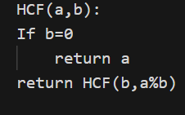

Slide 11
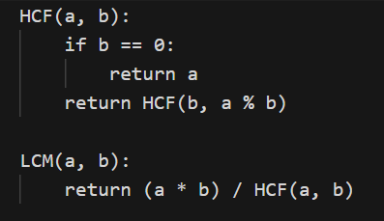
LCM × HCF = a × b

Slide 12
Fibonacci numbers
Fib(4) 3
Fib(3) 2
Fib(2) 1
Chapter 2
Fib(2) 1
Fib(1) 1 Fib(1)
1
Fib(0) 0
Fib(1) 1
Fib(0) 0
16

Slide 13
Execution of recursive calls
Execution of Recursive Calls:
1. When a recursive function is called:
- All reference parameters and local variables are pushed onto the stack.
- The function’s return address and place for return value are also stored.
- This collection is called a stack frame.
2. When the base condition is reached:
- If the stack is empty, return normally.
- Otherwise, POP the top stack frame:
a. Restore stack frame.
b. Use the return address to resume execution at the point of the call.
c. Execute remaining statements from that point.
Chapter 2
19

Slide 14
Recursive Solution
0
1
1
Chapter 2
2
2
2
n
3
3
3
3
factN
21
stacks

Slide 15
Recursive Solution
0
1
1
1
1
Chapter 2
2
2
2
2
n
3
3
3
3
6
factN
22
stacks

Slide 16
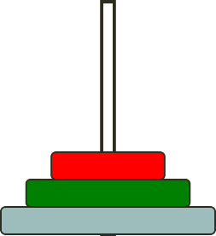
The Towers of Hanoi
Problem statement:
Only one disk could be moved at a time.
A larger disk must never be stacked above a smaller one.
Only one auxiliary needle could be used for the intermediate storage of disks.
Chapter 2
Source
Auxiliary
Destination
24

Slide 17
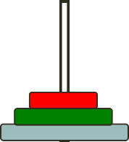
The Towers of Hanoi
move(3, A, C, B)
move(1, A, C, B)
4. A → C
move(2, A, B, C)
move(2, B, C, A)
Chapter 2
move(1, A, B, C)
2. A → B
move(1, B, C, A)
_{6.B → C} move(1,A , C, B)
7. A → C
move(1, A, C, B)
1. A → C
move(1, C, B, A)
3.C → B
move(1, B, A, C)
5. B → A
27
A
B
C

Slide 18
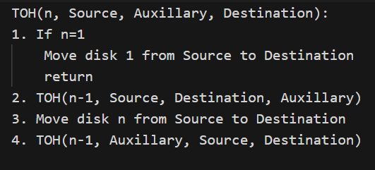
The Towers Algorithm
Chapter 2

Slide 19
Iteration Recursion
Buttom Up Approach
Top Down Approach
May be less efficient due to function call overhead
More efficient in terms of memory and speed
Chapter 2
30

Slide 20
Recursion is inefficient but if same code is written using iteration the logic becomes complex and code may be lengthy
Chapter 2
31

Slide 21
Applications of recursion
Tower of Hanoi
N Queens
Maze Solving
Computer file system is recursive
(A folder contains file and folders(which again contains more))
Chapter 5
Chapter 2
33

