Slide 1
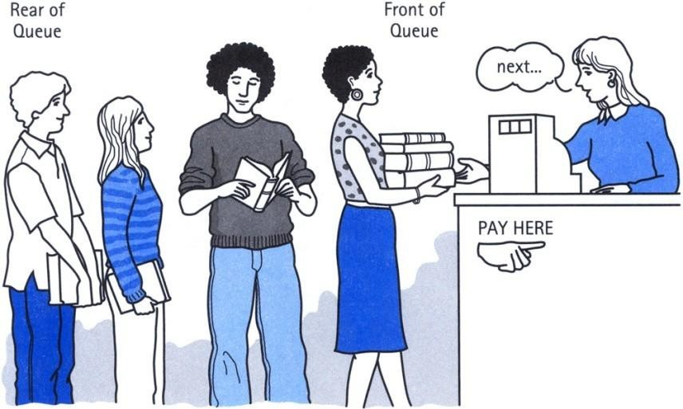
Queue : Introduction
A Queue is an ordered collection of items from which
items
may be deleted at one end (called the front of the and into which items may be inserted at the other rear of the queue).
queue) end (the
The first element inserted into the queue is the first element to be removed. For this reason a queue is sometimes called a FIFO (first-in first-out) list.
Enqueue: Inserting an item
Dequeue: Deleleting an item
Chapter2
2

Slide 2
LINEAR QUEUE:
initially front=rear=-1
Enqueue(Queue, n, front, rear, data):
if rear=n-1
write Overflow and return
if front=-1
front=rear=0
Queue[rear]=data
else
rear=rear+1
Queue[rear]=data
return
Chapter2
5

Slide 3
LINEAR QUEUE:
initially front = rear = -1
Dequeue(Queue, n, front, rear):
if front = -1
write underflow and return
item = Queue[front]
if front = rear
front = rear = -1
else
front = front+1
return item

Slide 4
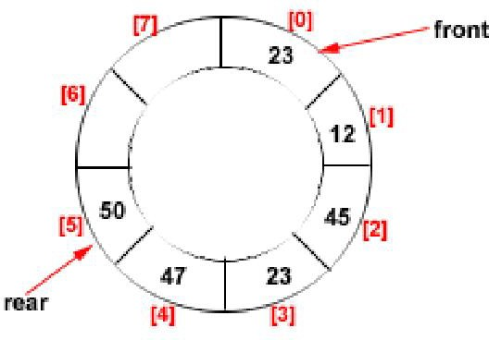
Circular Queue
Circular queue
In circular queue, once the Queue is full ,the "First" element of the queue becomes the “Rear" most element, if and only if ,the "Front“ has moved forward. Otherwise it will again be a "Queue overflow" state.
Chapter2
9
Figure: Circular Queue having Rear = 5
and Front = 0

Slide 5
Circular QUEUE:
initially front=rear=-1
Enqueue(Queue, n, front, rear, data):
if (rear+1)%n = front
write Overflow and return
if front = -1
front = rear = 0
Queue[rear] = data
else
rear = (rear + 1) % n
Queue[rear] = data
return
Chapter2
10

Slide 6
Circular QUEUE:
initially front=rear=-1
Dequeue(Queue, n, front, rear):
if front=-1
write Overflow and return
item=Queue[front]
if front=rear
front=rear=-1
else
front=(front+1)%n
return item
Chapter2
11

Slide 7
Priority Queue
Each element has a priority and element with highest priority is served first. If some elements have same priority then FCFS(First Come First Serve)
Two types
Ascending priority queue
Items are inserted arbitrarily but removes smallest element first
Descending priority queue
Items are inserted arbitrarily but removes largest element first
15
Chapter2

Slide 8
Priority Queue
Application
Scheduling queues for a processor, print queues, transmit
Chapter2
16

Slide 9
Deques
It is a double-ended queue.
Items can be inserted and deleted from either ends.
More versatile data structure than stack or queue.
E.g. policy-based application (e.g. low priority go to the end, high go to the front)
Two types:
Input restricted
Input from one end only but delete from both
Output restricted
Input from both end but delete from one end only
Chapter2
17

Slide 10
DEQUE:
initially front=rear=-1
enqueue_front(Queue, n, front, rear, data):
if front=0
write Overflow and return
if front=-1
front=rear=0
Queue[front]=data
else
front=front-1
Queue[front]=data
return
enqueue_rear(Queue, n, front, rear, data):
if rear=n-1
write Overflow and return
if rear=-1
front=rear=0
Queue[rear]=data
else
rear=rear+1
Queue[rear]=data
return
Chapter2
18

Slide 11
DEQUE:
initially front=rear=-1
dequeue_front(Queue, n, front, rear):
if front=-1
write Underflow and return
item=Queue[front]
if front=rear
front=rear=-1
else
front=front-1
return item
dequeue_rear(Queue, n, front, rear):
if rear=-1
write Underflow and return
item=Queue[rear]
if front=rear
front=rear=-1
else
rear=rear-1
return item
Chapter2
19

Slide 12
CIRCULAR_DEQUE:
initially front=rear=-1
enqueue_front(Queue, n, front, rear, data):
if (rear+1)%n=front
write Overflow and return
if front=-1
front=rear=0
Queue[front]=data
else
front=(front-1+n)%n
Queue[front]=data
return
enqueue_rear(Queue, n, front, rear, data):
if (rear+1)%n=front
write Overflow and return
if rear=-1
front=rear=0
Queue[rear]=data
else
rear=(rear+1)%n
Queue[rear]=data
return
Chapter2
19

Slide 13
CIRCULAR_DEQUE:
initially front=rear=-1
dequeue_front(Queue, n, front, rear):
if front=-1
write Underflow and return
item=Queue[front]
if front=rear
front=rear=-1
else
front=(front-1+n)%n
return item
dequeue_rear(Queue, n, front, rear):
if rear=-1
write Underflow and return
item=Queue[rear]
if front=rear
front=rear=-1
else
rear=(rear-1+n)%n
return item
Chapter2
19

