Slide 1
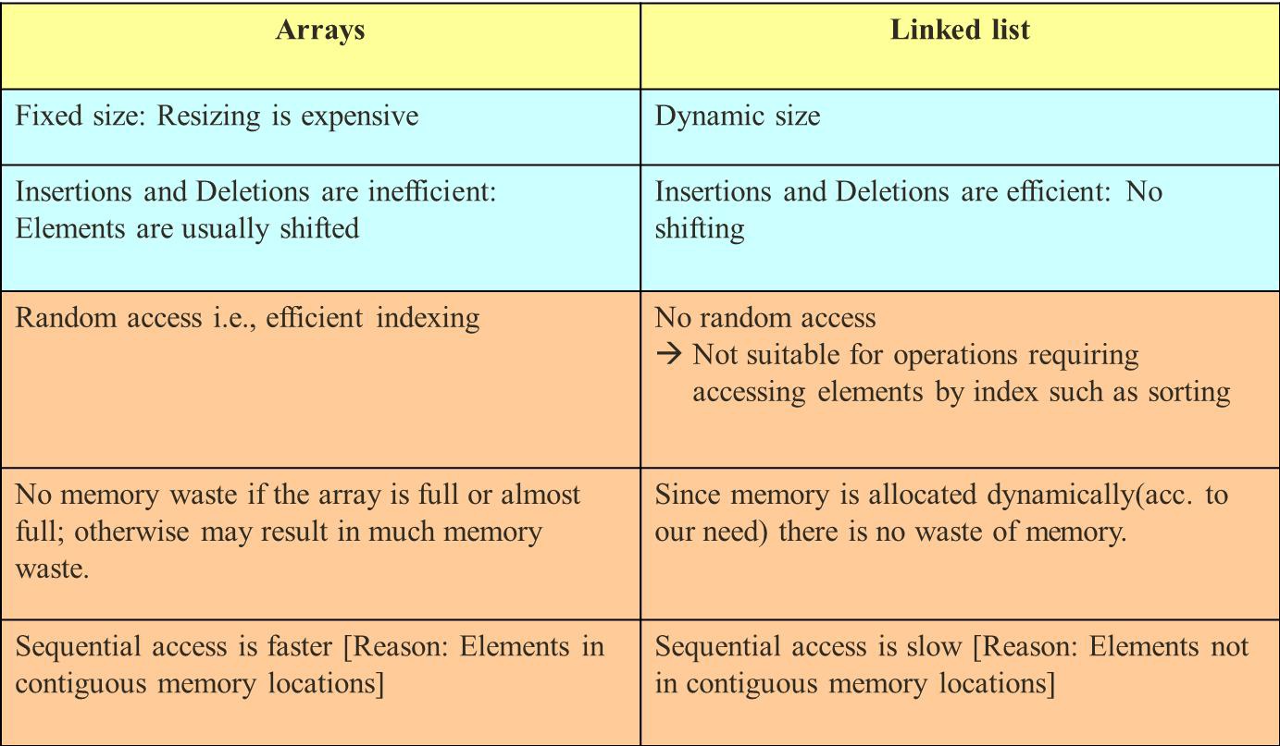
Array Vs Linked List
Chapter 4

Slide 2
Linked List : Introduction
It is a list or collection of data items that can be stored in scattered locations (positions) in memory by establishing link between the items.
Chapter 4

Slide 3
Types of linked list
There are two basic types of linked list
Singly Linked list
Singly linear linked list
Singly Circular linked list
Chapter 4
Doubly linked list
Doubly linear linked list
Doubly Circular linked list
6

Slide 4
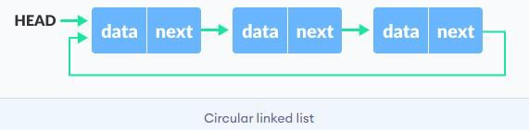
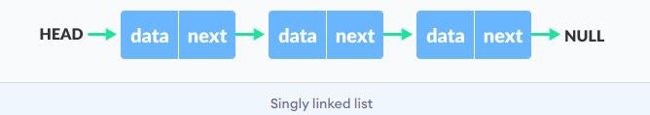
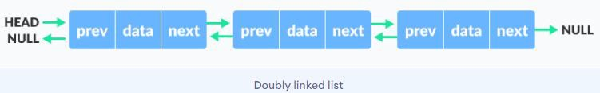
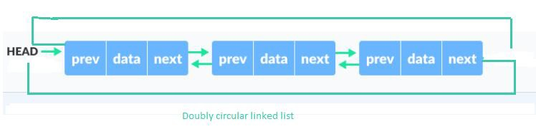


Types of linked list
Chapter 4

Slide 5
Singly Linked List
Chapter 4

Slide 6
Creating a node
struct node
{
int data;
node *next;
};
Chapter 4
node *start; //pointer to head of linked list

Slide 7
SINGLY_LINKED_LIST:
insertAtBeginning(data):
allocate memory for new node new
if n=null
write Memory Allocation Failed and return
n->data=data
n->next=start
start=n
return
Chapter 4

Slide 8
insertAtEnd(data):
allocate memory for new node n
if n=null
write Memory Allocation Failed and return
n->data=data
n->next=null
if start=null
start=n
return
temp=start
Repeat while temp->next != null
temp=temp->next
temp->next
return
Chapter 4

Slide 9
insertAfterSpecificNode(data,key):
allocate memory for new node n
if n=null
write Memory Allocation Failed and return
n->data=data
temp=start
Repeat while temp->data != key and temp != null
temp=temp->next
n->next=temp->next
temp->next=n
return
Chapter 4

Slide 10
insertBeforeSpecificNode(data, key):
if start=null
return
if start->data=key
insertAtBeginning(data)
prev=null
curr=start
Repeat while curr != null and current->data != key
prev=curr
curr=curr->next
if curr!=null
allocate memory for new node n
if n=null
write Memory Allocation Failed and return
n->data=data
n->next=prev-next
prev->next=n
Chapter 4

Slide 11
insertAtPosition(data, pos):
if pos<=0
return
if pos=1
insertAtBeginning(data)
temp=start
i=1
Repeat while i<pos-1 and temp!=null
temp=temp->next
i=i+1
if temp!=null
allocate memory for new node n
if n=null
write Memory Allocation Failed and return
n->data=data
n->next=temp->next
temp->next=n
return
Chapter 4

Slide 12
Insertion in a sorted list
insertInSortedList(data):
if start=null
startAtBeginning(data)
return
prev=null
curr=start
Repeat while curr->data < data and curr!=null
prev=curr
curr=curr->next
if curr=null
insertAtEnd(data)
return
allocate memory for new node n
if n=null
write Memory Allocation Failed and return
n->data=data
n->next=prev->next
prev->next=n
return
Chapter 4
22

Slide 13
Deletion
deletionFromBeginning():
if start=null
write Underflow and return
temp=start
start=start->next
free(temp)
return
Chapter 4

Slide 14
deletionFromEnd():
if start=null
write Underflow and return
if start->next=null
free(start)
start=null
return
temp=start
Repeat while temp->next->next != null
temp=temp->next
free(temp->next)
temp->next=null
return
Chapter 4

Slide 15
deletionAfterSpecificNode(key):
if start=null
write Underflow and return
temp=start
Repeat while temp != null and temp->data != key
temp=temp->next
if temp!=null and temp->next!=null
node_to_delete = temp->next
temp->next = node_to_delete->next
free(node_to_delete)
return
write NodeNotFound and return
Chapter 4

Slide 16
Deletion in sorted list
deletionInSortedList(key):
if start=null
write Underflow and return
prev=null
curr=start
Repeat while curr != null and curr->data != key
prev=curr
curr=curr->next
if curr!=null
prev->next=curr->next
free(curr)
return
write NodeNotFound and return
Chapter 4

Slide 17
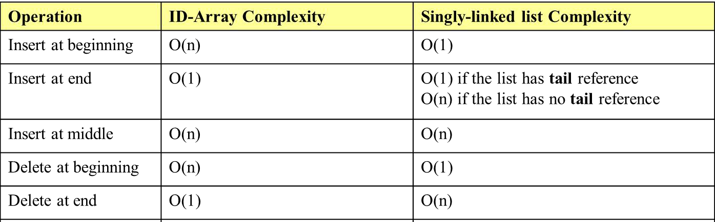
Complexity of array Vs SLL
Chapter 4

Slide 18
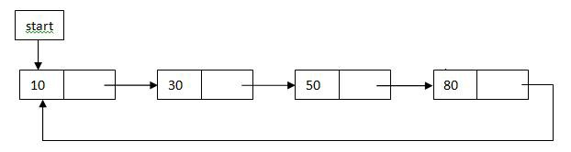
Circular linked list
A circular linked list is a singly- linked list, in which the link field of the last node contains the address of the first node of the list instead of pointing to NULL.
A circular linked list has no end, so we can use two pointers first and last to point to the first and the last nodes respectively (but not necessarily).
Chapter 4

Slide 19
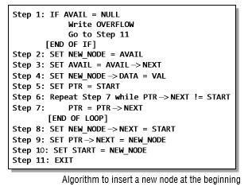
Inserting at beginning - CLL
Chapter 4

Slide 20
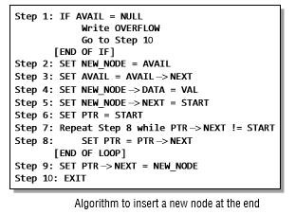
Inserting at end- CLL
Chapter 4

Slide 21
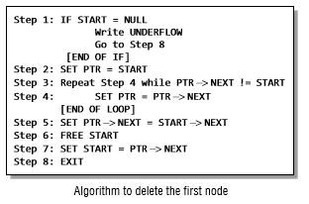
Deletion from beginning - CLL
Chapter 4

Slide 22
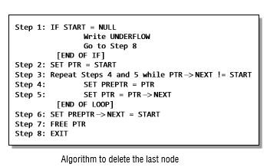
Deletion from end- CLL
Chapter 4

Slide 23
Stack as linked list
The START pointer of the linked list is used as TOP.
All insertions and deletions are done at the node pointed by TOP. If TOP = NULL, then it indicates that the stack is empty.
Chapter 4

Slide 24
Operations on linked stack
Push (top, data) :
Allocate memory for the new node n
n->data=data
n->next=top
top=n
Chapter 4
44

Slide 25
Operations on linked stack
Pop(top):
if top=null write Underflow and return
temp=top
top=top->next
free temp
return
Chapter 4
45

Slide 26
Queue as linked list
The START pointer of the linked list is used as FRONT.
Here, we will also use another pointer called REAR, which will store the address of the last element in the queue.
Chapter 4
46

Slide 27
Operations on linked queue
enqueue(front, rear, data) :
allocate memory for new node n
if n=null
write MemoryAllocationFailed and return
n->data=data
if rear=null
front=rear=n
n->next=null
else
rear->next=n
rear=n
rear->next=null
return
Chapter 4
47

Slide 28
Operations on linked queue
dequeue(front, rear):
if front=null
write Underflow and return
temp=front
front=front->next
free temp
return
Chapter 4
48

Slide 29

Application of linked list
Addition of two polynomials:
In the linked list representation of polynomials, each term is considered as a node. Such a node contains three fields.
Coefficient field
Exponent field
Link field
Chapter 4
Consider a polynomial 6x³ + 9x² + 7x + 1 :
49

Slide 30
ADDITION_OF_TWO_POLYNOMIAL():
//input
Read no. of terms of first Polynomial P
Read coefficient and exponent of P
Read no. of terms of second Polynomial Q
Read coefficient and exponent of Q
make a Resultant Polynomial R
set temporart pointers p,q to traverse P,Q respectively
compare the exponent of two nodes pointed by p and q until p=null or q=null:
if exponent of p = exponent of q
add coefficient
add sum and common exponent into R
if exponent of p > exponent of q
add p's content into R
if exponent of p < exponent of q
add q's content into R
Append remaining terms either from P or Q (if any) into R
Chapter 4
50

Slide 31
Doubly linked list
Doubly linked list is a linked data structure that consists of a set of sequentially linked records called nodes.
Each node contains three fields ::
one is data part which contain data only.
two other field is links part that are pointer references to the previous and to the next node in the sequence of nodes.
Chapter 4
The beginning and ending nodes' previous and next links, respectively, point to some kind of terminator, typically a sentinel node or null to facilitate traversal of the list.
53

Slide 32
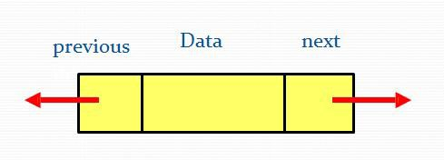
Structure of DLL
struct node
{
int data; node*next; node*previous;
};
Chapter 4
54

Slide 33
DLL vs. SLL
Advantages of DLL:
Can be traversed in either direction (may be essential for some programs)
Some operations, such as deletion and inserting before a node, become easier
Chapter 4
Disadvantages of DLL:
Requires more space
List manipulations are slower (because more links must be changed)
Greater chance of having bugs (because more links must be manipulated)
55

Slide 34
Operations in DLL
Insertion operations
At the beginning
At the end
After specific node
Before specific node
Deletion operations
From the beginning
From the end
After specific node
Chapter 4
56
• Before specific node

Slide 35
Insertion at beginning
Step 1: Allocate memory for NEW_NODE Step 2: IF NEW_NODE= NULL
Write OVERFLOW
Go to Step 9 [END OF IF]
Step 3: SET NEW_NODE ->DATA=VAL
Step 4: SET NEW_NODE ->PREV=NEW_NODE ->NEXT=NULL Step 5: IF START = NULL
SET START = NEW_NODE
Go to step 9 [END OF IF]
Step 6: SET NEW_NODE->NEXT = START
Step 7: SET START->PREV = NEW_NODE Step 8: SET START = NEW_NODE
Step 9: EXIT
Chapter 4
58

Slide 36
Insertion at end
Step 1: Allocate memory for NEW_NODE Step 2: IF NEW_NODE= NULL
Write OVERFLOW Go to Step 11 [END OF IF]
Step 3: SET NEW_NODE ->DATA=VAL
Step 4: SET NEW_NODE ->PREV=NEW_NODE ->NEXT=NULL Step 5: IF START = NULL
SET START = NEW_NODE
Go to step 11 [END OF IF]
Step 6: SET PTR = START
Step 7: Repeat Step 8 while PTR-> NEXT != NULL
Chapter 4
Step 8:
SET PTR = PTR-> NEXT [END OF LOOP]
Step 9: SET NEW_NODE-> PREV=PTR Step 10: SET PTR-> NEXT = NEW_NODE Step 11: EXIT
60

Slide 37
Insertion after specific node
Step 1: Allocate memory for NEW_NODE Step 2: IF NEW_NODE= NULL
Write OVERFLOW Go to Step 13 [END OF IF]
Step 3: SET NEW_NODE ->DATA=VAL
Step 4: SET NEW_NODE ->PREV=NEW_NODE ->NEXT=NULL Step 5: IF START = NULL
SET START = NEW_NODE
Go to step 13 [END OF IF]
Step 6: SET PTR = START
Step 7: Repeat Step 8 while PTR-> DATA!= NUM
Chapter 4
Step 8:
SET PTR = PTR-> NEXT [END OF LOOP]
Step 9: SET NEW_NODE ->NEXT = PTR-> NEXT Step 10:SET NEW_NODE-> PREV=PTR
Step 11: SET PTR-> NEXT -> PREV = NEW_NODE Step 12 :SET PTR-> NEXT = NEW_NODE
Step 13: EXIT
62

Slide 38
Insertion before specific node
Step 1: Allocate memory for NEW_NODE Step 2: IF NEW_NODE= NULL
Write OVERFLOW Go to Step 13 [END OF IF]
Step 3: SET NEW_NODE ->DATA=VAL
Step 4: SET NEW_NODE ->PREV=NEW_NODE ->NEXT=NULL Step 5: IF START = NULL
SET START = NEW_NODE
Go to step 13 [END OF IF]
Step 6: SET PTR = START
Step 7: Repeat Step 8 while PTR-> DATA!= NUM
Chapter 4
Step 8:
SET PTR = PTR-> NEXT [END OF LOOP]
Step 9: SET NEW_NODE ->NEXT = PTR
Step 10:SET NEW_NODE-> PREV=PTR->PREV Step 11: SET PTR-> PREV -> NEXT = NEW_NODE Step 12 :SET PTR-> PREV = NEW_NODE
Step 13: EXIT
64

Slide 39
Deletion from beginning
Step 1: IF START = NULL
Write UNDERFLOW
Go to Step 6 [END OF IF]
Step 2: SET PTR = START
Step 3: SET START = START-> NEXT Step 4: SET START->PREV=NULL Step 5: FREE PTR
Step 6: EXIT
Chapter 4

Slide 40
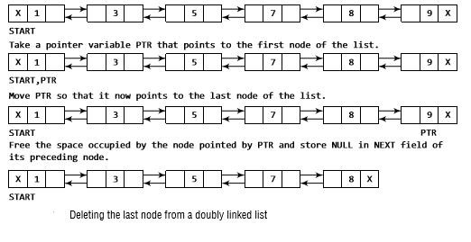
Deletion from end
Chapter 4

Slide 41
Deletion from end
Step 1: IF START = NULL
Write UNDERFLOW
Go to Step 7 [END OF IF]
Step 2: SET PTR = START
Step 3: Repeat step 4 while PTR ->NEXT!=NULL
Chapter 4
Step 4:
SET PTR = PTR-> NEXT [END OF LOOP]
Step 5: SET PTR->PREV->NEXT=NULL Step 6: FREE PTR
Step 7: EXIT

Slide 42
Deletion after specific node
Step 1: IF START = NULL
Write UNDERFLOW
Go to Step 9 [END OF IF]
Step 2: SET PTR = START
Step 3: Repeat step 4 while PTR ->DATA!=NUM Step 4: SET PTR = PTR-> NEXT
[END OF LOOP]
Step 5: SET TEMP= PTR->NEXT
Step 6: SET PTR->NEXT = TEMP->NEXT Step 7: SET TEMP->NEXT->PREV = PTR Step 8: FREE TEMP
Step 9: EXIT
Chapter 4

Slide 43
Deletion before specific node
Step 1: IF START = NULL
Write UNDERFLOW
Go to Step 9 [END OF IF]
Step 2: SET PTR = START
Step 3: Repeat step 4 while PTR ->DATA!=NUM Step 4: SET PTR = PTR-> NEXT
[END OF LOOP]
Step 5: SET TEMP= PTR->PREV
Step 6: SET TEMP ->PREV->NEXT= PTR Step 7: SET PTR->PREV = TEMP ->PREV Step 8: FREE TEMP
Step 9: EXIT
Chapter 4
71

Slide 44

Circular doubly linked list
A circular doubly linked list or a circular two-way linked list contains a pointer to the next as well as the previous node in the sequence.
The circular doubly linked list does not contain NULL in the previous field of the first node and the next field of the last node.
Rather, the next field of the last node stores the address of the first node of the list, i.e., START. Similarly, the previous field of the first field stores the address of the last node.
Chapter 4

Slide 45
Insertion at beginning in circular DLL
Step 1: Allocate memory for NEW_NODE Step 2: IF NEW_NODE= NULL
Write OVERFLOW Go to Step 14 [END OF IF]
Step 3: SET NEW_NODE ->DATA=VAL
Step 4: SET NEW_NODE ->PREV=NEW_NODE ->NEXT=NEW_NODE Step 5: IF START = NULL
SET START = NEW_NODE
Go to step 14 [END OF IF]
Step 6: SET PTR = START
Step 7: Repeat Step 8 while PTR-> NEXT!= START
Chapter 4
Step 8:
SET PTR = PTR-> NEXT [END OF LOOP]
Step 9: SET NEW_NODE-> PREV=PTR Step 10: SET NEW_NODE -> NEXT= START Step 11: SET PTR->NEXT = NEW_NODE Step 12: SET START-> PREV= NEW_NODE Step 13: SET START= NEW_NODE
Step 14: EXIT
74

Slide 46
Insertion at end in circular DLL
Step 1: Allocate memory for NEW_NODE Step 2: IF NEW_NODE= NULL
Write OVERFLOW Go to Step 13 [END OF IF]
Step 3: SET NEW_NODE ->DATA=VAL
Step 4: SET NEW_NODE ->PREV=NEW_NODE ->NEXT=NEW_NODE Step 5: IF START = NULL
SET START = NEW_NODE
Go to step 13 [END OF IF]
Step 6: SET PTR = START
Step 7: Repeat Step 8 while PTR-> NEXT!= START
Chapter 4
Step 8:
SET PTR = PTR-> NEXT [END OF LOOP]
Step 9: SET NEW_NODE-> PREV=PTR Step 10: SET NEW_NODE-> NEXT =START Step 11: SET PTR->NEXT = NEW_NODE Step 12: SET START-> PREV= NEW_NODE Step 13: EXIT
76

Slide 47
Deletion from beginning in circular DLL
Step 1: IF START = NULL
Write UNDERFLOW
Go to Step 9 [END OF IF]
Step 2: SET PTR = START
Step 3: Repeat step 4 while PTR ->DATA!=NUM Step 4: SET PTR = PTR-> NEXT
[END OF LOOP]
Step 5: SET PTR->NEXT = START ->NEXT Step 6: SET START->NEXT->PREV= PTR Step 7: FREE START
Step 8: SET START= PTR->NEXT Step 9: EXIT
Chapter 4
78

Slide 48
Deletion from end in circular DLL
Step 1: IF START = NULL
Write UNDERFLOW
Go to Step 9 [END OF IF]
Step 2: SET PTR = START
Step 3: Repeat step 4 while PTR ->NEXT!=START Step 4: SET PTR = PTR-> NEXT
[END OF LOOP]
Step 5: SET PTR->PREV->NEXT= START Step 6: SET START->PREV= PTR->PREV Step 7: FREE PTR
Step 8: EXIT
Chapter 4

