Slide 1
Introduction
A graph is an abstract data structure which is basically, a collection of
vertices (also called nodes) and edges that connect these vertices.
A graph is often viewed as a generalization of the tree structure, where instead of a having a purely parent-to-child relationship between tree nodes, any kind of complex relationships between the nodes can be represented.
Type y
Chapter 10
Why graphs are useful?
Graphs are widely used to model any situation where entities or things are related to each other in pairs; for example, the following information can be represented by graphs:
Family trees in which the member nodes have an edge from parent to each of their children.
Transportation networks in which nodes are airports, intersections, ports, etc. The edges can be airline flights, one-way roads, shipping routes, etc.
2

Slide 2
Definition
A graph G is defined as an ordered set (V, E), where V(G) represent the set of vertices and E(G) represents the edges that connect the vertices.
The figure given shows a graph with V(G) = { A, B, C, D and E} and
E(G) = { (A, B), (B, C), (A, D), (B, D), (D, E), (C, E) }. Note that there are
5 vertices or nodes and 6 edges in the graph.
Chapter 10
A
B
C
D E
3

Slide 3
Definition
A graph can be directed or undirected. In an undirected graph, the edges do not have any direction associated with them. That is, if an edge is drawn between nodes A and B, then the nodes can be traversed from A to B as well as from B to A. The above figure shows an undirected graph because it does not gives any information about the direction of the edges.
The given figure shows a directed graph. In a directed graph, edges form an ordered pair. If there is an edge from A to B, then there is a path from A to B but not from B to A. The edge (A, B) is said to initiate from node A (also known as initial node) and terminate at node B (terminal node).
Chapter 10
A
B
C
4
D
E

Slide 4
Graph terminology
Adjacent Nodes or Neighbors: For every edge, e = (u, v) the nodes u and v are said to be the adjacent nodes or neighbors.
Degree of a node: Degree of a node u, deg(u), is the total number of edges containing the node u. If deg(u) = 0, it is known as an isolated node.
Regular graph: That is every node has the same degree.
Chapter 10
5

Slide 5
Path: A path P, written as P = {v0, v1, v2,….., vn), of length n from a node u to v is defined as a sequence of (n+1) nodes. Here, u = v0, v = vn and vi-1 is adjacent to vi for i = 1, 2, 3, …, n.
Closed path: A path P is known as a closed path if the edge has the same end-points. That is, if v0 = vn.
Simple path: A path P is known as a simple path if all the nodes in the path are distinct with an exception that v0 may be equal to vn. If v0 = vn, then the path is called a closed simple path.
Cycle: A closed simple path with length 3 or more is known as a cycle. A
cycle of length k is called a k – cycle.
Connected graph: There are no isolated nodes in a connected graph. A connected graph that does not have any cycle is called a tree. If you pick any two vertices in the graph, you can travel from one to the other by following the edges.
Complete graph: There is a path from one node to every other node directly in the graph. A complete graph has ^{n}C₂ edges, where n is the number of nodes in G.
Chapter 10
6

Slide 6
Graph terminology
Labeled graph or weighted graph: A graph is said to be labeled if every edge in the graph is assigned some data. In a weighted graph, the edges of the graph are assigned some weight or length. Weight of the edge, denoted by w(e) is a positive value which indicates the cost of traversing the edge.
Multiple edges: Distinct edges which connect the same end points are called multiple edges. That is, e = {u, v) and e’ = (u, v) are known as multiple edges of G.
Loop: An edge that has identical end-points is called a loop. That is,
e = (u, u).
Multi- graph: A graph with multiple edges and/or a loop is called a
multi-graph.
Chapter 10
Size of the graph: The size of a graph is the total number of edges in
it.
7

Slide 7






Graph terminology
3
4
e1
A
B
C
A
B
C
Chapter 10
A
B
e4
2
e2
7
1
e3
D
E
F
C
e5
e6
D
D
B
e7
3
Multigraph
Tree
Weighted graph
8

Slide 8
Adjacency matrix representation
An adjacency matrix is used to represent which nodes are adjacent to one another. By definition, we have learnt that, two nodes are said to be adjacent if there is an edge connecting them.
In a directed graph G, if node v is adjacent to node u, then surely there is an edge from u to v. That is, if v is adjacent to u, we can get from u to v by traversing one edge. For any graph G having n nodes, the adjacency matrix will have dimensions of n X n.
In an adjacency matrix, the rows and columns are labeled by graph vertices. An entry aij in the adjacency matrix will contain 1, if vertices vi and vj are adjacent to each other. However, if the nodes are not adjacent, aij will be set to zero.
Chapter 10
9
1 if v_{i} is adjacent to v_{j}, that is there is an edge (v_{i}, v_{j})
aij
0 otherwise

Slide 9
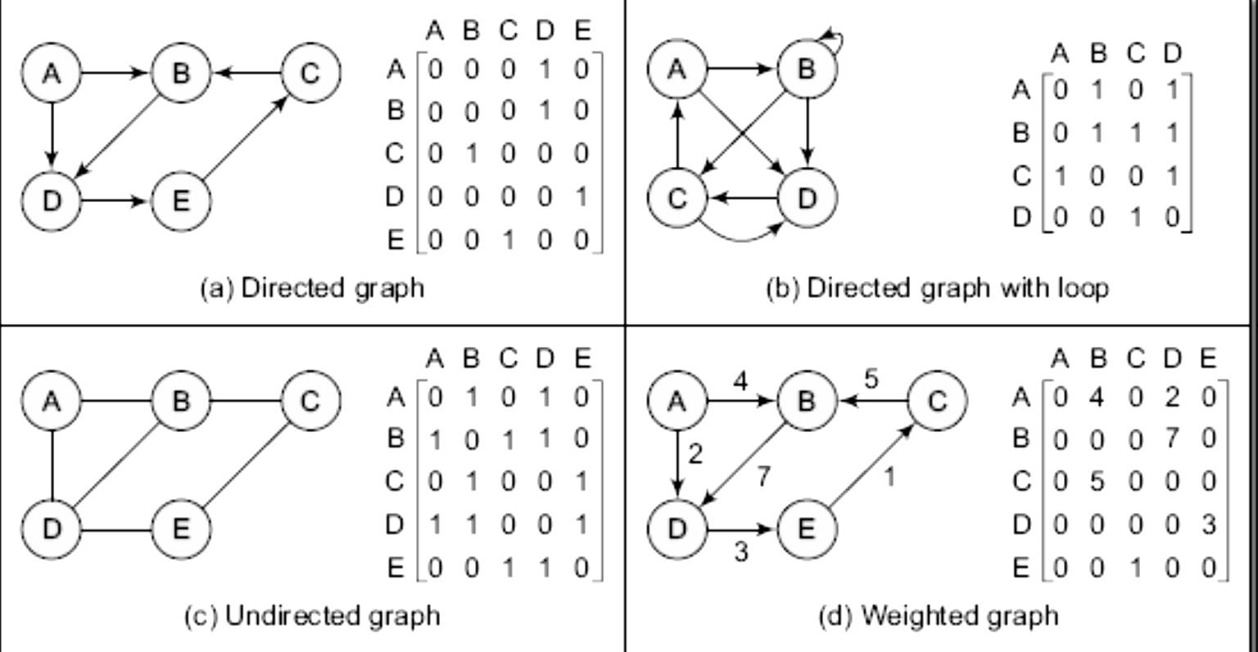

Adjacency matrix representation
Since an adjacency matrix contains only 0s and 1s, it is called a bit matrix or a Boolean matrix. The entries in the matrix depend on the ordering of the nodes in G. therefore, a change in the order of nodes will result in a different adjacency matrix.
Chapter 10
10

Slide 10
Adjacency list representation
The adjacency list is another way in which graphs can be represented in
computer’s memory. This structure consists of a list of all nodes in
G. Furthermore, every node is in turn linked to its own list that contains the
names of all other nodes that are adjacent to itself.
The key advantage of using an adjacency list includes:
It is easy to follow, and clearly shows the adjacent nodes of a particular node
It is often used for storing graphs that have a small to moderate number of edges. That is an Adjacency list is preferred for representing sparse graphs in computer’s memory; otherwise, an adjacency matrix is a good choice.
Chapter 10
•
Adding new nodes in G is easy and straightforward when G is represented using an Adjacency list. Adding new nodes in an Adjacency matrix is a difficult task as size of the matrix needs to be changed and existing nodes may have to be reordered.
11

Slide 11
Adjacency list representation
For a directed graph, the sum of lengths of all adjacency lists is equal to the number of edges in G. However, for an undirected graph, the sum of lengths of all adjacency lists is equal to twice the number of edges in G because an edge (u, v) means an edge from node u to v as well as an edge v to u. The adjacency list can also be modified to store weighted graphs.
Graph G and its adjacency list
Chapter 10
A
B
A
B
C
D
B
C X
B
D X
C
D
D X
12
A
B X

Slide 12
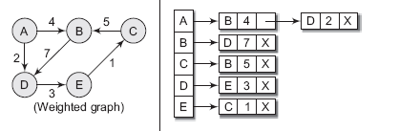
Adjacency list representation
A
B
C
A
B C
D E
B
D X
A
C
D X
D E
B
E X
A
B
E X
Chapter 10
C
D X
13

Slide 13
Graph traversal
By traversing a graph, we mean the method of examining the nodes and edges of the graph. There are two standard methods of graph traversal which we will discuss in this section. These two methods are-
Breadth first search
Depth first search
While breadth first search will use a queue as an auxiliary data structure to store nodes for further processing, the depth-first search scheme will use a stack. But both these algorithms will make use of a variable STATUS. During the execution of the algorithm, every node in the graph will have the variable STATUS set to 1, 2 or depending on its current state. Table I shows the value of status and its significance.
Chapter 10
14

Slide 14
Graph traversal
STATUS | STATE OF THE NODE | DESCRIPTION
1 | Ready | The initial state of the node N
2 | Waiting | Node N is placed on the queue or stack and waiting to be processed
3 | Processed | Node N has been completely processed
Chapter 10
15

Slide 15
Graph traversal
Aspect | BFS (Breadth First Search) | DFS (Depth First Search)
Traversal style | Explores level by level. | Explores deep branch first, then backtracks.
Data structure | Uses a Queue. | Uses a Stack (or recursion).
Shortest path | Always finds shortest path in an unweighted graph. | Does not guarantee shortest path.
Memory usage | Needs more memory (stores all neighbors in queue → depends on graph’s width). | Needs less memory (stores only current path → depends on graph’s depth).
Chapter 10
15

Slide 16
Breadth first traversal/search
Breadth-first search (BFS) is a graph search algorithm that begins at the root node and explores all the neighboring nodes. Then for each of those nearest nodes, the algorithm explores their unexplored neighbor nodes, and so on, until it finds the goal.
That is, we start examining the node A and then all the neighbors of A are examined. In the next step we examine the neighbors of neighbors of A, so on and so forth
Chapter 10
16

Slide 17
Breadth first traversal/search
Algorithm for breadth-first search in a graph G beginning at a starting node A
Step 1: SET STATUS = 1 (ready state) for each node in G.
Step 2: Enqueue the starting node A and set its STATUS = 2 (waiting state)
Step 3: Repeat Steps 4 and 5 until QUEUE is empty
Step 4: Dequeue a node N. Process it and set its STATUS = 3 (processed state).
Step 5: Enqueue all the neighbors of N that are in the ready state
(whose STATUS = 1) and set their STATUS = 2 (waiting state)
[END OF LOOP]
Step 6: EXIT
Chapter 10
17

Slide 18
Breadth first search
Example: Consider the graph G given below. The adjacency list of G is also given.
A
Adjacency Lists
A: B, C, D B: E C: B, G D: C, G E: C, F F: C, H G: F, H, I H: E, I I: F
Chapter 10
B
C
D
E
F
G
18
H
I
a)Initially add A to QUEUE and add NULL to visited, so

Slide 19
Set of visited vertices | Queue
NULL | A
A | B, C, D
A, B | C, D, E
A, B, C | D, E, G
A, B, C, D | E, G
A, B, C, D, E | G, F
A, B, C, D, E, G | F, H
A, B, C, D, E, G, F | H
A, B, C, D, E, G, F, H | I
A, B, C, D, E, G, F, H, I | NULL
Chapter 10
19

Slide 20
Depth first search/traversal
The Depth First Search algorithm progresses by expanding the starting node of G and thus going deeper and deeper until a goal node is found, or until a node that has no children is encountered. When a dead- end is reached, the algorithm backtracks, returning to the most recent node that has not been completely explored.
Chapter 10
In other words, the Depth- First Search algorithm begins at a starting node A which becomes the current node. Then it examines each node N along a path P which begins at A. That is, we process a neighbor of A, then a neighbor of neighbor of A and so on. During the execution of the algorithm, if we reach a path that has a node N that has already been processed, then we backtrack to the current node. Otherwise, the un-visited (un- processed node) becomes the current node.
21

Slide 21
Depth first search
Algorithm for depth-first search in a graph G beginning
at a starting node A
Step 1: SET STATUS = 1 (ready state) for each node in G.
Step 2: Push the starting node A on the stack and set
its STATUS = 2 (waiting state)
Step 3: Repeat Steps 4 and 5 until STACK is empty
Step 4:Pop the top node N. Process it and set its STATUS = 3 (processed state).
Step 5:Push on to the stack all the neighbors of N that are in the ready state (whose STATUS = 1) and set their STATUS = 2 (waiting state)
[END OF LOOP]
Step 6: EXIT
22
Chapter 10

Slide 22
Depth first search
Example: Consider the graph G given below. The adjacency list of G is also given. Suppose we want to print all nodes that can be reached from the node A (including A itself).
Chapter 10
A
Adjacency Lists
A: B, C, D B: E C: B, G D: C, G E: C, F F: C, H G: F, H, I H: E, I I: F
B
C
D
E
F
G
23
H
I

Slide 23
Set of visited vertices | Stack
NULL | A
A | B, C, D
A, D | B, C, G
A, D, G | B, C, F, H, I
A, D, G , I | B, C, F, H
A, D, G , I, H | B, C, F, E
A, D, G , I, H, E | B, C, F
A, D, G , I, H, E, F | B, C
A, D, G , I, H, E, F, C | B
A, D, G , I, H, E, F, C, B | NULL
Chapter 10
24

Slide 24
Minimum spanning tree (MST)
The sum of the weights of its edges is minimum.
Chapter 10
26

Slide 25
Prim’s algorithm for MST
Tree vertices: Vertices that are a part of the minimum spanning
tree T.
Fringe vertices: Vertices that are currently not a part of T, but are adjacent to some tree vertex.
Unseen Vertices: Vertices that are neither tree vertices nor
fringe vertices fall under this category.
The steps in the Prim algorithm can be given as follows:
Choose a starting vertex
Branch out from the starting vertex and during each iteration select a new vertex and edge. Basically, during each iteration of the algorithm, we have to select a vertex from the fringe vertices in such a way that the edge connecting the tree vertex and the new vertex has minimum weight assigned to it.
Chapter 10
30

Slide 26
Prim’s algorithm for MST
Prim’s Algorithm
Step 1: Select a starting vertex, add it in MST
Step 2: Repeat Steps 3 and 4 until there are
fringe vertices
Step 3:Select an edge e connecting the tree vertex and fringe vertex that has minimum weight
Step 4:Add the selected edge and the vertex to
Chapter 10
the minimum spanning
tree T it it don’t
create cycle
31

Slide 27


Prim’s algorithm for MST
Example: Construct a minimum spanning tree of the graph
given below.
7
11
A
B
E
3
4
9
C D
10
Chapter 10
Choose a starting vertex, A for example.
A
Add the fringe vertices (that are adjacent to A). The edges
connecting the vertex and fringe vertices are shown with
dotted lines.
7
A
B
3
32
C

Slide 28


Prim’s algorithm for MST
Select an edge connecting the tree vertex and fringe vertex that has minimum weight and add the selected edge and the vertex to the minimum spanning tree T. Since the edge connecting A and C has less weight, so add C to the tree. Now C is not a fringe vertex but a tree
vertex.
7
Chapter 10
A
B
3
C
Add the fringe vertices (that are adjacent to C).
7
A
B
3
4
33
C
D
10

Slide 29
Prim’s algorithm for MST
Select an edge connecting the tree vertex and fringe vertex that has minimum weight and add the selected edge and the vertex to the minimum spanning tree T. Since the edge connecting C and B has less weight, so add B to the tree. Now B is not a fringe vertex but a tree vertex.
A
B
Chapter 10
3
4
C
D
10
Add the fringe vertices (that are adjacent to B).
11
A
B
E
3
4
34
9
C
10
D

Slide 30
Prim’s algorithm for MST
Select an edge connecting the tree vertex and fringe vertex that has minimum weight and add the selected edge and the vertex to the minimum spanning tree T. Since the edge connecting B and D has less weight, so add D to the tree. Now D is not a fringe vertex but a
tree vertex.
11
A
B
E
Chapter 10
3
4
9
C
D
Note, now node E is not connected, so we will add it in the tree because a minimum spanning tree is one in which all n nodes are connected with n-1 edges that has minimum weight. So the minimum spanning tree can now be given as,
11
A
B
E
35
3
4
9
C
D

Slide 31
5
5
B
D
6
B
D
3
6
3
2 3 2
4
5
F
A
2
3 2
F
A
5
3
5
3
C
E
C
E
4
5
B
D
6
B
D
3
6
3
2
3 2
F
A
2
3 2
F
A
5
3
5
3
C
E
C
E
4
5
4
5
B
D
6
B
D
3
6
3
2
3 2
F
A
2
3 2
F
36
A
3
5
3
5
C
E
C
E
4
4

Slide 32
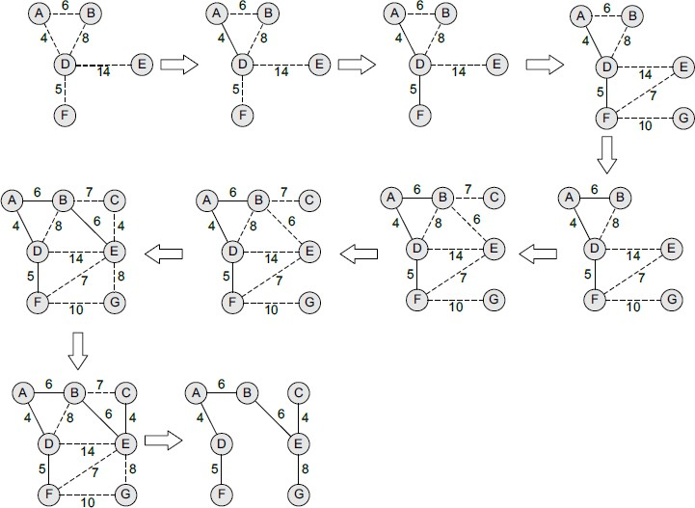
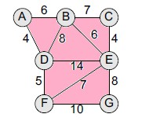
Chapter 10
37
Given graph

Slide 33
Kruskal’s algorithm for MST
Like the Prim’s algorithm, the Kruskal's algorithm is used to find a minimum spanning tree for a connected weighted graph. That is, the algorithm aims to find a subset of the edges that forms a tree that includes every vertex. The total weight of all the edges in the tree is minimized. However, if initially, the graph is not connected then it finds a minimum spanning forest (Note that a forest is a collection of trees. Similarly, a minimum spanning forest is a collection of minimum spanning trees).
Chapter 10
Kruskal's algorithm is an example of a greedy algorithm as it makes the locally optimal choice at each stage with the hope of finding the global optimum. The algorithm can be given as shown in figure.
38

Slide 34
Kruskal’s algorithm for MST
KRUSKAL’S ALGORTIHM
Step | 1: | Create a forest in such a way that each vertex
 |  | is a separate tree.
Step | 2: | Create a queue Q that contains all
 |  | the edges of the graph in increasing cost.
Step | 3: | Repeat Steps 4 and 5 while Q is NOT EMPTY
Step | 4: | Remove an edge e from Q
Step | 5: | Add this edge e into Forest if it doest’t create cycle
Chapter 10

Slide 35
Kruskal’s algorithm for MST
Example: Apply Kruskal’s algorithm on the graph given below
7
A
1
6
8
5
D
B
C
5
3
4
Chapter 10
E
F
2
Initially, we have F = {{A}, {B}, {C}. {D}, {E}, {F}} MST = {}
Q = {(A, D), (E, F), (C, E), (E, D), (C, D), (D, F), (A, C), (A, B), (B, C)}
40

Slide 36
The MST is obtained as,
7
A
1
D
B
C
Chapter 10
3
4
E
F
2
42

Slide 37

Prim’s: MST is always connected in intermediate step
Kruskal’s: MST may be isolated vertex in intermediate step
Best for:
Prim’s: Dense graphs.
Kruskal’s: Sparse graphs.
Chapter 10
42

Slide 38
Dijkstra’s algorithm
Dijkstra's algorithm, given by a Dutch scientist Edsger Dijkstra in 1959, is used to find the shortest path tree.
Given a graph G and a source node A, the algorithm is used to find the shortest path (one having the lowest cost) between A (source node) and every other node.
Moreover, Dijkstra’s algorithm is also used for finding costs of shortest paths from a source node to a destination node.
That means, it solves single source shortest path problem for a directed graph G(V,E) with non-negative edge weights i.e. w(u,v)>=0
Chapter 10
43

Slide 39
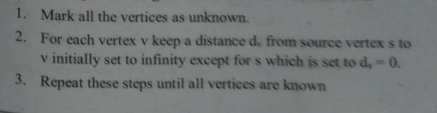
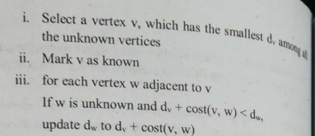
Dijkstra’s algorithm
Chapter 10
44

Slide 40
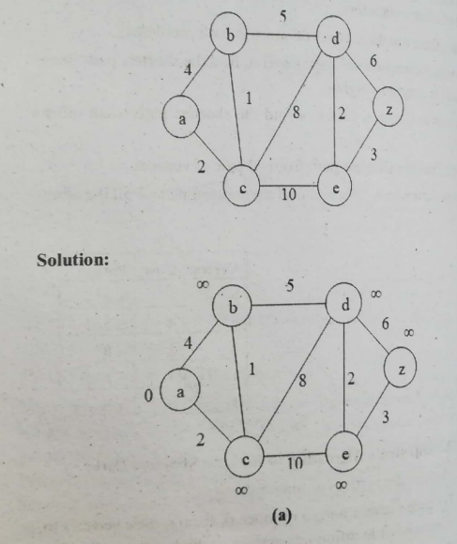
Dijkstra’s algorithm
Chapter 10
46

Slide 41
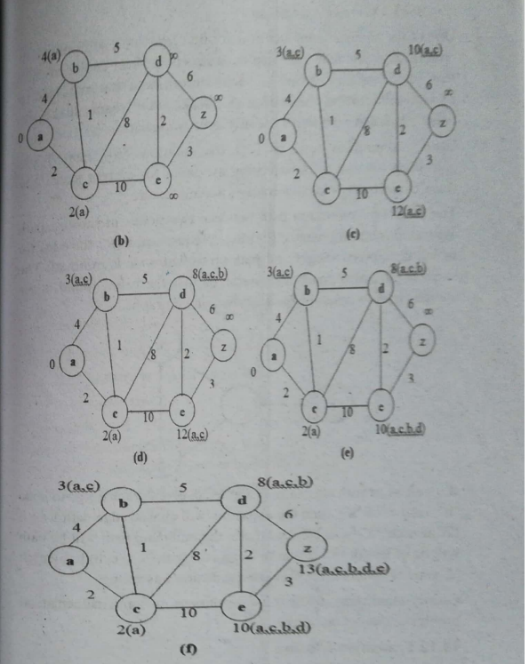

Slide 42
Warshall’s algorithm
Computes the transitive closure of a graph. That means it finds out which nodes are reachable from which other nodes.
Chapter 10
48

Slide 43
Warshall’s algorithm
1)Input: Adjacency matrix A[n][n] of a graph with n nodes
2) Initialize shortest path matrix R
for i = 0 to n-1:
for j = 0 to n-1:
if A[i][j] == 1:
R[i][j] = 1
else:
R[i][j] = 0
3)Compute transitive closure using intermediate nodes:
for i = 0 to n-1:
for j = 0 to n-1:
for k = 0 to n-1:
R[i][j] = R[i][j] OR (R[i][k] AND R[k][j])
Chapter 10
51

Slide 44
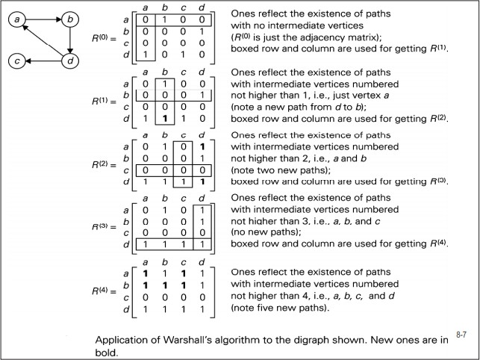
Chapter 10
52

Slide 45
Floyd -Warshall’s algorithm
Finds the shortest distances between all pairs of nodes in a weighted graph. That means it tells you the minimum path cost from every node to every other node.
Chapter 10

Slide 46
1)Input: Adjacency matrix A[n][n] of a graph with n nodes
2) Initialize shortest path matrix D
for i = 0 to n-1:
for j = 0 to n-1:
if i == j:
D[i][j] = 0
else if A[i][j] == 0:
D[i][j] = ∞
else:
D[i][j] = A[i][j]
3)Compute shortest paths using intermediate nodes:
for i=0 to n-1
for j=0 to n-1
for k=0 to n-1
D[i][j] = min(D[i][j], D[i][k] + D[k][j])
Chapter 10
54

Slide 47
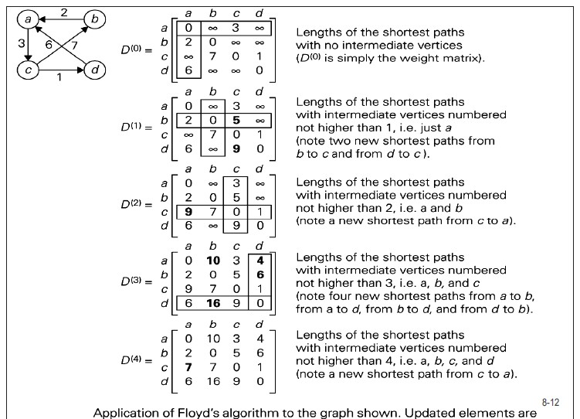
Floyd - Warshall’s algorithm
Chapter 10
55

