Slide 1
Searching
The process of retrieving some particular information from a large
amount of previously stored information.
The information can be in sorted or unsorted form.
Normally we think of the information as divided up into records, each record having a key for use in searching.
The goal of the search is to find all records with keys matching a
given search key.
The purpose of the search is usually to access information within the record for processing.
It is not compulsory that the searched key values are found in the
records.
Chapter 8
2

Slide 2
Searching (Types)
Searching generally falls in two categories:
Internal Search
External Search
Internal Search:
If the data to be searched are all present in main memory, then the searching becomes internal search
Internal Searches are faster than External Search and hence are recommended whenever possible
They are mainly done among the data which occupy less space compared to the space of RAM
External Search:
If most of the data to be searched are in auxiliary memory, then the search
becomes External Search.
If the data are very large and our main memory is not large enough to hold them all during the process, then the external search is used.
Chapter 8
3

Slide 3
Searching Algorithms
Different searching algorithms are used
The choice of proper algorithm depends upon the way the data are arranged
Any algorithm technique may be better than another according to the favorable way the data are arranged for it
We are going to study the following 3 searching techniques:
Linear Search
For unsorted data in linear structure
Binary Search
For sorted data in linear structure
Tree Search
For data maintained in search trees
4
Chapter 8

Slide 4
Linear Search
Also called Sequential Search
Simplest among all
Applicable for data organized in form of array or linked list
It is applicable for small data values
Each element in the array is compared with the value to be
searched
If the values are matched, then the search is successful
Otherwise the comparison is kept on doing until all the values are compared
By the end of the comparison if the value in the array is not matched with the value to be searched, then the search is considered unsuccessful
Chapter 8
5

Slide 5
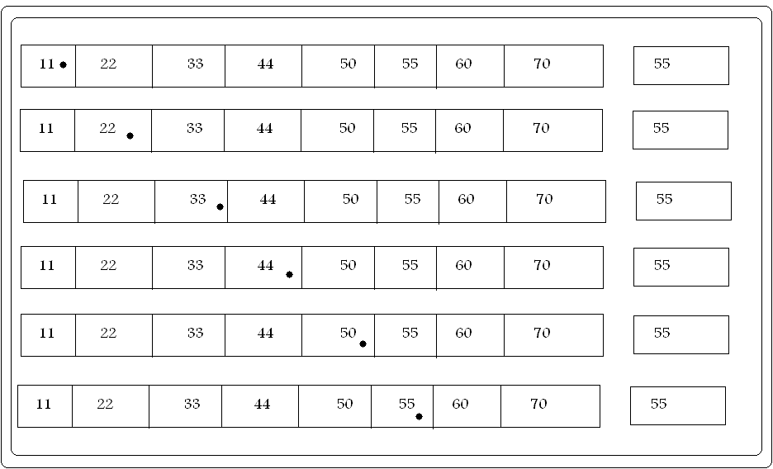
Linear Search (Example)
To find
Chapter 8
6
Result Found

Slide 6
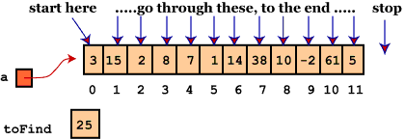
Linear Search (Example)
Chapter 8
Result Not Found
7

Slide 7
Linear Search (Algorithm)
Linear_Search(A, n,item):
flag = 0
for i = 0 to n-1
if A[i]=item
flag=1
print “Searching is Successful”
exit
if flag=0
print “Searching Failed”
Chapter 8
8

Slide 8
Linear Search
It is considered simple and is very applicable when searching
for small data
It is good in searching for unsorted data
Whereas,
It is slower as compared to other searching algorithms
It is applicable only for small amount of data
Chapter 8

Slide 9
Binary Search
If the data items are presented in sorted form (i.e. ascending or
descending), then this algorithm is used
It is much more efficient algorithm than the general linear search for the sorted data
Key value is compared with the middle element of the list
If the values are equal then the search is successful and the process is
stopped
If the middle values is less, then, the result is in upper half of the list
If the middle value is greater ,then ,the result is in lower half of the list
The search is repeated for the lower or upper half of the list until we
find the required value in the list or all items from the list is searched
Chapter 8

Slide 10
Binary Search (Algorithm)
Binary_Search(A,n,item)
first=0 last=n-1 flag=0
While (first<=last)
middle=(first + last)/2
if (a[middle]=item)
display “Search Successful”
flag=1;
exit
else if item<a[middle]
last=middle-1
else
first=middle+1
middle=(first + last)/2
if flag=0
display “Search unsuccessful”
Chapter 8
15

Slide 11
Tree Search
If the data are arranged in the form of search tree structure, then
the tree search can be applied
Search tree generally is a Binary Search Tree
Here the key value is compared with the root node at first.
If it matches then the search is successful
If it doesn’t matches then either the left or right sub-tree is
searched based upon the comparison result
If the data item is less than the root node, then left subtree is searched
If the data item is greater than the root node, then right subtree is
searched
The traversal is repeated until the searched item is found or null value is reached
Chapter 8
18

Slide 12
Tree Search (Algorithm)
Tree_Search(root, item):
node=root
Repeat forever
if node = NULL
print "Searching Unsuccessful"
Exit
Else if node->data = item
print "Searching Successful"
else if item > node->data
node = node->right
else
node = node->left
Chapter 8
21

Slide 13
Hashing
Hashing is the technique of representing longer records by shorter
values called keys
The keys are placed in a table called hash table where the keys are compared for finding the records
Hash table is a dictionary in which keys are mapped to array positions by using suitable mathematical function called hash function.
One of the simple search scheme where the records are indexed using certain hash function is called hashing
Items being searched can directly be accessed by using the hash
table by mapping the corresponding key values into records
Hashing technique requires minimum (generally 1) number of comparison for searching the desired record
Chapter 8
22

Slide 14

Hashing
Lets consider an example:
Numbers from 1 to 99 can be indexed in a hash table by
using the hash function of modulo 10 division
This function results with the last digit of the numbers which can be used as key for the hash table
If random numbers are chosen, all the indices may not be full
Some index may contain more than one values and some may not contain any
This imbalance in indices is called Clustering
More than one data in a single index is called Collision,
which results with the conflict while searching
Key | Value
0 | 10, 20, 40
1
2 | 42, 82
3
4 | 64
5 | 95
6
7 | 87, 47
8
 |  | 23
9 | 99
Chapter 8

Slide 15
Hashing (terminology)
Home Address:
Address produced by the hash function
Prime area:
The memory location that contains all the home addresses
Synonyms:
A set of keys that hash to the same locations
Collision:
The location of data to be inserted is already occupied by the synonym data
Probing:
Examining memory location in the hash table.
24
Chapter 8

Slide 16
Hash Function (Types)
Mathematical formula which when applied to a key, produces an integer which can be used as index for the key in hash table.
Its main aim is to distribute elements uniformly to minimize the number of collision.
Any given hashing technique can be considered ideal if,
There is no location collision (at least minimal)
The address space in memory is compact
Different types of hash functions can be used
Some of the popular ones are:
Chapter 8
Direct hashing
Modulo Division
Multiplicative
Digit Extraction (truncation)
Mid-Square
Folding
25

Slide 17
Direct Hashing
The address is the key itself
Hash(key)=key
The main advantage is that there is not any collision
The disadvantage is that the address space (storage) is as large as the key space
address | Key
0 | 0
1 | 1
--- | ---
--- | ---
50 | 50
51 | 51
--- | ---
--- | ---
1089 | 1089
1090 | 1090
Chapter 8
26

Slide 18
Modulo Division
Uses remainder obtained as address
Hash(key) = address = key % listsize
Yields hash value which belongs to the set {0,1,2,3,…..,listsize}
Fewer collisions if listsize is a prime number
Chapter 8
Example :
Numbering system to handle 1,500 students
If key is 12865, Address=hash(12865)=12865 % 1500=865
If key is 224568, Address=hash(224568)= 224568 % 1500= 1068
27

Slide 19
Multiplicative Method
Steps in this method:
1. Choose constant c , a real number, between 0 and 1
2. Multiply key k by c , [k*c]
3. Get fractional part of the product, [k*c-floor(k*c)]
This is a random number between 0 and 1
4. Multiply the result by listsize and obtain the integer part,
floor(listsize *[k*c-floor(k*c)]) or floor(listsize *[k*c mod 1])
5. The final result is the required address
Chapter 8
Address=hash(k)=floor(listsize*(k*c-floor(k*c))
Where 0<c<1
Note: floor(X) is the largest integer not greater than X
Knuth has suggested that best choice of c is 0.6180339887
28

Slide 20
Multiplicative Method
Example 1:
Assume; k=12876
Listsize=100
C=0.12
Now the address is: Address=hash(12876)
=Floor(100*(12876*0.12-
floor(12876*0.12)))
=floor(100*(1545.12- floor(1545.12)))
=floor(100*(1545.12-
1545))
=floor(100*0.12)
=12
Example 2:
Assume; k=12345
Listsize=1000
C=0.618033
Now the address is: Address=hash(12345)
=Floor(1000*(12345*0.
618033 mod 1))
=floor(1000*(7629.6173
85 mod 1))
=floor(1000*(.617385))
=floor(617.385)
=617
Chapter 8
29

Slide 21
Digit Extraction
Some digits from the number in specific places are extracted
The places from which the extraction has to be done are predefined
The same extraction technique is used for all the keys
Here,
Address=selected digit from the key
Example:
If places for digit extraction are – 10s , 100s and 100000s 345261=326
167524=152
543625=562
987709=970
Chapter 8
30

Slide 22
Mid Square
Few number of middle digits from the key are extracted
Thus extracted number is squared
The squared result is the required address value
The number of digits chosen depends on number of digits allowed for indexing
Example:
Assume; k=12876
Extract second and third digit N=28
Now, Address=hash(12876)=N*N
=28*28
=784
Chapter 8
31

Slide 23
Mid Square
The major disadvantage is value obtained by doing square
may be too large
The resolution can be to use only a portion of the result
Few number of digits from the middle of the result is used
Example:
K=39873
Address=98*98=9604 Which is long
Hence use only portion of the result New Address=60
32
Chapter 8

Slide 24
Folding
Step 1 : The key is divided into number of parts having same number of digits (or maybe less for the last part)
Step 2 : Sum all the individual divided parts
Step 3: If there is any carry in the result, then discard it
Step 4: Thus formed number is the address for the key
Example:
Assume; k=12896543
Hash table size = 000 to 999 (i.e. 3 digits) Our part division will be: 128+965+43
=1136
Truncate the carry (i.e. 1 in thousand’s place) Hence our address will be,
Address=136
Chapter 8
33

Slide 25
Collision Resolution
Direct hashing maps the key values with the individual addresses, hence it is a one-to-one mapping technique and no collision occurs.
All other hashing techniques may results with some collision
Different collision resolution techniques are used
These techniques are independent of the hashing functions
applied
All these techniques target to minimize clustering because clustering is the main reason for collision
Chapter 8

Slide 26
Collision Resolution Techniques
Two basic techniques are used:
1. Rehashing (Also called Open Addressing)
The types are:
Linear Probing
Quadratic Probing
Double Hashing
2. Chaining
Chapter 8

Slide 27
Collision Resolution
Open Addressing:
When collision occurs, an unoccupied address is searched for placing
the new element using probe sequence
Rehashing rh is applied to address value h(key) if the h(key) is already occupied in the hash table.
Again if rh(h(key)) is already occupied we apply rh(rh(h(key))) until an open address is found
It can be done in 3 different ways:
Linear Probing
Quadratic Probing
Double Hashing
Chapter 8

Slide 28
Linear probing
When a home address is occupied, go to the next address
Next address = current address + 1
Rh(k,i) = (h(k)+i) % listsize
Where h(k) = k % listsize
and i=0, 1, 2, 3, …………., listsize-1
Chapter 8

Slide 29
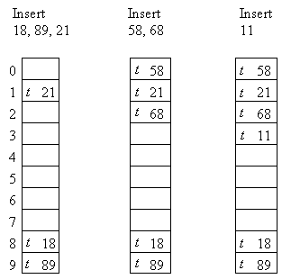
Linear Probing
Chapter 8

Slide 30
Linear Probing
Advantages:
Simple to implement
Disadvantages:
Data tend to cluster around specific home address (Primary
Clustering)
The linear searching is required if data is not present in the searched location, this is very slow process
Chapter 8

Slide 31
Linear Probing
Primary clustering occurs when collisions are resolved using linear probing.
In linear probing, if the home address is occupied, we check the next consecutive slots until we find an empty one.
h(k),h(k)+1,h(k)+2,…
Problem: keys that collide at one home address tend to cluster together in consecutive slots, forming long runs.
This increases search time and worsens performance.
Chapter 8

Slide 32
Quadratic Probing
Tends to minimize the problem of primary clustering from
linear probing
The value is moved considerable distance from the initial collision
The address incremented is the collision probe number
squared, i.e.
rh(k,i) = (h(k) + i²) % listsize
Where h(k) = k % listsize
and i=0, 1, 2, 3, ………, listsize-1
Chapter 8

Slide 33
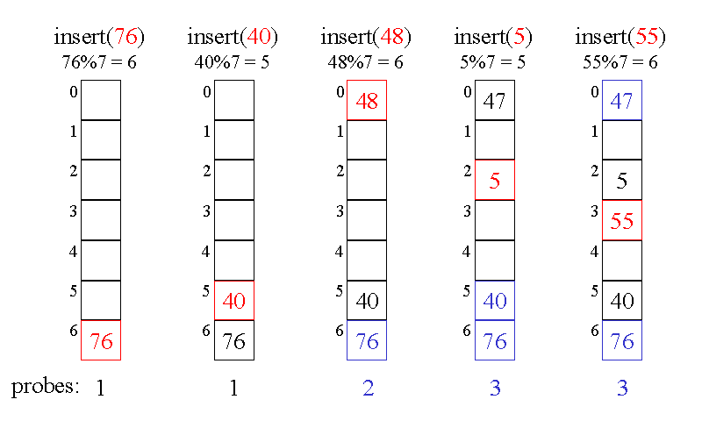
Quadratic Probing
Chapter 8

Slide 34
Quadratic Probing
Advantages:
Works much better than linear probing
Removes primary clustering
Disadvantages:
Time consuming than linear probing
Produces secondary clustering
Chapter 8

Slide 35
Double Hashing
Two different hash functions are used to generate the address
if the initial hashing results with collision
This removes the secondary collision
The initial hash value is reused to rehash functions and new hash value is computed
dh(k, i) = (h₁(k) + i*h₂(k)) % listsize
Where h₁(k) = k % listsize
and h2(k) = k % (some integer slightly less than listsize)
I = 0, 1, 2, 3, ………, (listsize-1)
Chapter 8

Slide 36
Double Hashing
76, 93, 40, 47, 10, 55, 73, 56
h₁(k)=k%10
hp(k,i)=(h₁(k) + i * h₂(k)) % listsize Where i = 0, 1, 2, 3, ………, listsize-1 h₂(k) = k % (listsize-1)
47 10 55
76
93
40
73
56
0
1
2
3
4
5
6
7
8
9
76
93
76
40
93
76
40
93
76
47
40
10
93
76
47
40
10
93
55
76
47
40
10
93
73
55
76
47
40
10
93
73
55
76
47
56
Chapter 8

Slide 37
Open Addressing (Disadvantage)
Major disadvantages are:
Each collision resolution results with the probability for future
collision
If the number keys are more than the address size of hash table, then collision is sure to occur.
This is called overflow
To overcome these disadvantages, separate chaining is used.
Chapter 8

Slide 38
Chaining
Also called separate chaining
Use fixed size hash table
Link lists are used to store the synonyms
Each slot in hash table points to the head of the linked list
All the elements for that address is placed in linked list
Chaining strategy: maintains a linked list at every hash index for collided items
Hash table T is a vector of linked list
Insert element at the head or at the tail
Chapter 8
Key k is stored in list at T[h(k)]
46

Slide 39
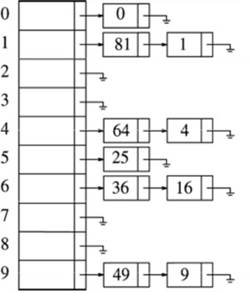
Chaining
E.g. Tablesize=10
H(k) = k mod 10
Insert first 10 perfect
squares
Insertion sequence:
{0,1,4,9,16,25,36,49,64,81}
Chapter 8

Slide 40
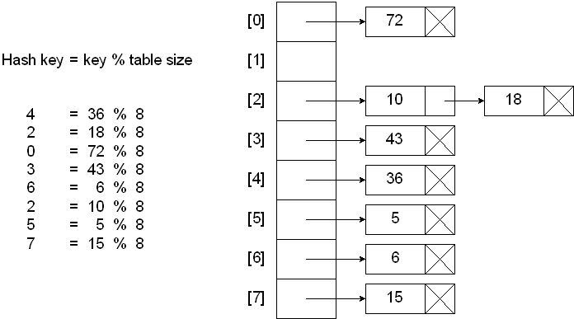
Chaining
Chapter 8

