Slide 1
Types of sorting
Sorting can be categorized into different categories:
1. Internal and external sorting
Internal Sorting
The sorting done within the computer main memory is called internal sorting
It is performed on data items small enough to easily fit within the main memory
External Sorting
The sorting is done in external file disk, i.e. secondary memory
It is performed if the data to be sorted does not fit within computer main memory

Slide 2
Types of sorting
2. In-place and non-in-place sorting
In-place sorting
Sorting can be done within array itself
E.g. Bubble sort
Non-in-place sorting
It requires more space/array (more than or equal to number of elements)
E.g. Merge sort

Slide 3
Types of sorting
3 . Stable and not-stable sorting
Stable sorting
After sorting, similar content stay in the same order as they were before sorting.
Not-stable sorting
After sorting, similar content doesn’t stay in the same order as they were before sorting.
10
3
3
6
8
3
3
6
8
10
10
3
3
6
8
3
3
6
8
10
Stable
Not-Stable

Slide 4
Types of sorting
4. Adaptive and Non-adaptive sorting
Adaptive sorting
The algorithm takes advantage of existing order in the data.
If the list is already partly sorted, it will run faster.
Insertion Sort,
Non-adaptive sorting
The algorithm does not care about existing order in the data.
Even if the list is already sorted, it will still take the same time.
Merge Sort

Slide 5
Sorting Efficiency
Time Complexity
Space Complexity

Slide 6
Bubble Sort
In each pass through the array, Bubble Sort compares
adjacent elements and swaps them if they are in the wrong order.
After the first full pass, the largest element has "bubbled up" to the
end of the array.
After the second pass, the second largest element is in place, and so on.

Slide 7
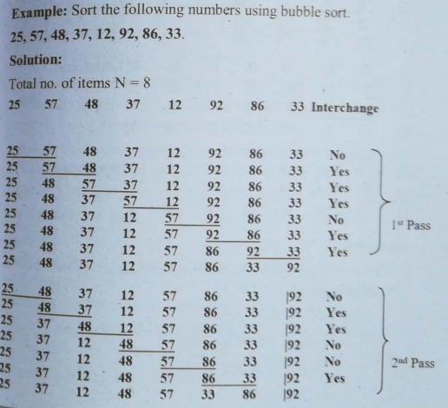
Bubble sort

Slide 8
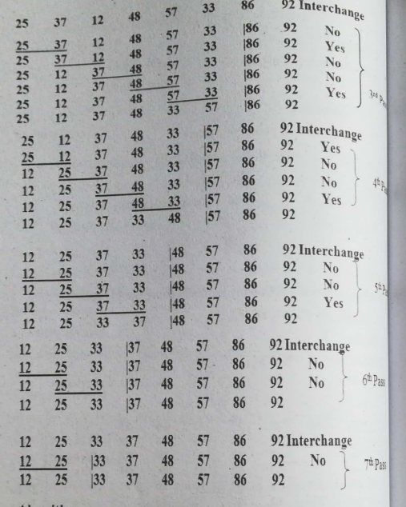
Bubble Sort

Slide 9
Bubble Sort (Algorithm-pseudocode)
Declare and Initialize necessary variables
n => number of data items
A[n] => an array holding all the data items to be sorted
BUBBLE_SORT(A, N)
Step 1: Repeat Step 2 for i = 0 to N-2
Step 2: Repeat for j = 0 to N-2-i
IF A[j] > A[j+1]
SWAP A[j] and A[j+1]
Step 3: EXIT

Slide 10
Modified Bubble Sort
MODIFIED_BUBBLE_SORT(A, N)
Repeat for i = 0 to N-2
Set swapped = false
Repeat for j = 0 to N-2-i
IF A[j] > A[j+1]
SWAP A[j], A[j+1]
swapped = true
If swapped = false
Exit
EXIT
// If this swapped flag is implemented it leads to best time complexity of n

Slide 11
Selection Sort
In each pass, the algorithm selects the smallest (or largest) element from
the unsorted portion of the array.
The selected element is then swapped with the first element of the unsorted
part, putting it in its sorted position.
This process repeats until the whole array is sorted.

Slide 12
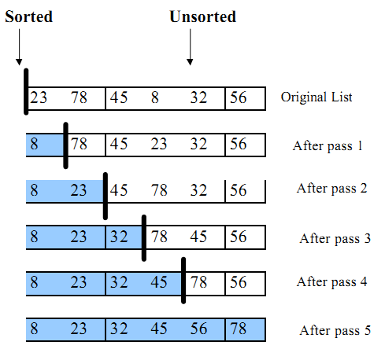
Selection Sort
Consider an example:
23 78 45 8 32 56 (six numbers, five passes required)

Slide 13
Selection Sort (Algorithm-pseudocode)
SELECTION_SORT(A, n):
1.Repeat Step 2,3 for i=0 to n-2
2.min = i
3.Repeat for j=i+1 to n-1
if A[j]<A[min]
min=j
4. If i!= min
swap(A[i], A[min])
5.Exit

Slide 14
Insertion Sort
1. Take first element from unsorted part each time. First element alone is already considered sorted part.
2. Compare it backward with sorted portion of the array. Shift greater elements one step to the right.
3. Inserts current element into correct sorted position. Sorted part grows until whole array becomes sorted.

Slide 15
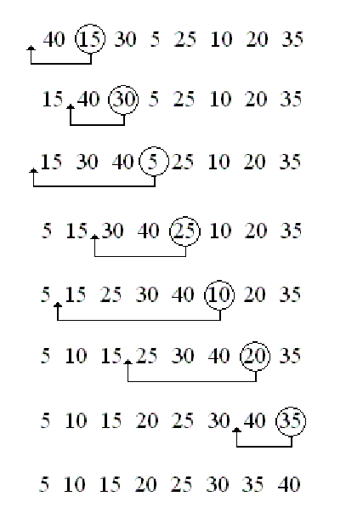
Insertion Sort
o

Slide 16
Insertion Sort
INSERTION-SORT (A, N):
Repeat Step 2,3,4 for i=1 to N-1
temp = A[i] & j=i-1
while j>=0 & temp<A[j]
A[ j+1 ]=A[ j ]
j = j – 1
A[ j+1 ] = temp
Exit

Slide 17
Quick Sort
Also called partition-exchange sort
Uses divide and conquer algorithm
1. Chooses a pivot element from the array. Partitions array into two parts around pivot.
2. Elements smaller go left side of pivot. Elements larger go right side of pivot.
3. Recursively sorts left and right partitions separately. Combines them to form completely sorted array.

Slide 18
Quick Sort
5
6
2
7
1
3
4
pivot
2
6
5
7
1
3
4
2
1
5
7
6
3
4
2
1
3
7
6
5
4
2
1
3
4
6
5
7
pivot

Slide 19
Quick Sort(Algorithm-pseudocode)
QuickSort(A, low, high):
1) If low < high
pivotIndex = Partition(A, low, high)
QuickSort(A, low, pivotIndex - 1)
QuickSort(A, pivotIndex + 1, high)
2) Exit
Partition(A, low, high):
1) pivot = A[high]
i = low - 1
2) Repeat for j = low to high - 1
If A[j] < pivot
i = i + 1
swap(A[i], A[j])
3) swap(A[i + 1], A[high])
4) Return i + 1

Slide 20
Shell Sort
1. Starts with a gap generally n/2. Reduces gap gradually gap=gap/2 until it becomes one.
2. Performs insertion sort on elements at each gap.
3. Final pass with gap = 1 completes sorting.

Slide 21
Shell Sort (Example)
Lets see an example
25, 57, 48, 37, 12, 92, 86, 33
We choose gap size of 5, 3, and 1
Original list
25, 57, 48, 37, 12, 92, 86, 33
Pass 1
Gap=5
25, 57, 48, 37, 12, 92, 86, 33
Pass 3
Gap=1
25, 12, 33, 37, 48, 92, 86, 57
Sorted
result
Pass 2
Gap=3
25, 57, 33, 37, 12, 92, 86, 48
12, 25, 33, 37, 48, 57, 86, 92

Slide 22
Shell Sort (Algorithm-Pseudocode)
SHELL_SORT(A, n):
gap=n
while gap > 0
gap = gap / 2
for i = gap to N-1
temp = A[i] & j = i - gap
while j >= 0 & temp < A[j]
A[j + gap] = A[j]
j = j - gap
A[j + gap] = temp
Exit

Slide 23
Merge Sort
1. Divide the array into two halves recursively. Keep dividing until each subarray has one element.
2. Merge two sorted subarrays into single sorted array. Compare elements and place in order.
3. Repeat merging until the full array is sorted. Final merge produces the completely sorted original array.

Slide 24
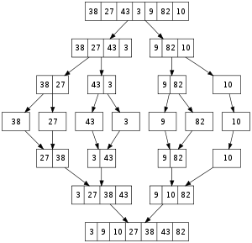
Merge Sort
Divide
Conquer

Slide 25
MERGE_SORT(A, low, high):
If low < high
mid = (low + high) / 2
MERGE_SORT(A, low, mid)
MERGE_SORT(A, mid + 1, high)
MERGE(A, low, mid, high)
Exit
MERGE(A, low, mid, high):
Create left = A[low..mid], right = A[mid+1..high]
i = 0, j = 0, k = low
while i < length(left) & j < length(right)
if left[i] <= right[j]
A[k] = left[i]
i = i + 1
else
A[k] = right[j]
j = j + 1
k = k + 1
Copy remaining elements of left, if any
Copy remaining elements of right, if any
Exit

Slide 26
Radix Sort
Non-comparative integer sorting algorithm
Queues are made for representing different key values
The data to be sorted in the given list is checked starting from any of the position(LSD/MSD) in data
If the starting position is LSD – Least Significant Digit, then the sorting is called LSD Radix Sort
If the starting position is MSD – Most Significant Digit, then the sorting is called MSD Radix Sort

Slide 27
Radix Sort
All the values are made of same length by adding 0s as MSDs if any of the values is shorter than others

Slide 28
Radix Sort
LSD Radix Sort is mainly used for sorting Numeral values
MSD Radix Sort is mainly used for sorting Alphabetical values

Slide 29
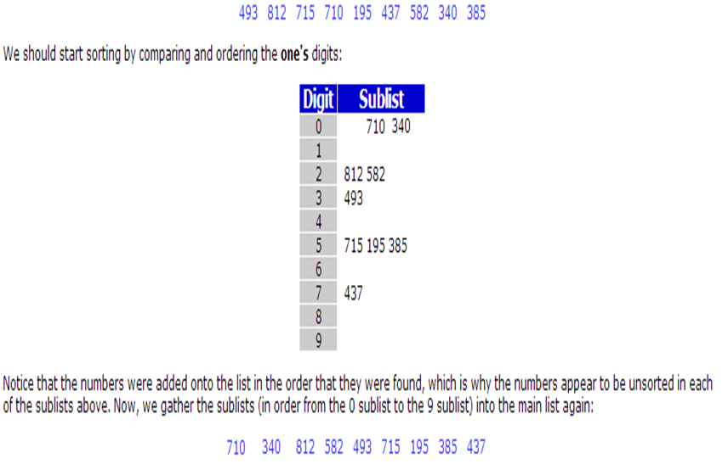
Radix Sort (Example)

Slide 30
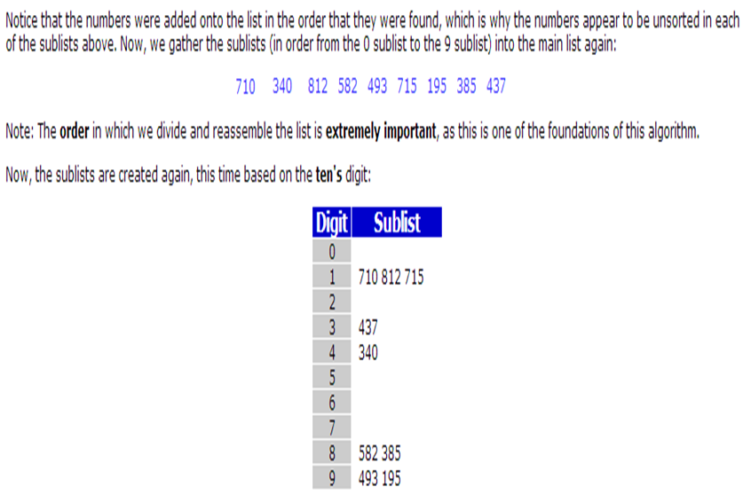
Radix Sort (Example)

Slide 31
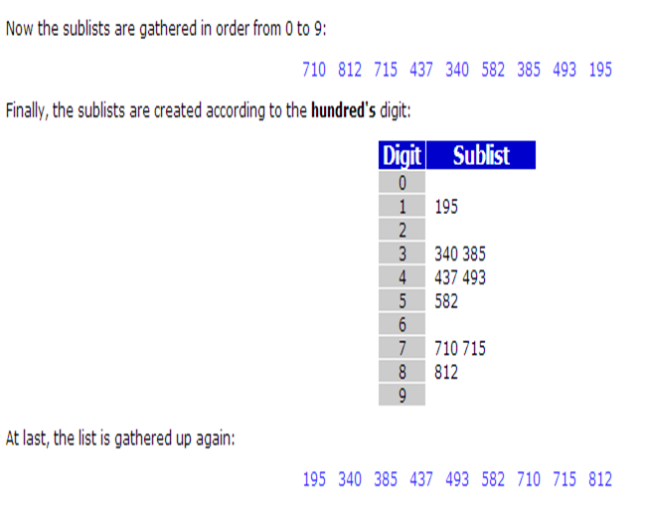
Radix Sort (Example)

Slide 32
Radix Sort (Algorithm-pseudocode)
Radix_Sort(A,n):
Find largest element in A -> largestElement
d = no of digits in largestElement
for i=0 to d-1
make empty bucket[0..9]
for j=0 to n-1
digit = i^{th} digit of A[j]
put A[j] in bucket[digit]
take out all elements of bucket into A in order
Exit

Slide 33
Heap
Max Heaps are ACBT almost complete binary tree, where
Content of each node is less than or equal to that of its father
All levels are full except the lowest level
If lowest level is not full, then nodes must be packed to left
The operations performed in a heap tree are: insertion and deletion
Insertion always occurs in empty left child node
Deletion occurs from root node
Note: There should not be any gap in a heap tree

Slide 34
Operations in Heap
Insertion in the heap
Add new element to the lowest available level
Check the newly inserted value with the value in its parent node
If the parent value is less than the child node
Then interchange the values of child and parent
Repeat the comparison and interchange with other ascending nodes
Note: the process of changing the node with its parent is called heapup

Slide 35
Operations in Heap
Deletion from heap
Remove the root element
Move the last node onto the root node
Check the value with child node and swap until it gets its proper position
During swapping the parent node is swapped with the greater child among the two children
Note: Process of changing the node with its child is called heapdown

Slide 36
Heap Sort
Comparison based sorting algorithm
One of the types of selection sort
It is an in-place algorithm
It is not a stable sort
Heap sort algorithm is divided into two-parts
Building of heap
Sorting of data in an array from the heap

Slide 37
Heap Sort (Algorithm)
Construct a heap using the data from the list by inserting every data sequentially
Create an array with its size equal to number of elements in the heap
Remove root value from heap and insert it into array
Remove the value of last node and place into root
Reconstruct the heap
Continue the above steps until all nodes are deleted

Slide 38
Heap Sort (Example)
.

Slide 39
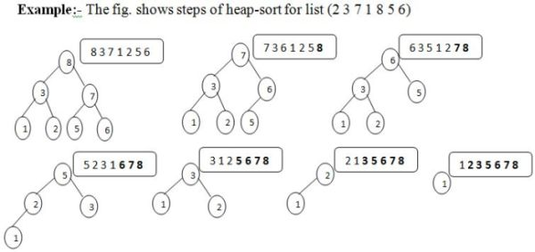
Heap Sort

Slide 40
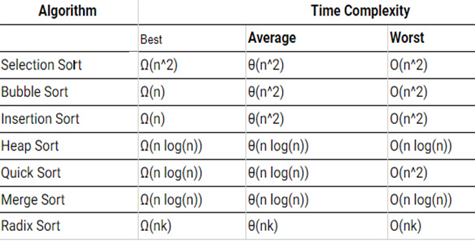
Efficiency of sorting algorithms

Slide 41
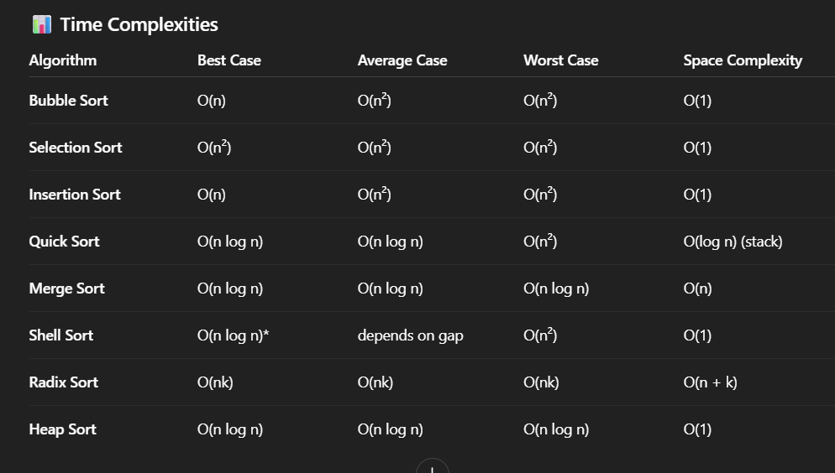
Efficiency of sorting algorithms
(depends on gap)

Slide 42
Merge sort space complexity is 0(n) because at very last merging it need to create left array of size n/2 and right array of size n/2

Slide 43
