Slide 1


Genetic Algorithms: A Powerful Optimization Technique
Genetic Algorithms (GAs) are a powerful optimization technique inspired by the principles of natural selection and evolution. They are particularly useful for solving complex, non-linear problems that are difficult to solve using traditional optimization methods. This document will provide an introduction to GAs, explore the key steps involved in implementing them, and demonstrate their application using Python.
Ba

Slide 2
Problem Analysis and Solution Development
The first step in implementing a Genetic Algorithm is to thoroughly analyze the problem at hand. This involves identifying the objective function, the decision variables, and any constraints or limitations. Once the problem is clearly defined, the next step is to develop a solution approach using the principles of GAs.
GAs work by maintaining a population of candidate solutions, called individuals, and then applying evolutionary operators like selection, crossover, and mutation to evolve the population over successive generations. The goal is to converge towards an optimal or near-optimal solution that maximizes the objective function while satisfying any constraints.
To successfully implement a GA, you need to carefully design the encoding and representation of the problem, define an appropriate fitness function, and choose the right selection, crossover, and mutation operators. These steps are crucial for the algorithm to effectively explore the search space and converge to a high-quality solution.

Slide 3
Encoding and Representation
Binary Encoding
Real-Valued Encoding
Permutation Encoding
One of the most common ways to represent the problem in a GA is through binary encoding. In this approach, each decision variable is represented as a binary string, and the entire solution is a concatenation of these binary strings.
For problems where the decision variables are naturally represented as real numbers, it may be more efficient to use a real-valued encoding. In this case, each decision variable is represented directly as a floating-point number.
Some problems, such as the Traveling Salesman Problem, involve finding the best order or sequence of elements. In these cases, a permutation encoding, where each individual is a unique ordering of the elements, can be used.
The choice of encoding and representation is crucial, as it can significantly impact the performance and efficiency of the Genetic Algorithm. Careful consideration of the problem structure and the decision variables is necessary to select the most appropriate encoding scheme.

Slide 4
Fitness Function and Selection
The fitness function is the cornerstone of a Genetic Algorithm, as it determines the quality of each individual in the population. The fitness function should be designed to accurately reflect the objective of the optimization problem and guide the algorithm towards the desired solution.
1
Fitness Function
2
Selection
The fitness function takes an individual (a candidate solution) as input and returns a numerical value that represents the quality or fitness of that solution. A higher fitness value indicates a better solution.
The selection process determines which individuals in the current population will be used as parents to produce the next generation. Common selection methods include Roulette Wheel Selection, Tournament Selection, and Rank Selection.
3
Elitism
4
Diversity Preservation
Elitism is a technique where the best-performing individuals from the current generation are directly carried over to the next generation, ensuring that the algorithm does not lose the best solutions found so far.
To prevent the algorithm from converging too quickly to a local optimum, it is important to maintain diversity within the population. Techniques like fitness sharing, crowding, and niching can be used to promote diversity.

Slide 5
Implementing Genetic Algorithms in Python
Python is a popular choice for implementing Genetic Algorithms due to its readability, flexibility, and extensive library support. Here's a high-level overview of the steps involved in implementing a GA using Python:
Initialize Population
1
Create an initial population of candidate solutions, represented using the appropriate encoding scheme (e.g., binary, real-valued, or permutation).
2
Evaluate Fitness
Calculate the fitness of each individual in the population using the defined fitness function.
Select Parents
3
Apply a selection method (e.g., Roulette Wheel, Tournament) to choose parent individuals from the population for crossover and mutation.
4
Apply Genetic Operators
Perform crossover and mutation on the selected parent individuals to create a new generation of offspring.
Replace Population
5
Replace the current population with the new generation of offspring, possibly incorporating elitism to preserve the best solutions.
6
Terminate Condition
Check if the termination condition (e.g., maximum number of generations, fitness threshold) has been met. If not, repeat the process from the "Evaluate Fitness" step.

Slide 6
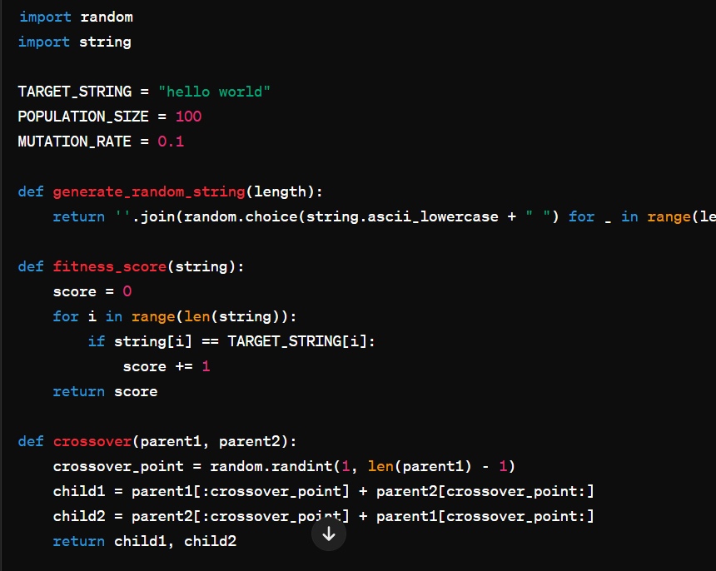
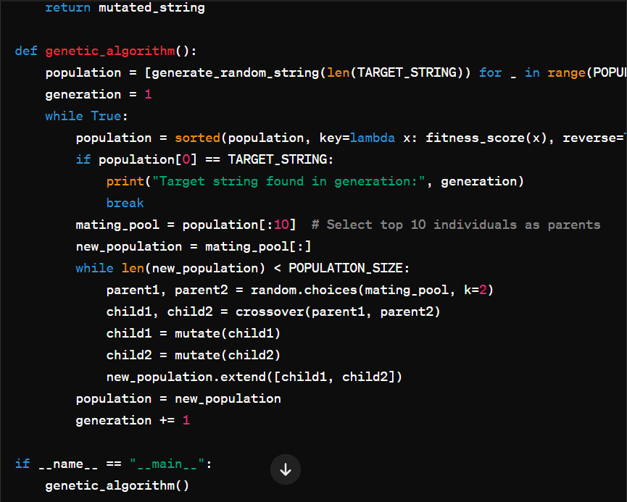

Slide 7
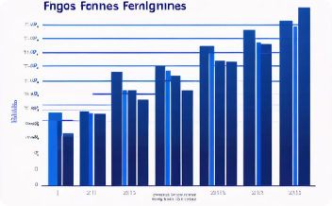


Visualizing Genetic Algorithm Results
Visualizing the progress and performance of a Genetic Algorithm is crucial for understanding its behavior and evaluating its effectiveness. Python provides several libraries, such as Matplotlib and Seaborn, that can be used to create informative visualizations.
Fitness Progression
Search Space Exploration
Population Diversity
A line plot showing the best fitness and average fitness of the population over successive generations can provide insights into the algorithm's convergence and the overall improvement in solution quality.
A scatter plot of the solutions in the search space can demonstrate how the Genetic Algorithm explores and navigates the problem domain, helping to identify areas of high and low fitness.
A histogram of the fitness values in the final population can reveal the diversity of the solutions, indicating whether the algorithm has converged to a single optimum or maintained a range of high-quality solutions.

Slide 8
Conclusion and Further Exploration
Genetic Algorithms are a powerful and versatile optimization technique that can be applied to a wide range of complex problems. By mimicking the principles of natural selection and evolution, GAs can explore large search spaces and converge towards high-quality solutions.
In this document, we've covered the key aspects of Genetic Algorithms, including problem analysis, solution development, encoding and representation, fitness function and selection, and implementation in Python. We've also explored various ways to visualize the results of a GA, which can provide valuable insights into the algorithm's behavior and performance.
As you continue to explore and work with Genetic Algorithms, consider experimenting with different encoding schemes, fitness functions, and genetic operators to tailor the algorithm to your specific problem. Additionally, you may want to investigate advanced techniques like multi-objective optimization, hybrid algorithms, and parallel computing to further enhance the capabilities of Genetic Algorithms.

