Slide 1

SDG 15 Life on Land
Evidence update for the THE Impact Rankings 2027
THE Core Team (SO No. 26-649) · update as of 30 October 2026
Notes:
Purpose of this update: where the SDG 15 evidence package stands, what we learned from VSU, and what we need from the team before the 3 to 5 November workshop and the 9 November data deadline.

Slide 2
Ten of 14 questions have evidence; three have none
7
2025 evidence
15.2.1, 15.2.3, 15.2.4, 15.2.5, 15.3.5, 15.4.1, 15.4.2
3
Pre-2025 policy only
14
indicators
15.3.1, 15.3.3, 15.4.3
1
Draft only
15.2.6: no 2025 programme found
3
No evidence yet
15.2.2, 15.3.2, 15.3.4
Notes:
Seven indicators have dated 2025 evidence. Three more (15.3.1, 15.3.3, 15.4.3) are covered only by policies adopted before 2025. 15.2.6 is a draft because no 2025 community programme on land management for tourism was found. 15.2.2, 15.3.2 and 15.3.4 have nothing yet.

Slide 3



The package lists 2025 first, then what continues
11 indicator PDFs
1 Evidence from 2025
One per indicator, written to stand alone. 15.2.6 is marked as a draft.
Dated activities with photos, figures and sources.
46-page Word compendium
Editable version with every photo and source, for the team to revise.
2 Continuing implementation
Policies still in force and 2024 to 2026 activity that shows the work is ongoing.
Checklist
Facts to confirm before upload, and what each missing item would earn.
Notes:
The first edition kept only 2025 items. After comparing with VSU we added a Continuing implementation section to every indicator so that pre-2025 policies and 2024 to 2026 activity are visible. All files are in the repository under submission/sdg15/evidence-docs.

Slide 4
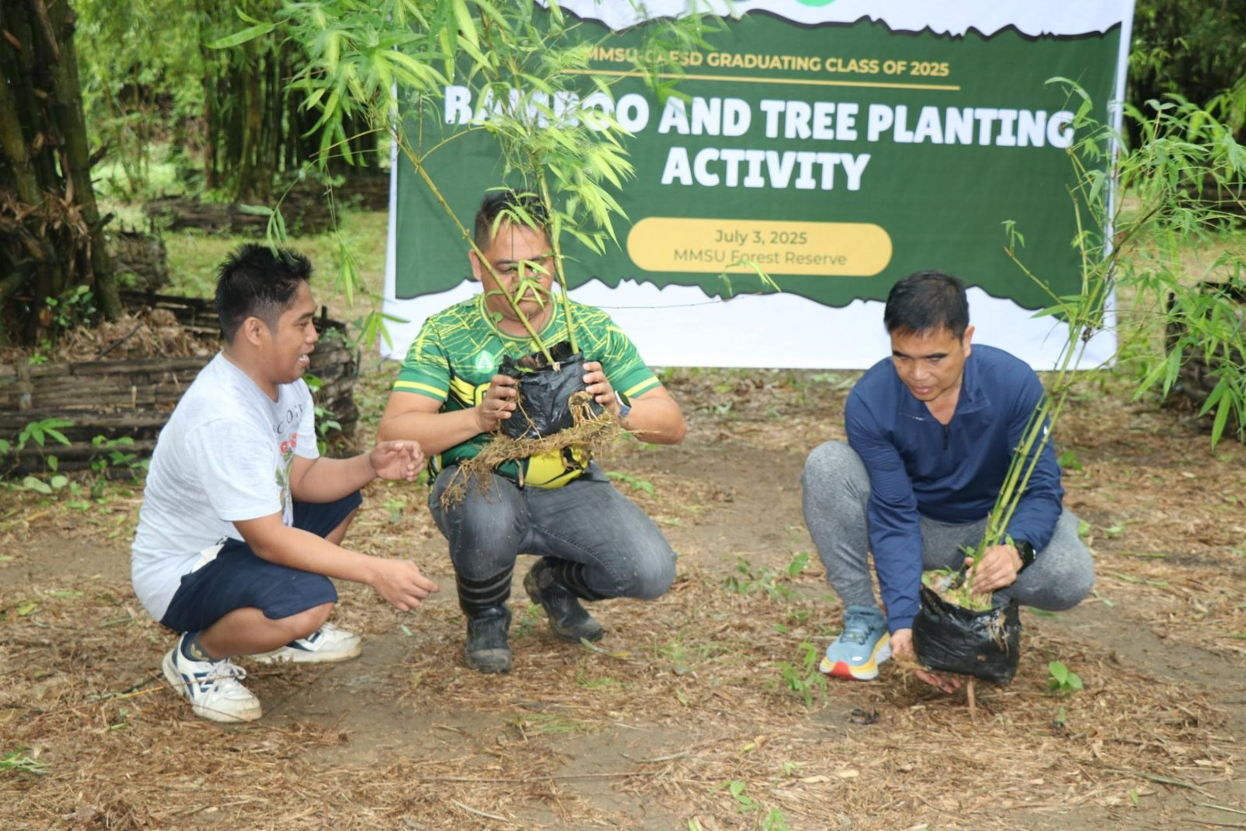
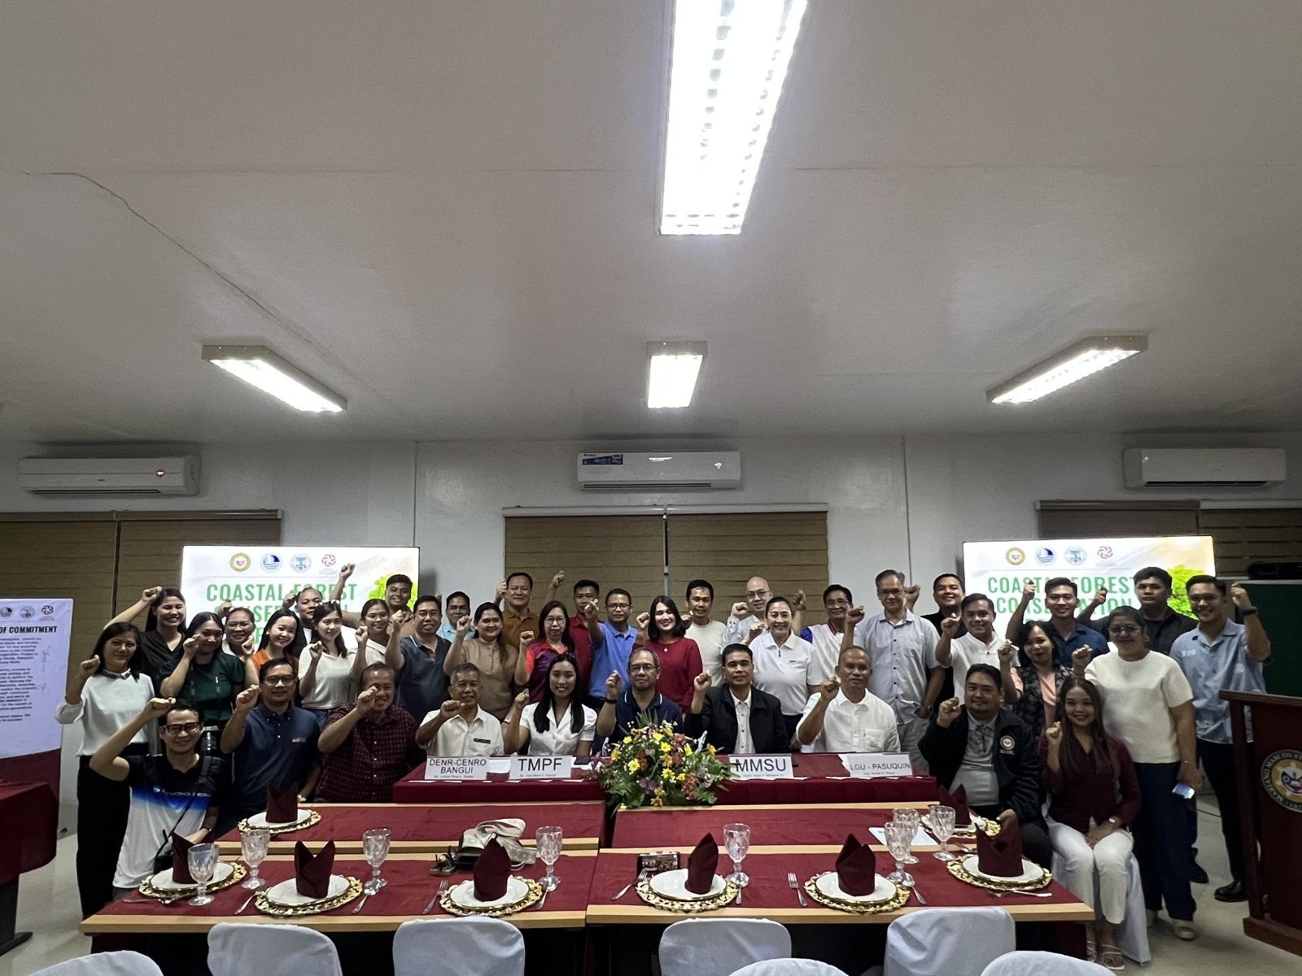
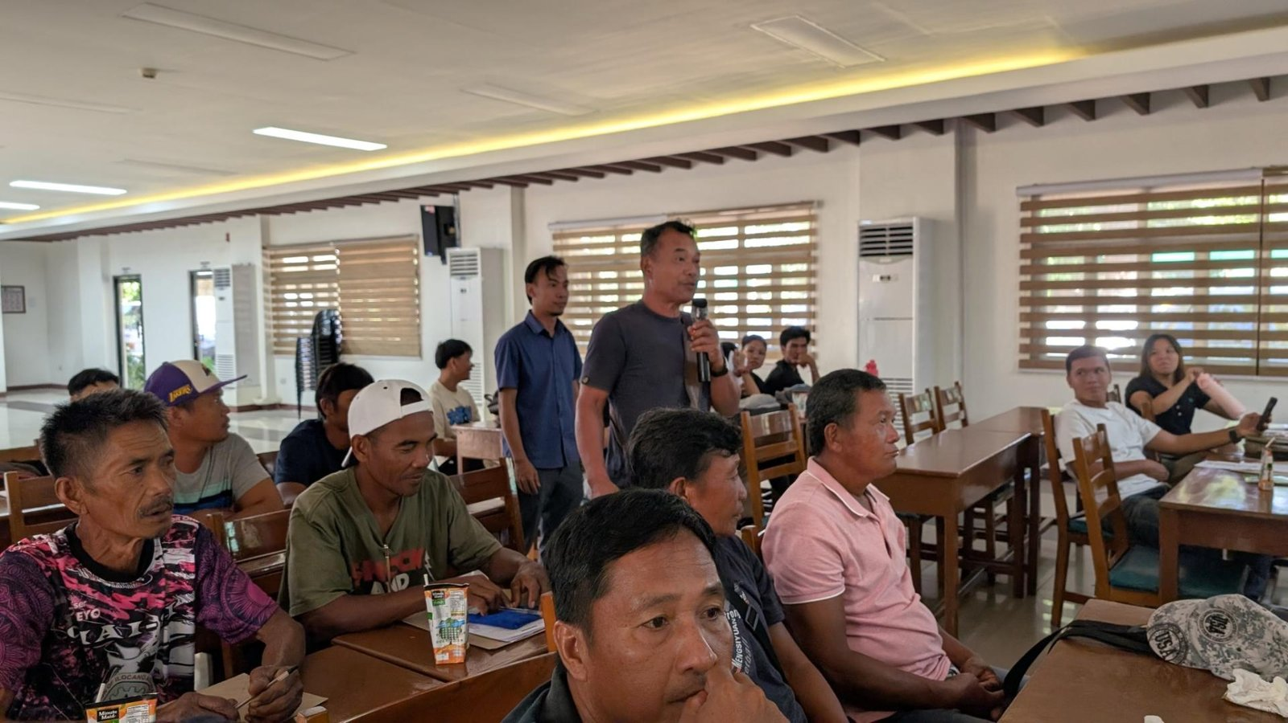
What we can already show from 2025
250 seedlings and propagules
1,750 mangrove propagules
4 municipalities trained
CAFSD graduands plant native trees and bamboo in the University Forest Reserves, 2 July 2025
Agreement with TMP Foundation, DENR and LGU-Pasuquin signed 29 November 2025
Mangrove propagation seminar for Currimao, Pasuquin, Badoc and Burgos, 27 to 28 October 2025
Also in the package: School-on-the-Air (1,000 enrollees), Pinili bamboo training (46 participants), alukon training (64 farmers), Badoc mangrove planting (280 propagules).
Notes:
These are examples, not the full list. Each has a dated source article and photos from MMSU STRATCOM. The Pasuquin item still needs a copy of the signed agreement. Free-access wording for the trainings is also still to be confirmed.

Slide 5


VSU placed 91st in SDG 15 with multi-year evidence
One PDF per indicator
91st
Six to 20 pages each, public on VSU's SDG portal, covering all 14 indicators.
Years are mixed
of 658 universities in SDG 15, THE Impact Rankings 2026
2025 items sit beside older ones: 2013 and 2022 memoranda, 2019 and 2023 events.
Policy answers cite law and a memo
Overall 301 to 400 band; top state university in the Philippines.
National laws such as RA 9147 and RA 9275, plus a dated university memorandum.
For MMSU: keep 2025 first, then add dated policies and programmes that continue. A policy that only restates national law should not be our model.
Notes:
VSU's 2026 result comes from its June 2026 announcement. VSU's evidence files are public. They mix years, which is why we added a Continuing implementation section. We cannot tell from outside how much of VSU's rank came from the documents versus its research metrics, so treat this as a pattern, not proof.

Slide 6
Continuing implementation fills the policy gaps
Indicator | What continues | Since
15.3.1 | Land use policy: conserve, restore and protect university lands | 2021
15.3.3 | Sirmata 2040: protected land and forest reserve kept no-build | 2021
15.4.1 | Water policy against pollution; groundwater monitoring of 17 farm wells | 2021; to June 2025
15.4.2 | Styrofoam and plastic rules; No Bottled Water memoranda | 2009 to 2023
15.4.3 | Hazardous waste storage and disposal under the IPWMP | Revised 2020
15.2.1 | Graduation tree planting by CAFSD classes | 2024, 2025, 2026
15.2.3 | Mangrove nature-based solutions project, Badoc and Currimao | Jun 2024 to Apr 2026
Catch: THE adds a point for a policy created or reviewed inside its window, so each older policy needs a 2025 review or reiteration.
Notes:
These items come from the MMSU Sirmata 2040 documents, the Integrated Pollution and Waste Management Program and news articles. We have not confirmed that each policy is still in force or when THE's review window starts. The 2020 IPWMP revision is the one most at risk of falling outside it.

Slide 7



No Bottled Water: what shows it is applied
Public article
Facebook posts MMSU cites
Presidential memos
CAFSD Waste and Pollution Management launch, 15 October 2024: plastic bottled water banned in its auxiliary building; reusable tumblers encouraged.
CCIS SipSmart campaign, BioCircle Society refilling station, hydration stations of academic units. Behind a login, so screenshots with dates are needed.
OP Memo 24-075 (16 Feb 2024) and 24-088 (29 Feb 2024) tell employees to bring their own tumbler or water bottle.
Missing: the 2024 and 2025 reiterations of the policy and Administrative Council minutes. No public post covers the 2022 or 2023 memoranda themselves.
Notes:
We scanned all 2,866 articles on the MMSU news site (2007 to October 2026) and found no post about the memoranda. The best public item is the CAFSD article. MMSU's own SDG pages cite three Facebook posts that we could not open without logging in. The two memos are in the focal person's mailbox.

Slide 8


Four gaps and four risks to settle
Gaps
Risks
15.2.2
Needs a policy on sustainably farmed campus food. Our farm practices do not replace it.
Data year
THE has not confirmed it for 2027; we assume 2025.
15.2.6
No 2025 community programme on land management for tourism.
Review window
Older policies may fall outside it (IPWMP 2020, Sirmata 2021).
15.3.2
No threatened-species policy or register.
Links
Reviewers do not follow links, so each PDF must stand alone.
15.3.4
No alien-species policy.
Free access
Not stated for the 2025 trainings; charged programmes score 0.25.
Notes:
The gaps are where no document exists. 15.2.2 asks for a policy, so submitting farm practices would mislead reviewers. The risks are decisions or confirmations rather than missing documents.

Slide 9
What we need from the team
# | Action | Proposed owner
1 | Confirm the 2027 data year and policy-review window with THE | Chair and Co-Chair
2 | Screenshot the three Facebook posts; find the 2024 and 2025 bottled-water reiterations and council minutes | CCIS, BioCircle, University Secretary
3 | Free-access statements, attendance sheets and the signed Pasuquin agreement | Extension and Research Directorates
4 | A 2025 review or reiteration of the land use, water and waste policies | Planning and General Services
5 | A policy or programme for 15.2.2, 15.2.6, 15.3.2 and 15.3.4 | SDG 15 focal persons with CAFSD
Owners are proposals for discussion, not assignments.
Notes:
Owners are suggestions based on who is likely to hold each record. Please correct them in the meeting.

Slide 10


Next steps to the 9 November deadline
Now to 3 Nov
3 to 5 Nov
9 Nov
Collect the missing records and confirm the data year
Locked-in workshop: finalise one PDF per indicator
THE data due: upload the final PDFs
The Special Order also lists a session on 29 November, after the deadline. Please verify that date.
Notes:
Dates from Special Order 26-649 and the data deadline recorded earlier in this project. The 29 November session falls after the 9 November data deadline, so one of the two dates may be wrong.

