Slide 1
Image Steganography using LSB Technique
Under the guidance of :
Mrs Sumalatha , M. Tech
Assistant Professor
Department of CSE
By:
Bhishma Sukhavasi(14FE1A0516)
Krishna Chaitanya(14FE1A0510)
Seetha Ramaiah (14FE1A0509)
Avinash Boyapati(14FE1A0522)
Vignan’s Lara Institute of Technology and Science
Vadlamudi-522 213

Slide 2
Contents
Abstract
Introduction
Flow Diagram
Image Representation
Types of images
ASCII Values
RBG Image
How to hide data?
Results
Applications

Slide 3
Abstract
Steganography is the practice of concealing messages or information within other non-secret data e.g., digital carrier i.e., image, audio, and video files. Our focus is on image based steganography. Steganography helps to prevent illegal attention through covering the secret message in a number of digitally electronically representative media, without hurting the accessibility of secret message. Image steganography methods are recently been helpful to send any secret message in the protected image carrier to prevent threats and attacks whereas it does not give any kind of opportunity to hackers to find out the secret concept. Secret text is encoded in Least Significant Bits (LSB) of three components of color image namely red, green and blue (RGB) channels using the angular transformation concept. On the receiving end, the message is extracted by performing the same angular rotation to the stego image. To really make it safer, the secrets information might be encrypted embedded then, it will be decrypted in the receiver.

Slide 4
Introduction
Steganography is one of the popular methods in information hiding that allows people to communicate secretly. The main advantage of image steganography is that the image with in which the secret is encoded does not attract the attention of an attacker. Methods for image steganography always concentrate on maintaining the visual quality of an image while encoding a secret message in it. In our project we use LSB technique for embedding secret text in digital colour images.

Slide 5

Flow Diagram
KEY
ENCRYPTION ALGORITHM(LSB MODIFICATION)
Message file
Image with Data
Image
DECRYPTION ALGORITHM
KEY
Recovered Message
File

Slide 6
Flow Chart(for encryption algorithm)
start
Read Inputs
start
Select a pixel and character
Message file
Image
Hiding Function
Hide the characters in pixels
l<String length
Yes
end
Return
No

Slide 7

Image Representation
Pixels
The basic(smallest) unit
Resolution
No. of pixels
Intensity
Color level of pixel

Slide 8

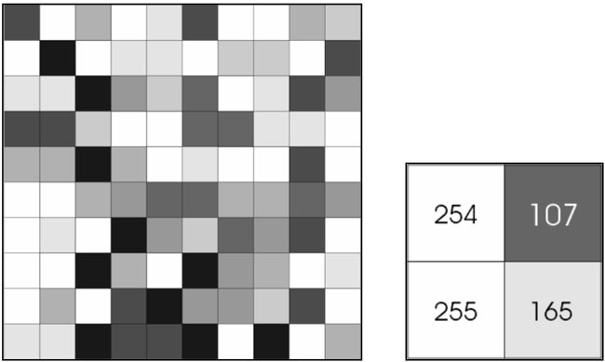
Types of Images
Black And White Images
Represented by two levels.
Need only 1 bit (0 or 1)
Grey Scale Image
Represented by 256 levels (0 to 255)
Need 8 bits to represent a level

Slide 9

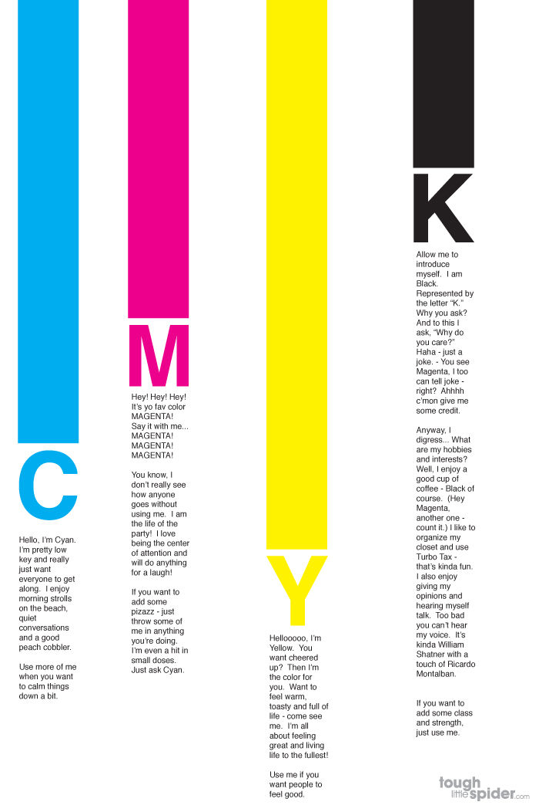
Types Of Images(cont..)
Colour Images
No. of Levels and bits depend on type of colour model used.
Most commonly used colour models are:
RGB COLOUR MODEL CMYK COLOUR MODEL

Slide 10
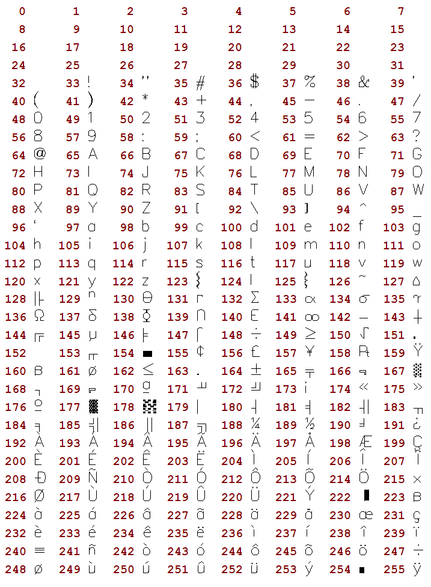
ASCII Values
AMERICAN STANDARD CODE FOR INFORMATION INTERCHANGE
Specific number (ASCII value for every character).
255 in number
Used in computers and
communication devices.

Slide 11
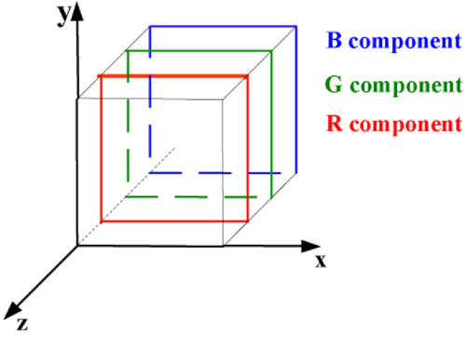
RGB Image
Each pixel need 3 color components.
Each component has 256 levels.
Each component need 8 bits.
So each pixel need 24 bits.
MSB bits carry most information.

Slide 12


RGB Image(cont..)
For example consider the red component values 159 and 152( only LSB bits are varied)
159(decimal) - 10011111 (Binary)
152(decimal) - 10011000 (Binary)
But if the MSB bits are varied as in case of 159 and 31 a huge difference is observed and picture quality is lost.
159(decimal) - 10011111 (Binary)
31(decimal) - 00011111(Binary)
R=159
R=152
R=159
R=31

Slide 13
How to hide data?
LSB bits do not contribute much in representing a colour.
They can often be called redundant.
Manipulating them won’t affect the image.
Thus the character data is hidden in these bits.

Slide 14
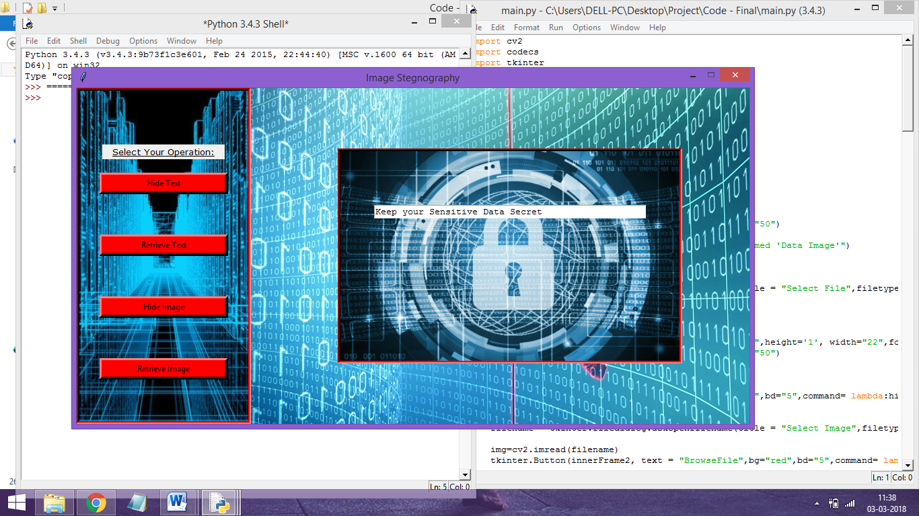
Results
As soon as the embedding program is run on the Python platform the following GUI appears.

Slide 15
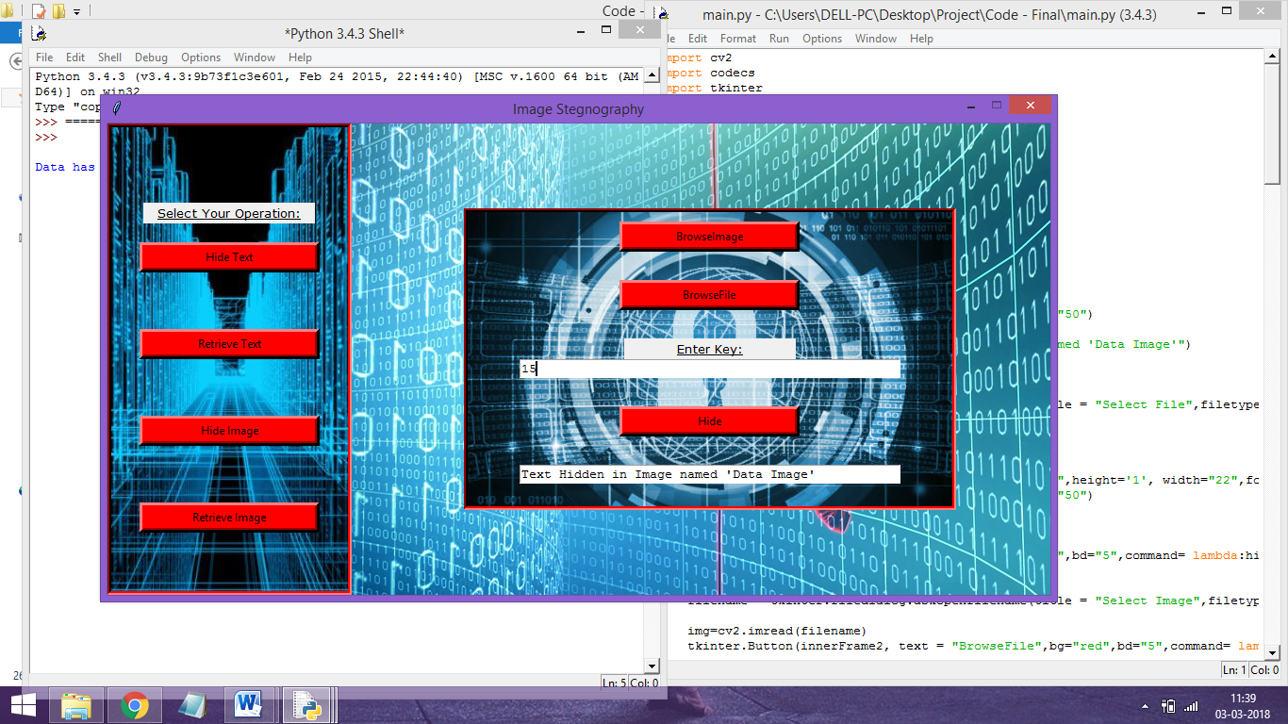
Results(cont..)
Performing the selected operation the user gets a message that the operation is done and the name of the image or the file where the information

Slide 16
Applications
Confidential military data transmission
Storing confidential keys and passwords
Storing the details of owner of a digital art.
As measure to protect copyright.

Slide 17


