Slide 1


Perfect parking
By Rhys quilter
Available at https://github.com/rhys-lit/perfect-parking-fyp

Slide 2
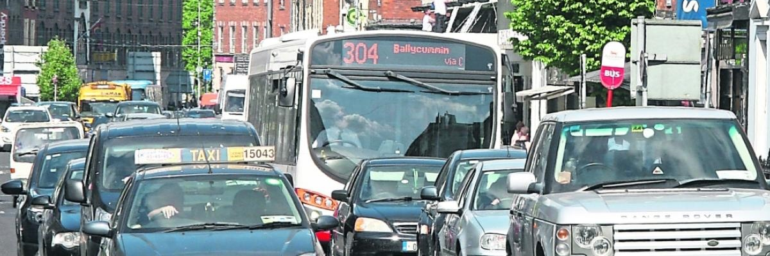
Introduction
To provide a central database of all parking spaces in a city
To determine the status of the parking spots i.e., free or occupied.
To reduce the time motorists spend looking for parking in cities.
Limerick City Traffic

Slide 3
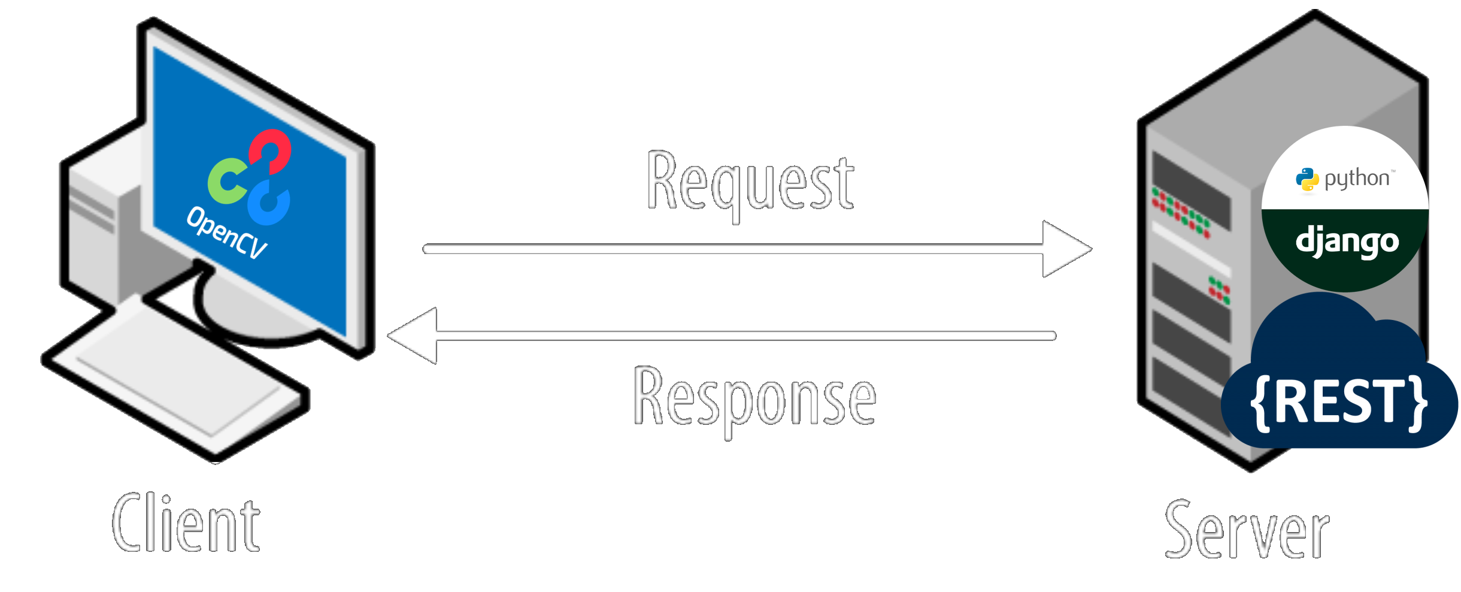
Client – Server Architecture
Perfect Parking Clients-Sever model
Notes:
Talk about the technologies: Open CV and Django
A lot an AI development is done in a Python
Server is a website, built upon Django/Python for Users
Server has a REST API for the Parking Monitor Client Apps to update the Server
Parking Monitor Client App uses OpenCV to determine if space is free. (using olgarose)

Slide 4
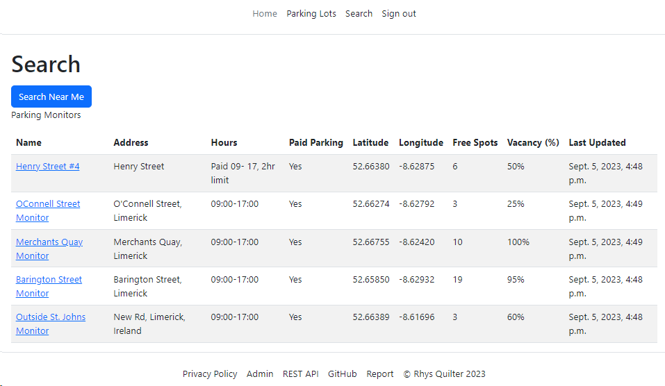
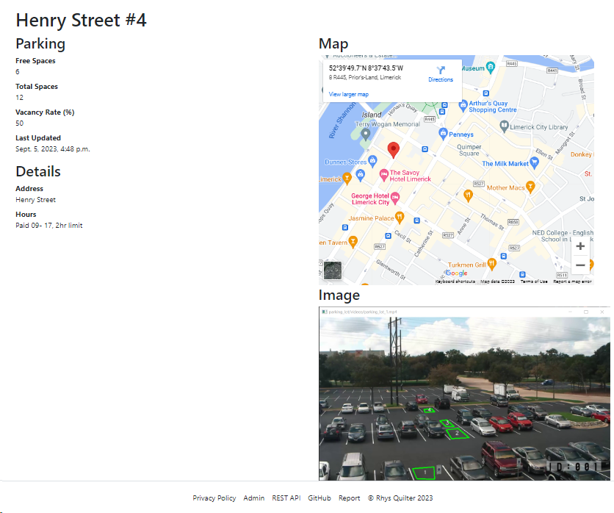
Perfect Parking Website
Search Near Me Page
Henry Street View
Notes:
The Website,
You can see the parking monitor data (parking availability) and with some JavaScript your distance to the parking lot
You can see full details (drill-down) of any parking monitor . Use google maps to get directions. You have an image of the parking lot.
In future releases you want to upload a current pic of the parking lot.
http://127.0.0.1:8000/parking-lot-monitors

Slide 5
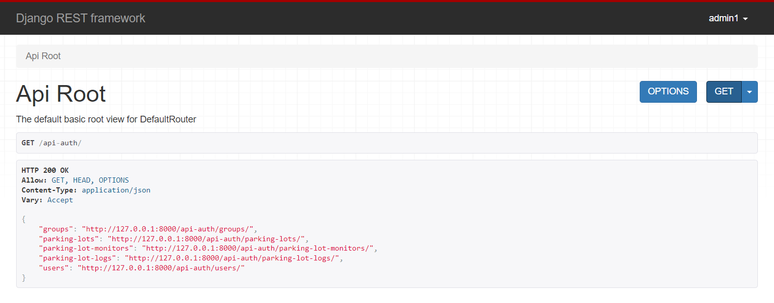
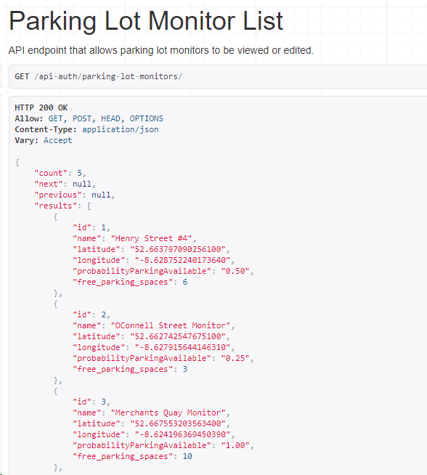
Perfect Parking REST API
Django REST API Root page
Parking Lot monitors
Notes:
Purpose is so that third party applications /aka parking monitor clients can view/update the data on the website..
It makes the data available to third parties , e.g., to use for stats and analysis in Jupyter Notebooks
Standard for interoperability.

Slide 6
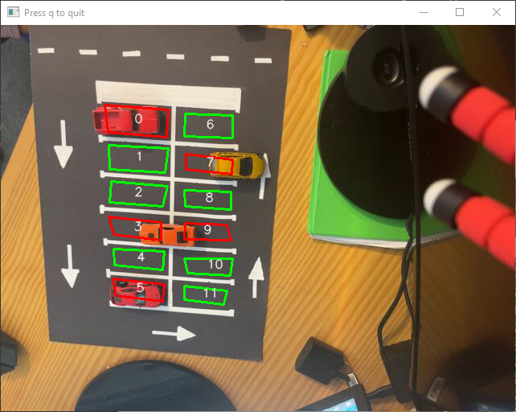
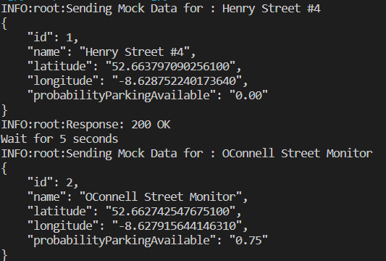
Perfect Parking (Client)
Client
Mock Client
Image Of The Live Camera Feed
Image Of The Mock Data
Notes:
I have the clients one real and one with mock data.
On the left , the real client
The real client takes data from a live video source.
In this image we can see five spots are occupied
On the right the mock client
The mock sends random parking data put requests to the server at random times

Slide 7
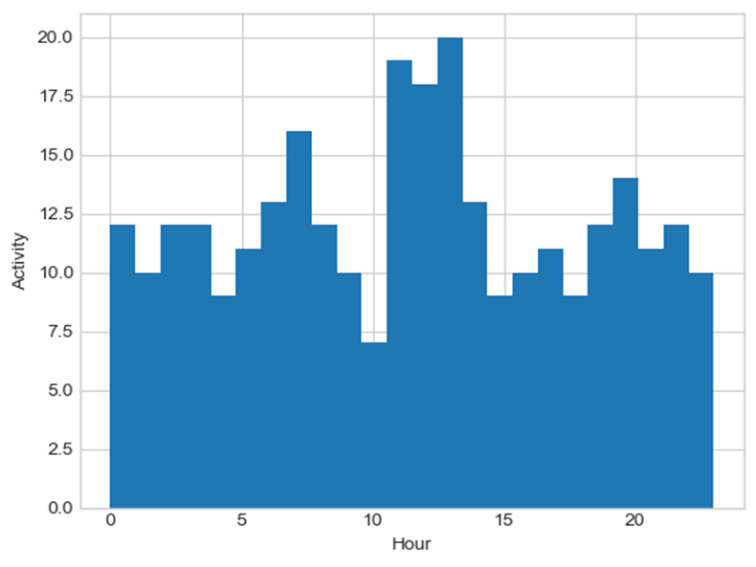
App Data collection
While Building Perfect Parking demonstrates the usefulness of gathering data from parking lots to optimize operations and user experience in the future.
Why collecting data is important:
Provides insights for parking lot operators to optimize space.
Enables historical analysis for better planning
Data Collection Process:
The data is collected from the Parking Lot Monitor
When there is a change, a log is created noting the free spaces, and the time and then stored in the database.
Car park activity by the hour

Slide 8
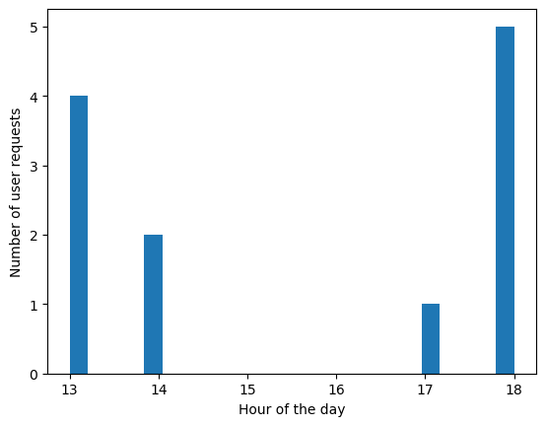
User Data Collection
Collection of user searches
IP Address
GPS location
User
Date Time
Requires Privacy Policy for GDPR
Shows the busiest hours of app usage, is a strong indication of parking wanted at a time.

Slide 9



Thank You
Any Questions?

