Slide 1
Automatic License Number Plate Recognition System MACHINE LEARNING LABORATORY PROJECT PRESENTATION
Presented by:
T .Sai Avinash-208W1A05C4
P.Bhogeswar-208W1A05A6
E.G.Srihas- 208W1A0577
Ram prasad-208W1A0581

Slide 2
Introduction:
This machine learning project aims to develop an Automatic License Number Plate Recognition system that can detect and recognize the license plate of a vehicle and read the license numbers printed on it.
The primary objective is to create a system that can accurately identify license plates and extract relevant information from them, which could have numerous practical applications, including security scans and traffic monitoring.

Slide 3
Introduction:
Automatic Number Plate Recognition (or 'number plate recognition') is a special form of optical character recognition (OCR).
It enables computer systems to read automatically the registration number (license number) of vehicles from digital pictures.
Reading automatically the registration number means transforming the pixels of the digital image into the ASCII text of the number plate.

Slide 4
What is OpenCV?
OpenCV (Open Source Computer Vision Library) is an open-source computer vision and machine learning software library.
OpenCV provides a wide range of tools and functions for image and video processing, machine learning, and computer vision applications.
OpenCV has become one of the most popular libraries for computer vision applications due to its ease of use, speed, and versatility.
It is widely used in industry, academia, and research for applications such as object recognition, face detection, gesture recognition, and robotics, among others.

Slide 5
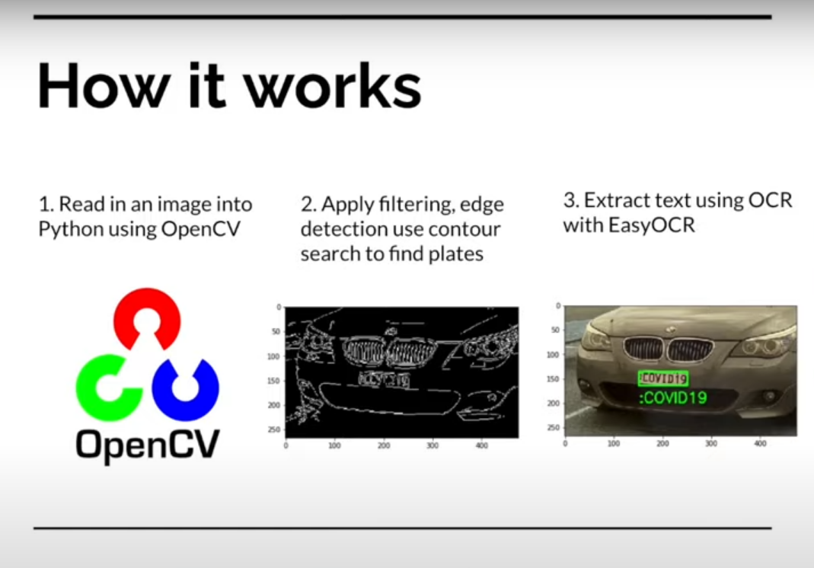
How it works?

Slide 6
Implementation Steps:
Image Acquisition: Use OpenCV to acquire an image or video feed of a vehicle. This can be done using a camera connected to a computer.
Image Pre-processing: Use OpenCV to clean up the image by applying pre-processing techniques to remove noise and enhance contrast.
Number Plate Localization: Use OpenCV to detect the location of the number plate within the pre-processed image.

Slide 7
Implementation Steps:
Character Segmentation: Once the number plate is localized, use OpenCV to segment the individual characters on the plate. This can be done using techniques like edge detection and contour detection
Character Recognition: Use an OCR library like Tesseract to recognize the characters on the plate. Tesseract is a free, open-source OCR engine that can recognize text in images and videos.
Post-Processing: Finally, store the recognized number plate and its corresponding information in a database, and take any necessary actions based on the application of ANPR technology.

Slide 8
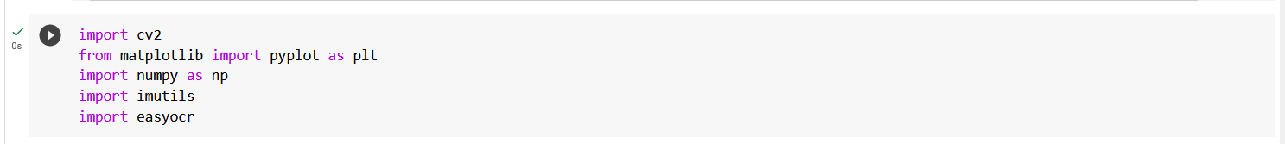
Execution of the Project
Installing Dependencies
Importing Dependencies

Slide 9
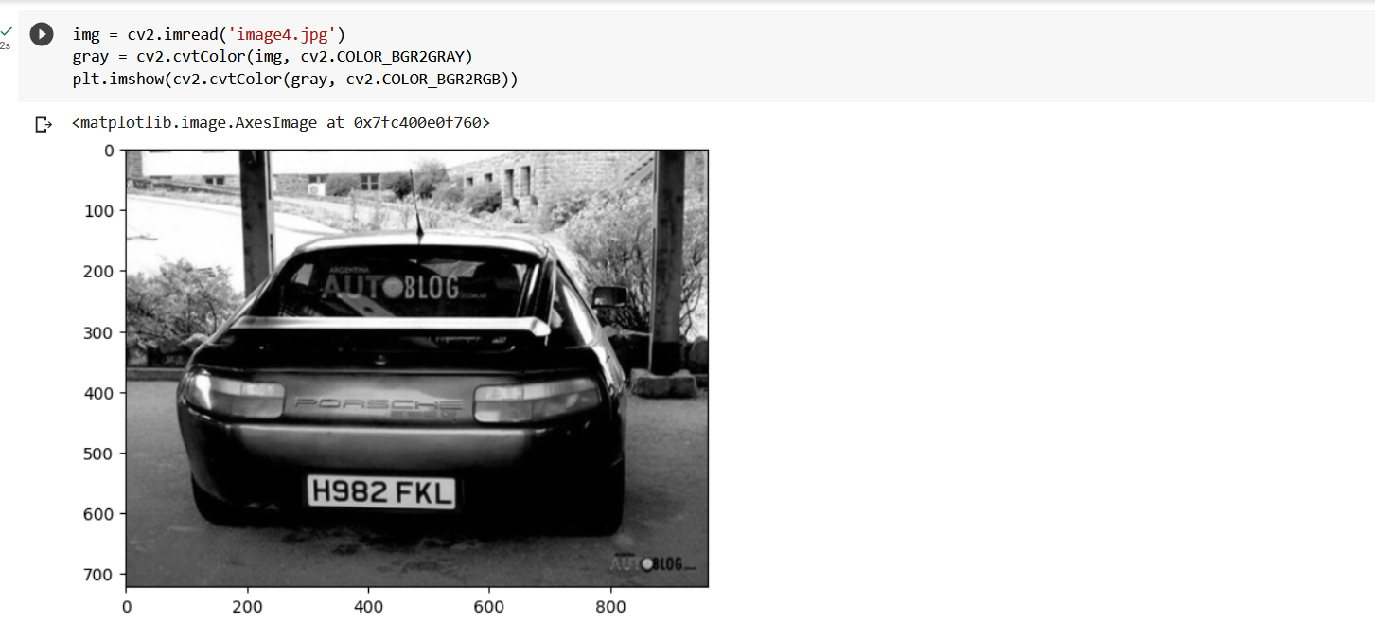
Execution:
Read in Image, Grayscale and Blur

Slide 10
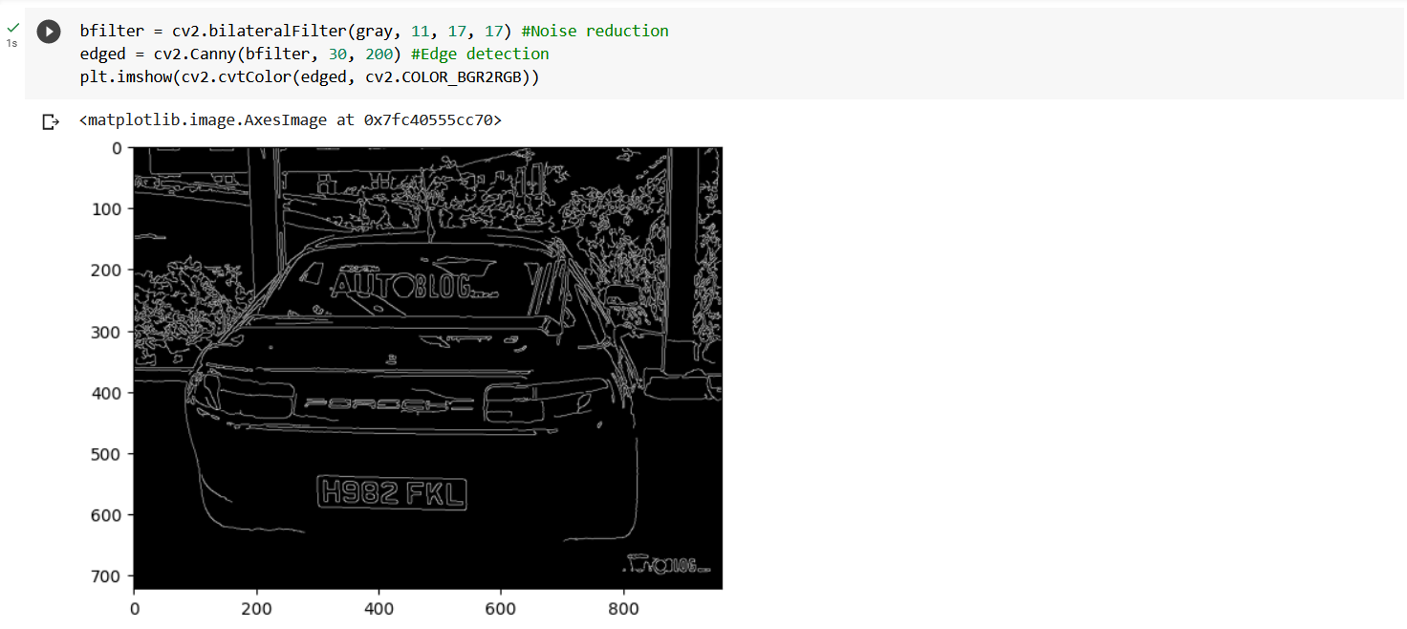
Execution:
Apply filter and find edges for localization

Slide 11
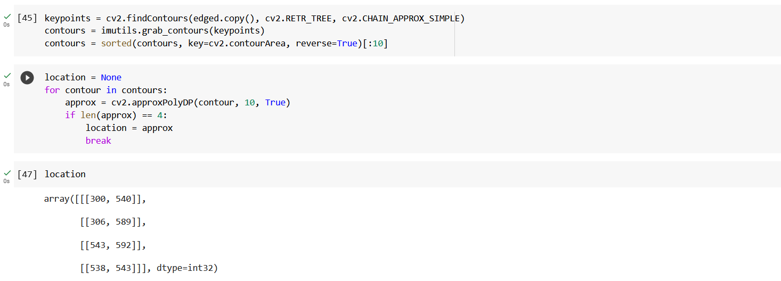
Execution:
Find Contours and Apply Mask

Slide 12
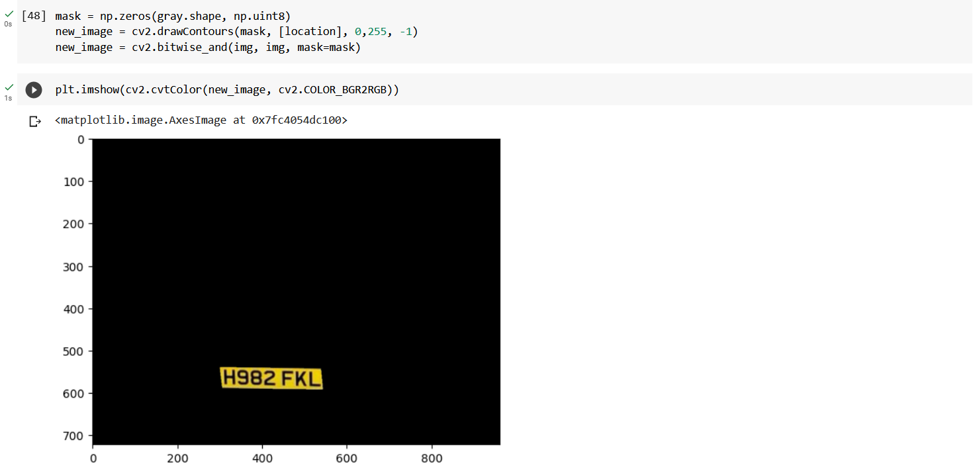
Execution:

Slide 13
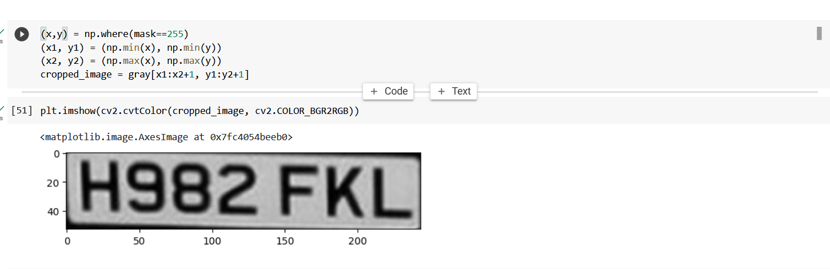
Execution:

Slide 14
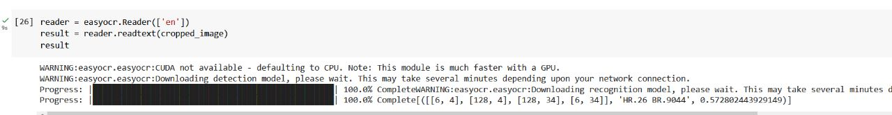
Execution:

Slide 15
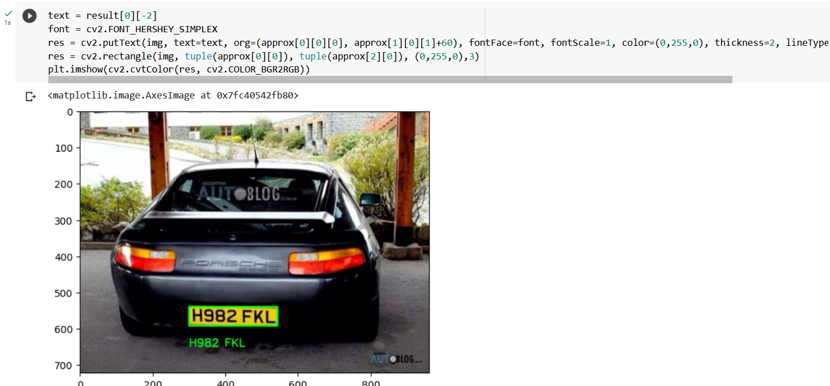
Execution:
Render Result

Slide 16
Applications:
Car park management
Security access control
Toll Collection
Automation of vehicle entry to and exit from car parks
State border control
Security Surveillance

Slide 17


