Slide 1


Enhancing Acoustic Clarity: An Advanced Noise Suppression with Speech Enhancement Generative Adversarial Networks
VR SIDDHARTHA ENGINEERING COLLEGE, VIJAYAWADA
Department of Computer Science and Engineering
20CS8551: B. Tech Major Project
April 19th, 2024
Batch No: 16
Batch Members
P. Bhogeswar (208W1A05A6)
Dakshayani Reddi (208W1A05B0)
Under the Guidance of
Dr. D. Rajeswara Rao, M. Tech, Ph.D.
Professor & HOD CSE

Slide 2
Abstract
The project, "Enhancing Acoustic Clarity: An Advanced Noise Suppression with SEGAN," centers on optimizing audio quality using the Speech Enhancement Generative Adversarial Network (SEGAN) for noise suppression. Emphasizing the implementation of SEGAN, a sophisticated deep learning model used for speech enhancement, the project aims to discern and eliminate background noise while preserving the integrity of the primary audio signal. Through comprehensive evaluation and analysis, the study focuses on SEGAN's strengths, computational efficiency, and adaptability across diverse acoustic environments. SEGAN helps to enhance the acoustic quality in the given medium. Key components involve developing a robust testing framework, real-time processing capabilities, user-friendly interfaces, and potential extensions exploring machine learning integration and multi-modal noise suppression. The project's objective is to provide valuable insights into advanced noise suppression techniques, fostering enhanced audio clarity for immersive and accessible experiences in various applications.
Keywords: Acoustic Clarity, Noise Suppression, Speech Enhancement, SEGAN (Spectrogram-based Generative Adversarial Network).

Slide 3
Presentation Outline
Aim and Motivation
Research Questions
Title Justification
Objectives
Scope
Introduction
Study on Existing Technologies
Gap Analysis
SDLC Model
UML Diagrams
Functional and Non-Functional Requirements
Methodology
12.1. Proposed Model
12.2. Modules of the Proposed Model
12.3 Algorithms
13. Dataset Description
Results and Outputs
Conclusion and Future Work
References

Slide 4
1. Aim and Motivation
AIM
The aim of this project is to advance the quality of audio signals by implementing the Speech Enhancement Generative Adversarial Network (SEGAN) for advanced noise suppression.
The primary goal is to enhance acoustic clarity in various applications, contributing to a more immersive and accessible audio experience.
MOTIVATION
The motivation behind this project lies in the increasing demand for high-quality audio in diverse settings, such as telecommunication, content creation, and live streaming.
Effective noise suppression is crucial for improving speech intelligibility and overall audio enjoyment.
By leveraging the capabilities of SEGAN, we aim to address this need and contribute to the development of sophisticated noise suppression techniques.

Slide 5
2. Research Questions
How does SEGAN compare with other advanced noise suppression algorithms in terms of performance metrics, including computational efficiency and adaptability?
What is the impact of SEGAN on audio quality and speech intelligibility in diverse acoustic environments?
How can real-time processing capabilities be effectively integrated into the noise suppression solution to enhance its practicality?
What are the user preferences and customization needs regarding noise suppression settings, and how can user-friendly interfaces be designed to address them?

Slide 6
3. Title Justification
The chosen title, "Enhancing Acoustic Clarity: An Advanced Noise Suppression with SEGAN," reflects the project's core focus on implementation of SEGAN to achieve superior noise suppression and elevate acoustic clarity.
The title establishes the project's advanced nature and highlights SEGAN as the key technology used for the noise suppression efforts.

Slide 7
4. Objectives
To Implement SEGAN for noise suppression to enhance the quality of audio signals.
To Create user-friendly interfaces for customization and control of noise suppression settings.

Slide 8
5. Scope
The project scope encompasses the implementation and evaluation of SEGAN for noise suppression in various audio scenarios.
The respective model only works for MP4 type audio file
The Model is trained on the limited amount of audio files.

Slide 9
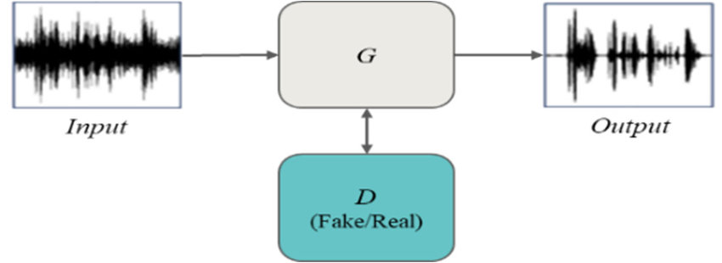
6. Basic Concepts
Speech Enhancement:
Significance of Acoustic Clarity: In an era dominated by audio communication, achieving optimal acoustic clarity is essential for immersive user experiences in applications ranging from telecommunication to content creation.
Challenges in Noisy Environments: Background noise poses a significant challenge to audio quality, affecting speech intelligibility and overall user satisfaction. Effective noise suppression techniques are crucial to address this issue.
Fig:1. Overview structure of the Speech Enhancement Mechanism

Slide 10

6. Basic Concepts
Overview of SEGAN:
Speech Enhancement Generative Adversarial Network(SEGAN), is an advanced deep learning architecture specifically designed for speech enhancement tasks.
Unlike traditional methods that operate on raw waveform data, SEGAN operates on spectrograms, which provide a visual representation of the frequency content of the audio signal over time.
SEGAN employs a generative adversarial network (GAN) framework, where a generator network learns to generate enhanced spectrograms from noisy input spectrograms, and a discriminator network learns to distinguish between real clean spectrograms and generated enhanced ones
Fig:2. Process flow of SEGAN model

Slide 11
6. Basic Concepts
Structure of SEGAN:
The SEGAN (Speech Enhancement Generative Adversarial Network) architecture is a novel framework designed specifically for speech enhancement tasks. It operates in the time frequency domain, leveraging spectrograms as input representations for both noisy and clean speech signals.
Generator Network
Discriminator Network
Adversarial Training

Slide 12
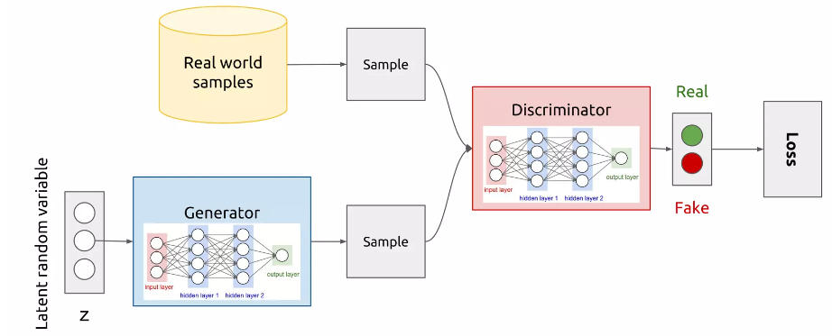
6. Basic Concepts
Adversarial Training
SEGAN employs an adversarial training strategy, where the generator and discriminator networks are trained simultaneously in a minimax game framework.
The generator aims to produce enhanced spectrograms that deceive the discriminator into classifying them as real clean spectrograms.
Conversely, the discriminator strives to accurately distinguish between real and generated spectrograms, providing feedback to the generator to improve its performance over time.
Fig:3. Structural Representation of Adversarial Training

Slide 13
7. Study on Existing Technologies
Title: Improvement of Noise Suppression Performance of SEGAN by Sparse Latent Vectors [1]
Journal Details: IEEE Access, Vol.8, IEEE, 2020.
Description:
This paper proposes a novel approach to enhance the noise suppression performance of SEGAN by introducing sparse latent vectors. By encouraging sparsity in the latent representations, the model focuses on capturing essential features, leading to improved discrimination between signal and noise components. Experimental results demonstrate superior noise reduction capabilities, showcasing the potential for optimizing SEGAN through the integration of sparse latent vectors.
Advantages:
Enhanced Discrimination: Sparse latent vectors promote focused feature extraction, improving SEGAN's ability to distinguish between signal and noise components effectively.
Improved Noise Reduction: The proposed approach demonstrates superior noise suppression performance, contributing to enhanced audio quality in various applications.
Disadvantages:
Computational Overhead: Introducing sparsity may increase computational complexity, potentially impacting real-time processing capabilities.
Optimal Sparsity Threshold: Determining the optimal sparsity threshold for latent vectors may require fine-tuning, posing a challenge in achieving universal applicability.

Slide 14
7. Study on Existing Technologies
Title: Exploring Speech Enhancement with Generative Adversarial Networks for Robust Speech Recognition [2]
Journal Details: IEEE Transactions on Neural Networks and Learning Systems, Vol.32, IEEE, 2021.
Description:
This project explores the application of Generative Adversarial Networks (GANs) in speech enhancement to improve the robustness of speech recognition systems. By leveraging GANs, the model learns to generate clean and enhanced speech signals, mitigating the impact of environmental noise and enhancing the overall performance of automatic speech recognition (ASR) systems.
Advantages:
GAN-based speech enhancement contributes to more accurate and robust speech recognition, particularly in noisy environments.
The model's ability to learn and adapt to diverse acoustic conditions ensures improved performance across different real-world scenarios.
Disadvantages:
There is a risk of overfitting to specific noise conditions during training, potentially limiting the generalization of the model to unforeseen noise patterns. Regularization techniques may be needed to address this concern.

Slide 15
7. Study on Existing Technologies
Title: Improved Speech Enhancement with the Wave-U-Net [3]
Journal Details: MDPI Electronics, Vol.10, 2021.
Description:
This project focuses on enhancing speech signals using the Wave-U-Net architecture for improved speech quality and intelligibility. Wave-U-Net, a deep neural network designed for audio source separation, is employed to address noise interference, leading to superior speech enhancement. The project aims to explore the potential of Wave-U-Net in real-world applications and assess its effectiveness across varying noise conditions, contributing to advancements in speech enhancement technology.
Advantages:
Wave-U-Net excels in capturing intricate details, contributing to high-fidelity restoration of speech signals and maintaining natural sound characteristics.
The model showcases adaptability to various noise types, making it effective in diverse acoustic environments.
Disadvantages:
Implementing the Wave-U-Net may involve increased computational demands, potentially impacting real-time applications and requiring optimization for efficiency.

Slide 16
7. Study on Existing Technologies
Title: Speech Enhancement for Noise-Robust Speech Synthesis using Wasserstein GAN [4]
Journal Details: IEEE Access, IEEE, Vol.8, 2020.
Description:
This project delves into enhancing speech synthesis in noise-robust scenarios through the application of Wasserstein Generative Adversarial Networks (WGANs). The focus is on leveraging WGANs to generate clean and contextually rich speech signals, ensuring robust and high-quality speech synthesis in the presence of environmental noise.
Advantages:
The use of Wasserstein GANs enhances the robustness of speech synthesis models, enabling them to produce high-quality speech even in challenging acoustic environments.
Disadvantages:
Implementing Wasserstein GANs may require careful tuning and training due to their inherent complexity, demanding computational resources and expertise.

Slide 17
7. Study on Existing Technologies
Title: Seismic random noise suppression using improved CycleGAN [5]
Journal Details: IEEE Access, IEEE, Vol.11, 2023.
Description:
This project focuses on the development of a Random Noise Suppression system using an improved CycleGAN architecture. The aim is to leverage the capabilities of CycleGAN for unsupervised image-to-image translation to enhance the quality of noisy images by removing random noise. The improved CycleGAN is tailored to handle diverse noise patterns, providing a flexible solution for various imaging scenarios, such as photography and medical imaging.
Advantages:
1. The project employs an unsupervised learning approach, allowing the model to learn and suppress random noise patterns without explicit noise-label pairs during training. Disadvantages:
1. Achieving optimal performance may depend on fine-tuning hyperparameters, and the model's effectiveness could be sensitive to these parameters.

Slide 18
7. Study on Existing Technologies
Title: A New Framework for CNN-Based Speech Enhancement[6]
Journal Details: IEEE/ACM Trans Audio Speech Lang Process. 2019 Jul.
Description:
This project introduces a novel framework for Convolutional Neural Network (CNN)-Based Speech Enhancement in the time domain. Unlike traditional frequency-domain methods, this approach operates directly on the time-domain signal, aiming to improve speech quality by reducing background noise. The framework leverages the capabilities of CNNs to learn complex temporal dependencies, enhancing its ability to suppress noise while preserving essential speech features.
Advantages:
The CNN-based approach enables end-to-end learning, eliminating the need for handcrafted feature engineering and providing the model with the ability to learn hierarchical representations from raw input signals.
Disadvantages:
Implementing CNN-based models for speech enhancement in the time domain may involve increased computational complexity, potentially impacting real-time processing capabilities.

Slide 19
7. Study on Existing Technologies
Title: Overview of speech enhancement techniques for automatic speaker recognition[7]
Journal Details: MDPI, Volume 23, Issue 1, 2023.
Description:
Speech enhancement techniques play a critical role in improving the performance of automatic speaker recognition systems by enhancing the quality of speech signals and reducing the impact of background noise. Automatic speaker recognition systems are widely used in various applications, including security access control, forensic analysis, and personalized services. However, the performance of these systems can be significantly affected by environmental noise, channel distortions, and other acoustic interferences present in real-world scenarios.
Advantages:
Speech enhancement techniques help improve the quality of speech signals, leading to better feature extraction and more accurate speaker recognition results, especially in noisy environments
Disadvantages:
1. Speech enhancement techniques may be optimized for specific noise types or conditions encountered during training, limiting their ability to generalize to unseen noise types or diverse acoustic environments..

Slide 20
7. Study on Existing Technologies
Title: A regression approach to speech enhancement based on deep neural networks[8]
Journal Details: IEEE/ACM Transactions on Audio, Speech and Language Processing, Volume-23,Issue 1,2015.
Description:
This project employs a regression approach for speech enhancement, leveraging deep neural networks to map noisy speech signals to their corresponding clean versions. The objective is to enhance the quality of speech by training the model to learn the complex mapping between noisy and clean speech patterns. By adopting a regression-based methodology, the project aims to address the challenges posed by background noise, improving the overall intelligibility and perceptual quality of speech signals.
Advantages:
The regression-based approach enables end-to-end learning, allowing the deep neural network to automatically learn the mapping from noisy to clean speech without the need for explicit feature engineering.
Disadvantages:
1. Training deep neural networks for regression tasks can be computationally demanding, requiring substantial resources and potentially impacting the feasibility of real-time processing in certain applications.

Slide 21
7. Study on Existing Technologies
S. No. | Article Title | Journal Details | Algorithms/ Models | Dataset | Advantages | Disadvantages
1 | Improvement of Noise Suppression Performance | IEEE Access, Vol.8, IEEE, 2020. | Sparse Latent Vectors | WIDER dataset | This paper provides a brief overview of face recognition technology, its development stages, related technologies, and potential applications | 1. This paper gives only an overview of different algorithms but not discussed methodology deeply. 2. It doesn’t gives solutions to all problems that occur in face recognition technology.
2 | Exploring Speech Enhancement with Generative Adversarial Networks for Robust Speech Recognition | IEEE Transactions on Neural Networks and Learning Systems, Vol.32, IEEE, 2021. | BoostGAN | Multi-PIE dataset | 1. GAN-based speech enhancement contributes to more accurate and robust speech recognition, particularly in noisy environments. | 1. There is a risk of overfitting to specific noise conditions during training, potentially limiting the generalization of the model to unforeseen noise patterns. Regularization techniques may be needed to address this concern.

Slide 22
7. Study on Existing Technologies
S. No. | Article Title | Journal Details | Algorithms/ Models | Dataset | Advantages | Disadvantages
3 | Improved Speech Enhancement with the Wave-U-Net | MDPI Electronics, Vol.10, 2021. | U-net | FDDB dataset | Wave-U-Net excels in capturing intricate details, contributing to high-fidelity restoration of speech signals and maintaining natural sound characteristics | Implementing the Wave-U-Net may involve increased computational demands, potentially impacting real-time applications and requiring optimization for efficiency.
4 | Speech Enhancement for Noise-Robust Speech Synthesis using Wasserstein GAN | IEEE Access, IEEE, Vol.8, 2020. | W-GAN | YTF dataset | The use of Wasserstein GANs enhances the robustness of speech synthesis models, enabling them to produce high-quality speech even in challenging acoustic environments. | Implementing Wasserstein GANs may require careful tuning and training due to their inherent complexity, demanding computational resources and expertise

Slide 23
7. Study on Existing Technologies
S. No. | Article Title | Journal Details | Algorithms/ Models | Dataset | Advantages | Disadvantages
5 | Seismic random noise suppression using improved CycleGAN | IEEE Access, IEEE, Vol.11, 2023. | Cycle GAN | YTF dataset | The project employs an unsupervised learning approach, allowing the model to learn and suppress random noise patterns without explicit noise-label pairs during training. | Achieving optimal performance may depend on fine-tuning hyperparameters, and the model's effectiveness could be sensitive to these parameters.
6 | A New Framework for CNN-Based Speech Enhancement | IEEE/ACM Trans Audio Speech Lang Process. 2019 Jul. | CNN | AFW dataset | The CNN-based approach enables end-to-end learning, eliminating the need for handcrafted feature engineering and providing the model with the ability to learn hierarchical representations from raw input signals. | Implementing CNN-based models for speech enhancement in the time domain may involve increased computational complexity, potentially impacting real-time processing capabilities.

Slide 24
7. Study on Existing Technologies
S. No. | Article Title | Journal Details | Algorithms/ Models | Dataset | Advantages | Disadvantages
7 | Overview of speech enhancement techniques for automatic speaker recognition | MDPI, Sensors, Volume 23, Issue 1, 2023. | CNN,C-GAN | AFW Dataset | Speech enhancement techniques help improve the quality of speech signals, leading to better feature extraction and more accurate speaker recognition results, especially in noisy environments | Speech enhancement techniques may be optimized for specific noise types or conditions encountered during training, limiting their ability to generalize to unseen noise types or diverse acoustic environments
8 | A regression approach to speech enhancement based on deep neural networks | IEEE/ACM Transactions on Audio, Speech and Language Processing, Volume-23,Issue 1,2015 | Deep Neural Network | YTF dataset | The regression-based approach enables end-to-end learning, allowing the deep neural network to automatically learn the mapping from noisy to clean speech without the need for explicit feature engineering. | Training deep neural networks for regression tasks can be computationally demanding, requiring substantial resources and potentially impacting the feasibility of real-time processing in certain applications.

Slide 25
8. Gap Analysis
Limited Adoption of SEGAN: Current noise suppression methods often overlook the potential of the Speech Enhancement Generative Adversarial Network (SEGAN), creating a gap in leveraging advanced deep learning for enhanced acoustic clarity.

Slide 26
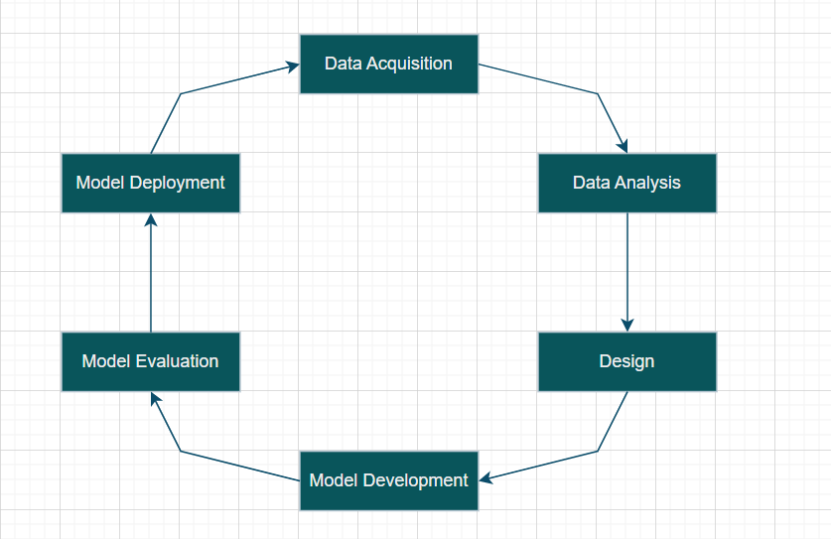
9. SDLC Model: Incremental model
Fig 4: Incremental Model

Slide 27
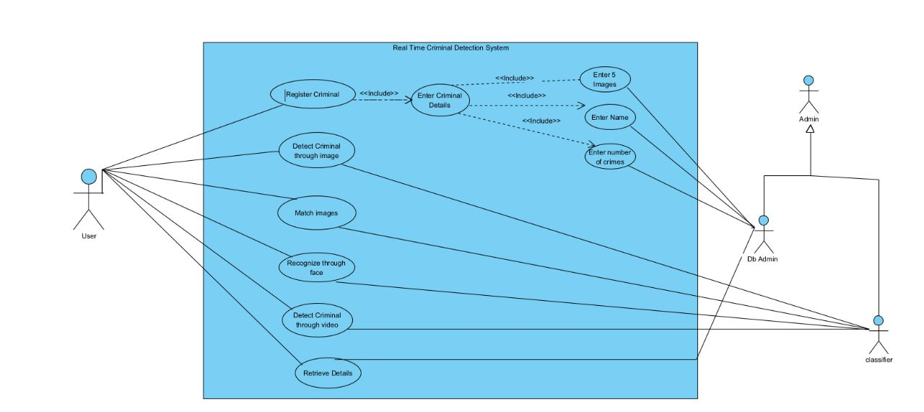
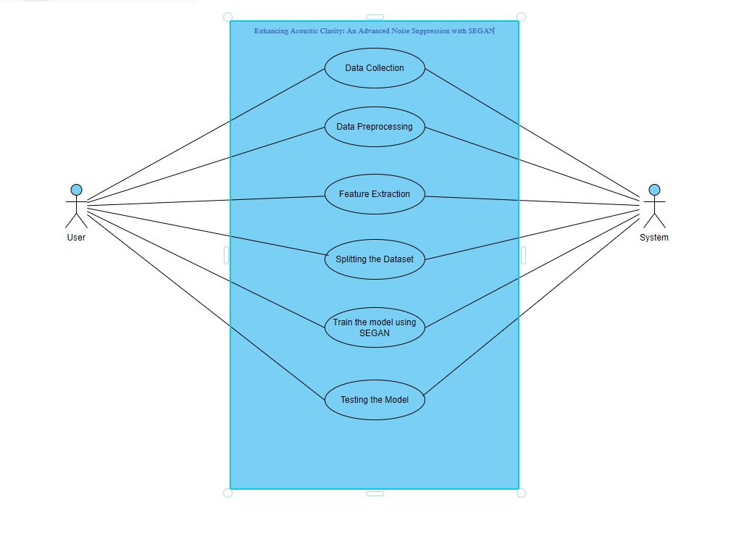
10.1. Use Case Diagram
Fig 2: Use Case diagram
Fig:5. Use Case Diagram for the Speech Enhancement Model

Slide 28
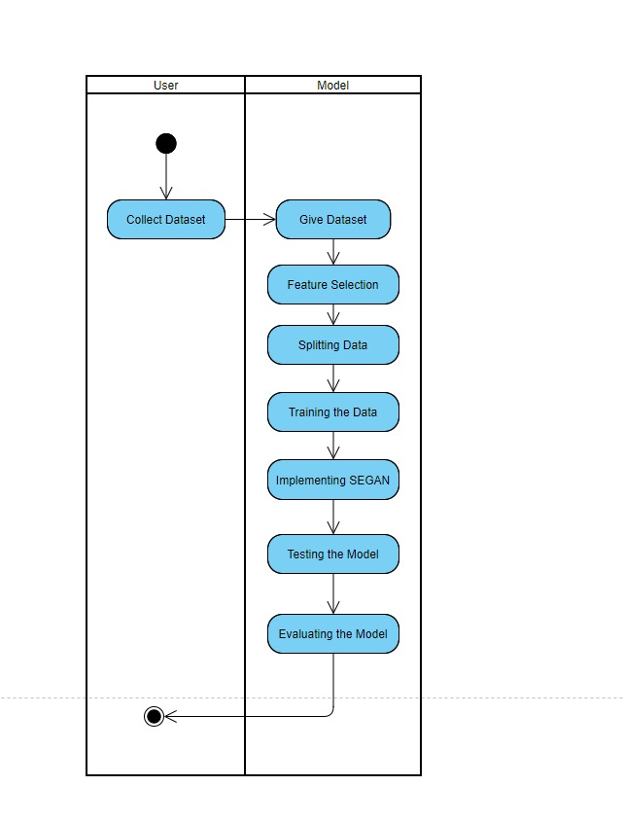
10.2. Activity Diagram
Fig:6. Activity Diagram for the Speech Enhancement Model

Slide 29
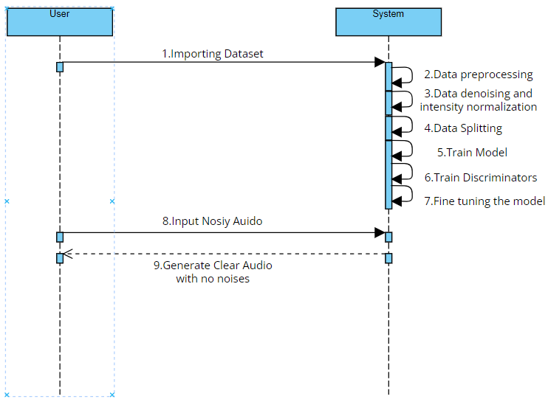
10.3. Sequence Diagram
Fig:7. Sequence Diagram for the Speech Enhancement Model

Slide 30
11. Functional and Non-Functional Requirements
Functional Requirements:
Software Requirements:
1. Microsoft Windows 7 or higher
2. Python 3.5+
Hardware Requirements:
1. 4 GB RAM (Minimum)
2. 80 GB HDD
3. Dual Core processor

Slide 31
Non-Functional Requirements:
The model should be computationally efficient.
The system should manage memory efficiently, avoiding excessive memory usage that could lead to memory overflow or performance degradation.
The system should be easy to use, with a user-friendly interface.
The system should be reliable, and able to consistently produce accurate and consistent results.

Slide 32
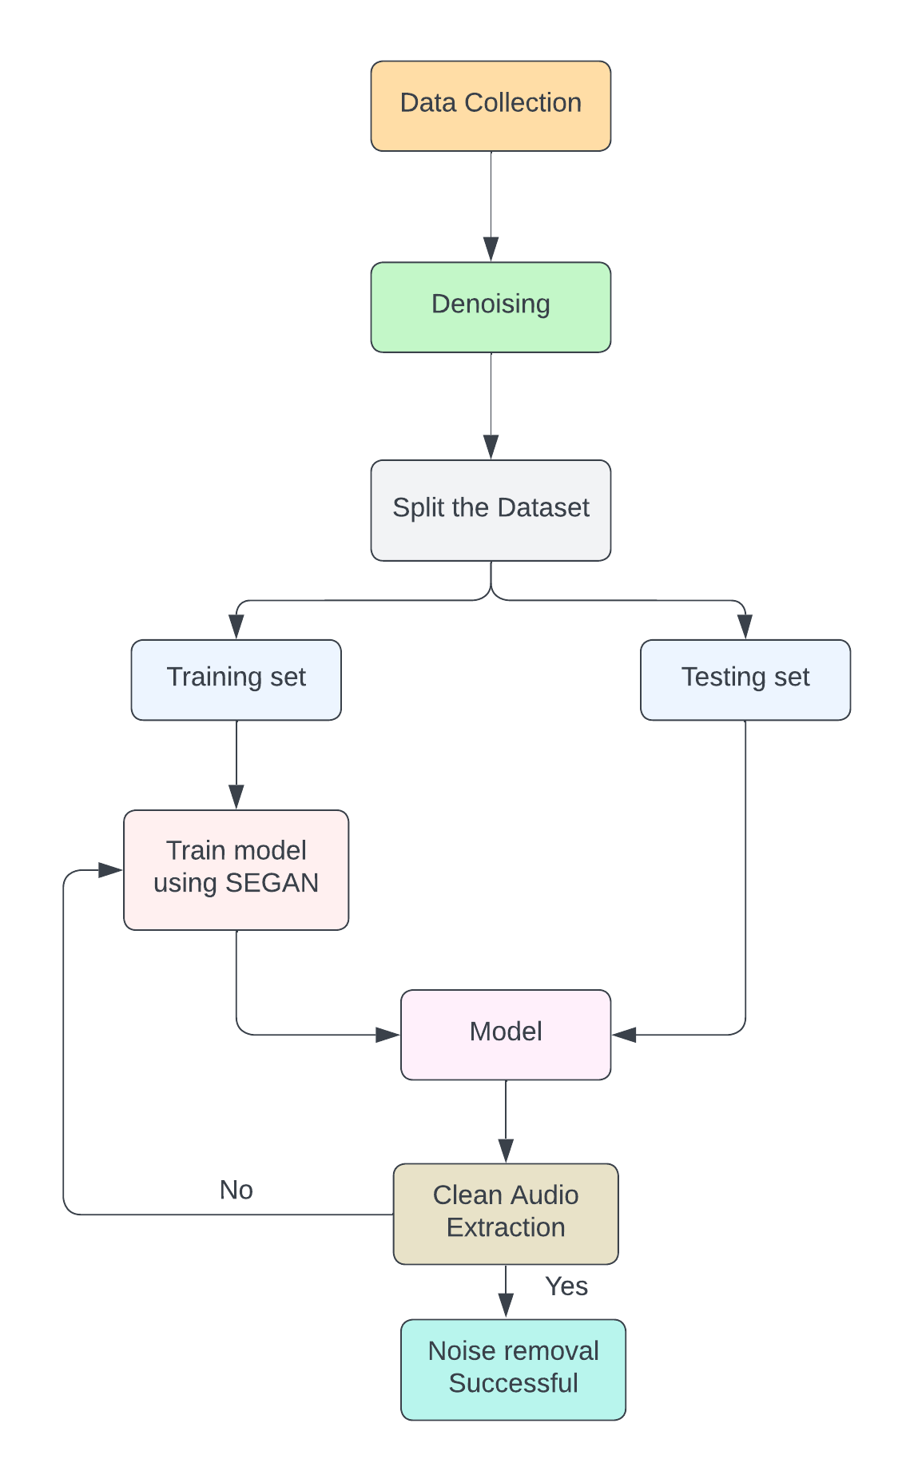
12.1. Proposed Model
Fig:9. Proposed Model Diagram for the Speech Enhancement Model

Slide 33
12.2. Modules of Proposed Model
1. Data Preprocessing:
Prepare and Denoise the audio dataset for training and testing.
Loading, cleaning, and formatting audio data for input to the SEGAN model.
2. SEGAN Model Implementation:
Implement the Speech Enhancement Generative Adversarial Network (SEGAN) for noise suppression.
Developing the SEGAN architecture, training the model on the preprocessed data.
3. Evaluation and Testing:
Establish robust evaluation to measure the effectiveness of the noise suppression algorithms.

Slide 34
12.3. Algorithms/Pseudo Codes
SEGAN Algorithm:
SEGAN, or Speech Enhancement Generative Adversarial Network, is an algorithm designed for speech enhancement, specifically focused on removing background noise from speech signals. The model utilizes a generative adversarial network (GAN) architecture to achieve this task.
Pseudo code:
Input: The input to SEGAN is a Speech enhancement representation of a speech signal corrupted by background noise.
Processing: The generator processes the input file, attempting to remove or minimize the impact of the background noise while preserving essential speech features.
Output: The generator outputs an enhanced audio file, which ideally resembles the core part of clean speech.
Evaluation: The discriminator evaluates the generated audio file, providing feedback to the model on how realistic and close to real clean speech the enhancement is.

Slide 35
12.3. Algorithms/Pseudo Codes
Initialization: Initialize the generator network (G) and discriminator network (D) with random weights.
Data Preparation: Prepare a dataset containing pairs of noisy speech signals and their corresponding clean speech signals.
Training Loop:
Generator Training:
Generate fake clean speech signals by passing noisy speech signals through the generator network.
Compute the generator loss, which measures the discrepancy between the generated fake clean signals and real clean signals.
Update the parameters of the generator network using backpropagation to minimize the generator loss.

Slide 36
12.3. Algorithms/Pseudo Codes
Discriminator Training:
Train the discriminator network to distinguish between real clean speech signals and generated fake clean signals.
Compute the discriminator loss, which quantifies the discriminator’s ability to correctly classify real and fake signals.
Update the parameters of the discriminator network using backpropagation to minimize the discriminator loss.
Iteration: Repeat the training loop for a predefined number of iterations or until convergence criteria are met.

Slide 37
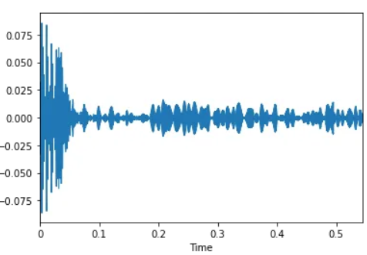
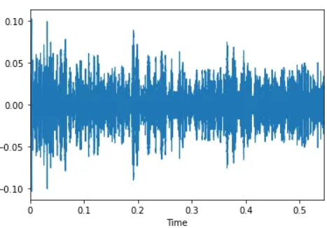
12.4. Dataset Description
The data set is a selection from 30 speakers from the Voice corpus ,28 are included in the train set and 2 in the test set. To make the noisy training set, a total of 40 different conditions are considered to generate the audio files for each speaker set. The whole dataset maintains about 1200 individual audio files. Thereby considering 1120 files for training and 80 audio files for testing set.
Fig:10. Cleam Audio File Spectrogram Fig:11. Noisy Audio File Spectrogram

Slide 38
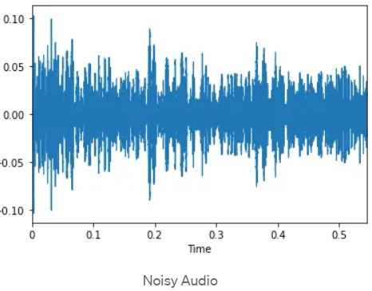
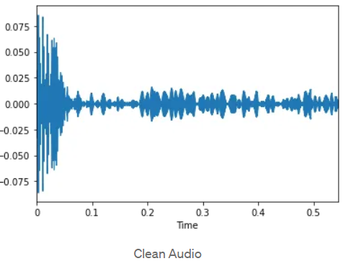
13. Results
Fig:12. Images of Audio file plot with and without noises

Slide 39
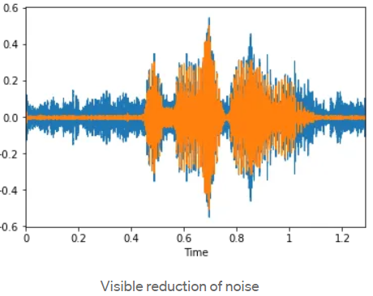
13. Results
Fig:13.Output of Audio file-1

Slide 40
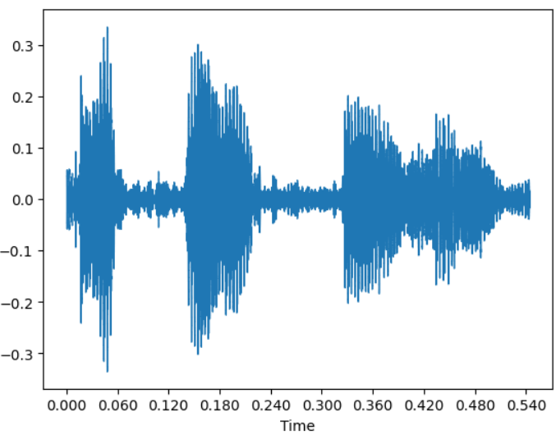
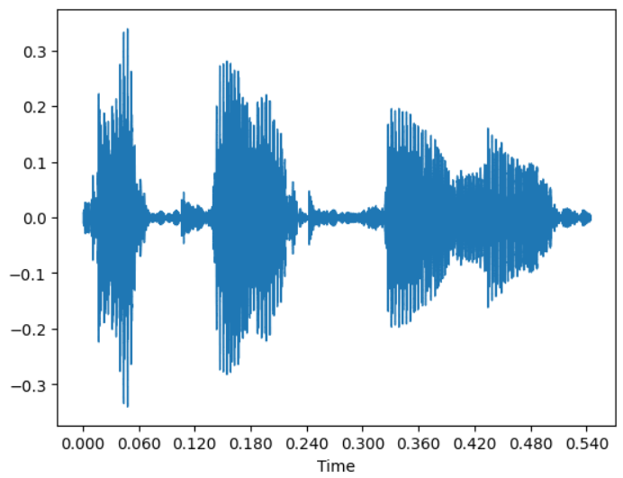
13. Results
Fig:14. Noisy Audio File Spectrogramic
Representation
Fig:15. Denoised Audio File Spectrogramic
Representation

Slide 41
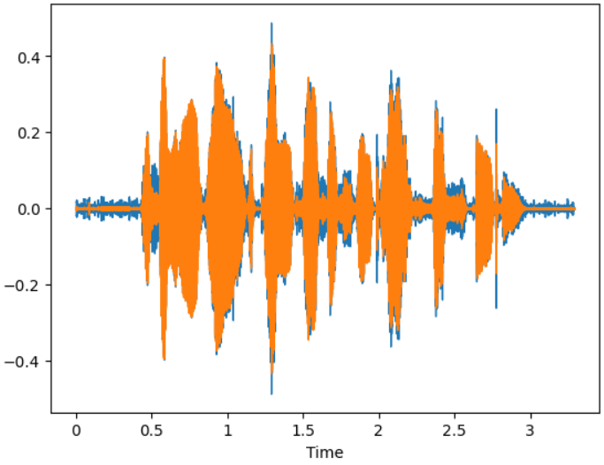
13. Results
Fig:16.Output of the refined and denoised Audio file

Slide 42
14. Conclusion
The project exemplifies SEGAN's prowess in noise suppression, elevating audio quality through advanced deep learning techniques.
Promising results highlight its potential for real-time applications, inspiring future research in adaptive algorithms for diverse environments.
SEGAN's success underscores its relevance in addressing contemporary challenges in audio processing, fostering innovation in speech enhancement and telecommunications.
As noise reduction becomes increasingly pivotal in digital communication, SEGAN stands poised to lead advancements in audio technology, promising improved user experiences and enhanced communication platforms.

Slide 43
15. Future Work
Future endeavors will focus on refining SEGAN's performance across diverse audio environments, optimizing computational efficiency for real-time applications, and exploring its integration into various audio processing systems.
Additionally, research will address robustness to different noise types and levels for enhanced applicability.

Slide 44
16. Summary
Here, what we have discussed:
This project aims to improve audio quality through advanced noise suppression using SEGAN.
Motivated by the growing demand for enhanced acoustic clarity, the project involves implementing SEGAN and conducting a comparative analysis with other algorithms.
Objectives include the development of a robust testing framework, real-time processing integration, and user-friendly interfaces.
The project's scope extends to potential enhancements through machine learning and multi-modal noise suppression, aiming to provide valuable insights for diverse applications in audio processing.

Slide 45
17. References
M. Sakuma, Y. Sugiura and T. Shimamura, "Improvement of Noise Suppression Performance of SEGAN by Sparse Latent Vectors," 2019 International Symposium on Intelligent Signal Processing and Communication Systems (ISPACS), Taipei, Taiwan, 2019, pp. 1-2.
C. Donahue, B. Li and R. Prabhavalkar, "Exploring Speech Enhancement with Generative Adversarial Networks for Robust Speech Recognition," 2018 IEEE International Conference on Acoustics, Speech and Signal Processing (ICASSP), Calgary, AB, Canada, 2018, pp. 5024-5028.
Improved Speech Enhancement with the Wave-U-Net,Craig Macartney and Tillman Weyde,2018,1811.11307.arXivcs.SD
Adiga, Nagaraj & Pantazis, Yannis & Tsiaras, Vassilis & Stylianou, Yannis. (2019). Speech Enhancement for Noise-Robust Speech Synthesis Using Wasserstein GAN.
Sun Shimin, Li Guihua, Ding Renwei, Zhao Lihong, Zhang Yujie, Zhao Shuo, Zhang Jinwei, Ye Junlin,Seismic random noise suppression using improved CycleGAN,Frontiers in Earth Science,VOLUME-11,2023.
Pandey A, Wang D. A New Framework for CNN-Based Speech Enhancement in the Time Domain. IEEE/ACM Trans Audio Speech Lang Process. 2019 Jul;27(7):1179-1188. Epub 2019 Apr 29. PMID: 34262993; PMCID: PMC8276831.

Slide 46
17. References
.
7. J. Ortega-Garcia and J. Gonzalez-Rodriguez, "Overview of speech enhancement techniques for automatic speaker recognition," Proceeding of Fourth International Conference on Spoken Language Processing. ICSLP '96, Philadelphia, PA, USA, 1996, pp. 929-932 vol.2, doi: 10.1109/ICSLP.1996.607754.
8. Y. Xu, J. Du, L. -R. Dai and C. -H. Lee, "A Regression Approach to Speech Enhancement Based on Deep Neural Networks," in IEEE/ACM Transactions on Audio, Speech, and Language Processing, vol. 23, no. 1, pp. 7-19, Jan. 2015, doi: 10.1109/TASLP.2014.2364452.
9. Donahue, Chris, et al. ”Adversarial audio synthesis.” arXiv preprint arXiv:1802.04208 (2018)
10. Luo, Yi, and Nima Mesgarani. ”Conv-TasNet: Surpassing ideal time–frequency magnitude masking for speech separation.” IEEE/ACM Transactions on Audio, Speech, and Language Processing 27.8 (2019): 1256-1266.
11. Zhao, Yang, et al. ”A new time-domain approach to single-channel speech enhancement based on deep neural networks.” IEEE/ACM Transactions on Audio, Speech, and Language Processing 22.12 (2014): 1679-1689
12. Lathoud, Guillaume, et al. ”Investigation of deep learning techniques for speech enhancement in the context of a mobile application.” 2019 IEEE International Conference on Acoustics, Speech and Signal Processing (ICASSP). IEEE, 2019.
13. Yong Xu, Jun Du, Li-Rong Dai, and Chin-Hui Lee, “An experimental study on speech enhancement based on deep neural networks,” IEEE Signal processing letters, vol. 21, no. 1, pp. 65–68, 2021

Slide 47


